Slide 1
Chapter 4-GK
General Properties of Radiation
Detectors
Lec-5
Notes:
1

Slide 2
VI. DETECTION EFFICIENCY-GK-35
VI. DETECTION EFFICIENCY
All radiation detectors will, in principle, give rise to an output pulse for each quantum of radiation that interacts within its active volume.
For primary charged radiation such as alpha or beta particles, interaction in the form of ionization or excitation will take place immediately upon entry of the particle into the active volume.
After traveling a small fraction of its range, a typical particle will form enough ion pairs along its path to ensure that the resulting pulse is large enough to be recorded.
Thus, it is often easy to arrange a situation in which a detector will see every alpha or beta particle that enters its active volume.
Under these conditions, the detector is said to have a counting efficiency of 100%.
On the other hand, uncharged radiations such as gamma rays or neutrons must first undergo a significant interaction in the detector before detection is possible.
Because these radiations can travel large distances between interactions, detectors are often less than 100% efficient.
It then becomes necessary to have a precise figure for the detector efficiency in order to relate the number of pulses counted to the number of neutrons or photons incident on the detector.
It is convenient to subdivide counting efficiencies into two classes: absolute and intrinsic.
Absolute efficiencies are defined as:
and are dependent not only on detector properties but also on the details of the
counting geometry (primarily the distance from the source to the detector).
The intrinsic efficiency is defined as:
and no longer includes the solid angle subtended by the detector as an implicit
factor.

Slide 3
VI. DETECTION EFFICIENCY-GK-35

Slide 4
The two efficiencies are simply related for isotropic sources by :
where Ω is the solid angle of the detector seen from the actual source position.
The intrinsic efficiency of a detector usually depends primarily on the detector material, the radiation energy, and the physical thickness of the detector in the direction of the incident radiation.
A slight dependence on distance between the source and the detector does remain, however, because the average path length of the radiation through the detector will change somewhat with this spacing.
Counting efficiencies are also categorized by the nature of the event recorded.
If we accept all pulses from the detector, then it is appropriate to use total efficiencies.
In this case all interactions, no matter how low in energy, are assumed to be counted. In terms of a hypothetical differential pulse height distribution shown in Fig. 4.6, the entire area under the spectrum is a measure of the number of all pulses that are recorded, regardless of amplitude, and would be counted in defining the total efficiency.
In practice, any measurement system always imposes a requirement that pulses be larger than some finite threshold level set to discriminate against very small pulses from electronic noise sources.
Thus, one can only approach the theoretical total efficiency by setting this threshold level as low as possible.
The peak efficiency, however, assumes that only those interactions that deposit the full energy of the incident radiation are counted.
In a differential pulse height distribution, these full energy events are normally evidenced by a peak that appears at the highest end of the spectrum.
Events that deposit only part of the incident radiation energy then will appear farther to the left in the spectrum.
The number of full energy events can be obtained by simply integrating the total area under the peak, which is shown as the cross-hatched area in Fig. 4.6.
The total and peak efficiencies are related by the peak-to-total ratio r
It is often preferable from an experimental standpoint to use only peak efficiencies, because the number of full energy events is not sensitive to some perturbing effects such as scattering from surrounding objects or spurious noise.

Slide 5
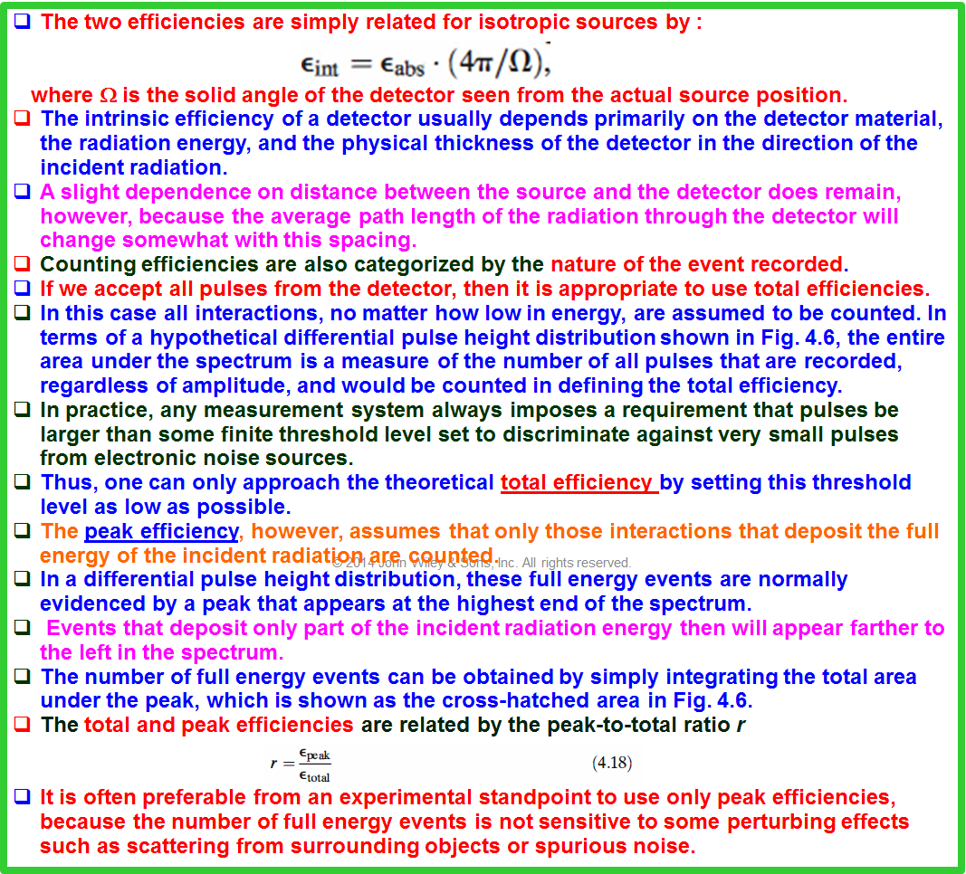
VI. DETECTION EFFICIENCY-GK-36

Slide 6
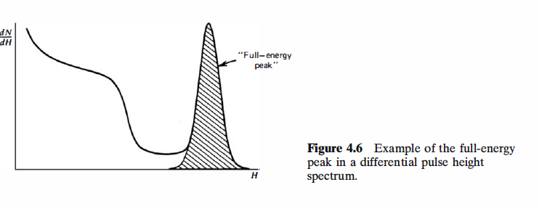
VI. DETECTION EFFICIENCY-GK-37

Slide 7
A detector efficiency should be specified according to both of the above criteria.
For example, the most common type of efficiency tabulated for gamma-ray detectors is the intrinsic peak efficiency.
A detector with known efficiency can be used to measure the absolute activity of a radioactive source.
In the following discussion, we assume that a detector with an intrinsic peak efficiency ε _{ip} has been used to record N events under the full-energy peak in the detector spectrum.
For simplicity, we also assume that the source emits radiation isotropically and that no attenuation takes place between the source and detector.
From the definition of intrinsic peak efficiency, the number of radiation quanta S emitted by the source over the measurement period is then given by:
where Ω represent the solid angle (in steradians) subtended by the detector at the
source position.
The solid angle is defined by an integral over the detector surface that faces the source, of the form
where r represents the distance between the source and a surface element dA, and α is the angle between the normal to the surface element and the source direction.
If the volume of the source is not negligible, then a second integration must be carried out over all volume elements of the source.

Slide 8
VI. DETECTION EFFICIENCY-GK-38

Slide 9
VI. DETECTION EFFICIENCY-GK-39

Slide 10
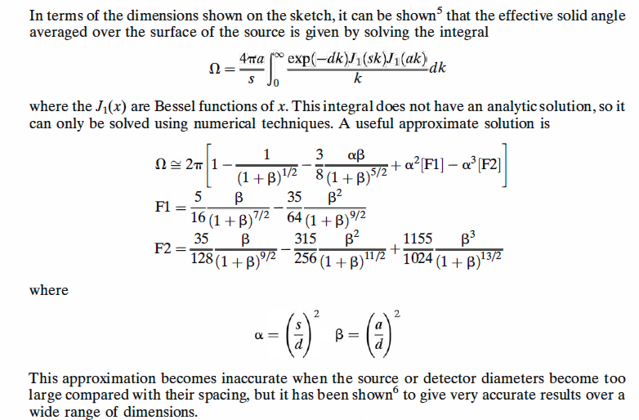
VI. DETECTION EFFICIENCY-GK-40

Slide 11
VII. DEAD TIME GK- 41
VII. DEAD TIME
In nearly all detector systems, there will be a minimum amount of time that must separate two events in order that they be recorded as two separate pulses.
In some cases the limiting time may be set by processes in the detector itself, and in other cases the limit may arise in the associated electronics.
This minimum time separation is usually called the dead time of the counting system.
Because of the random nature of radioactive decay, there is always some probability that a true event will be lost because it occurs too quickly following a preceding event.
These "dead time losses" can become rather severe when high counting rates are encountered, and any accurate counting measurements made under these conditions must include some correction for these losses.
In this section we discuss some simple models of dead time behavior of counting systems, together with two experimental methods of determining system dead time.
A. Models for Dead Time Behavior
Two models of dead time behavior of counting systems have come into common usage: paralyzable and nonparalyzable response.
These models represent idealized behavior, one or the other of which often adequately resembles the response of a real counting system.
The fundamental assumptions of the models are illustrated in Fig. 4.7.
At the center of the figure, a time scale is shown on which six randomly spaced events in the detector are indicated.

Slide 12
VII. DEAD TIME GK- 41

Slide 13
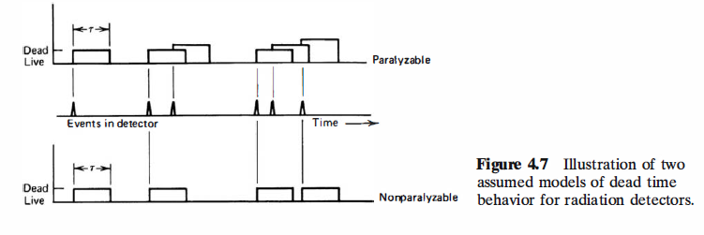
VII. DEAD TIME GK- 42
At the bottom of the figure is the corresponding dead time behavior of a detector assumed to be nonparalyzable.
A fixed time τ is assumed to follow each true event that occurs during the "live period" of the detector.
True events that occur during the dead period are lost and assumed to have no effect whatsoever on the behavior of the detector.
In the example shown, the nonparalyzable detector would record four counts from the six true interactions.
In contrast, the behavior of a paralyzable detector is shown along the top line of Fig. 4.7.
The same dead time τ is assumed to follow each true interaction that occurs during the live period of the detector.
True events that occur during the dead period, however, although still not recorded as counts, are assumed to extend the dead time by another period τ following the lost event.
In the example shown, only three counts are recorded for the six true events.
The two models predict the same first-order losses and differ only when true event rates are high.

Slide 14
VII. DEAD TIME GK- 42

Slide 15
VII. DEAD TIME GK- 43
They are in some sense two extremes of idealized system behavior, and real counting systems will often display a behavior that is intermediate between these extremes.
The detailed behavior of a specific counting system may depend on the physical processes taking place in the detector itself or on delays introduced by the pulse processing and recording electronics.
In the discussion that follows, we examine the response of a detector system to a steady state source of radiation, and we adopt the following definitions:
n =true interaction rate
m = recorded count rate
τ = system dead time
We assume that the counting time is long so that both n and m may be regarded as average rates.
In general, we would like to obtain an expression for the true interaction rate n as a function of the measured rate m and the system dead time τ, so that appropriate corrections can be made to measured data to account for the dead time losses.
In the nonparalyzable case, the fraction of all time that the detector is dead is given simply by the product mτ.
Therefore, the rate at which true events are lost is simply nmτ.
But because n - m is another expression for the rate of losses,

Slide 16
VII. DEAD TIME GK- 43

Slide 17
VII. DEAD TIME GK- 44
In the paralyzable case, dead periods are not always of fixed length, so we cannot apply the same argument.
Instead, we note that rate m is identical to the rate of occurrences of time intervals between true events that exceed τ.
The distribution of intervals between random events occurring at an average rate n was previously shown [Eq. (3.71)] to be
where P₁ (T) dT is the probability of observing an interval whose length lies within dT
about T.
The probability of intervals larger than τ can be obtained by integrating this distribution between τ and ∞
The rate of occurrence of such intervals is then obtained by simply multiplying the above expression by the true rate n
The paralyzable model leads to a more cumbersome result because we cannot solve explicitly for the true rate n.
Instead, Eq. ( 4.27) must be solved iteratively if n is to be calculated from measurements of m and knowledge of τ .

Slide 18
VII. DEAD TIME GK- 44

Slide 19
A plot of the observed rate m versus the true rate n is given in Fig. 4.8 for both models.
When the rates are low the two models give virtually the same result, but the behavior at high rates is markedly different.
A nonparalyzable system will approach an asymptotic value for the observed rate of 1/τ, which represents the situation in which the counter barely has time to finish one dead period before starting another.
For paralyzable behavior, the observed rate is seen to go through a maximum.
Very high true interaction rates result in a multiple extension of the dead period following an initial recorded count, and very few true events can be recorded.
Mistakes in the interpretation of nuclear counting data from paralyzable systems have occurred in the past by overlooking the fact that there are always two possible true interaction rates corresponding to a given observed rate.
As shown in Fig. 4.8, the observed rate m₁ can correspond to either true rates n₁ or n₂•
The ambiguity can be resolved only by changing the true rate in a known direction while observing whether the observed rate increases or decreases.
Thus, the two models lead to identical results in the limit of small dead time losses.
If possible, one should avoid measurement conditions under which dead time losses are high because of the errors that inevitably occur in making corrections for the losses.
The value of τ may be uncertain or subject to variation, and the system behavior may not follow exactly either of the models described above.
When losses are greater than 30 or 40%, the calculated true rate becomes very sensitive to small changes in the measured rate and the assumed system behavior.
Instead, the user should seek to reduce the losses by changing the conditions of the measurement or by choosing a counting system with smaller dead time.

Slide 20
VII. DEAD TIME GK- 45

Slide 21
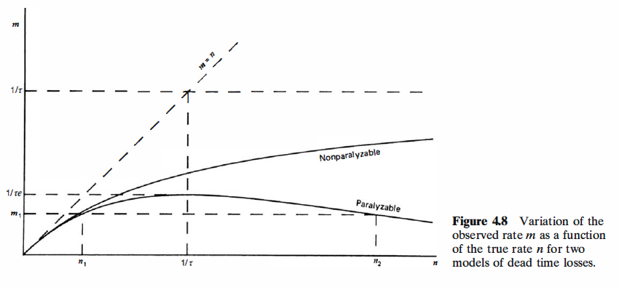
VII. DEAD TIME GK- 46

Slide 22
B. Methods of Dead Time Measurement-GK-47
B. Methods of Dead Time Measurement
In order to make dead time corrections using either model, prior knowledge of the dead time τ is required.
Sometimes this dead time can be associated with a known limiting property of the counting system (e.g., a fixed resolving time of an electronic circuit).
More often, the dead time will not be known or may vary with operating conditions and must therefore be measured directly.
Common measurement techniques are based on the fact that the observed rate varies nonlinearly with the true rate.
Therefore, by assuming that one of the specific models is applicable, and by measuring the observed rate for at least two different true rates that differ by a known ratio, the dead time can be calculated.
The common example is the two-source method.
The method is based on observing the counting rate from two sources individually and in combination.
Because the counting losses are nonlinear, the observed rate due to the combined sources will be less than the sum of the rates due to the two sources counted individually, and the dead time can be calculated from the discrepancy.
To illustrate the method, let n₁, n₂, and n₁₂ be the true counting rates (sample plus background) with source 1, source 2, and the combined sources, respectively, in place.
Let m₁, m₂, and m₁₂ represent the corresponding observed rates.
Also, let n_{b} and m_{b} be the true and measured background rates with both sources removed.

Slide 23
B. Methods of Dead Time Measurement-GK-47

Slide 24
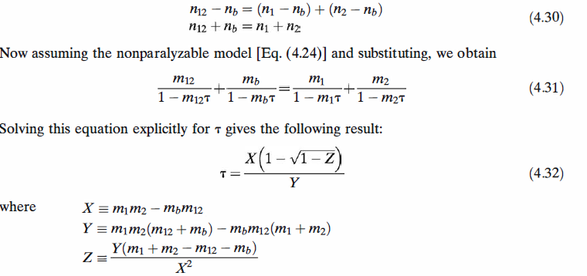
Then
Because the method is essentially based on observing the difference between two nearly equal large numbers, careful measurements are required in order to get reliable values for the dead time.
The measurement is usually carried out by counting source 1, placing source 2 nearby and measuring the combined rate, and then removing source 1 to measure the rate caused by source 2 alone.
During this operation, care must be exercised not to move the source already in place, and consideration must be given to the possibility that the presence of a second source will scatter radiation into the detector that would not ordinarily be counted from the first source alone.
In order to keep the scattering unchanged, a dummy second source without activity is normally put in place when the sources are counted individually.
Best results are obtained by using sources active enough to result in a fractional dead time m₁₂τ of at least 20%.

Slide 25
B. Methods of Dead Time Measurement-GK-48

Slide 26
B. Methods of Dead Time Measurement-GK-49 second method
A second method can be carried out if a short-lived radioisotope source is available.
In this case the departure of the observed counting rate from the known exponential decay of the source can be used to calculate the dead time.
The technique, known as the decaying source method, is based on the known behavior of the true rate n:
where n₀ is the true rate at the beginning of the measurement and λ is the decay
constant of the particular isotope used for the measurement.
In the limit of negligible background, a simple graphical procedure can be applied to analyze the resulting data.
Then Eq. ( 4.33) becomes
By inserting Eq. ( 4.34) into Eq. ( 4.24) and carrying out some algebra, we get the following relation for the nonparalyzable model:
If we identify, as in Fig. 4.9a, the abscissa as m and the ordinate as the product , then Eq. ( 4.35) is that of a straight line.
The experimental procedure consists of measuring the observed rate m as a function of time t, and thus defining points that should lie on this line starting from the right and moving left as the source decays.
By fitting the best straight line to the data, the intercept will give n₀, the true rate at the beginning of the measurement, and the negative slope will give the product of n₀τ.
The dead time τ then follows directly from the ratio of the slope to the intercept.

Slide 27
B. Methods of Dead Time Measurement-GK-49 second method

Slide 28
For the paralyzable model, inserting Eq. (4.34) into Eq. (4.27) gives the following result:
Again by choosing the abscissa and ordinate as shown in Fig. 4.9b, the equation of a straight line results.
In this case the intercept gives the value ln n₀, whereas the slope again gives the negative of the product n₀τ.
The dead time can simply be derived from these two values.
The decaying source method offers the advantage of not only being able to measure the value of the dead time but also being able to test the validity of the assumed models.
If a nonparalyzable model best describes the counting system, the data will most closely fit a straight line for the format shown in Fig. 4.9a.
On the other hand, if a paralyzable model is more appropriate, the format shown in Fig. 4.9b will result in a more nearly linear plot of the data.
In order to be effective, the measurements should be carried out for a time period at least equal to the half-life of the decaying radioisotope, and the initial loss fraction mτ should be at least 20%.
If the background is more than a few percent of the smallest measured rate, the graphical procedure can lead to significant errors.
Although some improvement will result from subtracting the observed background rate from all the measured m values, this correction is not rigorous and an exact analysis can only be made by reverting back to Eq. ( 4.33).
It then becomes necessary to use numerical computation techniques to derive values for n₀ and τ which, when inserted in an assumed model of the dead time behavior, result in a best fit to the measured data.
The methods described above are applicable to determine the dead time of simple counting systems in which all pulses above a threshold amplitude are recorded.
For spectroscopic systems in which the pulse height spectrum is recorded from the detector, other methods are available to deal with counting losses that are based on the mixture of artificial pulses from a pulse generator into the signal processing chain.

Slide 29
B. Methods of Dead Time Measurement-GK-50 second method

Slide 30
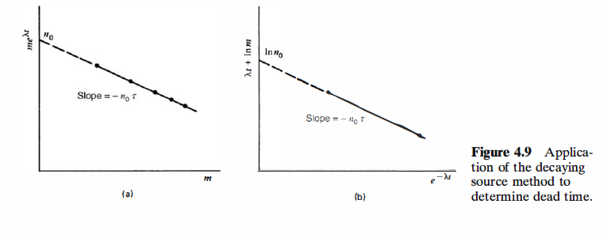
B. Methods of Dead Time Measurement-GK-51 second method

Slide 31
C. Statistics of Dead Time Losses-GK-52
C. Statistics of Dead Time Losses
When measuring radiation from steady-state sources, we normally assume that the true events occurring in the detector follow Poisson statistics in which the probability of an event occurring per unit time is a constant.
The effect of system dead time is to remove selectively some of the events before they are recorded as counts.
Specifically, events occurring after short time intervals following preceding events are preferentially discarded, and the interval distribution [Eq. (3.71)] is modified from its normal exponential shape.
Dead time losses therefore distort the statistics of the recorded counts away from a true Poisson behavior.
If the losses are small (nτ less than 10 or 20% ), however, this distortion has little practical effect on the validity of the statistical formulas for the prediction of statistical counting uncertainties developed in Chapter 3.
If the dead time losses are not small, the deviations from Poisson statistics become more significant.
The discarding of events that occur after short time intervals causes the sequence of recorded counts to become somewhat more regular, and the variance expected in repeated measurements is reduced.
Detailed analyses of the statistics of counts distorted by dead time are beyond the present scope, but can be found in Refs. 22-25.
With either paralyzable or nonparalyzable behavior, there is some chance that more than one true event is lost per dead period.
A recorded count therefore can correspond to the occurrence of any number of true events, from one to many.
The relative probability that multiple true events are contained in a typical dead period will increase as the true event rate becomes higher.
Because the true events still obey Poisson statistics, relatively simple analysescan be made to predict the probability that a typical recorded count results from the combination of exactly x true events.
These analyses are given later in this text, beginning on p. 658 in connection with the closely related topic of pulse pile-up.

Slide 32
C. Statistics of Dead Time Losses-GK-52

Slide 33
D. Dead Time Losses from Pulsed Sources GK-53
D. Dead Time Losses from Pulsed Sources
The analysis of counting losses due to detector dead time in the previous sections assumed that the detector was irradiated by a steady-state source of constant intensity.
There are many applications in which the source of radiation is not continuous but instead consists of short pulses repeated at a constant frequency.
For example, electron linear accelerators used to generate high-energy X-rays can be operated to produce pulses of a few microsecond width with a repetition frequency of several kilohertz.
In such cases, the results given previously may not be applicable to correct properly for the effects of dead time losses.
Substitute analytical methods must now be applied that make use of some of the statistical principles introduced in Chapter 3.
We confine our analysis to a radiation source that can be represented by the time dependent intensity sketched below:
It is assumed that the radiation intensity is constant throughout the duration T of each pulse, and that the pulses occur at a constant frequency f Depending on the relative value of the detector dead time τ, several conditions may apply:
1. If τ is much smaller than T, the fact that the source is pulsed has little effect, and the results given earlier in this section for steady-state sources may be applied with reasonable accuracy.
2. If τ is less than T but not by a large factor, only a small number of counts may be registered by the detector during a single pulse. This is the most complicated circumstance and is beyond the scope of the present discussion. Detailed analysis of this case may be found in Refs. 26 and 27.
3. If τ is larger than T but less than the "off" time between pulses (given by l/f-1), the following analysis applies.
Note that under these conditions, we can have a maximum of only one detector count per source pulse.
Also, the detector will be fully recovered at the start of each pulse.

Slide 34
D. Dead Time Losses from Pulsed Sources GK-53

Slide 35
D. Dead Time Losses from Pulsed Sources GK-54
For the analysis that follows, it is no longer necessary that the radiation be constant over the pulse length T, but it is required that each radiation pulse be of the same intensity.
We carry through the following definitions:
τ = dead time of the detector system
m = observed counting rate
n = true counting rate (if τ were 0)
T = source pulse length
f = source pulse frequency
Since there can be at most a single count per pulse, the probability of an observed count per source pulse is given by m/f
The average number of true events per source pulse is by definition equal to n/f (Note that this average can be greater than 1.)
We can apply the Poisson distribution [Eq. (3.24)] to predictthe probability that at least one true event occurs per source pulse:
Since the detector is "live" at the start of each pulse, a count will be recorded if at least one true event occurs during the pulse.
Only one such count can be recorded, so the above expression is also the probability of recording a count per source pulse.
Equating the two expressions for this probability, we obtain:

Slide 36
D. Dead Time Losses from Pulsed Sources GK-54

Slide 37
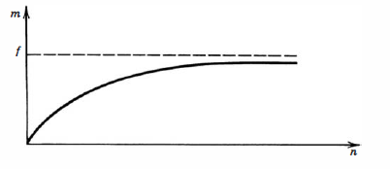
A plot of this behavior is shown below:
Under these conditions, the maximum observable counting rate is just the pulse repetition frequency, since no more than a single count can be recorded per pulse.
Also, neither the specific length of the dead time nor the detailed dead time behavior of the system (whether it is paralyzable or nonparalyzable) has any influence on the losses.
Under normal circumstances, we are more interested in a correction formula to predict the true rate from the measured rate and the system dead time.
Solving Eq. ( 4.38) for n, we derive
Recall that this correction is valid only under the conditions T <τ< (l/f - T).
In this case, the dead time losses are small under the condition m << f.
Expanding the logarithmic term above for this limit, we find that a first-order correction is then given by
This result, because of its similarity to Eq. ( 4.24), can be viewed as predicting an effective dead time value of 1/2f in this low-loss limit.
Since this value is now one-half the source pulsing period, it can be many times larger than the actual physical dead time of the detector system.

Slide 38
D. Dead Time Losses from Pulsed Sources GK-55

