Slide 1
Chapter 4-GK
General Properties of Radiation
Detectors
Lec-12-13
Notes:
1

Slide 2
Lec-No-12-13

Slide 3
Lec-No-12

Slide 4
VI. DETECTION EFFICIENCY-GK-35

Slide 5
VI. DETECTION EFFICIENCY-GK-36

Slide 6
VI. DETECTION EFFICIENCY-GK-37

Slide 7
VI. DETECTION EFFICIENCY-GK-38

Slide 8
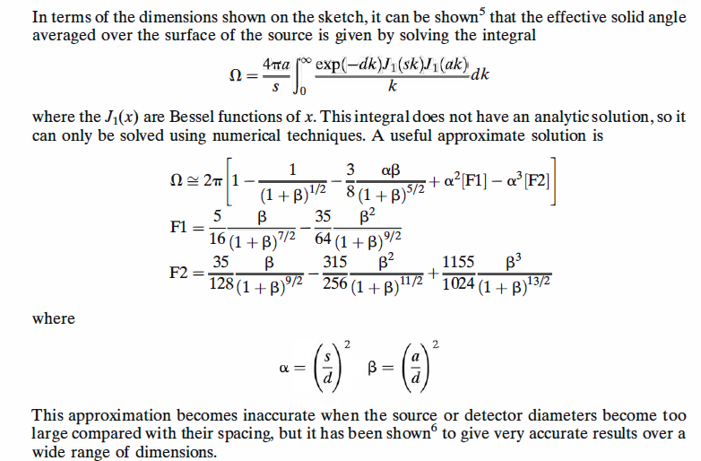
VI. DETECTION EFFICIENCY-GK-39

Slide 9
VII. DEAD TIME GK- 40

Slide 10
VII. DEAD TIME GK- 41

Slide 11
VII. DEAD TIME GK- 42

Slide 12
VII. DEAD TIME GK- 43

Slide 13
VII. DEAD TIME GK- 44

Slide 14
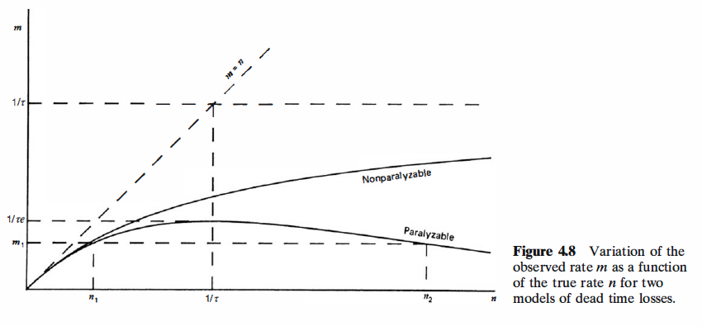
VII. DEAD TIME GK- 45

Slide 15
Lec-No-13

Slide 16
B. Methods of Dead Time Measurement-GK-46

Slide 17
B. Methods of Dead Time Measurement-GK-47

Slide 18
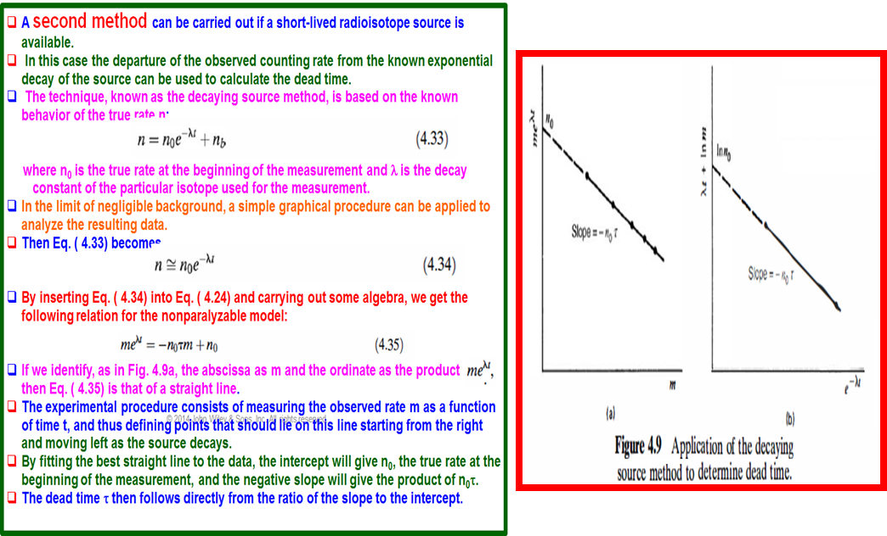
B. Methods of Dead Time Measurement-GK-48- second method

Slide 19
B. Methods of Dead Time Measurement-GK-49- second method

Slide 20
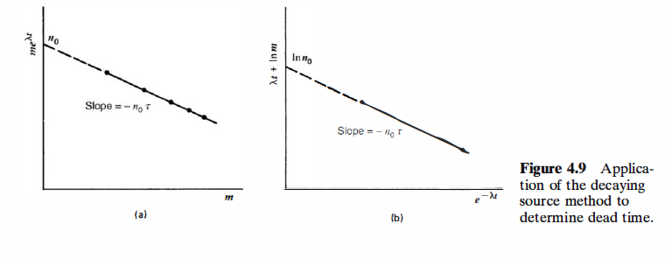
B. Methods of Dead Time Measurement-GK-50-second method

Slide 21
C. Statistics of Dead Time Losses-GK-51

Slide 22
D. Dead Time Losses from Pulsed Sources- GK-52

Slide 23
D. Dead Time Losses from Pulsed Sources-GK-53

Slide 24
D. Dead Time Losses from Pulsed Sources- GK-54

