Slide 1
HW-Ch-3
6, 8, 10, 17, 20, 21

Slide 5
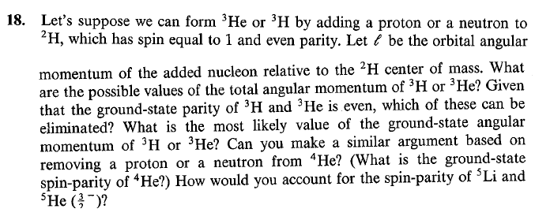

Slide 6
²H+n→³H
Considering spin of ²H of ⁺1 and for neutron s=1/2 and orbital angular momentum l
I=j _{core} +j _{particle}
I= ⁺1 +(1/2) +l
Possible l values l=0 (even parity) ,1 (odd parity) ,2 (even parity ),
even parity of added nucleon
Parity of ³H is even
Possible values of l with even parity only l = 0, 2
For l=0, j= 1 ±(1/2) = ½, 3/2 (even parity)
For l=1, j= 2±(1/2) =½, 3/2, 5/2 (odd parity)
For l=2, j= 3±(1/2) =½, 3/2, 5/2, 7/2 (even parity)
Since two nucleon couple to 0, odd nucleon has spin ½ in A=3 systems
giving the spin of ³H or ³He

