Slide 1
Phy 503
Presentation
Boron Concentration Measurement in Water Sample using CeBr₃ detector
Student: Abul Lais
Instructor: Dr A A Naqvi
Notes:
3-D wood block with texture and engraved text
(Advanced)
To reproduce the shape effects on this slide, do the following:
On the Home tab, in the Slides group, click Layout, and then click Blank.
On the Home tab, in the Drawing group, click Shapes, and then under Rectangles, click Rectangle (first option from the left). On the slide, drag to draw a rectangle.
Under Drawing Tools, on the Format tab, in the Size group, do the following:
In the Shape Height box, enter 3”.
In the Shape Width box, enter 3”.
On the Home tab, in the bottom right corner of the Drawing group, click the Format Shape dialog box launcher. In the Format Shape dialog box, click Fill in the left pane, and then in the Fill pane, select Picture or texture fill. Click the button next to Texture, and then click Oak (fifth row, third option from the left).
Also in the Format Shape dialog box, click Line Color in the left pane, and then in the Line Color pane, then select No line.
Also in the Format Shape dialog box, click 3-D Rotation in the left pane, and then in the 3-D Rotation pane, do the following:
Click the button next to Presets, and then under Perspective click Perspective Left (first row, second option from the left).
In the X box, enter 40°.
In the Y box, enter 10°.
In the Perspective box, enter 20°.
Also in the Format Shape dialog box, click 3-D Format in the left pane, and then in the 3-D Format pane, do the following:
Under Bevel, click the button next to Top, and then under Bevel click Circle (first row, first option from the left). Click the button next to Bottom, and then under Bevel click Circle (first row, first option from the left).
Under Depth, in the Depth box, enter 200 pt.
Under Surface, click the button next to Material, and then under Standard, click Warm Matte (second option from the left). Click the button next to Lighting, and then under Neutral, click Soft (first row, third option from the left). In the Angle box, enter 270°.
Also in the Format Shape dialog box, click Shadow in the left pane, and then in the Shadow pane, click the button next to Presets, and then under Perspective, click Perspective Diagonal Upper Right (first row, second option from the left).
To reproduce the text effects on this slide, do the following:
On the slide, right-click the rounded rectangle, click Edit Text, then enter text.
Select the text. On the Home tab, in the Font group, select Arial Rounded MT Bold from the Font list, and then select 36 from the Font Size list.
On the Home tab, in the Paragraph group, click Center to center the text within the rectangle.
Under Drawing Tools, on the Format tab, in the bottom right corner of the WordArt Styles group, click the Format Text Effects dialog box launcher. In the Format Text Effects dialog box, click Text Fill in the left pane, and then in the Text Fill pane, do the following:
Select Solid fill.
Click the button next to Color, click More Colors, and then in the Colors dialog box, on the Custom tab, enter values for Red: 130, Green: 101, and Blue: 58.
Also in the Format Text Effects dialog box, click Shadow in the left pane, and then in the Shadow pane, do the following:
Click the button next to Presets, and then under Inner click Inside Diagonal Top Left (first row, first option from the left).
In the Transparency box, enter 25%.
In the Distance box, enter 5 pt.
To reproduce the background on this slide, do the following:
Right-click the slide background area, and then click Format Background. In the Format Background dialog box, click Fill in the left pane, select Gradient fill in the Fill pane, and then do the following:
In the Type list, select Linear.
Click the button next to Direction, and then click Linear Down (first row, second option from the left).
Under Gradient stops, , click Add gradient stops or Remove gradient stops until four stops appear in the slider.
Also under Gradient stops, customize the gradient stops that you added as follows:
Select the first stop in the slider, and then do the following:
In the Position box, enter 0%.
Click the button next to Color, click More Colors, and then in the Colors dialog box, on the Custom tab, enter values for Red: 196, Green: 178, and Blue: 152.
Select the second stop in the slider, and then do the following:
In the Position box, enter 45%.
Click the button next to Color, and then under Theme Colors click Tan, Background 2, Darker 90% (sixth row, third option from the left).
Select the third stop in the slider, and then do the following:
In the Position box, enter 72%.
Click the button next to Color, click More Colors, and then in the Colors dialog box, on the Custom tab, enter values for Red: 66, Green: 62, and Blue: 50.
Select the fourth stop in the slider, and then do the following:
In the Position box, enter 100%.
Click the button next to Color, click More Colors, and then in the Colors dialog box, on the Custom tab, enter values for Red: 149, Green: 128, and Blue: 107.

Slide 2
Contents
Measuring [Boron] in water with CeBr₃ detector
Introduction
Results and
Discussion
Experimental
procedure
Theoretical
Background

Slide 3
Contents
Introduction
Measuring [Boron] in water with CeBr₃ detector
Results and
Discussion
Experimental
procedure
Theoretical
Background

Slide 4
Introduction
PGNAA (Prompt Gamma Neutron Activation Analysis)
Materials characterization technique
irradiate with matter/energetic particles & study radiation emitted
XPS/XRD/Electron microsopy/PGNAA =
family of techniques
PGNAA = elemental characterisation = identity & % composition of atoms present
Many uses! E.g. food/water/brick/soil samples’ testing

Slide 5
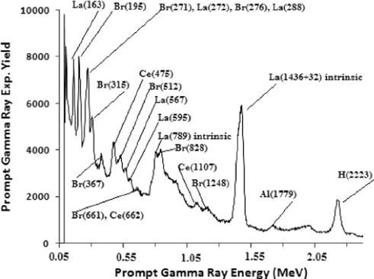
Introduction
Basic idea = irradiate with thermal (why?) neutrons
which get absorbed making nucleus unstable
To stabilise, instant emission of PG rays within fs
Peak height = density of atoms present
Peak location = identity of atoms present
which & how much of each element present in sample

Slide 6
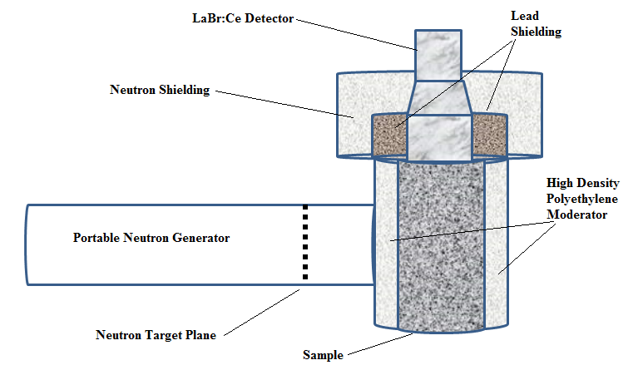
Introduction
neutron generator + moderator + sample + detector
n-gen: produce fast neutrons by fusion: D + D -> He-3 + n
moderator = slow to thermal n; usually polyethylene
sample e.g. boron-contaminated water samples
detector = CeBR₃ solid-state detector; counts PG rays (energy & intensity)
CeBr₃ detector
Moderator
Neutron generator
Sample

Slide 7
Contents
Measuring [Boron] in water with CeBr₃ detector
Results and
Discussion
Introduction
Experimental
procedure
Theoretical
Background

Slide 8
Contents
Measuring [Boron] in water with CeBr₃ detector
Introduction
Results and
Discussion
Experimental
procedure
Theoretical
Background

Slide 9
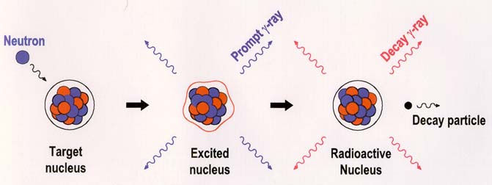
Theoretical Background
Thermal neutron strike target atoms
Advantages of PGNAA:
Fast, non-destructive
& always works
Why thermal n? Ramsauer model:
eff. ¹n size proportional to thermal DB wavelength
Which is inv. proportional to speed,
Hence slow ¹n = large DBW = large interaction cross-section = high absorption probability by nucleus = stronger signals

Slide 10
Contents
Measuring [Boron] in water with CeBr₃ detector
Introduction
Results and
Discussion
Experimental
procedure
Theoretical
Background

Slide 11
Contents
Measuring [Boron] in water with CeBr₃ detector
Introduction
Results and
Discussion
Theoretical
Background
Experimental
procedure

Slide 12
Experimental procedure
Preparation of boron-contaminated water samples
By diluting standard Boron solution in stoichiometric proportion with distilled water
5 samples prepared: 0.03125 – 0.25 wt% samples
Wiped clean to avoid contamination
placed in bottles of equal dimensions to avoid signal discrepancies arising from geometrical factors
Insert sample into cavity & irradiate for ~1500 s
Concentration proportional to signal intensity

Slide 13
Experimental procedure
3 ‘types’ of runs (detector always on)
1) n-beam off, sample absent (natural radioisotopes in detector element) = intrinsic spectrum
2) n-beam on, sample absent (n-activation of detector elements – Ce,Br) = detector activation spectrum
3) n-beam on, sample present = sample spectrum
3 – 2 = integrated yield of Boron $∝$ [B] (theoretical)
If we get that, detector is working well
To improve accuracy, run times of 2 & 3 should approx. equal

Slide 14
Experimental procedure
Last issue: Calibration
Ba(356)

Slide 15
Contents
Measuring [Boron] in water with CeBr₃ detector
Introduction
Results and
Discussion
Experimental
procedure
Theoretical
Background

Slide 16
Contents
Measuring [Boron] in water with CeBr₃ detector
Introduction
Results and
Discussion
Experimental
procedure
Theoretical
Background

Slide 17
Results and Discussion
Type 1 - intrinsic spectrum
Due to natural radioisotopes in detector
²²⁷Ac contamination with cerium (Schotanus et al)
1510

Slide 18
Results and Discussion
Type 2 - detector activation spectrum
Neutron activation of cerium & bromine atoms
No hydrogen peaks due to low amplifier settings (coarse gain = 20, fine gain = 8)

Slide 19
Results and Discussion
Type 2 (dotted line) & Type 3 (solid line)
Br(367)

Slide 20
Results and Discussion
Type 3 – sample spectrum – for 5 boron water samples

Slide 21
Results and Discussion
(Type 3 – Type 2) = integrated yield (boron only)
Area under graph $∝$ [B] in wt%

Slide 22
Results and Discussion
Linear regression of integrated yield vs [B] (wt%)
Good linear fit => detector is functioning normally
Can be used to test conc. of unknown samples

Slide 23
Conclusions
Verified the performance of the detector
Useful technique for testing unknown samples
Studied the various types of curves that occur in PGNAA
A widely-applicable technique with almost unlimited applications

Slide 24
Thank You for your Attention !!!

Slide 25
Detectors ahead…
Appendix

Slide 26
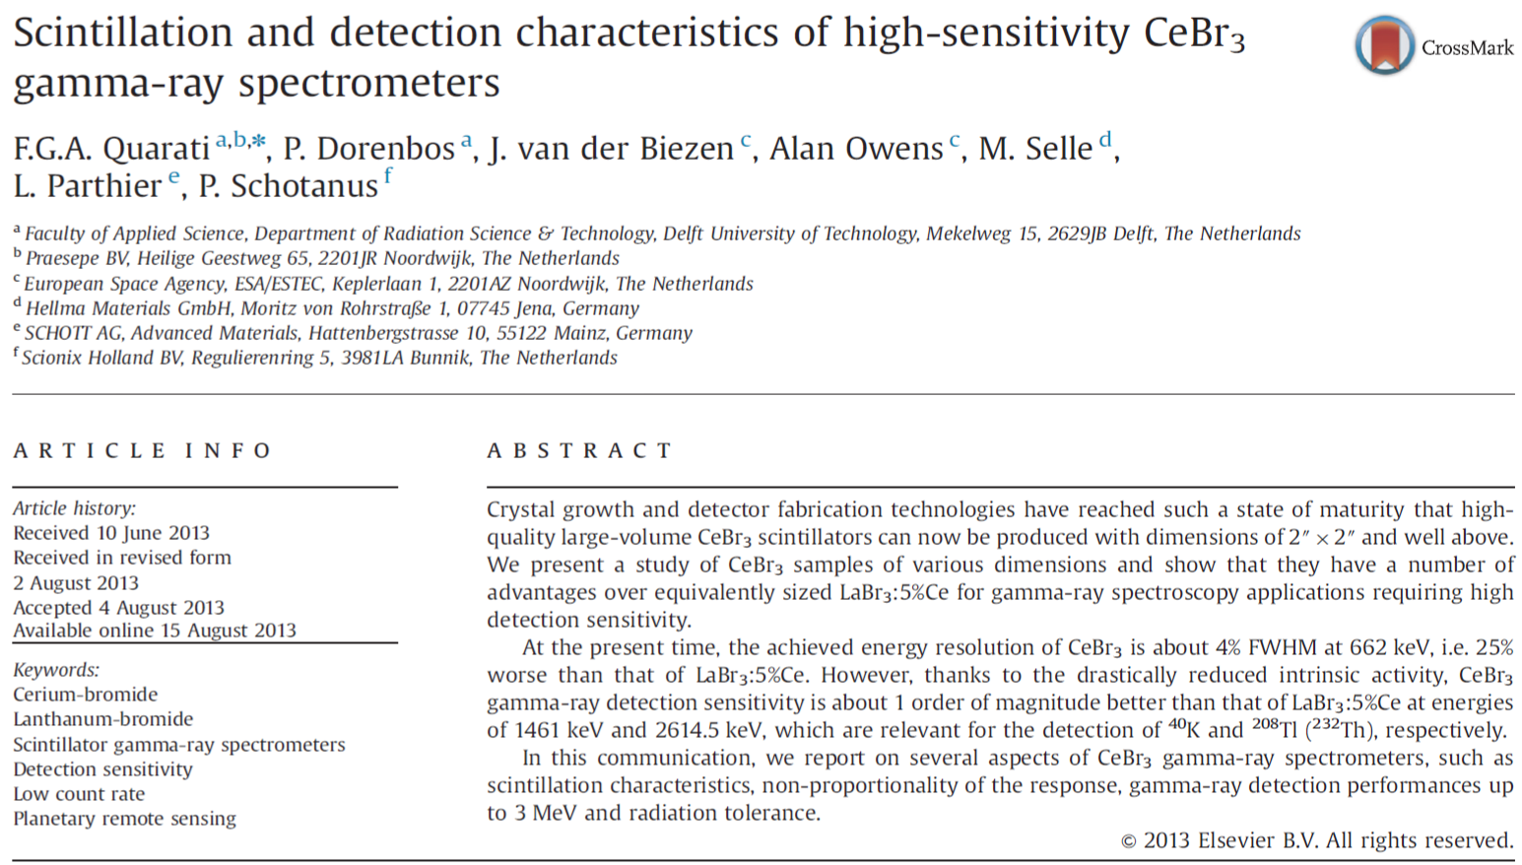
CeBr₃ Scintillation Detector

Slide 27
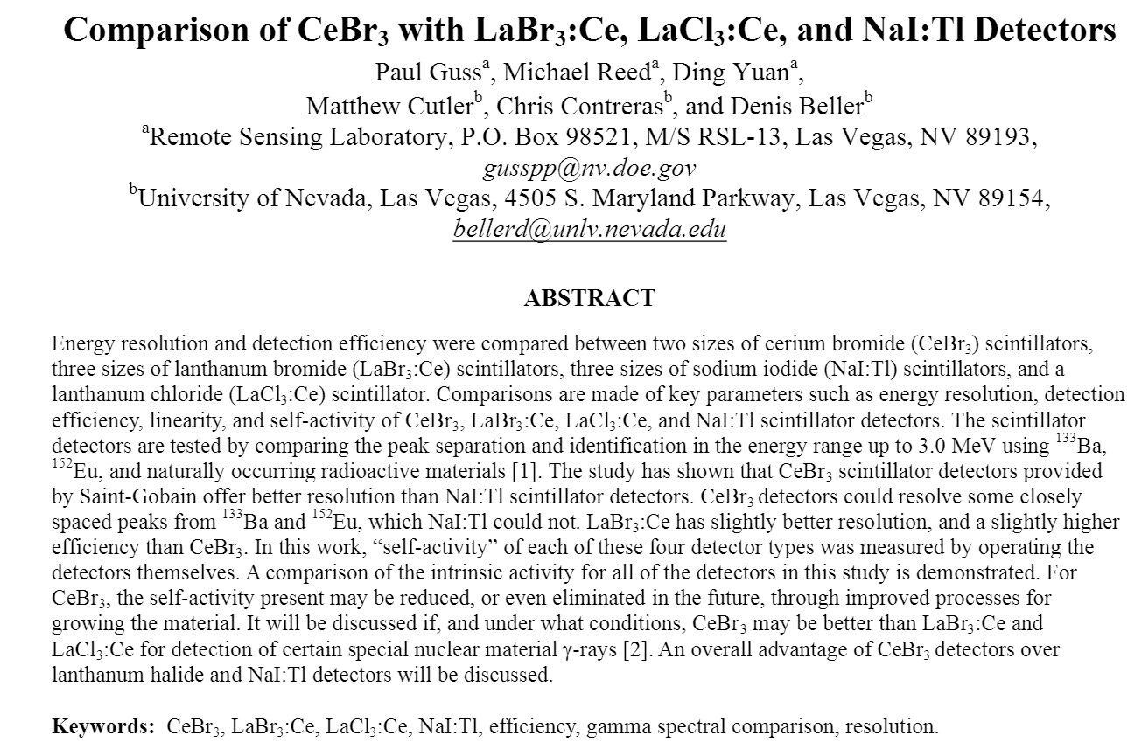
CeBr₃ Scintillation Detector

Slide 28
CeBr₃ Scintillation Detector
Advantages:
Good-energy resolution
Easier to resolve closely spaced peaks
Drastically-reduced intrinsic activity
Good linearity
Reasonable detection efficiency

Slide 29
Detection Efficiency

Slide 30
Linearity of Response

