Slide 1
Power Generators
Done by:
Asim AlDayel.
Aqeel AlMayan.

Slide 2
What are power generators?
How are they manufactured?
How do they work?

Slide 3
What is the generator
Generator: it is a device that converts different kind of energy to electrical energy.
Generators
Electromagnetic generators
Electrostatic generator
Dynamo
Alternator
Van de Graaff generator

Slide 4
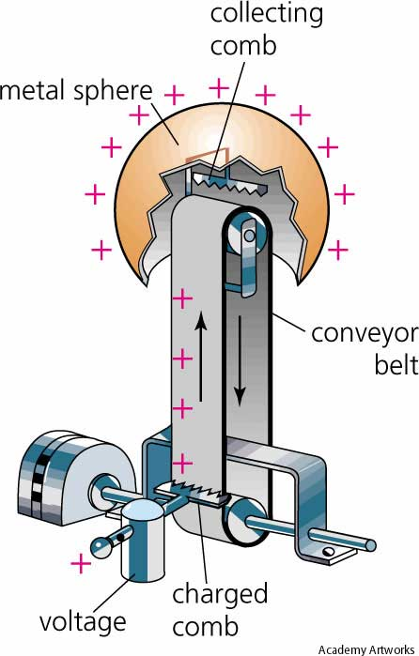
Van de Graaff generator
An electrostatic generator in which an electric
charge is either removed from or transferred to
a large hollow spherical electrode by a rapidly
moving belt, accelerating particles to energies
of about ten million electron volts.

Slide 5
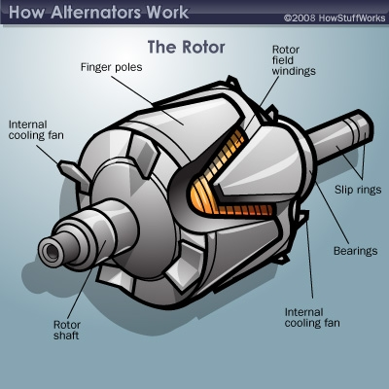
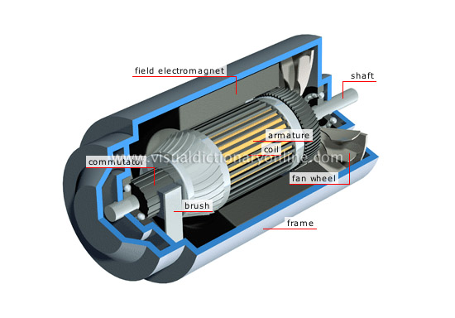
Dynamo
Alternator

Slide 6
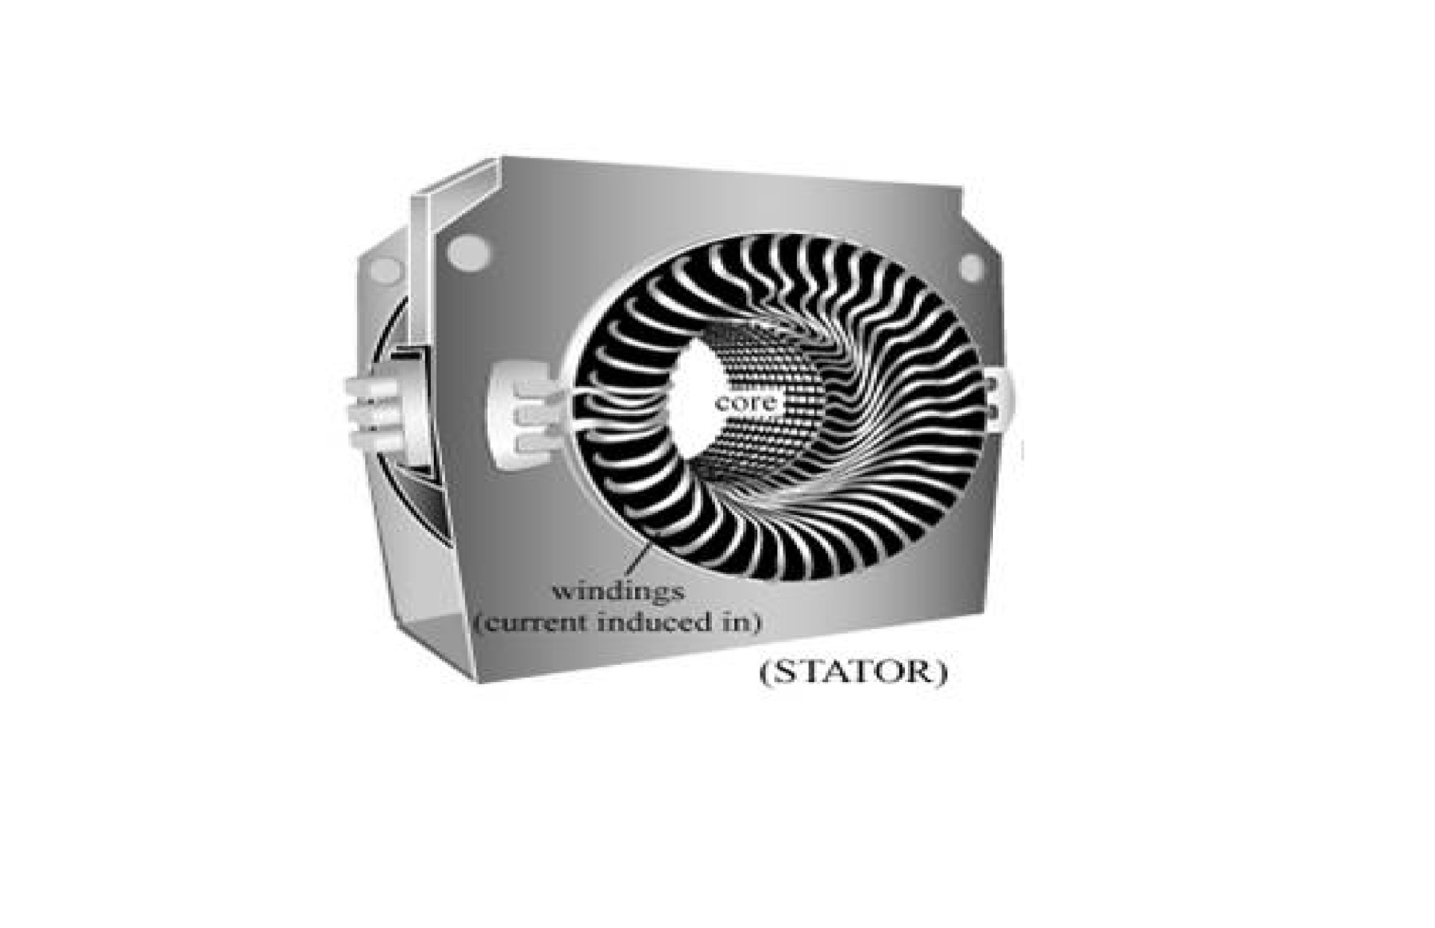
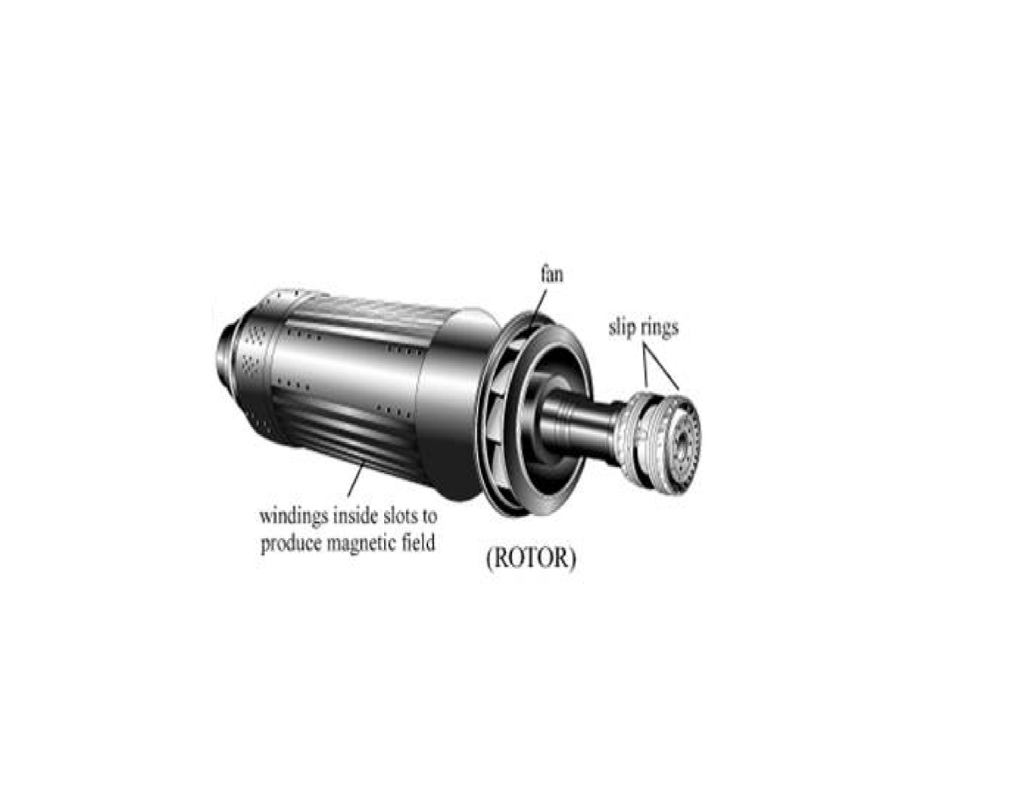
How are the manufactured
Mechanical:
Rotor: The rotating part of an electrical machine.
Stator: The stationary part of an electrical machine.

Slide 7
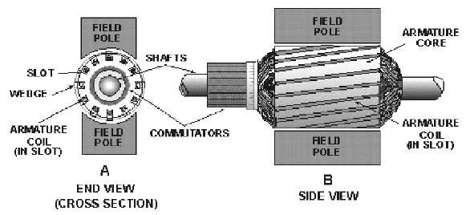
Electrical:
Armature: The power-producing component of an electrical machine. In a generator, alternator, or dynamo the armature windings generate the electric current. The armature can be on either the rotor or the stator.
Field: The magnetic field component of an electrical machine. The magnetic field of the dynamo or alternator can be provided by either electromagnets or permanent magnets mounted on either the rotor or the stator.

Slide 9
Sources:
http://terry-eng35.blogspot.com/2012/05/electricity-production.html
http://www.eon-uk.com/EnergyExperience/700.htm
http://en.wikipedia.org/wiki/Electrical_generator
http://www.poweredgenerators.com/
http://upload.wikimedia.org/wikipedia/commons/thumb/5/58/Stator_and_rotor_by_Zureks.JPG/800px-Stator_and_rotor_by_Zureks.JPG

