Slide 1
EE 207
Chapter 3 The Fourier Series
Adil S. Balghonaim

Slide 2
Vectors in 2D
Vectors in 3D
N-Dimension

Slide 4
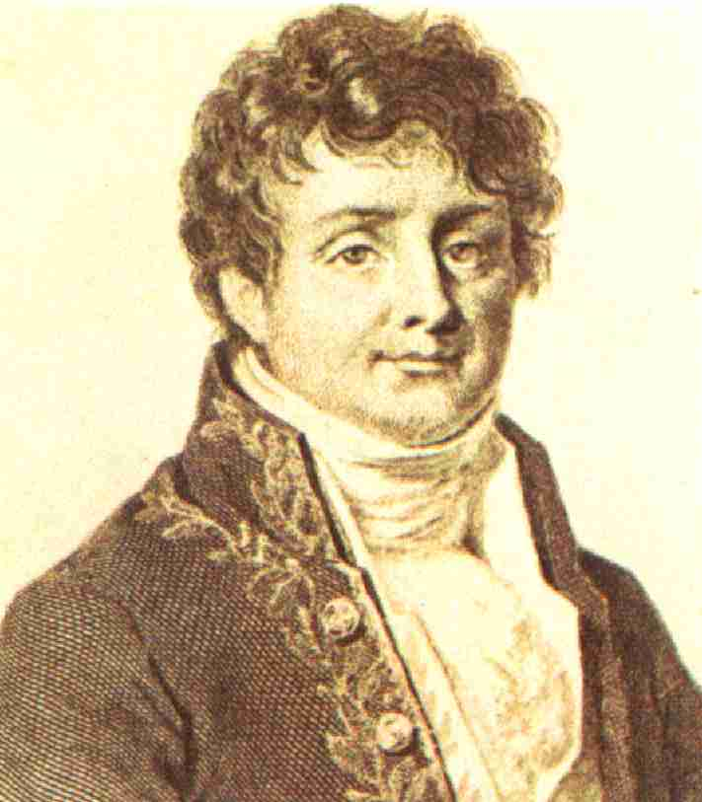
Jean Baptiste Joseph Fourier (21 March 1768 – 16 May 1830)
was a French mathematician and physicist
best known for initiating the investigation of Fourier series
and their applications to problems of heat transfer
and vibrations

Slide 5
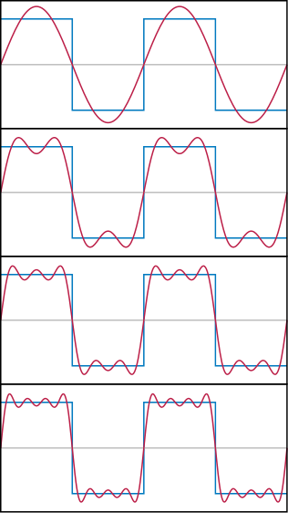
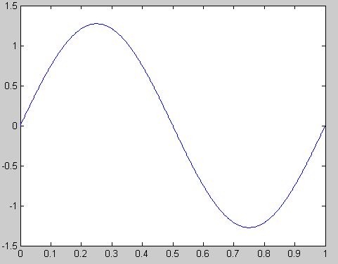
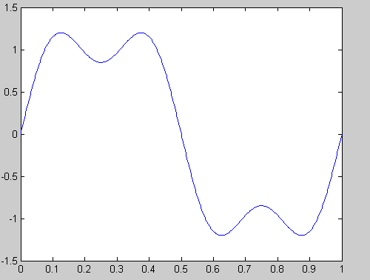
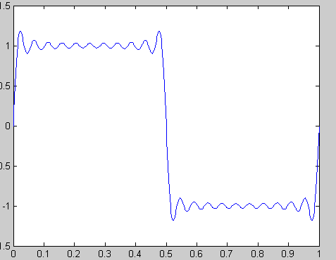
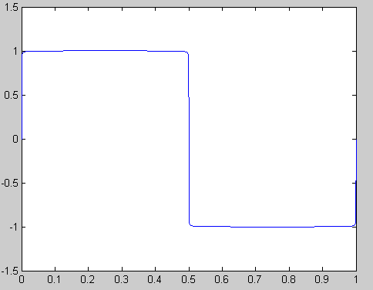
Fourier observed that the addition of Sinusoidal functions with different frequencies and amplitude resulted in other periodical
functions
Example

Slide 6
Fourier proposed the following:
For any periodical function of period
were
Then
Periodicals functions can be decomposed to sin and cosine functions
Similar to decompose a vector in terms of i,j,k,…
Notes:
6

Slide 7
Notes:
7

Slide 8
Notes:
8

Slide 9
Notes:
9

Slide 11
We seek to find the coefficients or coordinates
Notes:
11

Slide 12
Integrating both side over one period
Notes:
12

Slide 13
By comparison to the 2D-vector ,
Similarly
Notes:
13

Slide 14
Multiplying both side by cos5ω₀t and Integrating over one period
Notes:
14

Slide 15
Integrating
sinusoidal
over one period
Notes:
15

Slide 16
Notes:
16

Slide 17
Notes:
17

Slide 18
Notes:
18

Slide 19
Notes:
19

Slide 20
Notes:
20

Slide 21
The average of x(t)

Slide 22
Example 3-4
The average value of x(t) = 0

Slide 25
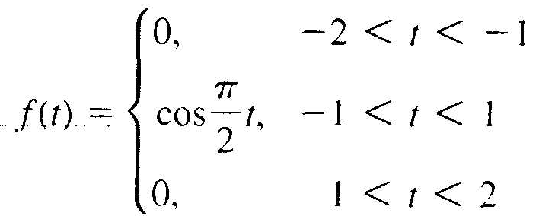

Slide 26
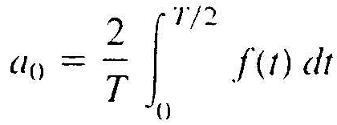
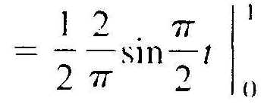

Slide 29
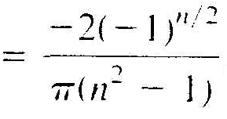
Now for n =`1

Slide 31
Notes:
31

Slide 32
term 1 and term 2 are complex conjugate of each other
Then we can write x(t) as
Where
Notes:
32

Slide 33
Notes:
33

Slide 34
Since
Notes:
34

Slide 35
Notes:
35

Slide 36
Since it is true for all m then it is true for all n
Notes:
36

Slide 37
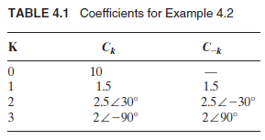

Slide 38
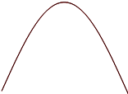
Example 3-6 Find the complex Fourier series coefficients for
A half-rectified sine wave

Slide 39
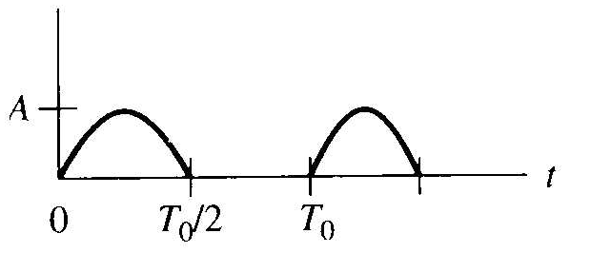

Slide 41
Similarly

Slide 42
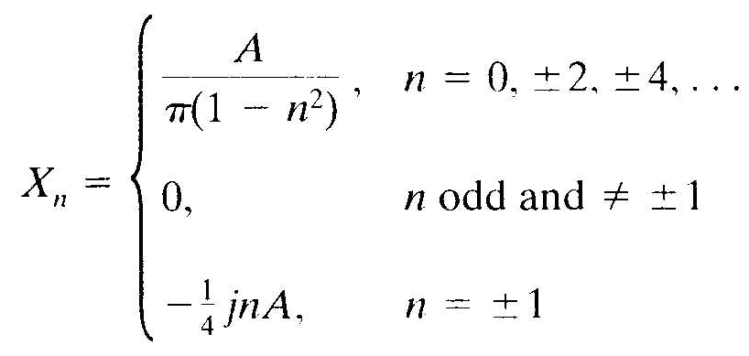
First Entry in Table 3-1

Slide 43
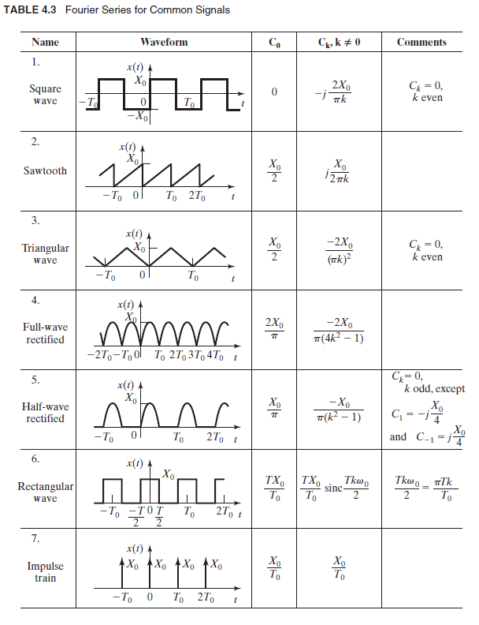

Slide 44
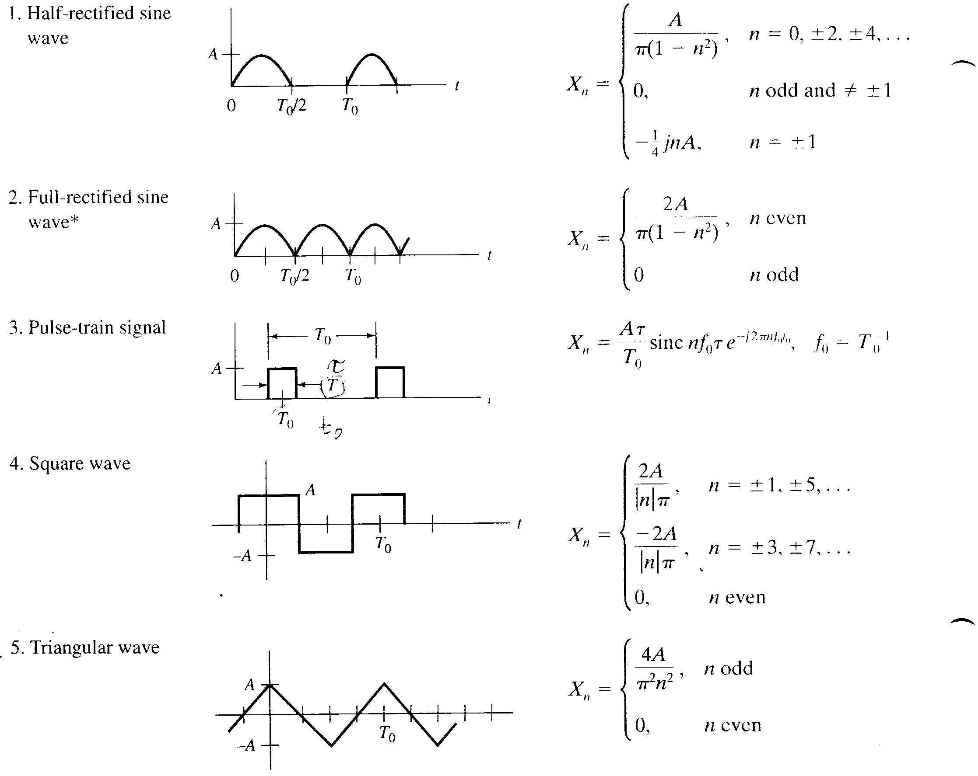
Table 3-1(old Book)

Slide 45
Symmetry Properties of Fourier Series coefficients

Slide 46
Line Spectra
where
In general a complex number that can be represented as
a phasor
Is a rotating phasor of frequency
Therefore, x(t) consists of a summation of rotating phasors

Slide 49
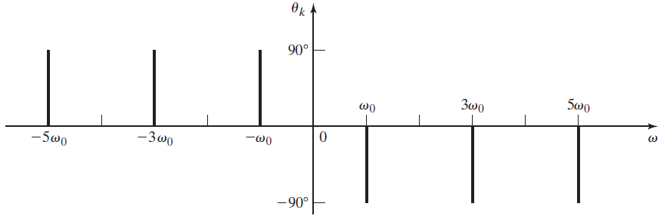

Slide 51
