Slide 1
Advanced MS Excel using Visual Basic for Apps (VBA)
Wajih Abu-Al-Saud
May 20, 2008

Slide 2
Outline
Basic use of Excel vs. Use of Basic in Excel
VBA !! What is That ???
Recording macros vs. Writing macros
How may I reference individual cells or ranges of cells in VBA?
What properties of cells may I change?
VBA General Subroutines & Worksheet (event driven) Subroutines
Can you give some Examples?
Helpful Functions in VBA for Excel

Slide 3
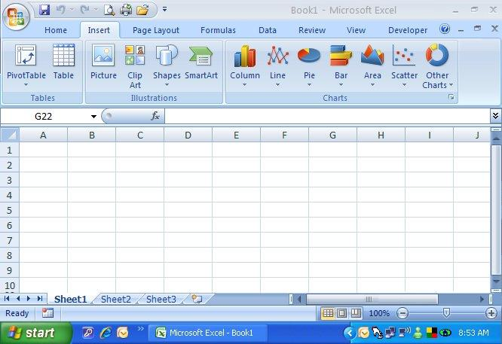
Basic use of Excel vs. Use of Basic in Excel

Slide 4
Basic use of Excel vs. Use of Basic in Excel
Question:
What can’t I do with basic use of Excel?
Answer:
A lot of things. For example,
Excel cannot fix your car,
Excel cannot build you a house
Also:

Slide 5
Basic use of Excel vs. Use of Basic in Excel
Excel cannot match Marks of Students in the lab to the Marks of Students in a class!!
ID | Class Mark | Lab Mark
100000 | 60
200000 | 65
400000 | 70
600000 | 80
ID | Lab Mark
200000 | 15
300000 | 17
500000 | 18
600000 | 12

Slide 6
Basic use of Excel vs. Use of Basic in Excel
Excel cannot match Marks of Students in the lab to the Marks of Students in a class!!
ID | Class Mark | Lab Mark
100000 | 60
200000 | 65
400000 | 70
600000 | 80
ID | Lab Mark
200000 | 15
300000 | 17
500000 | 18
600000 | 12

Slide 7
VBA !! What is That ???

Slide 8
VBA !! What is That ???
To access VBA in Excel 2003
Tools | Macro | Macros OR Visual Basic Editor
To access VBA in Excel 2007
You must show the “Developer” dropdown Menu first
Click
Click
Click
Check
Click “OK”

Slide 9
Column and Row Numbering in Excel
Default numbering of cells in Excel is:
Rows have numbers: 1, 2, 3, …
Columns have letters: A, B, C, … , Z , AA, AB, AC, ….
This is NOT optimum numbering method to write macros
You can switch to the following numbering system in Excel to help you determine the column and row positions that you are interested in:
Rows have numbers: 1, 2, 3, …
Columns have numbers: 1, 2, 3, …
By doing the following in Excel 2007 (also possible in Excel 2003):
Click
Click
Click
Check
Click “OK”

Slide 10
VBA !! What is That ???
To run macros (Visual Basic Code) in Excel (See next slide for an explanation of how to modify security settings in Excel 2007):
Excel 2003: Macro Security Setting at “MEDIUM LEVEL” (recommended) or lower (not recommended)
Excel 2007: Macro Security Setting at “DISABLE ALL MACROS WITH NOTIFICATION” (recommended) or lower (not recommended)
After writing any macro in an Excel file, the next time you open the document, you will receive a security warning informing you of the existence of macros in the file and option of “enabling” or disabling macros. If you would like to run macros, you must choose “Enable”. If you simply want to see the data in sheet but not run macros, you may choose “Disable”

Slide 11
VBA !! What is That ???
Developer Menu
Basic Components Advanced Components
To change security setting to enable running macros: click on this, and then choose
From my experience, this is the safest setting that will allow you to run your macros (you will be notified when opening an Excel file with existing macros and given option to enable or disable them). Remember: Enable macros in files from sources you TRUST ONLY.
“TRUSTFUL” means that they have good and updated virus scanner and know what they are doing

Slide 12
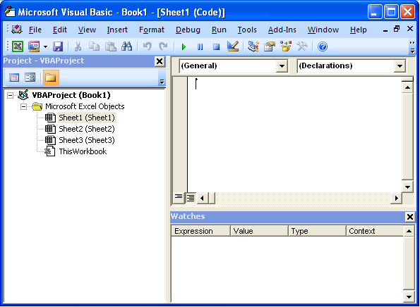
VBA !! What is That ???

Slide 13
Recording vs. Writing macros
Recording Macros can be used for simple repeated tasks
Simple
Sometimes unreliable
Very limited
Writing Macros can be used for very complicated tasks
More complicated to use
Very Reliable
Virtually unlimited

Slide 14
How may I reference individual cells or ranges of cells in VBA
Worksheets(“SheetName”).Cells(Row,Column).Property
Sheet1 1 3 .Value
Results 4 4 .Font.Color
Data x y .Comment.Text
Sheet2 I j .Interior.Color
Output a b .FormulaArray
Test .Cells. .Font.Name
Output .Rows(5). .Font.Size
Test .Columns(4). .Font.Name
SheetName.Cells(… Many of other properties exist
Another Format: .Cells(“B4”).
Useful for non-changing references

Slide 15
How may I reference individual cells or ranges of cells in VBA
Worksheets(“Sheet Name”).
Range(Cells(R1, C1), Cells(R2, C2))
.Property
Corner of Range
Opposite Corner of Range
Another Format .Range("A4:C9").

Slide 16
What Cell Properties may I change?
Worksheets(“Sheet Name”).Cells(Row, Column).Property
ALL PROPERTIES OF CELLS including
Font Type, Font Color, Font Size, …
. Font.Color = vbRed, .Font.Color = RGB(10,255,200) .Font.Name = “Arial”, .Font.Size = 16
Cell Boarder Type Border Color …
.Borders(xlBottom).LineStyle = xlDouble .Borders.Color = vbGreen
Interior Cell Color
.Interior.Color = vbBlue .Interior.Color = RGB(255,10,100)
Values
.Value = “ABCD” .Value = 123 .Value = sin(2*3.14159*Worksheets(“Sheet1”).Cells(1,2).Value))
Formula
.Value = “=sum(A1:A5)” .Formula = “=sum(A1:A5)” .FormulaArray = _ "=Sum(R4C5:R7C9)"

Slide 17
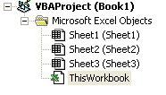
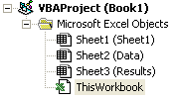
VBA General Subroutines & Sheet (Event Driven) Subroutines
All code you write will be part of a macro (or a subroutine)
All subroutines are either GENERAL or SHEET-related (or Workbook-related)
Subroutines
Subroutines in Excel will belong to one of the items shown here ➔ :
The workbook (meaning all sheets in the file)
Workbook-related subroutines are activated when an event occurs in any different sheets or the
workbook itself (for example: when a sheet is double clicked, when the workbook is opened, …)
General workbook subroutines are activated manually and have access to all sheets of the workbook
One sheet in the workbook (for example, the sheets here are “Sheet1”, “Data”, “Results”)
[The name of the sheets appear in parenthesis “(…)”]) ➔
Worksheet-related subroutines are activated when an event occurs in that particular sheet
(for example: when that sheet is double clicked, when that sheet is activated, …)
General worksheet subroutines are activated manually and have access to all sheets of the workbook
More Explanation of subroutines comes
in next slides

Slide 18
VBA General Subroutines & Sheet (Event Driven) Subroutines
General Subroutines:
If declared as PUBLIC (default if not provided):
Appear as macros with the same names as the subroutine names,
Can be accessed from Public or Private subroutines of the same sheet or other sheets
Example: Assuming Sub belongs to “Sheet1”, macro will be “Sheet1.XYZ” :
Public Sub XYZ()
Worksheets("Sheet2").Cells(2, 3).Value = 7
‘ CALL Worksheets("Sheet2").ABC() ➔ GIVES ERROR if used here because call is to
‘ a private subroutine in another sheet
‘ No error if call is to a private sub
‘ in the same sheet
End Sub
If declared as PRIVATE:
Do not appear as macros (used to implement small tasks that do not qualify as complete processes),
Can be accesses from Public or Private subroutines of the same sheet but not of other sheets
Example (Assume Sub belongs to “Sheet2”):
Private Sub ABC()
Worksheets("Sheet2").Cells(2, 3).Value = 7
Call Worksheets("Sheet1").XYZ() ‘ or Call Sheet1.XYZ() This is fine because called sub
‘ is a public sub even if it is in another sheet
End Sub

Slide 19
VBA General Subroutines & Sheet (Event Driven) Subroutines
Sheet Subroutines:
Are ALL private to a specific sheet:
Cannot be activated manually, but must be activated by one of the EVENTS:
Activate: Sub executed when the sheet is activated (switch from any sheet to the sheet containing the macro),
Deactivate: Sub executed when the sheet is deactivated (switch from sheet containing macro to another sheet),
BeforeDoubleClick: Sub executed when sheet is double-clicked (Arguments passed to Sub are Target.Row & Target.Column)
BeforeRightClick: Sub executed when sheet is right-clicked (Arguments passed to Sub are Target.Row & Target.Column)
Calculate: Sub executed when any calculation is done in sheet
Change: Sub executed when any modification is done to sheet (Arguments passed are Target.Row & Target.Column)
SelectionChange: Sub executed when the another cell is selected in sheet (Arguments passed are Target.Row & Target.Column)

Slide 20
Can you give some Examples?
NOTE: If you execute a macro with an error, VBA will inform you of the error. After fixing the error, you may need to click on (RUN | RESET) in the Visual Basic window to reset the macro so that you can re-run it again (The error message you will get is something like “You cannot run macro in debug mode”)
Example 1: Fill the interior color of cells with random colors
Copy the following code to the code window of any sheet and run the macro
Public Sub Nice_Colors()
For i = 1 To 30
For j = 1 To 30
Worksheets("Sheet1").Cells(i, j).Interior.Color = RGB(255 * Rnd(), 255 * Rnd(), 255 * Rnd())
Next j
Next i
End Sub

Slide 21
Can you give some Examples?
Example 2: Make Excel read the contents of any cell that is selected
NOTE: A Text-to-speech / Speech-to-Text engine is built into MS Windows XP. You need to activate it first and then you can use from different applications to read text or to dictate text for you (really nice). To install, search for “Install speech recognition” in the windows help.
Copy the following code to the code window of SHEET1 , type some text or numbers in different cells of Sheet1, and then simply click on these cells one by one, the content of the cell you click on will be read for you.
Private Sub Worksheet_SelectionChange(ByVal Target As Range)
X = Target.Row
Y = Target.Column
If Worksheets("Sheet1").Cells(X, Y).Value <> "" Then
Application.Speech.Speak "This cell contains " & Worksheets("Sheet1").Cells(X, Y).Value
End If
End Sub

Slide 22
Can you give some Examples?
Example 3: Add a sequential number to each cell that is clicked in Sheet 1 and read that number
Copy the following code to the code window of SHEET1. Click on different cells, and Excel will type a sequential number in each cell you click and read that number for you. If you switch to another sheet and back to sheet 1, the sheet will be cleared and counting will start back from 0.
Dim Counter As Integer
Private Sub Worksheet_Activate()
Worksheets("Sheet1").Cells.ClearContents
Counter = 0
End Sub
Private Sub Worksheet_SelectionChange(ByVal Target As Range)
X = Target.Row
Y = Target.Column
Worksheets("Sheet1").Cells(X, Y).Value = Counter
Application.Speech.Speak Counter
Counter = Counter + 1
End Sub

Slide 23
Can you give some Examples?
Example 4: Transfer Grades of lab from “LAB” sheet to corresponding ID in the “COURSE” sheet
The idea here is to copy the corresponding lab grade, lab instructor name, and lab section number of each student from a sheet that contains lab grades called “Lab” to another sheet that contains student IDs and organized based on course sections numbers called “Course”. Any ID in the Lab sheet that is found in the Course grades sheet will be colored in red to indicate that it is found (remaining ones will remain black). Initially, the content of the cells in the Course sheet that will receive the lab grade data is cleared first and all entries in the Lab sheet are initialized to black color at the beginning.
Please see the Excel file called “All Lab Grades” and run the macro called “Process”.

Slide 24
Helpful Functions in VBA for Excel
To comment a statement, use ‘ (a single quotation mark) before the statement
To set or get a property of a cell or range of cells in the same sheet that the subroutine belongs to
Worksheets(“Sheet Name”).Cells(Row, Column).Property
Worksheets(“Sheet Name”).Range(Cells(R1,C1),Cells(R2,C2)).Property
To set or get a property of a cell or range of cells in a sheet other than the one that subroutine belongs to
Worksheets(“Sheet Name”).Cells(Row, Column).Property ➔ Same as above
Worksheets(“Sheet Name”).Range(Worksheets(“Sheet Name”).Cells(R1,C1),Worksheets(“SheetName”). Cells(R2,C2)) .Property
To clear contents of a cell or range of cells, simply change “.Property” above to “.ClearContents”.
To switch from once sheet to another, sheet called SheetName, use Worksheets(“SheetName”).Activate
To Copy part of “Sheet1” to “Sheet3”, use the two statements
Worksheets(“Sheet1”).Range(Worksheets(“Sheet1”).Cells(3,4),Worksheets(“Sheet1”).Cells(8, 9)).Copy
Worksheets(“Sheet3”). Paste
To set the interior color of a cell or range of cells, change “.Property” above to “.Interior.Color = RGB(Red_Value, Green_Value, Blue_Value)”.
To set the font type of a cell or range of cells to “Arial” for example, change “.Property” above to “ .Font.Name = “Arial” ”.

Slide 25
Helpful Functions in VBA for Excel
To set multiple properties of the same cell or range of cells use the “WITH” statements
With Sheet2.Range(Cells(3, 6), Cells(8, 12))
.Font.Name = "Arial“ ‘ Set Font
.Font.Size = 14 ‘ Set Font size
.Font.Color = vbBlue ‘ Set Font color
.Value = “HELLO” ‘ Set value
End With
To let Excel read a cell, use (a text-to-speech/speech-to-text engine comes built in with Windows XP, (and I am sure with Windows Vista too). This engine is the one that actually reads the data).
Application.Speech.Speak Worksheets(“Sheet Name”).Cells(R,C).Value
To email the active workbook (the file currently open) to someone, use
ActiveWorkbook.SendMail recipients := "wajih@kfupm.edu.sa"
I have parts of code that will allow you to email one part of a sheet to different different people. Please inform me if you need it.
I also have tens of fragments of code that will do different tasks, please let me know if you need any help at
wajih@kfupm.edu.sa.

