Slide 1
The Karnaugh Map
COE 202
Digital Logic Design
Dr. Muhamed Mudawar
King Fahd University of Petroleum and Minerals

Slide 2
Presentation Outline
Boolean Function Minimization
The Karnaugh Map (K-Map)
Two, Three, and Four-Variable K-Maps
Prime and Essential Prime Implicants
Minimal Sum-of-Products and Product-of-Sums
Don't Cares
Five and Six-Variable K-Maps
Multiple Outputs

Slide 3
Boolean Function Minimization
Complexity of a Boolean function is directly related to the complexity of the algebraic expression
The truth table of a function is unique
However, the algebraic expression is not unique
Boolean function can be simplified by algebraic manipulation
However, algebraic manipulation depends on experience
Algebraic manipulation does not guarantee that the simplified Boolean expression is minimal

Slide 4
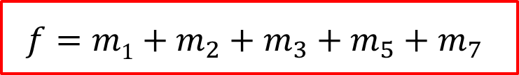
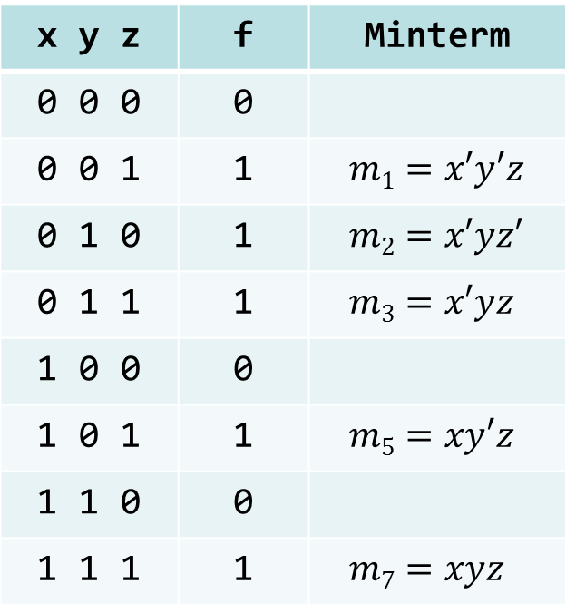
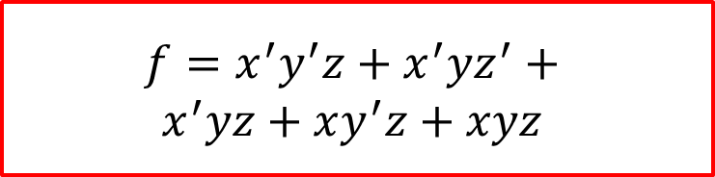

Example: Sum of Minterms
Truth Table
x y z | f | Minterm
0 0 0 | 0
0 0 1 | 1 | $$m1=x′y′z$$
0 1 0 | 1 | $$m2=x′yz′$$
0 1 1 | 1 | $$m3=x′yz$$
1 0 0 | 0
1 0 1 | 1 | $$m5=xy′z$$
1 1 0 | 0
1 1 1 | 1 | $$m7=xyz$$
Focus on the ‘1’ entries
$$f=m1+m_{2}+m_{3}+m_{5}+m_{7}$$
$$f=\sum{\left(1, 2, 3, 5, 7\right)}$$
$$f=x^{′}y^{′}z+x^{′}yz^{′}+$$
$$x^{′}yz+xy^{′}z+xyz$$
Sum-of-Minterms has 15 literals ➔ Can be simplified

Slide 5
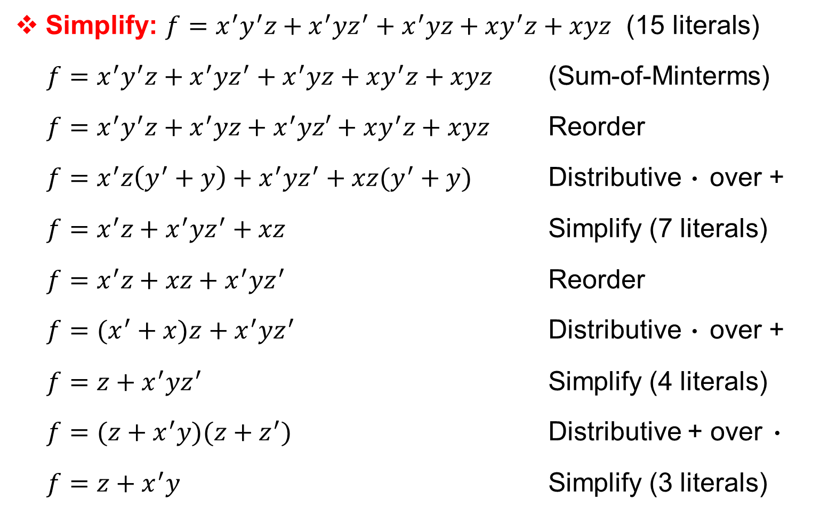
Algebraic Manipulation
Simplify: $f=x^{′}y^{′}z+x^{′}yz^{′}+x^{′}yz+xy^{′}z+xyz$ (15 literals)
$f=x^{′}y^{′}z+x^{′}yz^{′}+x^{′}yz+xy^{′}z+xyz$ (Sum-of-Minterms)
$f=x^{′}y^{′}z+x^{′}yz+x^{′}yz′+xy^{′}z+xyz$ Reorder
$f=x^{′}z\left(y^{′}+y\right)+x^{′}yz^{′}+xz(y^{′}+y)$ Distributive · over +
$f=x^{′}z+x^{′}yz^{′}+xz$ Simplify (7 literals)
$f=x^{′}z+xz+x^{′}yz^{′}$ Reorder
$f=(x^{′}+x)z+x^{′}yz^{′}$ Distributive · over +
$f=z+x^{′}yz^{′}$ Simplify (4 literals)
$f=(z+x^{′}y)(z+z^{′})$ Distributive + over ·
$f=z+x^{′}y$ Simplify (3 literals)

Slide 6
Drawback of Algebraic Manipulation
No clear steps in the manipulation process
  Not clear which terms should be grouped together
  Not clear which property of Boolean algebra should be used next
Does not always guarantee a minimal expression
  Simplified expression may or may not be minimal
  Different steps might lead to different non-minimal expressions
However, the goal is to minimize a Boolean function
Minimize the number of literals in the Boolean expression
  The literal count is a good measure of the cost of logic implementation
  Proportional to the number of transistors in the circuit implementation

Slide 7
Karnaugh Map
Called also K-map for short
The Karnaugh map is a diagram made up of squares
It is a reorganized version of the truth table
Each square in the Karnaugh map represents a minterm
Adjacent squares differ in the value of one variable
Simplified expressions can be derived from the Karnaugh map
  By recognizing patterns of squares
Simplified sum-of-products expression (AND-OR circuits)
Simplified product-of-sums expression (OR-AND circuits)

Slide 8
Next . . .
Boolean Function Minimization
The Karnaugh Map (K-Map)
Two, Three, and Four-Variable K-Maps
Prime and Essential Prime Implicants
Minimal Sum-of-Products and Product-of-Sums
Don't Cares
Five and Six-Variable K-Maps
Multiple Outputs

Slide 9
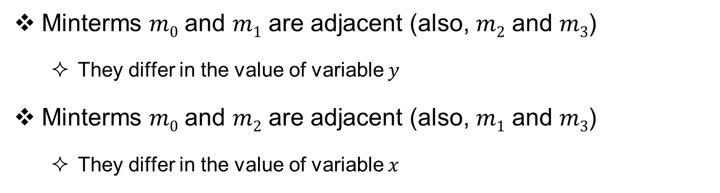
Two-Variable Karnaugh Map
Minterms $m0$ and $m1$ are adjacent (also, $m2$ and $m3$)
  They differ in the value of variable $y$
Minterms $m0$ and $m2$ are adjacent (also, $m1$ and $m3$)
  They differ in the value of variable $x$
Two-variable K-map
y
0
1
y
0
1
x
x
0
m₀
m₁
0
x' y'
x' y
1
m₂
m₃
1
x y'
x y

Slide 10
From a Truth Table to Karnaugh Map
Given a truth table, construct the corresponding K-map
Copy the function values from the truth table into the K-map
Make sure to copy each value into the proper K-map square
Truth Table
K-map
y
0
1
x y | f
0 0 | 1
0 1 | 0
1 0 | 1
1 1 | 1
x
0
1
0
1
1
1

Slide 11
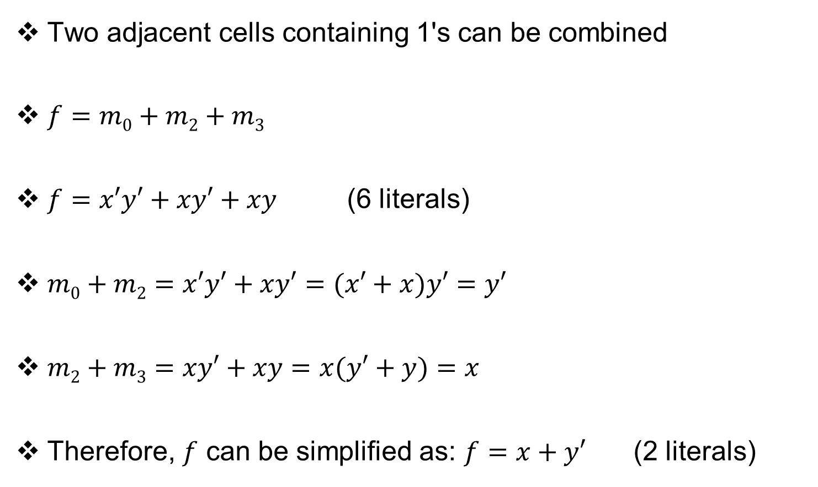
K-Map Function Minimization
Two adjacent cells containing 1's can be combined
$f=m0+m2+m3$
$f=x′y′+xy′+xy$ (6 literals)
$m0+m2=x′y′+xy′=(x′+x)y′=y′$
$m2+m3=xy′+xy=x(y′+y)=x$
Therefore, $f$ can be simplified as: $f=x+y′$ (2 literals)
K-map
y
0
1
x
0
1
0
1
1
1

Slide 12



























Three-Variable Karnaugh Map
Have eight squares (for the 8 minterms), numbered 0 to 7
The last two columns are not in numeric order: 11, 10
  Remember the numbering of the squares in the K-map
Each square is adjacent to three other squares
Minterms in adjacent squares can always be combined
  This is the key idea that makes the K-map work
Labeling of rows and columns is also useful
$$yz$$
$$yz$$
$$y′$$
$$y$$
$$x$$
00
01
11
10
$$x$$
00
01
11
10
0
$$m0$$
$$m1$$
$$m3$$
$$m2$$
$$x′$$
0
$$x^{′}y^{′}z′$$
$$x^{′}y^{′}z$$
$$x^{′}yz$$
$$x^{′}yz′$$
1
$$m4$$
$$m5$$
$$m7$$
$$m6$$
$$x$$
1
$$xy^{′}z′$$
$$xy^{′}z$$
$$xyz$$
$$xyz′$$
$$z′$$
$$z$$
$$z′$$

Slide 13



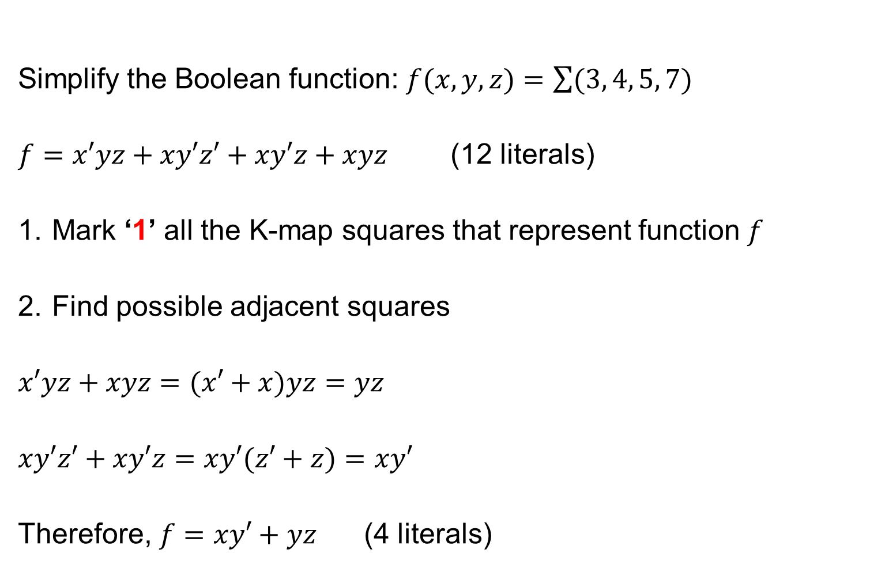






Simplifying a Three-Variable Function
Simplify the Boolean function: $f(x,y,z)=\sum{(3, 4, 5, 7)}$
$f=x′yz+xy′z′+xy′z+xyz$ (12 literals)
Mark ‘1’ all the K-map squares that represent function $f$
Find possible adjacent squares
$x′yz+xyz=(x′+x)yz=yz$
$xy′z′+xy′z=xy′(z′+z)=xy′$
Therefore, $f=xy′+yz$ (4 literals)
$$yz$$
$$y′$$
$$y$$
$$x$$
00
01
11
10
$$x′$$
0
0
0
1
0
$$x$$
1
1
1
1
0
$$z′$$
$$z$$
$$z′$$

Slide 14
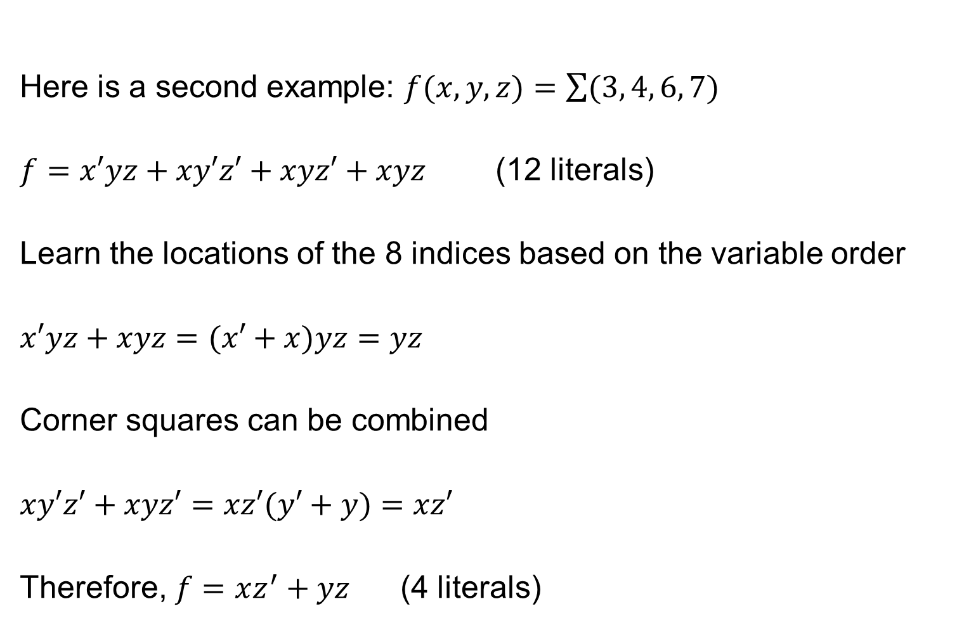
Simplifying a Three-Variable Function (2)
Here is a second example: $f(x,y,z)=\sum{(3, 4, 6, 7)}$
$f=x′yz+xy′z′+xyz′+xyz$ (12 literals)
Learn the locations of the 8 indices based on the variable order
$x′yz+xyz=(x′+x)yz=yz$
Corner squares can be combined
$xy′z′+xyz′=xz′(y′+y)=xz′$
Therefore, $f=xz^{′}+yz$ (4 literals)
$$yz$$
$$y′$$
$$y$$
$$x$$
00
01
11
10
$$x′$$
0
0
0
1
0
$$x$$
1
1
0
1
1
$$z′$$
$$z$$
$$z′$$

Slide 15
Combining Squares on a 3-Variable K-Map
By combining squares, we reduce number of literals in a product term, thereby reducing the cost
On a 3-variable K-Map:
  One square represents a minterm with 3 variables
  Two adjacent squares represent a term with 2 variables
  Four adjacent squares represent a term with 1 variable
  Eight adjacent square is the constant ‘1’ (no variables)

Slide 16

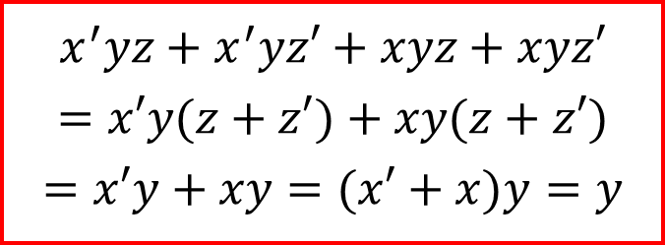


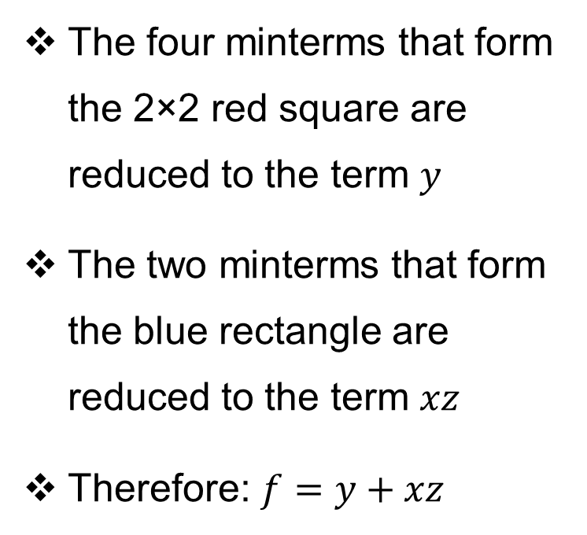
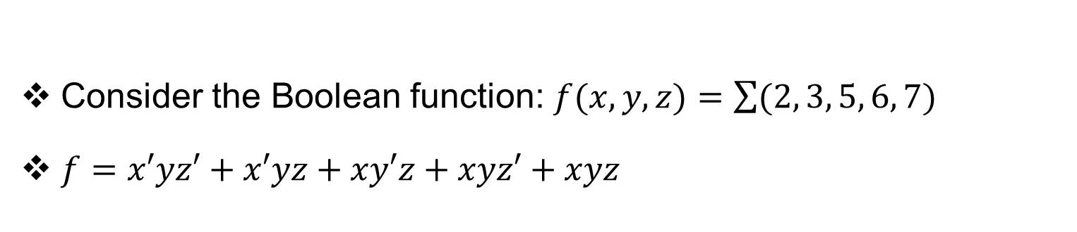






Example of Combining Squares
Consider the Boolean function: $f(x,y,z)=\sum{(2, 3, 5, 6, 7)}$
$f=x′yz′+x′yz+xy′z+xyz′+xyz$
$$yz$$
$$y′$$
$$y$$
The four minterms that form the 2×2 red square are reduced to the term $y$
The two minterms that form the blue rectangle are reduced to the term $xz$
Therefore: $f=y+xz$
$$x$$
00
01
11
10
$$x′$$
0
0
0
1
1
$$x$$
1
0
1
1
1
$$z′$$
$$z$$
$$z′$$
$$x^{′}yz+x^{′}yz′+xyz+xyz′$$
$$=x′y(z+z′)+xy(z+z′)$$
$$=x′y+xy=(x′+x)y=y$$

Slide 17



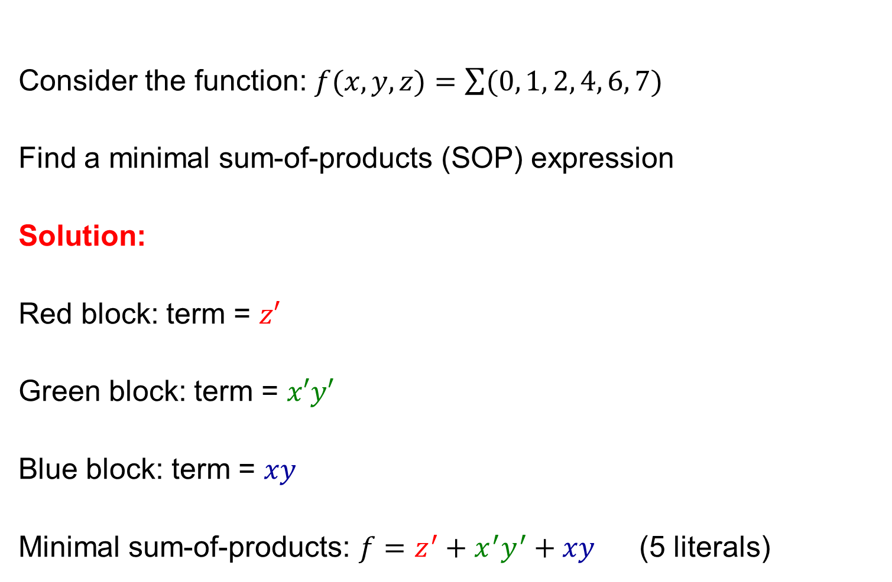






Minimal Sum-of-Products Expression
Consider the function: $f(x,y,z)=\sum{(0, 1, 2, 4, 6, 7)}$
Find a minimal sum-of-products (SOP) expression
Solution:
Red block: term = $z′$
Green block: term = $x′y′$
Blue block: term = $xy$
Minimal sum-of-products: $f=z^{′}+x^{′}y^{′}+xy$ (5 literals)
$$yz$$
$$y′$$
$$y$$
$$x$$
00
01
11
10
$$x′$$
0
1
1
0
1
$$x$$
1
1
0
1
1
$$z′$$
$$z$$
$$z′$$

Slide 18










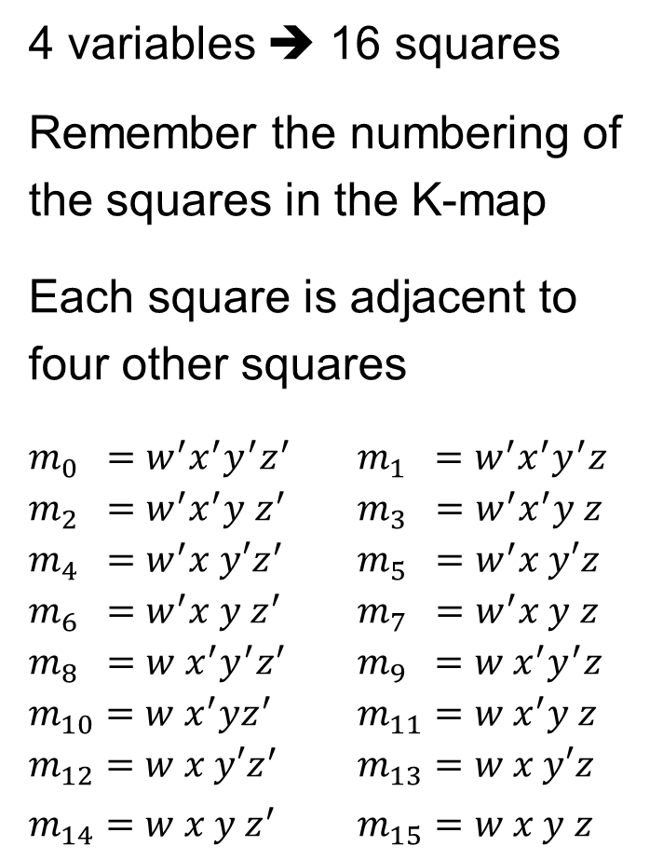


















Four-Variable Karnaugh Map
4 variables ➔ 16 squares
Remember the numbering of the squares in the K-map
Each square is adjacent to four other squares
$m_{00}=w^{′}x^{′}y^{′}z^{′}$ $m_{10}=w^{′}x^{′}y^{′}z$
$m_{20}=w^{′}x^{′}y{ z}^{′}$ $m_{30}=w^{′}x^{′}y z$
$m_{40}=w^{′}x y′z^{′}$ $m_{50}=w^{′}x y′z$
$m_{60}=w^{′}x y z^{′}$ $m_{70}=w^{′}x y z$
$m_{80}=w{ x}^{′}y^{′}z^{′}$ $m_{90}=w{ x}^{′}y^{′}z$
$m_{10}=w x^{′}yz^{′}$ $m_{11}=w{ x}^{′}y z$
$m_{12}=w x y′z^{′}$ $m_{13}=w x y′z$
$m_{14}=w x y z^{′}$ $m_{15}=w x y z$
Notice the order of Rows 11 and 10
and the order of columns 11 and 10
$$yz$$
$$y′$$
$$y$$
$$wx$$
00
01
11
10
00
$$m_{0}$$
$$m_{1}$$
$$m_{3}$$
$$m_{2}$$
$$x′$$
$$w′$$
01
$$m_{4}$$
$$m_{5}$$
$$m_{7}$$
$$m_{6}$$
$$x$$
11
$$m_{12}$$
$$m_{13}$$
$$m_{15}$$
$$m_{14}$$
$$w$$
10
$$m_{8}$$
$$m_{9}$$
$$m_{11}$$
$$m_{10}$$
$$x′$$
$$z′$$
$$z$$
$$z′$$

Slide 19
Combining Squares on a 4-Variable K-Map
On a 4-variable K-Map:
  One square represents a minterm with 4 variables
  Two adjacent squares represent a term with 3 variables
  Four adjacent squares represent a term with 2 variables
  Eight adjacent squares represent a term with 1 variable
  Combining all 16 squares is the constant ‘1’ (no variables)

Slide 20

















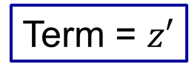






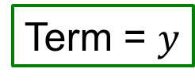





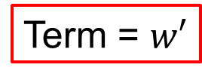
Combining Eight Squares
$$yz$$
$$y′$$
$$y$$
Term = $y$
$$wx$$
00
01
11
10
Term = $w′$
00
$$m_{0}$$
$$m_{1}$$
$$m_{3}$$
$$m_{2}$$
$$x′$$
$$w′$$
01
$$m_{4}$$
$$m_{5}$$
$$m_{7}$$
$$m_{6}$$
$$x$$
11
$$m_{12}$$
$$m_{13}$$
$$m_{15}$$
$$m_{14}$$
$$w$$
10
$$m_{8}$$
$$m_{9}$$
$$m_{11}$$
$$m_{10}$$
$$x′$$
$$z′$$
$$z$$
$$z′$$
Term = $z′$

Slide 21

















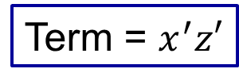






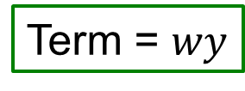





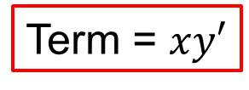
Combining Four Squares
$$yz$$
$$y′$$
$$y$$
$$wx$$
00
01
11
10
00
$$m_{0}$$
$$m_{1}$$
$$m_{3}$$
$$m_{2}$$
$$x′$$
$$w′$$
Term = $xy′$
01
$$m_{4}$$
$$m_{5}$$
$$m_{7}$$
$$m_{6}$$
$$x$$
11
$$m_{12}$$
$$m_{13}$$
$$m_{15}$$
$$m_{14}$$
Term = $wy$
$$w$$
10
$$m_{8}$$
$$m_{9}$$
$$m_{11}$$
$$m_{10}$$
$$x′$$
$$z′$$
$$z$$
$$z′$$
Term = $x^{′}z′$

Slide 22
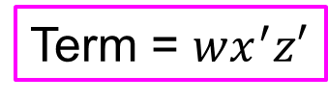
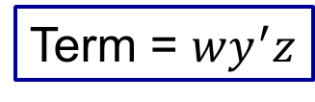
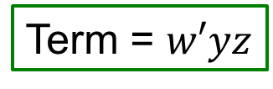
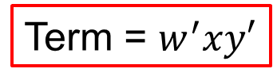
Combining Two Squares
$$yz$$
$$y′$$
$$y$$
Term = $w′yz$
$$wx$$
00
01
11
10
00
$$m_{0}$$
$$m_{1}$$
$$m_{3}$$
$$m_{2}$$
$$x′$$
$$w′$$
Term = $w^{′}xy′$
01
$$m_{4}$$
$$m_{5}$$
$$m_{7}$$
$$m_{6}$$
$$x$$
11
$$m_{12}$$
$$m_{13}$$
$$m_{15}$$
$$m_{14}$$
$$w$$
10
$$m_{8}$$
$$m_{9}$$
$$m_{11}$$
$$m_{10}$$
$$x′$$
$$z′$$
$$z$$
$$z′$$
Term = $wx^{′}z′$
Term = $wy^{′}z$

Slide 23





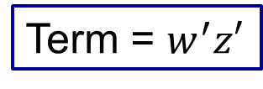
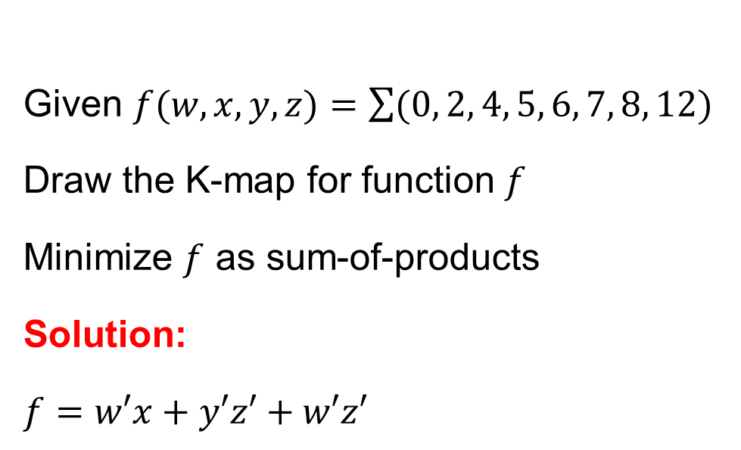
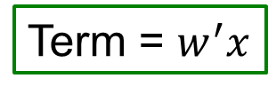



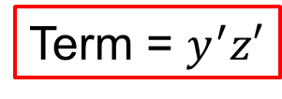




Simplifying a 4-Variable Function
Given $f(w,x,y,z)=\sum{(0, 2, 4, 5, 6, 7, 8, 12)}$
Draw the K-map for function $f$
Minimize $f$ as sum-of-products
Solution:
$f=w′x+y′z′+w′z′$
Term = $w^{′}z′$
$$yz$$
$$y′$$
$$y$$
$$wx$$
00
01
11
10
00
1
0
0
1
$$x′$$
$$w′$$
01
1
1
1
1
$$x$$
Term = $w^{′}x$
11
1
0
0
0
$$w$$
Term = $y^{′}z′$
10
1
0
0
0
$$x′$$
$$z′$$
$$z$$
$$z′$$

Slide 24
Next . . .
Boolean Function Minimization
The Karnaugh Map (K-Map)
Two, Three, and Four-Variable K-Maps
Prime and Essential Prime Implicants
Minimal Sum-of-Products and Product-of-Sums
Don't Cares
Five and Six-Variable K-Maps
Multiple Outputs

Slide 25
Prime Implicants
Prime Implicant: a product term obtained by combining the maximum number of adjacent squares in the K-map
The number of combined squares must be a power of 2
Essential Prime Implicant: is a prime implicant that covers at least one minterm not covered by the other prime implicants
The prime implicants and essential prime implicants can be determined by inspecting the K-map

Slide 26




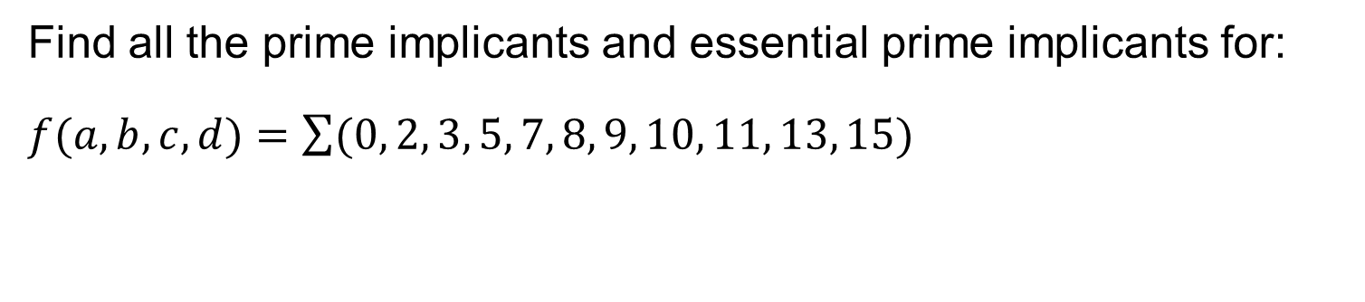



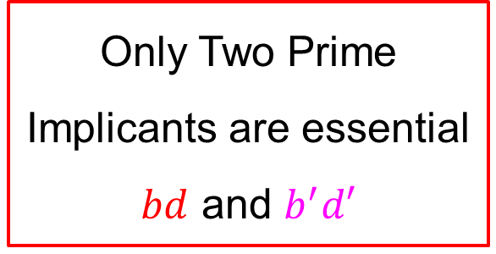

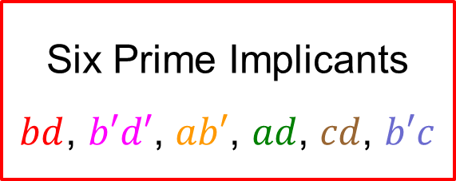
Example of Prime Implicants
Find all the prime implicants and essential prime implicants for:
$f(a,b,c,d)=\sum{(0, 2, 3, 5, 7, 8, 9, 10, 11, 13, 15)}$
K-Map
$$cd$$
Six Prime Implicants
$bd$, $b′d′$, $ab′$, $ad$, $cd$, $b′c$
$$ab$$
00
01
11
10
$$b′d′$$
00
1
1
1
$$b^{′}c$$
$$bd$$
01
1
1
$$cd$$
11
1
1
Only Two Prime Implicants are essential
$bd$ and $b^{′}d′$
10
1
1
1
1
$$ab′$$
$$ad$$

Slide 27
Simplification Procedure Using the K-Map
Find all the essential prime implicants
  Covering maximum number (power of 2) of 1's in the K-map
  Mark the minterm(s) that make the prime implicants essential
Add prime implicants to cover the function
  Choose a minimal subset of prime implicants that cover all remaining 1's
  Make sure to cover all 1's not covered by the essential prime implicants
  Minimize the overlap among the additional prime implicants
Sometimes, a function has multiple simplified expressions
  You may be asked to list all the simplified sum-of-product expressions

Slide 28
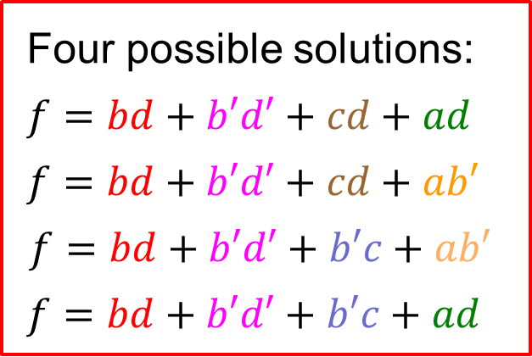
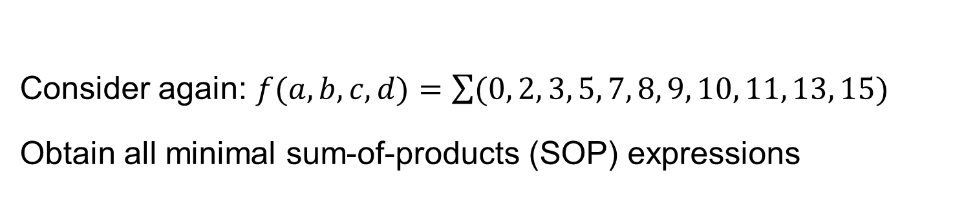
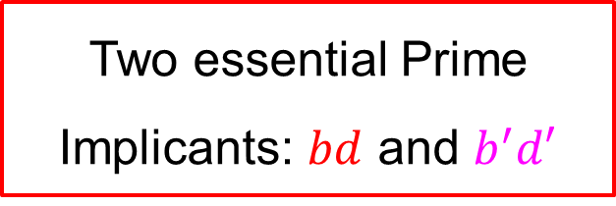
Obtaining All Minimal SOP Expressions
Consider again: $f(a,b,c,d)=\sum{(0, 2, 3, 5, 7, 8, 9, 10, 11, 13, 15)}$
Obtain all minimal sum-of-products (SOP) expressions
K-Map
Two essential Prime Implicants: $bd$ and $b^{′}d′$
$$cd$$
$$ab$$
00
01
11
10
$$b′d′$$
00
1
1
1
$$b^{′}c$$
01
1
1
$$cd$$
Four possible solutions:
$f=bd+b′d′+cd+ad$
$f=bd+b′d′+cd+ab′$
$$f=bd+b′d′+b′c+ab′$$
$f=bd+b′d′+b′c+ad$
$$bd$$
11
1
1
10
1
1
1
1
$$ab′$$
$$ad$$

Slide 29
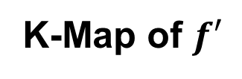
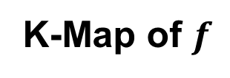
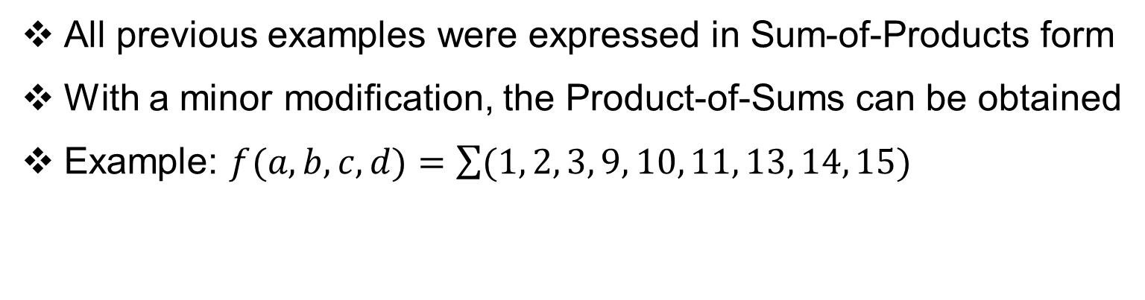
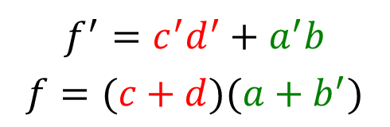
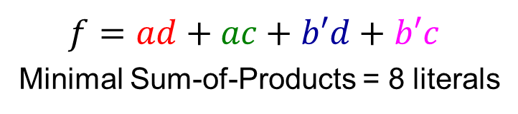
Product-of-Sums (POS) Simplification
All previous examples were expressed in Sum-of-Products form
With a minor modification, the Product-of-Sums can be obtained
Example: $f(a,b,c,d)=\sum{(1, 2, 3, 9, 10, 11, 13, 14, 15)}$
K-Map of $f$
K-Map of $f′$
$$cd$$
$$cd$$
$$ab$$
00
01
11
10
$$ab$$
00
01
11
10
00
1
1
1
00
1
All prime implicants are essential
01
01
1
1
1
1
Minimal Product-of-Sums = 4 literals
11
1
1
1
11
1
10
1
1
1
10
1
$f=ad+ac+b′d+b′c$
Minimal Sum-of-Products = 8 literals
$$f^{′}=c^{′}d^{′}+a^{′}b$$
$$f=(c+d)(a+b^{′})$$

Slide 30
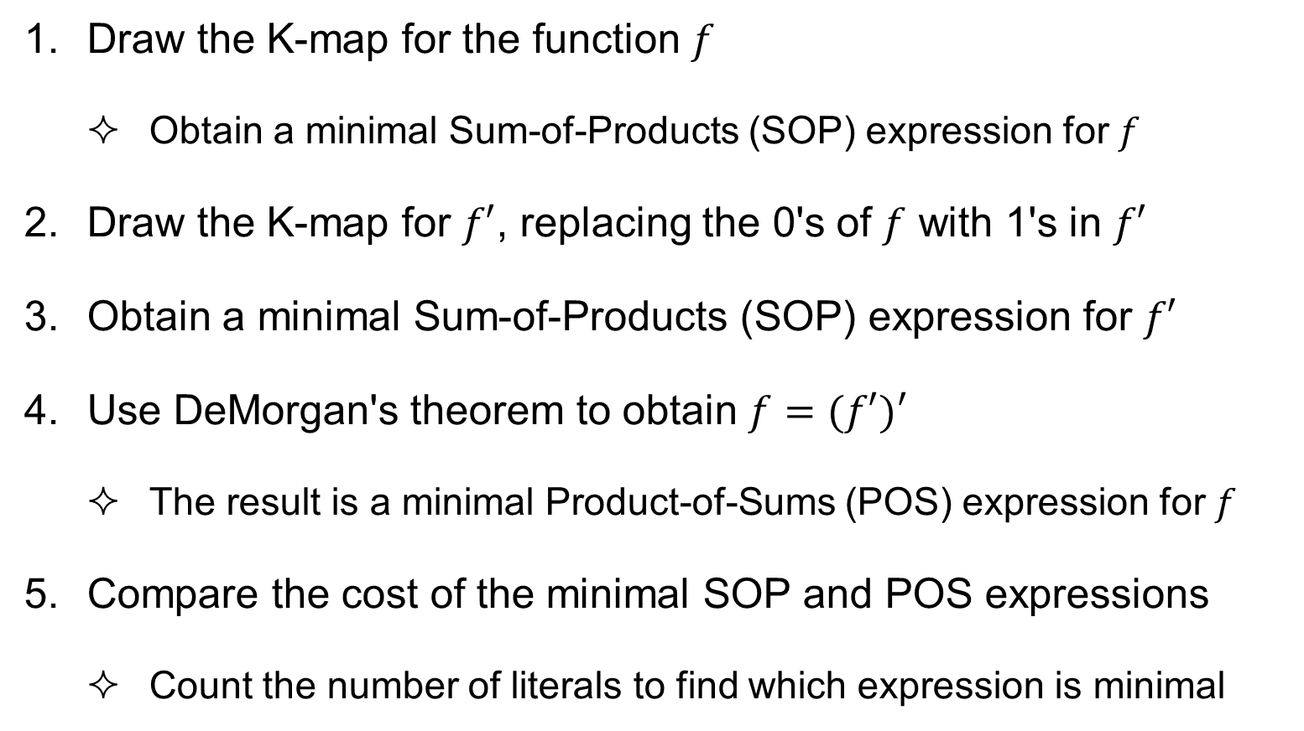
Product-of-Sums Simplification Procedure
Draw the K-map for the function $f$
  Obtain a minimal Sum-of-Products (SOP) expression for $f$
Draw the K-map for $f′$, replacing the 0's of $f$ with 1's in $f′$
Obtain a minimal Sum-of-Products (SOP) expression for $f′$
Use DeMorgan's theorem to obtain $f=(f′)′$
  The result is a minimal Product-of-Sums (POS) expression for $f$
Compare the cost of the minimal SOP and POS expressions
  Count the number of literals to find which expression is minimal

Slide 31
Next . . .
Boolean Function Minimization
The Karnaugh Map (K-Map)
Two, Three, and Four-Variable K-Maps
Prime and Essential Prime Implicants
Minimal Sum-of-Products and Product-of-Sums
Don't Cares
Five and Six-Variable K-Maps
Multiple Outputs

Slide 32
Don't Cares
Sometimes, a function table may contain entries for which:
  The input values of the variables will never occur, or
  The output value of the function is never used
In this case, the output value of the function is not defined
The output value of the function is called a don't care
A don't care is an X value that appears in the function table
The X value can be later chosen to be 0 or 1
  To minimize the function implementation

Slide 33
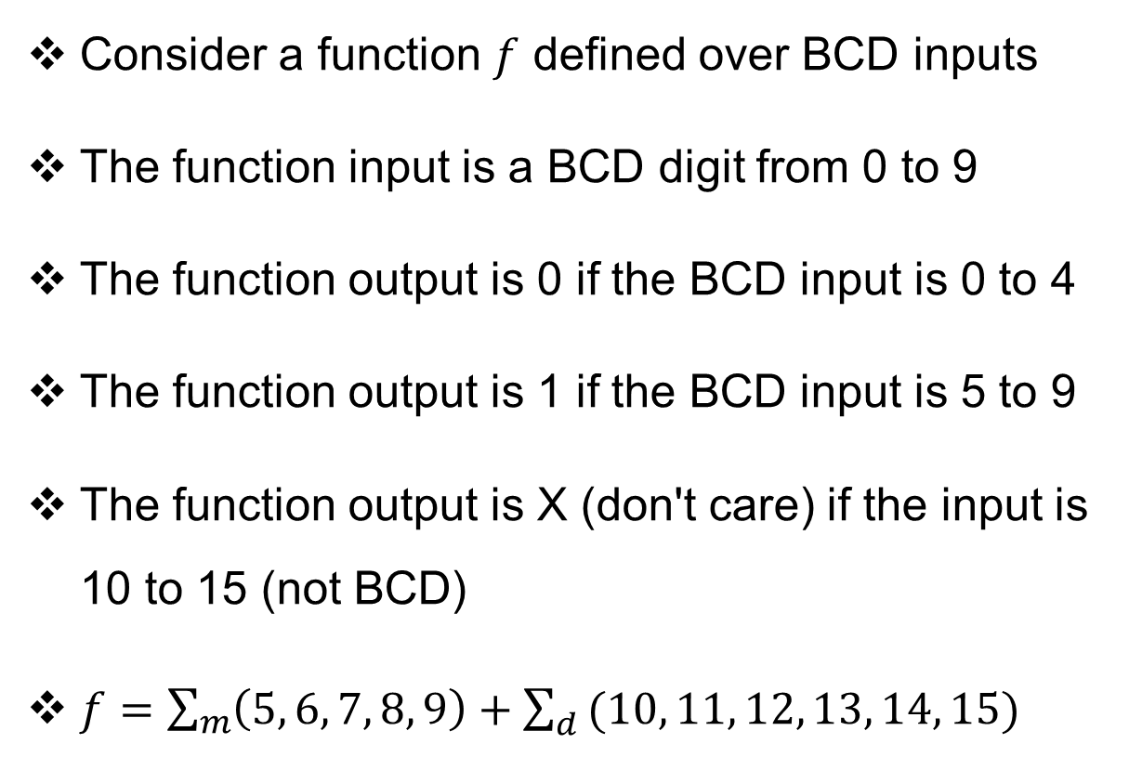
Example of a Function with Don't Cares
Truth Table
Consider a function $f$ defined over BCD inputs
The function input is a BCD digit from 0 to 9
The function output is 0 if the BCD input is 0 to 4
The function output is 1 if the BCD input is 5 to 9
The function output is X (don't care) if the input is 10 to 15 (not BCD)
$f=\sum_{m}{\left(5, 6, 7, 8, 9\right)+\sum_{d}{(10, 11, 12, 13, 14, 15)}}$
a b c d | f
0 0 0 0 | 0
0 0 0 1 | 0
0 0 1 0 | 0
0 0 1 1 | 0
0 1 0 0 | 0
0 1 0 1 | 1
0 1 1 0 | 1
0 1 1 1 | 1
1 0 0 0 | 1
1 0 0 1 | 1
1 0 1 0 | X
1 0 1 1 | X
1 1 0 0 | X
1 1 0 1 | X
1 1 1 0 | X
1 1 1 1 | X
Minterms
Don't Cares

Slide 34

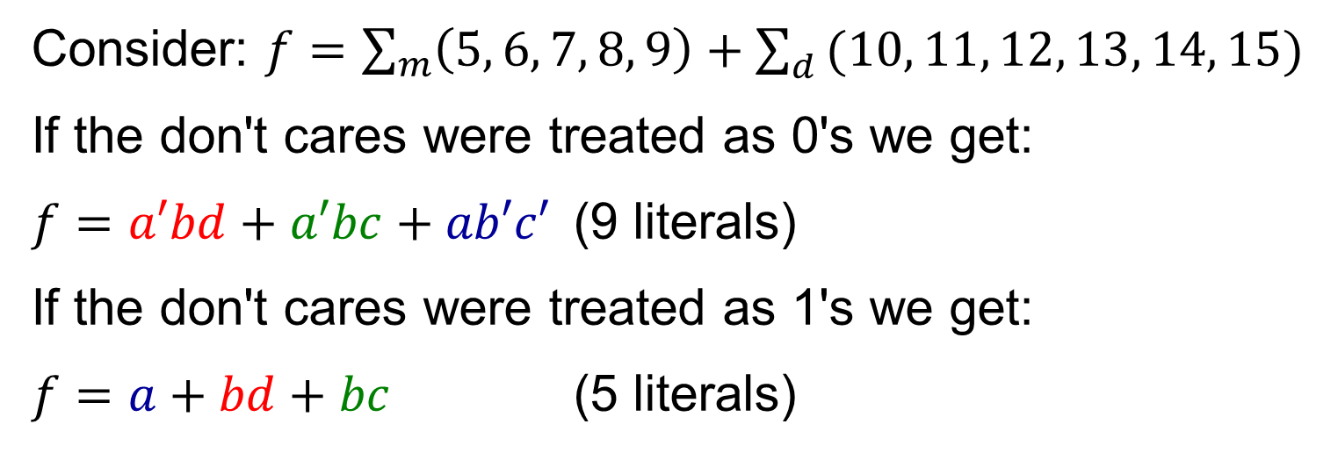
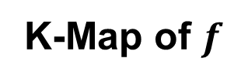

Minimizing Functions with Don't Cares
Consider: $f=\sum_{m}{\left(5, 6, 7, 8, 9\right)+\sum_{d}{(10, 11, 12, 13, 14, 15)}}$
If the don't cares were treated as 0's we get:
$f=a′bd+a′bc+ab′c′$ (9 literals)
If the don't cares were treated as 1's we get:
$f=a+bd+bc$ (5 literals)
K-Map of $f$
$$cd$$
$$ab$$
00
01
11
10
The don't care values can be selected to be either 0 or 1, to produce a minimal expression
00
0
0
0
0
01
0
1
1
1
11
X
X
X
X
10
1
1
X
X

Slide 35
Simplification Procedure with Don't Cares
Find all the essential prime implicants
  Covering maximum number (power of 2) of 1's and X's (don't cares)
  Mark the 1's that make the prime implicants essential
Add prime implicants to cover the function
  Choose a minimal subset of prime implicants that cover all remaining 1's
  Make sure to cover all 1's not covered by the essential prime implicants
  Minimize the overlap among the additional prime implicants
  You need not cover all the don't cares (some can remain uncovered)
Sometimes, a function has multiple simplified expressions

Slide 36
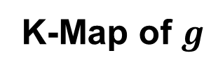


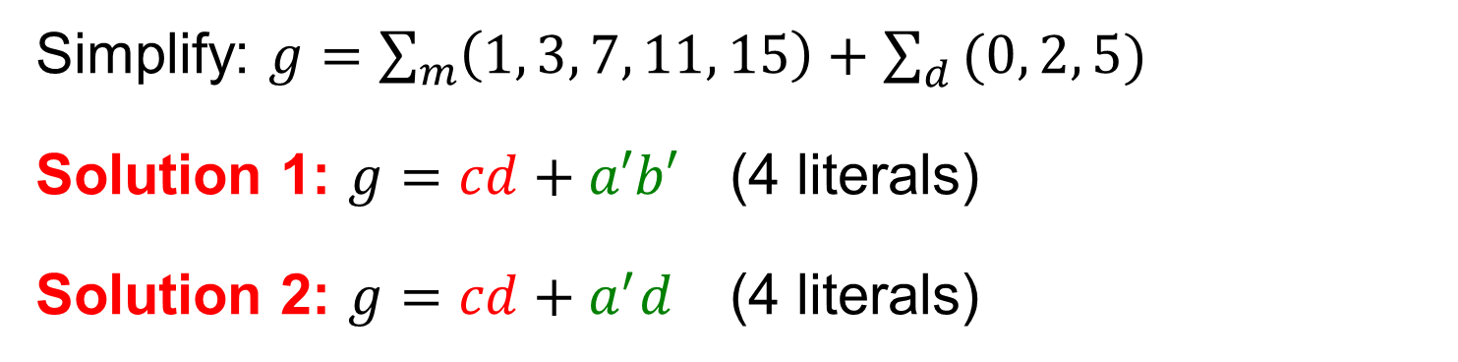

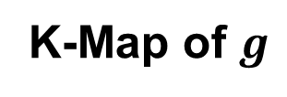

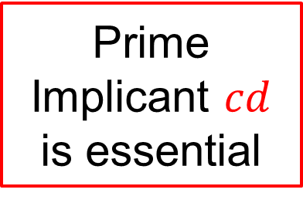
Minimizing Functions with Don't Cares (2)
Simplify: $g=\sum_{m}{\left(1, 3, 7, 11, 15\right)+\sum_{d}{(0, 2, 5)}}$
Solution 1: $g=cd+a′b′$ (4 literals)
Solution 2: $g=cd+a^{′}d$ (4 literals)
Prime Implicant $cd$ is essential
K-Map of $g$
K-Map of $g$
$$cd$$
$$cd$$
$$ab$$
00
01
11
10
$$ab$$
00
01
11
10
00
X
1
1
X
00
X
1
1
X
Not all don't cares need be covered
01
0
X
1
0
01
0
X
1
0
11
0
0
1
0
11
0
0
1
0
10
0
0
1
0
10
0
0
1
0

Slide 37

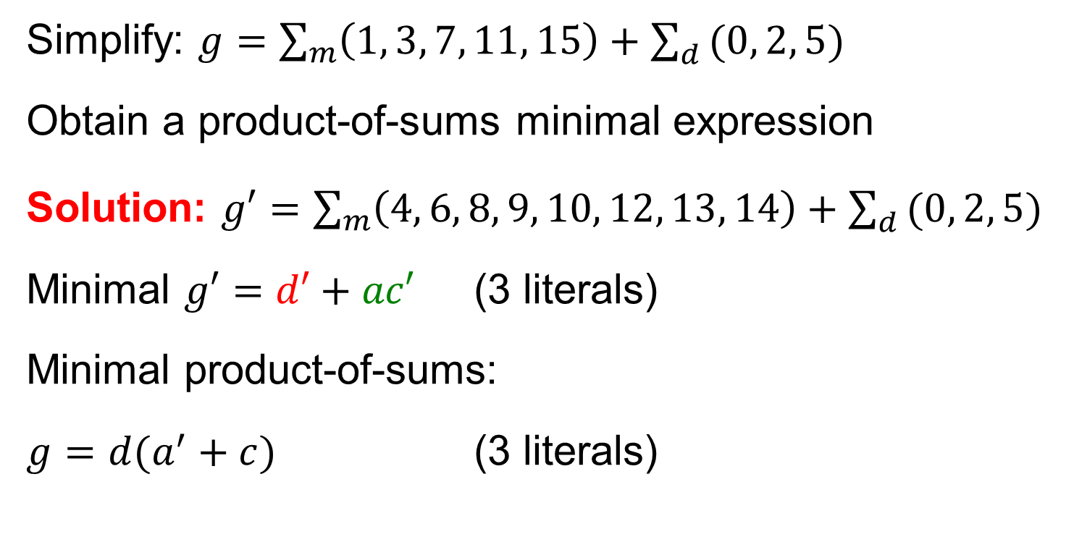
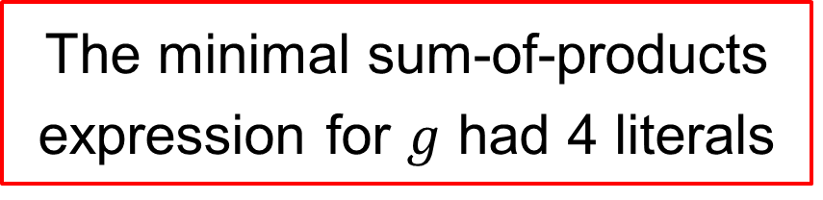
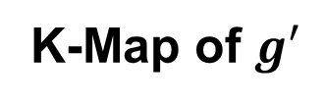

Minimal Product-of-Sums with Don't Cares
Simplify: $g=\sum_{m}{\left(1, 3, 7, 11, 15\right)+\sum_{d}{(0, 2, 5)}}$
Obtain a product-of-sums minimal expression
Solution: $g′=\sum_{m}{\left(4, 6, 8, 9, 10, 12, 13, 14\right)+\sum_{d}{(0, 2, 5)}}$
Minimal $g′=d′+ac′$ (3 literals)
Minimal product-of-sums:
$g=d(a^{′}+c)$ (3 literals)
K-Map of $g′$
$$cd$$
$$ab$$
00
01
11
10
00
X
0
0
X
01
1
X
0
1
The minimal sum-of-products expression for $g$ had 4 literals
11
1
1
0
1
10
1
1
0
1

Slide 38
Next . . .
Boolean Function Minimization
The Karnaugh Map (K-Map)
Two, Three, and Four-Variable K-Maps
Prime and Essential Prime Implicants
Minimal Sum-of-Products and Product-of-Sums
Don't Cares
Five and Six-Variable K-Maps
Multiple Outputs

Slide 39














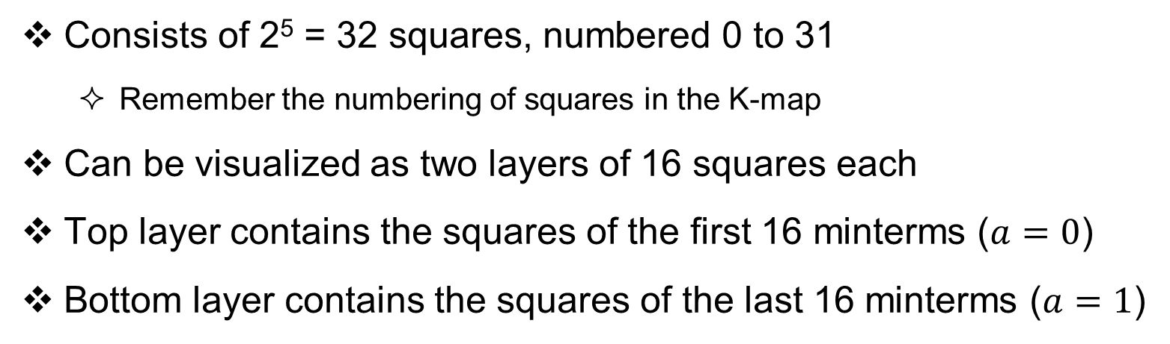

























Five-Variable Karnaugh Map
Consists of 2⁵ = 32 squares, numbered 0 to 31
  Remember the numbering of squares in the K-map
Can be visualized as two layers of 16 squares each
Top layer contains the squares of the first 16 minterms ($a=0$)
Bottom layer contains the squares of the last 16 minterms ($a=1$)
$$a=0$$
$$a=1$$
$$de$$
$$de$$
$$bc$$
00
01
11
10
$$bc$$
00
01
11
10
Each square is adjacent to 5 other squares:
4 in the same layer and
1 in the other layer:
$m0$ is adjacent to $m16$
$m1$ is adjacent to $m17$
$m4$ is adjacent to $m20$ …
00
$$m_{0}$$
$$m_{1}$$
$$m_{3}$$
$$m_{2}$$
00
$$m_{16}$$
$$m_{17}$$
$$m_{19}$$
$$m_{18}$$
01
$$m_{4}$$
$$m_{5}$$
$$m_{7}$$
$$m_{6}$$
01
$$m_{20}$$
$$m_{21}$$
$$m_{23}$$
$$m_{22}$$
11
$$m_{12}$$
$$m_{13}$$
$$m_{15}$$
$$m_{14}$$
11
$$m_{28}$$
$$m_{29}$$
$$m_{31}$$
$$m_{30}$$
10
$$m_{8}$$
$$m_{9}$$
$$m_{11}$$
$$m_{10}$$
10
$$m_{24}$$
$$m_{25}$$
$$m_{27}$$
$$m_{26}$$

Slide 40









Example of a Five-Variable K-Map
Given: $f(a,b,c,d,e)=\sum{(0, 1, 8, 9, 16, 17, 22, 23, 24, 25)}$
Draw the 5-Variable K-Map
Obtain a minimal Sum-of-Products expression for $f$
Solution: $f = c′d′+ab′cd$ (6 literals)
5-Variable K-Map
$$a=0$$
$$a=1$$
$$de$$
$$de$$
$$bc$$
00
01
11
10
$$bc$$
00
01
11
10
00
1
1
00
1
1
$$c′d′$$
01
01
1
1
$$ab^{′}cd$$
11
11
10
1
1
10
1
1

Slide 41




Five-Variable K-Map with Don't Cares
$g(a,b,c,d,e)=\sum_{m}{(3, 6, 7, 11, 24, 25, 27, 28, 29)+\sum_{d}{(2, 8, 9, 12, 13, 26)}}$
Draw the 5-Variable K-Map
Obtain a minimal Sum-of-Products expression for $g$
Solution: $g =bd^{′}+a^{′}b^{′}d+bc^{′}e$ (8 literals)
5-Variable K-Map
$$a=0$$
$$a=1$$
$$de$$
$$de$$
All prime implicants are essential
$$bc$$
00
01
11
10
$$bc$$
00
01
11
10
00
1
X
00
$$a′b′d$$
01
1
1
01
$$bd′$$
11
X
X
11
1
1
$$bc^{′}e$$
10
X
X
1
10
1
1
1
X
Not covered

Slide 42







































Six-Variable Karnaugh Map
Consists of 2⁶ = 64 squares, numbered 0 to 63
Can be visualized as four layers of 16 squares each
  Four layers: $ab=00, 01, 11, 10$ (Notice that layer 11 comes before 10)
Each square is adjacent to 6 other squares:
  4 squares in the same layer and 2 squares in the above and below layers
$$ab=00$$
$$ab=01$$
$$ab=11$$
$$ab=10$$
$$ef$$
$$cd$$
00
01
11
10
00
01
11
10
00
01
11
10
00
01
11
10
00
$$m_{0}$$
$$m_{1}$$
$$m_{3}$$
$$m_{2}$$
$$m_{16}$$
$$m_{17}$$
$$m_{19}$$
$$m_{18}$$
$$m_{48}$$
$$m_{49}$$
$$m_{51}$$
$$m_{50}$$
$$m_{32}$$
$$m_{33}$$
$$m_{35}$$
$$m_{34}$$
01
$$m_{4}$$
$$m_{5}$$
$$m_{7}$$
$$m_{6}$$
$$m_{20}$$
$$m_{21}$$
$$m_{23}$$
$$m_{22}$$
$$m_{52}$$
$$m_{53}$$
$$m_{55}$$
$$m_{54}$$
$$m_{36}$$
$$m_{37}$$
$$m_{39}$$
$$m_{38}$$
11
$$m_{12}$$
$$m_{13}$$
$$m_{15}$$
$$m_{14}$$
$$m_{28}$$
$$m_{29}$$
$$m_{31}$$
$$m_{30}$$
$$m_{60}$$
$$m_{61}$$
$$m_{63}$$
$$m_{62}$$
$$m_{44}$$
$$m_{45}$$
$$m_{47}$$
$$m_{46}$$
10
$$m_{8}$$
$$m_{9}$$
$$m_{11}$$
$$m_{10}$$
$$m_{24}$$
$$m_{25}$$
$$m_{27}$$
$$m_{26}$$
$$m_{56}$$
$$m_{57}$$
$$m_{59}$$
$$m_{58}$$
$$m_{40}$$
$$m_{41}$$
$$m_{43}$$
$$m_{42}$$

Slide 43





Example of a Six-Variable K-Map
$h(a,b,c,d,e,f)=\sum{(2, 10, 11, 18, 21, 23, 29, 31, 34, 41, 50, 53, 55, 61, 63)}$
Draw the 6-Variable K-Map
Obtain a minimal Sum-of-Products expression for $h$
Solution: $h = c^{′}d^{′}ef^{′}+b d f+a^{′}b^{′}c d^{′}e+a b′ c d^{′}e^{′}f$ (18 literals)
$$ab=00$$
$$ab=01$$
$$ab=11$$
$$ab=10$$
$$ef$$
$$cd$$
00
01
11
10
00
01
11
10
00
01
11
10
00
01
11
10
00
$$c′d′ef′$$
1
1
1
1
01
$$bdf$$
1
1
1
1
11
1
1
1
1
10
1
1
$$a^{′}b^{′}c d^{′}e$$
$$a b′ c d^{′}e^{′}f$$
1

Slide 44
Next . . .
Boolean Function Minimization
The Karnaugh Map (K-Map)
Two, Three, and Four-Variable K-Maps
Prime and Essential Prime Implicants
Minimal Sum-of-Products and Product-of-Sums
Don't Cares
Five and Six-Variable K-Maps
Multiple Outputs

Slide 45














Multiple Outputs
Suppose we have two functions: $f(a,b,c)$ and $g(a,b,c)$
Same inputs: $a, b, c$, but two outputs: $f$ and $g$
We can minimize each function separately, or
Minimize $f$ and $g$ as one circuit with two outputs
The idea is to share terms (gates) among $f$ and $g$
$$a$$
$$b$$
$$f$$
$$c$$
$$a$$
$$f$$
$$b$$
$$a$$
$$c$$
$$g$$
$$b$$
$$g$$
$$c$$
One circuit with
Two Outputs
Two separate circuits

Slide 46




























Multiple Outputs: Example 1
Given: $f\left(a,b,c\right)=\sum{(0, 2, 6, 7)}$ and $g\left(a,b,c\right)=\sum{(1, 3, 6, 7)}$
Minimize each function separately
Minimize both functions as one circuit
$$a′$$
$$c′$$
$$f$$
$$a$$
K-Map of $f$
$$b$$
One circuit per function
$$bc$$
$$a′$$
$$a$$
00
01
11
10
$$c$$
$$g$$
0
1
0
0
1
$$a$$
$$f=a′c′+ab$$
$$b$$
1
0
0
1
1
Common
Term = $ab$
$$a′$$
K-Map of $g$
$$c′$$
$$bc$$
$$f$$
$$a$$
00
01
11
10
$$a$$
One circuit with
two Outputs
$$b$$
0
0
1
1
0
$$g$$
$$g=a′c+ab$$
$$a′$$
$$c$$
1
0
0
1
1

Slide 47









Multiple Outputs: Example 2
$f\left(a,b,c,d\right)=\sum{(3, 5, 7, 10, 11, 14, 15)}$, $g\left(a,b,c, d\right)=\sum{(1, 3, 5, 7, 10, 14)}$
Draw the K-map and write minimal SOP expressions of $f$ and $g$
$f=a′bd+ac+cd$ $g=a′d+acd′$
Extract the common terms of $f$ and $g$
K-Map of $f$
K-Map of $g$
$$cd$$
$$cd$$
Common Terms
$T_{1}=a′d$ and $T_{2}=ac$
$$ab$$
00
01
11
10
$$ab$$
00
01
11
10
00
1
00
1
1
01
1
1
01
1
1
Minimal $f$ and $g$
$$f=T_{1}b+T_{2}+cd$$
$$g=T_{1}+T_{2}d′$$
11
1
1
11
1
10
1
1
10
1

Slide 48

























Common Terms ➔ Shared Gates
Minimal $f=a′bd+ac+cd$ Minimal $g=a′d+acd′$
Let $T_{1}=a′d$ and $T_{2}=ac$ (shared by $f$ and $g$)
Minimal $f=T_{1}b+T_{2}+cd$, Minimal $g=T_{1}+T_{2}d′$
$$c$$
$$d$$
$$c$$
$$a′$$
$$d$$
$$b$$
$$f$$
$$b$$
$$d$$
$$a$$
$$a′$$
$$f$$
$$c$$
$$d$$
$$a′$$
$$a$$
$$d$$
$$c$$
$$g$$
$$a$$
$$g$$
$$d′$$
$$c$$
$$d′$$
One Circuit
Two Shared Gates
NO Shared Gates

