Slide 1
User Authentication & Key Distribution

Slide 2
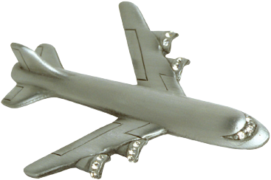
Identify Friend or Foe (IFF)
Russian
MIG
Angola
SAAF
Impala
K
2. E(N,K)
1. N
Namibia
K

Slide 3
MIG in the Middle
3. N
SAAF
Impala
K
4. E(N,K)
Angola
2. N
5. E(N,K)
6. E(N,K)
Russian
MiG
1. N
Namibia
K

Slide 4
Authentication Protocols

Slide 5
Authentication
Alice must prove her identity to Bob
Alice and Bob can be humans or computers
May also require Bob to prove he’s Bob (mutual authentication)
Probably need to establish a session key
May have other requirements, such as
Use public keys
Use symmetric keys
Use hash functions
Anonymity, plausible deniability, etc., etc.

Slide 6
Authentication
Authentication on a stand-alone computer is relatively simple
Hash password with salt
“Secure path,” attacks on authentication software, keystroke logging, etc., can be issues
Authentication over a network is challenging
Attacker can passively observe messages
Attacker can replay messages
Active attacks possible (insert, delete, change)

Slide 7
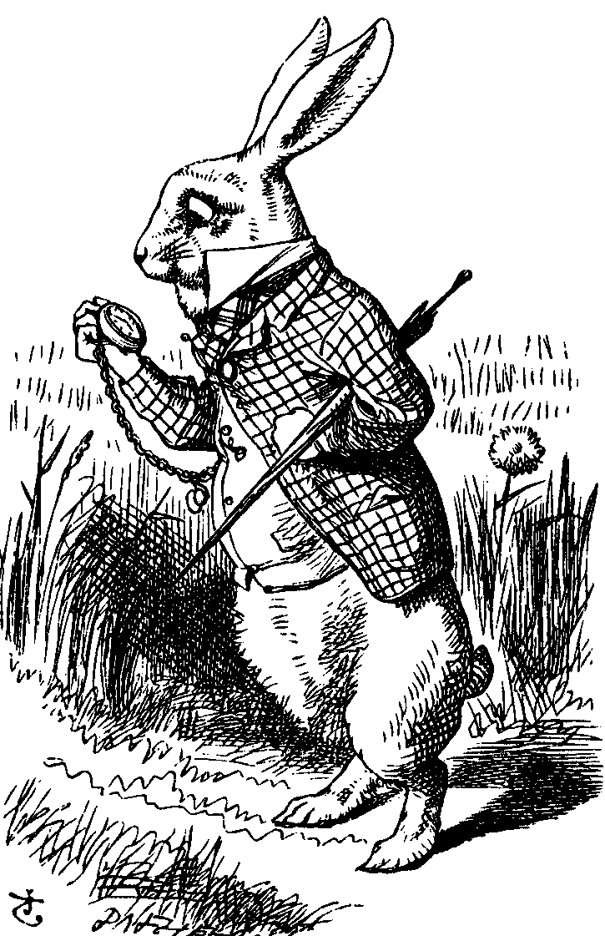
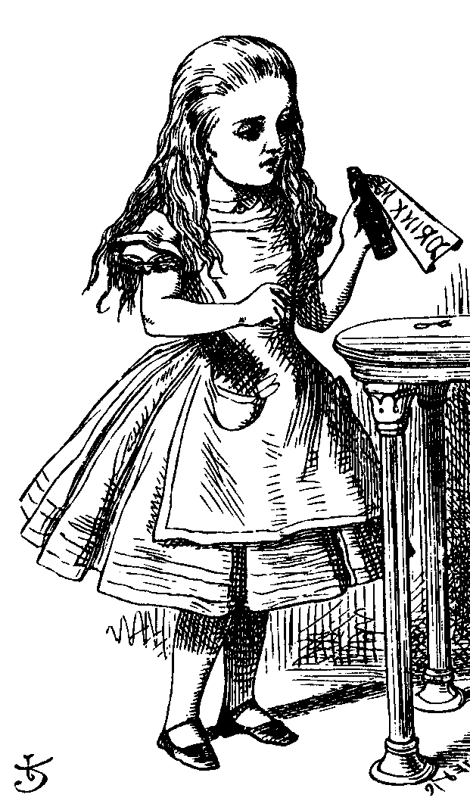
Simple Authentication
“I’m Alice”
Prove it
My password is “frank”
Alice
Bob
Simple and may be OK for standalone system
But insecure for networked system
Subject to a replay attack (next 2 slides)
Also, Bob must know Alice’s password

Slide 8
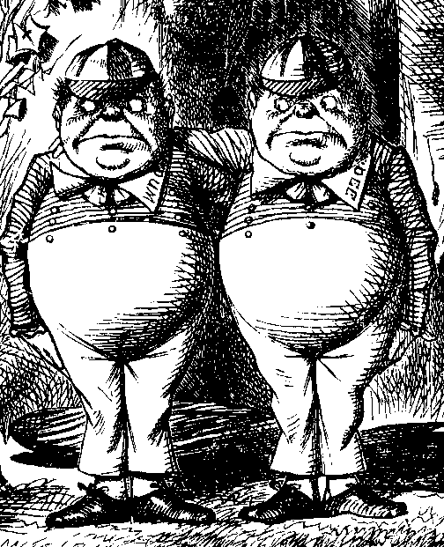
Authentication Attack
“I’m Alice”
Prove it
My password is “frank”
Alice
Bob
Trudy

Slide 9
Authentication Attack
“I’m Alice”
Prove it
My password is “frank”
Trudy
Bob
This is an example of a replay attack
How can we prevent a replay?

Slide 10
Simple Authentication
I’m Alice, my password is “frank”
Alice
Bob
More efficient, but…
… same problem as previous version

Slide 11
Better Authentication
“I’m Alice”
Prove it
h(Alice’s password)
Alice
Bob
Better since it hides Alice’s password
From both Bob and Trudy
But still subject to replay

Slide 12
Challenge-Response
To prevent replay, use challenge-response
Goal is to ensure “freshness”
Suppose Bob wants to authenticate Alice
Challenge sent from Bob to Alice
Challenge is chosen so that…
Replay is not possible
Only Alice can provide the correct response
Bob can verify the response

Slide 13
Nonce
To ensure freshness, can employ a nonce
Nonce == number used once
What to use for nonces?
That is, what is the challenge?
What should Alice do with the nonce?
That is, how to compute the response?
How can Bob verify the response?
Should we rely on passwords or keys?

Slide 14
Challenge-Response
“I’m Alice”
Nonce
h(Alice’s password, Nonce)
Alice
Bob
Nonce is the challenge
The hash is the response
Nonce prevents replay, ensures freshness
Password is something Alice knows
Note: Bob must know Alice’s pwd to verify

Slide 15
Generic Challenge-Response
“I’m Alice”
Nonce
Something that could only be
Alice
from Alice (and Bob can verify)
Bob
In practice, how to achieve this?
Hashed password works, but…
Encryption is better here (Why?)

Slide 16
Symmetric Key Notation
Encrypt plaintext P with key K
C = E(P,K)
Decrypt ciphertext C with key K
P = D(C,K)
Here, we are concerned with attacks on protocols, not attacks on crypto
So, we assume crypto algorithms are secure

Slide 17
Authentication: Symmetric Key
Alice and Bob share symmetric key K
Key K known only to Alice and Bob
Authenticate by proving knowledge of shared symmetric key
How to accomplish this?
Cannot reveal key, must not allow replay (or other) attack, must be verifiable, …

Slide 18
Authentication with Symmetric Key
“I’m Alice”
R
E(R,K)
Alice, K
Bob, K
Secure method for Bob to authenticate Alice
Alice does not authenticate Bob
So, can we achieve mutual authentication?

Slide 19
Mutual Authentication?
“I’m Alice”, R
E(R,K)
E(R,K)
Alice, K
Bob, K
What’s wrong with this picture?
“Alice” could be Trudy (or anybody else)!

Slide 20
Mutual Authentication
Since we have a secure one-way authentication protocol…
The obvious thing to do is to use the protocol twice
Once for Bob to authenticate Alice
Once for Alice to authenticate Bob
This has got to work…

Slide 21
Mutual Authentication
“I’m Alice”, R_{A}
R_{B}, E(R_{A}, K)
E(R_{B}, K)
Alice, K
Bob, K
This provides mutual authentication…
…or does it? See the next slide

Slide 22
Mutual Authentication Attack
1. “I’m Alice”, R_{A}
2. R_{B}, E(R_{A}, K)
5. E(R_{B}, K)
Trudy
Bob, K
3. “I’m Alice”, R_{B}
4. R_{C}, E(R_{B}, K)
Trudy
Bob, K

Slide 23
Mutual Authentication
Our one-way authentication protocol is not secure for mutual authentication
Protocols are subtle!
The “obvious” thing may not be secure
Also, if assumptions or environment change, protocol may not be secure
This is a common source of security failure
For example, Internet protocols

Slide 24
Symmetric Key Mutual Authentication
“I’m Alice”, R_{A}
R_{B}, E(“Bob”,R_{A},K)
E(“Alice”,R_{B},K)
Alice, K
Bob, K
Do these “insignificant” changes help?
Yes!

Slide 25
Public Key Notation
Encrypt M with Alice’s public key: {M}_{Alice}
Sign M with Alice’s private key: [M]_{Alice}
Then
[{M}_{Alice} ]_{Alice} = M
{[M]_{Alice} }_{Alice} = M
Anybody can use Alice’s public key
Only Alice can use her private key

Slide 26
Public Key Authentication
“I’m Alice”
{R}_{Alice}
R
Alice
Bob
Is this secure?
Trudy can get Alice to decrypt anything!
So, should have two key pairs

Slide 27
Public Key Authentication
“I’m Alice”
R
[R]_{Alice}
Alice
Bob
Is this secure?
Trudy can get Alice to sign anything!
Same as previous ⎯ should have two key pairs

Slide 28
Public Keys
Generally, a bad idea to use the same key pair for encryption and signing
Instead, should have…
…one key pair for encryption/decryption…
…and a different key pair for signing/verifying signatures

Slide 29
Key Distribution

Slide 30
Session Key
Usually, a session key is required
i.e., a symmetric key for a particular session
Used for confidentiality and/or integrity
How to authenticate and establish a session key (i.e., shared symmetric key)?
When authentication completed, want Alice and Bob to share a session key
Trudy cannot break the authentication…
…and Trudy cannot determine the session key

Slide 31
Session Key (Cntd.)
Session key (i.e., shared symmetric key) can be established using
Public-key crypto systems
Symmetric-key crypto system !!
Kerberos

Slide 32
Key Distribution using Public-key

Slide 33
Authentication & Session Key
“I’m Alice”, R
{R,K}_{Alice}
{R +1,K}_{Bob}
Alice
Bob
Is this secure?
Alice is authenticated and session key is secure
Alice’s “nonce”, R, useless to authenticate Bob
The key K is acting as Bob’s nonce to Alice
No mutual authentication

Slide 34
Public Key Authentication and Session Key
“I’m Alice”, R
[R,K]_{Bob}
[R +1,K]_{Alice}
Alice
Bob
Is this secure?
Mutual authentication (good), but…
… session key is not secret (very bad)

Slide 35
Public Key Authentication and Session Key
“I’m Alice”, R
{[R,K]_{Bob}}_{Alice}
{[R +1,K]_{Alice}}_{Bob}
Alice
Bob
Is this secure?
Seems to be OK
Mutual authentication and session key!

Slide 36
Public Key Authentication and Session Key
“I’m Alice”, R
[{R,K}_{Alice}]_{Bob}
[{R +1,K}_{Bob}]_{Alice}
Alice
Bob
Is this secure?
Seems to be OK
Anyone can see {R,K}_{Alice} and {R +1,K}_{Bob}

Slide 37
Timestamps
A timestamp T is derived from current time
Timestamps used in some security protocols
Kerberos, for example
Timestamps reduce number of msgs (good)
Like a nonce that both sides know in advance
“Time” is a security-critical parameter (bad)
Clocks never exactly the same, so must allow for clock skew ⎯ creates risk of replay
How much clock skew is enough?

Slide 38
Public Key Authentication with Timestamp T
“I’m Alice”, {[T, K]_{Alice}}_{Bob}
{[T +1, K]_{Bob}}_{Alice}
Alice
Bob
Secure mutual authentication?
Session key?
Seems to be OK

Slide 39
Public Key Authentication with Timestamp T
“I’m Alice”, [{T, K}_{Bob}]_{Alice}
[{T +1, K}_{Alice}]_{Bob}
Alice
Bob
Secure authentication and session key?
Trudy can use Alice’s public key to find
{T, K}_{Bob} and then…

Slide 40
Public Key Authentication with Timestamp T
“I’m Trudy”, [{T, K}_{Bob}]_{Trudy}
[{T +1, K}_{Trudy}]_{Bob}
Trudy
Bob
Trudy obtains Alice-Bob session key K
Note: Trudy must act within clock skew

Slide 41
Public Key Authentication
Sign and encrypt with nonce…
Secure
Encrypt and sign with nonce…
Secure
Sign and encrypt with timestamp…
Secure
Encrypt and sign with timestamp…
Insecure
Protocols can be subtle!

Slide 42
Public Key Authentication with Timestamp T
“I’m Alice”, [{T, K}_{Bob}]_{Alice}
[{T +1}_{Alice}]_{Bob}
Alice
Bob
Is this “encrypt and sign” secure?
Yes, seems to be OK
Does “sign and encrypt” also work here?
Notes:
Note that either of (T+1) and K in the 2nd message on slide 41 can be used to authenticate Bob → drop K from 2nd message to solve the problem on slide 43 !!

Slide 43
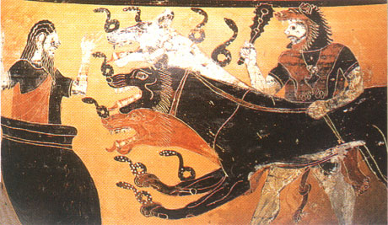
Key Distribution using Symmetric-key (Kerberos)

Slide 44
Kerberos
In Greek mythology, Kerberos is 3-headed dog that guards entrance to Hades
“Wouldn’t it make more sense to guard the exit?”
In security, Kerberos is an authentication protocol based on symmetric key crypto
Originated at MIT
Based on work by Needham and Schroeder
Relies on a Trusted Third Party (TTP)

Slide 45
Motivation for Kerberos
Authentication using public keys
N users ⇒ N key pairs
Authentication using symmetric keys
N users requires (on the order of) N² keys
Symmetric key case does not scale
Kerberos based on symmetric keys but only requires N keys for N users
Security depends on TTP
No PKI is needed

Slide 46
Kerberos KDC
Kerberos Key Distribution Center or KDC
KDC acts as the TTP
TTP is trusted, so it must not be compromised
KDC shares symmetric key K_{A} with Alice, key K_{B} with Bob, key K_{C} with Carol, etc.
And a master key K_{KDC} known only to KDC
KDC enables authentication, session keys
Session key for confidentiality and integrity
In practice, crypto algorithm is DES

Slide 47
Kerberos Tickets
KDC issue tickets containing info needed to access network resources
KDC also issues Ticket-Granting Tickets or TGTs that are used to obtain tickets
Each TGT contains
Session key
User’s ID
Expiration time
Every TGT is encrypted with K_{KDC}
So, TGT can only be read by the KDC

Slide 48
Kerberized Login
Alice enters her password
Then Alice’s computer does following:
Derives K_{A} from Alice’s password
Uses K_{A} to get TGT for Alice from KDC
Alice then uses her TGT (credentials) to securely access network resources
Plus: Security is transparent to Alice
Minus: KDC must be secure ⎯ it’s trusted!

Slide 49
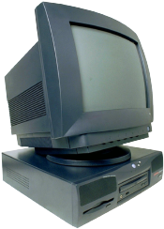
Kerberized Login
Alice wants
Alice’s
a TGT
password
E(S_{A},TGT,K_{A})
Alice
Computer
KDC
Key K_{A} = h(Alice’s password)
KDC creates session key S_{A}
Alice’s computer decrypts S_{A} and TGT
Then it forgets K_{A}
TGT = E(“Alice”, S_{A}, K_{KDC})

Slide 50
Alice Requests “Ticket to Bob”
I want to
talk to Bob
Talk to Bob
REQUEST
REPLY
Alice
Computer
KDC
REQUEST = (TGT, authenticator)
authenticator = E(timestamp, S_{A})
REPLY = E(“Bob”, K_{AB}, ticket to Bob, S_{A})
ticket to Bob = E(“Alice”, K_{AB}, K_{B})
KDC gets S_{A} from TGT to verify timestamp

Slide 51
Alice Uses Ticket to Bob
ticket to Bob, authenticator
E(timestamp + 1, K_{AB})
Alice’s
Computer
Bob
ticket to Bob = E(“Alice”, K_{AB}, K_{B})
authenticator = E(timestamp, K_{AB})
Bob decrypts “ticket to Bob” to get K_{AB} which he then uses to verify timestamp

Slide 52
Kerberos
Key S_{A} used in authentication
For confidentiality/integrity
Timestamps for authentication and replay protection
Recall, that timestamps…
Reduce the number of messages⎯like a nonce that is known in advance
But, “time” is a security-critical parameter

Slide 53
Kerberos Questions
When Alice logs in, KDC sends E(S_{A}, TGT, K_{A}) where TGT = E(“Alice”, S_{A}, K_{KDC})
Q: Why is TGT encrypted with K_{A}?
A: Extra work for no added security!
In Alice’s “Kerberized” login to Bob, why can Alice remain anonymous?
Why is “ticket to Bob” sent to Alice?
Why doesn’t KDC send it directly to Bob?

Slide 54
Kerberos Alternatives
Could have Alice’s computer remember password and use that for authentication
Then no KDC required
But hard to protect passwords
Also, does not scale
Could have KDC remember session key instead of putting it in a TGT
Then no need for TGT
But stateless KDC is major feature of Kerberos

Slide 55
Kerberos Keys
In Kerberos, K_{A} = h(Alice’s password)
Could instead generate random K_{A}
Compute K_{h} = h(Alice’s password)
And Alice’s computer stores E(K_{A}, K_{h})
Then K_{A} need not change when Alice changes her password
But E(K_{A}, K_{h}) must be stored on computer
This alternative approach is often used
But not in Kerberos

Slide 56
Differences between versions 4 and 5
Environmental shortcomings
Technical deficiencies
Encryption system dependence
Internet protocol dependence
Message byte ordering
Ticket lifetime
Authentication forwarding
Interrealm authentication
Double encryption
PCBC encryption
Session keys
Password attacks
Notes:
Version 5 is intended to address the
limitations of version 4 in two areas: environmental shortcomings and technical
deficiencies. We briefly summarize the improvements in each area. Kerberos version
4 did not fully address the need to be of general purpose. This led to the following
environmental shortcomings
Encryption system dependence
Internet protocol dependence
Message byte ordering
Ticket lifetime
Authentication forwarding
Interrealm authentication
Apart from these environmental limitations, there are technical deficiencies
in the version 4 protocol itself. Most of these deficiencies were documented in
[BELL90], and version 5 attempts to address these. The deficiencies are the
Following:
Double encryption
PCBC encryption
Session keys
Password attacks

Slide 57
Authentication Protocols (additional desired features)

Slide 58
Perfect Forward Secrecy
Consider this “issue”…
Alice encrypts message with shared key K and sends ciphertext to Bob
Trudy records ciphertext and later attacks Alice’s (or Bob’s) computer to recover K
Then Trudy decrypts recorded messages
Perfect forward secrecy (PFS): Trudy cannot later decrypt recorded ciphertext
Even if Trudy gets key K or other secret(s)
Is PFS possible?

Slide 59
Perfect Forward Secrecy
Suppose Alice and Bob share key K
For perfect forward secrecy, Alice and Bob cannot use K to encrypt
Instead they must use a session key K_{S} and forget it after it’s used
Can Alice and Bob agree on session key K_{S} in a way that ensures PFS?

Slide 60
Naïve Session Key Protocol
E(K_{S}, K)
E(messages, K_{S})
Alice, K
Bob, K
Trudy could record E(K_{S}, K)
If Trudy later gets K then she can get K_{S}
Then Trudy can decrypt recorded messages

Slide 61
Perfect Forward Secrecy
We use Diffie-Hellman for PFS
Recall: public g and p
gª mod p
g^{b} mod p
Alice, a
Bob, b
But Diffie-Hellman is subject to MiM
How to get PFS and prevent MiM?

Slide 62
Perfect Forward Secrecy
E(gª mod p, K)
E(g^{b} mod p, K)
Alice: K, a
Bob: K, b
Session key K_{S} = g^{ab} mod p
Alice forgets a, Bob forgets b
So-called Ephemeral Diffie-Hellman
Neither Alice nor Bob can later recover K_{S}
Are there other ways to achieve PFS?

Slide 63
Mutual Authentication, Session Key and PFS
“I’m Alice”, R_{A}
R_{B}, [{R_{A}, g^{b} mod p}_{Alice}]_{Bob}
[{R_{B}, gª mod p}_{Bob}]_{Alice}
Alice, a
Bob, b
Session key is K = g^{ab} mod p
Alice forgets a and Bob forgets b
If Trudy later gets Bob’s and Alice’s secrets (i.e. private keys), she cannot recover session key K_{s}

Slide 64
Zero Knowledge Proofs

Slide 65
Zero Knowledge Proof (ZKP)
Alice wants to prove that she knows a secret without revealing any info about it
Bob must verify that Alice knows secret
But, Bob gains no info about the secret
Process is probabilistic
Bob can verify that Alice knows the secret to an arbitrarily high probability
An “interactive proof system”

Slide 66
Bob’s Cave
Alice knows secret phrase to open path between R and S (“open sesame”)
Can she convince Bob that she knows the secret without revealing phrase?
P
Q
R
S

Slide 67
Bob’s Cave
Bob: “Alice come out on S side”
P
Alice (quietly): “Open sesame”
Q
If Alice does not know the secret…
R
S
…then Alice could come out from the correct side with probability 1/2
If Bob repeats this n times, then Alice (who does not know secret) can only fool Bob with probability 1/2^{n}

Slide 68
Fiat-Shamir Protocol
Cave-based protocols are inconvenient
Can we achieve same effect without the cave?
Finding square roots modulo N is difficult
Equivalent to factoring
Suppose N = pq, where p and q prime
Alice has a secret S
N and v = S² mod N are public, S is secret
Alice must convince Bob that she knows S without revealing any information about S

Slide 69
Fiat-Shamir
x = r² mod N
e ∈ {0,1}
y = r ⋅ S^{e} mod N
Alice
secret S
random r
Bob
random e
Public: Modulus N and v = S² mod N
Alice selects random r, Bob chooses e ∈ {0,1}
Bob verifies: y² = x ⋅ v^{e} mod N
Why? Because… y² = r² ⋅ S^{2e} = r² ⋅ (S²)^{e} = x ⋅ v^{e} mod N

Slide 70
Fiat-Shamir: e = 1
x = r² mod N
e = 1
y = r ⋅ S mod N
Alice
secret S
random r
Bob
random e
Public: Modulus N and v = S² mod N
Alice selects random r, Bob chooses e =1
If y² = x ⋅ v mod N then Bob accepts it
i.e., “Alice” passes this iteration of the protocol
Note that Alice must know S in this case

Slide 71
Fiat-Shamir: e = 0
x = r² mod N
e = 0
y = r mod N
Alice
secret S
random r
Bob
random e
Public: Modulus N and v = S² mod N
Alice selects random r, Bob chooses e = 0
Bob checks if y² = x mod N
Alice does not need to know S in this case!

Slide 72
Fiat-Shamir
Public: modulus N and v = S² mod N
Secret: Alice knows S
Alice selects random r and commits to r by sending x = r² mod N to Bob
Bob sends challenge e ∈ {0,1} to Alice
Alice responds with y = r ⋅ S^{e} mod N
Bob checks whether y² = x ⋅ v^{e} mod N
Does this prove response is from Alice?

Slide 73
Does Fiat-Shamir Work?
If everyone follows protocol, math works:
Public: v = S² mod N
Alice to Bob: x = r² mod N and y = r ⋅ S^{e} mod N
Bob verifies: y² = x ⋅ v^{e} mod N
Can Trudy convince Bob she is Alice?
If Trudy expects e = 0, she sends x = r² in msg 1 and y = r in msg 3 (i.e., follow the protocol)
If Trudy expects e = 1, sends x = r² ⋅ v⁻¹ in msg 1 and y = r in msg 3
If Bob chooses e ∈ {0,1} at random, Trudy can only trick Bob with probability 1/2

Slide 74
Fiat-Shamir Facts
Trudy can trick Bob with probability 1/2, but…
…after n iterations, the probability that Trudy can convince Bob that she is Alice is only 1/2^{n}
Just like Bob’s cave!
Bob’s e ∈ {0,1} must be unpredictable
Alice must use new r each iteration, or else…
If e = 0, Alice sends r mod N in message 3
If e = 1, Alice sends r ⋅ S mod N in message 3
Anyone can find S given r mod N and r ⋅ S mod N

Slide 75
Fiat-Shamir Zero Knowledge?
Zero knowledge means that nobody learns anything about the secret S
Public: v = S² mod N
Trudy sees r² mod N in message 1
Trudy sees r ⋅ S mod N in message 3 (if e = 1)
If Trudy can find r from r² mod N, gets S
But that requires modular square root
If Trudy could find modular square roots, she could get S from public v
Protocol does not seem to “help” to find S

Slide 76
ZKP in the Real World
Public key certificates identify users
No anonymity if certificates sent in plaintext
ZKP offers a way to authenticate without revealing identities
ZKP supported in MS’s Next Generation Secure Computing Base (NGSCB)*, where…
… ZKP used to authenticate software “without revealing machine identifying data”
ZKP is not just pointless mathematics!
* “cancelled software architecture designed by Microsoft which aimed to provide users of the Windows OS with better privacy, security, and system integrity.” – [ref.]

