Slide 1
COE 202: Digital Logic Design Memory
Courtesy of Dr. Ahmad Almulhem

Slide 2
Objectives
Memory

Slide 3
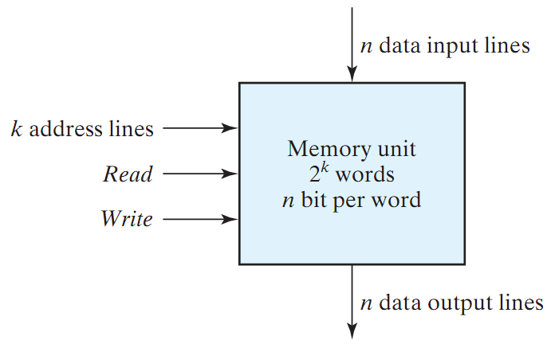
Memory
Memory: A collection of cells capable of storing binary information (1s or 0s) – in addition to electronic circuit for storing (writing) and retrieving (reading) information.
n data lines (input/output)
k address lines
2^{k} words (data unit)
Read/Write Control
Memory size = 2^{k} X n
Word: group of bits stored in one location

Slide 4
Memory (cont.)
Two Types of Memory:
Random Access Memory (RAM):
Write/Read operations
Volatile: Data is lost when power is turned off
Read Only Memory (ROM):
Read operation (no write)
Non-Volatile: Data is permanent.
PROM is programmable (allow special write)

Slide 5
Read-Only Memory (ROM)
ROM: A device in which “permanent” binary information is stored using a special device (programmer)
k inputs (address) → 2^{k} words each of size n bits (data)
ROM DOES NOT have a write operation ➔ ROM DOES NOT have data inputs
k inputs
(address)
2^{k} x n ROM
n outputs
(data)
Word: group of bits stored in one location

Slide 6
ROM Internal Logic
The decoder stage produces ALL possible minterms
32 words of 8 bits each
5 input lines (address)
Each OR gate has a 32 input
A contact can be made using fuse/anti-fuse
Internal Logic of a 32x8 ROM
I₀
I₁
I₂
I₃
I₄
0
1
2
3
.
.
.
28
29
30
31
5-to-32
decoder
A7 A6 A5 A4 A3 A2 A1 A0

Slide 7
Programming a ROM
Inputs |  |  |  |  |  | Outputs
I4 | I3 | I2 | I1 | I0 |  | A7 | A6 | A5 | A4 | A3 | A2 | A1 | A0
0 | 0 | 0 | 0 | 0 |  | 1 | 0 | 1 | 1 | 0 | 1 | 1 | 0
0 | 0 | 0 | 0 | 1 |  | 0 | 0 | 0 | 1 | 1 | 1 | 0 | 1
0 | 0 | 0 | 1 | 0 |  | 1 | 1 | 0 | 0 | 0 | 1 | 0 | 1
0 | 0 | 0 | 1 | 1 |  | 1 | 0 | 1 | 1 | 0 | 0 | 1 | 0
 |  | . |  |  |  |  |  |  | .
 |  | . |  |  |  |  |  |  | .
 |  | . |  |  |  |  |  |  | .
1 | 1 | 1 | 0 | 0 |  | 0 | 0 | 0 | 0 | 1 | 0 | 0 | 1
1 | 1 | 1 | 0 | 1 |  | 1 | 1 | 1 | 0 | 0 | 0 | 1 | 0
1 | 1 | 1 | 1 | 0 |  | 0 | 1 | 0 | 0 | 1 | 0 | 1 | 0
1 | 1 | 1 | 1 | 1 |  | 0 | 0 | 1 | 1 | 0 | 0 | 1 | 1
0
1
2
3
.
.
.
28
29
30
31
x
x
x
x
x
I₀
I₁
I₂
I₃
I₄
x
x
x
x
x
x
x
x
x
x
x
x
5-to-32
decoder
x
x
x
x
x
x
x
x
x
x
x
x
x
A7 A6 A5 A4 A3 A2 A1 A0
Every ONE in truth table specifies a closed circuit
Every ZERO in truth table specifies an OPEN circuit
Example: At address 00011 → The word 10110010 is stored

Slide 8
Combinational Circuit Implementation with ROM
ROM = Decoder + OR gates
Implementation of a combinational circuit is easy
Store the truth table by programming the ROM
Only need to provide the truth table

Slide 9
Example 1
Example: Design a combinational circuit using ROM. The circuit accepts a 3-bit number and generates an output binary number equal to the square of the number.
Solution: Derive truth table:
Inputs |  |  |  | Outputs
A2 | A1 | A0 |  | B5 | B4 | B3 | B2 | B1 | B0 | SQ
0 | 0 | 0 |  | 0 | 0 | 0 | 0 | 0 | 0 | 0
0 | 0 | 1 |  | 0 | 0 | 0 | 0 | 0 | 1 | 1
0 | 1 | 0 |  | 0 | 0 | 0 | 1 | 0 | 0 | 4
0 | 1 | 1 |  | 0 | 0 | 1 | 0 | 0 | 1 | 9
1 | 0 | 0 |  | 0 | 1 | 0 | 0 | 0 | 0 | 16
1 | 0 | 1 |  | 0 | 1 | 1 | 0 | 0 | 1 | 25
1 | 1 | 0 |  | 1 | 0 | 0 | 1 | 0 | 0 | 36
1 | 1 | 1 |  | 1 | 1 | 0 | 0 | 0 | 1 | 49

Slide 10
Example 1 (cont.)
Inputs |  |  |  | Outputs
A2 | A1 | A0 |  | B5 | B4 | B3 | B2 | B1 | B0 | SQ
0 | 0 | 0 |  | 0 | 0 | 0 | 0 | 0 | 0 | 0
0 | 0 | 1 |  | 0 | 0 | 0 | 0 | 0 | 1 | 1
0 | 1 | 0 |  | 0 | 0 | 0 | 1 | 0 | 0 | 4
0 | 1 | 1 |  | 0 | 0 | 1 | 0 | 0 | 1 | 9
1 | 0 | 0 |  | 0 | 1 | 0 | 0 | 0 | 0 | 16
1 | 0 | 1 |  | 0 | 1 | 1 | 0 | 0 | 1 | 25
1 | 1 | 0 |  | 1 | 0 | 0 | 1 | 0 | 0 | 36
1 | 1 | 1 |  | 1 | 1 | 0 | 0 | 0 | 1 | 49
B₀
ROM truth table – specifies the required connections
0
B₁
A₀
8 X 4 ROM
B₂
B1 is ALWAYS 0 ➔ no need to generate it using the ROM
B0 is equal to A0 ➔ no need to generate it using the ROM
Therefore: The minimum size of ROM needed is 2³X4 or 8X4
A₁
B₃
B₄
A₂
B₅

Slide 11
Example 2
Problem: Tabulate the truth for an 8 X 4 ROM that implements the following four Boolean functions:
A(X,Y,Z) = Σm(3,6,7); B(X,Y,Z) = Σm(0,1,4,5,6)
C(X,Y,Z) = Σm(2,3,4); D(X,Y,Z) = Σm(2,3,4,7)
Solution:
8 X 4 ROM
A
X
B
Y
Z
C
D
Inputs |  |  |  | Outputs
X | Y | Z |  | A | B | C | D
0 | 0 | 0 |  | 0 | 1 | 0 | 0
0 | 0 | 1 |  | 0 | 1 | 0 | 0
0 | 1 | 0 |  | 0 | 0 | 1 | 1
0 | 1 | 1 |  | 1 | 0 | 1 | 1
1 | 0 | 0 |  | 0 | 1 | 1 | 1
1 | 0 | 1 |  | 0 | 1 | 0 | 0
1 | 1 | 0 |  | 1 | 1 | 0 | 0
1 | 1 | 1 |  | 1 | 0 | 0 | 1

Slide 12
Example 3 (Size of a ROM)
Problem: Specify the size of a ROM (number of words and number of bits per word) that will accommodate the truth table for the following combinational circuit: An 8-bit adder/subtractor with Cin and Cout.
Solution:
Inputs to the ROM (address lines) = 8 (first number) + (8 second number) + 1 (Cin) + 1 (Add/Subtract) ➔ 18 lines
Hence number of words in ROM is 218 = 256K
Size of each word = number of possible functions/outputs
= 16 (addition/subtraction) + 1 (Cout)
= 17
Hence ROM size = 256K X 17

Slide 13
Sequential Circuit Implementation with ROM
Combinational
Circuits
inputs X
outputs Z
present state
next state
FFs
sequential circuit = combinational circuit + memory
Combinational part can be built with a ROM as shown previously
Number of address lines = No. of FF + No. of inputs
Number of outputs = No. of FF + No. of outputs

Slide 14
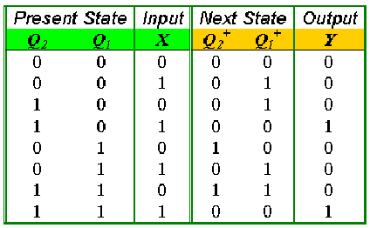
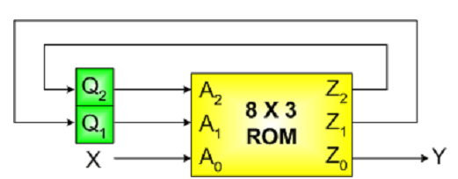
Example
Example: Design a sequential circuit whose state table is given, using a ROM and a register.
State Table
We need a 8x3 ROM (why?)
3 address lines and 3 data lines
Exercise: Compare design with ROMs with the traditional design procedure.

Slide 15
Types of ROMs
A ROM programmed in four different ways:
ROM: Mask Programming
By a semiconductor company
PROM (Programmable ROM)
User can blow/connect fuses with a special programming device (PROM programmer)
Only programmed once!
EPROM (Erasable PROM)
Can be erased using Ultraviolet Light
Electrically Erasable PROM (EEPROM or E²PROM)
Like an EPROM, but erased with electrical signal

