Slide 1
COE 202: Digital Logic Design Sequential Circuits Part 4
Courtesy of Dr. Ahmad Almulhem

Slide 2
Objectives
Registers
Counters

Slide 3
Registers
n-1 | … | 1 | 0
A register is a group of flip-flops.
An n-bit register is made of n flip-flips and can store n bits
A register may have additional combinational gates to perform certain operations

Slide 4
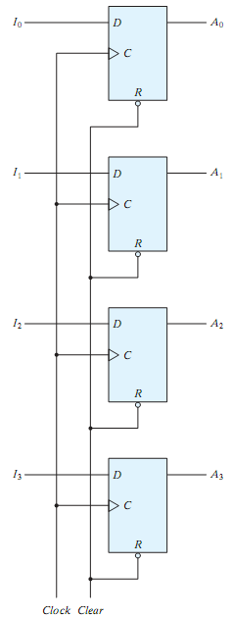
4-Bit Register
A simple 4-bit register can be made with 4 D-FF
Data is loaded in parallel
Common Clock
At each positive-edge, 4 bits are loaded in parallel
Previous data is overwritten
Entering data is called loading
Common Clear
Asynchronous active-low clear
When Clear = 0, all FFs are cleared; i.e. 0 is stored.

Slide 5
4-Bit Register (cont.)
Question: How to modify this register to enable/disable loading new data (overwriting previous) ?

Slide 6
4-Bit Register (cont.)
Question: How to modify this register to enable/disable loading new data (overwriting previous) ?
Answer: When Load=0, the clock input to the FFs will never take a transition (0 to 1, 1 to 0), no new data will be loaded. When Load=1, normal data loading takes place
This is called clock gating

Slide 7
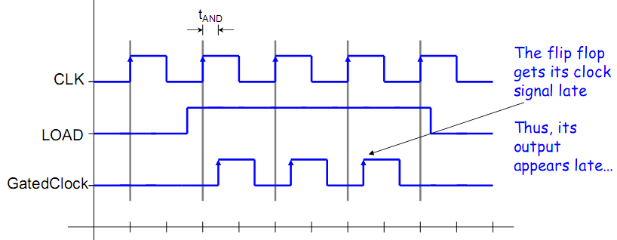
4-Bit Register (cont.)
Clock Skew Problem:
It results from clock gating.

Slide 8
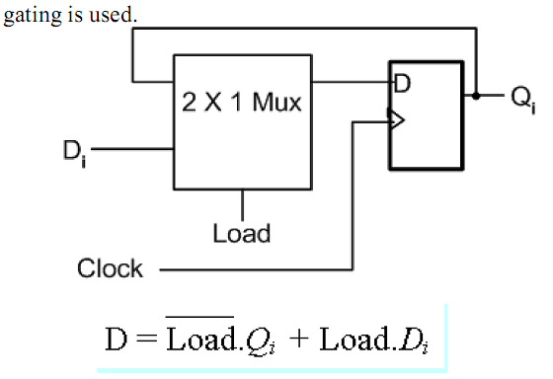
4-Bit Register (cont.)
Better Solution: Register with Parallel Load
Use a 2x1 MUX as shown:
Q: Why the D-FF output is fed back?

Slide 9
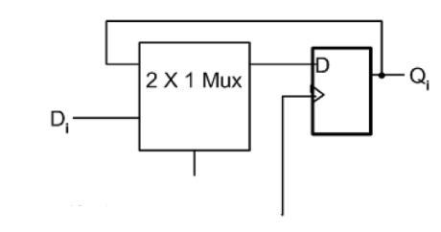
4-Bit Register (cont.)
A 4-bit Parallel Load Register
When Load = 0, the data is not changed (no loading)
When Load = 1, the data is loaded in parallel at the rising edge (+ve)
load
clock

Slide 10
Shift Registers
n-1 | … | 1 | 0
A shift register is a register which shifts its content (right, left, or both)
Made of flip-flops with common clock
Useful to load data serially

Slide 11
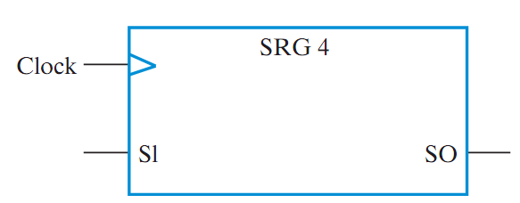
4-bit Shift Register
A simple 4-bit shift register can be made with 4 D-FF
Common Clock
At each positive-edge, 1 bit is shifted in
Rightmost bit is discarded
Which direction this register is shifting?

Slide 12
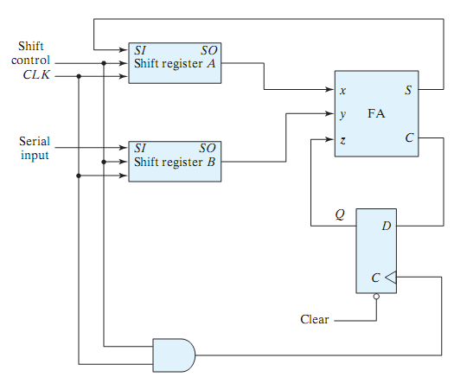
Using Shift Register (Examples)
Serial Addition

Slide 13
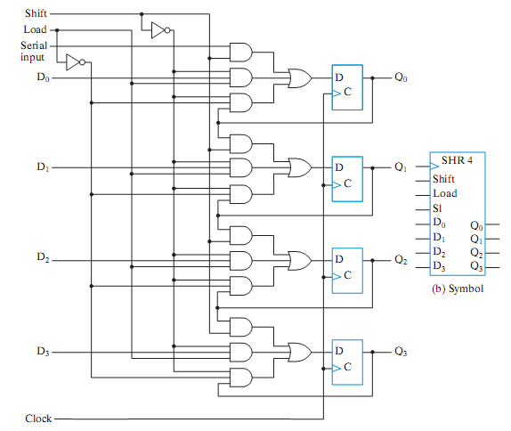
Shift Register with Parallel Load
Two control inputs (shift, load)
Each stage consists of
D-FF
OR gate
Three AND gates
AND to enable shift
AND to enable load
AND for “no change”
Idea: Use a MUX to implement more functions (see next slides)
Q_{i}→ Qi
D₀D₁D₂D₃
Serial Input → Q₀
Q_{i-1} → Q_{i} ; i=1,…,3

Slide 14
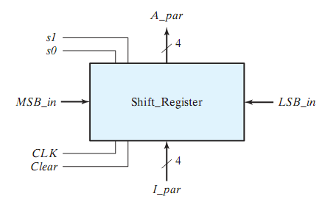
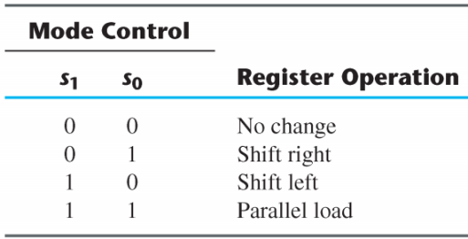
Universal Shift Register
Question: Design a Universal Shift Register with the following capabilities:
A clear control to clear the register to 0
A clock to synchronize the operations
A shift-right control (associated with serial in/out)
A shift-left control (associated with serial in/out)
A parallel-load control (to parallel load n bits)
n-parallel output lines
A control signal to leave register unchanged

Slide 15
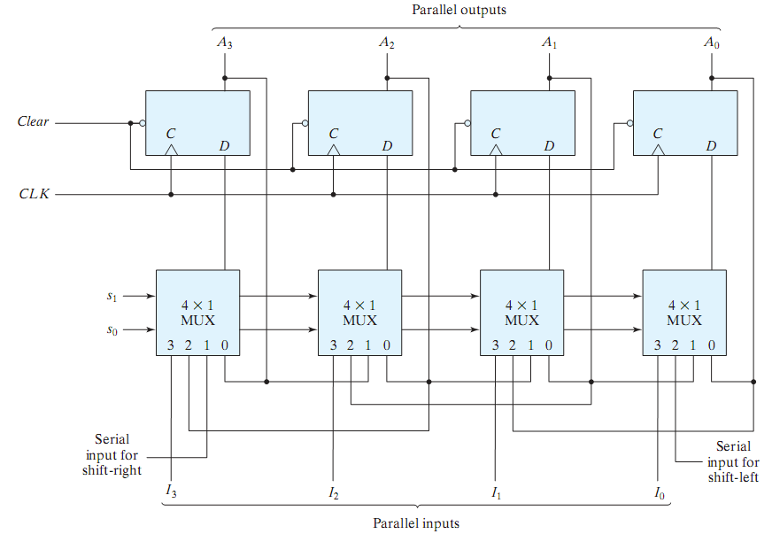
Universal Shift Register (cont.)

Slide 16
Universal Shift Register (cont.)
How does it work?
4 D-FF and 4 MUXs with selection S₀,S₁
S₀S₁=00, FF output is feedback to its input
S₀S₁=01, FF input comes from left FF or serial-in (shift-right)
S₀S₁=10, FF input comes from right FF or serial-in (shift-left)
S₀S₁=11, parallel data transferred in
Applications:
Parallel ↔ Serial conversions
Arithmetic multiplication/division
Delaying input sequence

Slide 17
Counters
Counter: A register (sequential circuit) that goes through a pre-determined sequence of states upon the application of input (clock or other source) pulses
Binary Counter: The sequence of the states follows the binary number sequence (e.g. 000 → 001 → 010 → 011 → etc.)
n-bit binary counter requires n flip-flops – counts from 0 to 2^{n}-1
Sequences can be binary, BCD, random, etc.
Counting can be up, down
A modulo-n counter goes through values 0,1,2, …, (n-1)
e.g. modulo-10 up counter counts: 0,1,…9
Two Types of Counters:
Ripple counter (asynchronous):
Flip-flop output transition serves as source for triggering the other flip-flops
Synchronous counter:
common clock for all flip-flops (same design procedure)

Slide 18
Counters
Some Applications:
Frequency division
Event counting
Timers
ABC (LSB)
000
001
010
011
100
101
000
001
This is a modulo-?
Up/Down? Counter
Successive
Clock
Pulses

Slide 19
Ripple Counters
Instead of having a common clock signal to all Flip Flops, in a Ripple counter the output of one stage (Flip Flop) is connected to the clock input of the next stage
Clock is connected to the least significant bit
Flip flops are negative edge-triggered (clock is bubbled) – are active when the clock signal is falling (high to low)
Flip flops invert their stored bits, when the input clock signal goes from high (1) to low (0)

Slide 20
Ripple Counters (cont.)
For a D-FF, connecting Q’ to D makes it to toggle at each clock!
Q₃ | Q₂ | Q₁ | Q₀
0 | 0 | 0 | 0
0 | 0 | 0 | 1
0 | 0 | 1 | 0
0 | 0 | 1 | 1
.
.
.
.
.
.
.
.
Q1: How to make it count down?
Q2: What if we use positive-edge FF?
Q3: Is this counter asynchronous? Why?

Slide 21
Ripple Counters
Advantages:
Simple hardware
Disadvantages:
Asynchronous – delay dependent
Good for low power circuits

Slide 22
Synchronous Counters
Common clock to all FFs
Design following the same design procedure for synchronous sequential circuits (see slides 4_3)
Important: Study the examples in slides 4_3
Counters have a regular pattern
Alternatively, counters can be designed without following the procedure (algorithmically, hierarchically)

Slide 23
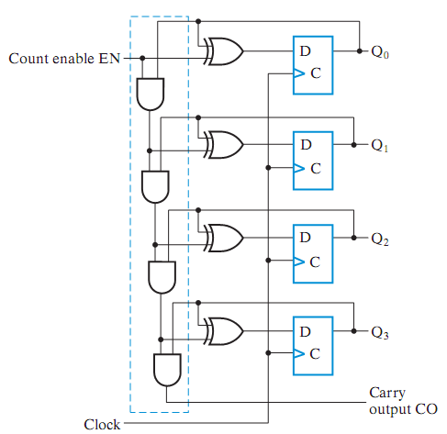
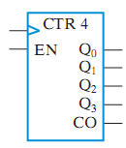
4-bit Synchronous Binary Counter with D-FF
When En = 0, feed back same value
When En = 1, increment the saved value at each clock
Least significant bit (Q₀) toggles at every clock
Other FFs toggle when all lower FFs are equal to 1 (e.g. 0011 → 0100)
XORs act like an adder
EN = 1 → Q₃Q₂Q₁Q₀ + 0001
EN = 0 → Q₃Q₂Q₁Q₀ + 0000
Incrementer
+1
A3
Y3
D3
Q3
symbol
A2
Y2
D2
Q2
A1
Y1
D1
Q1
A0
Y0
D0
Q0

Slide 24
4-bit Synchronous Binary Counter (Contd.)
Question: How to build a bigger counter?
A₀
A₁
A₂
A₃
A₀
A₁
A₂
A₃
Clock
En
En
CO
CO

Slide 25
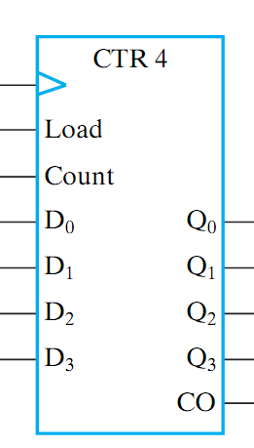
Binary Counter with Parallel Load
Counter with parallel load: capability for transferring an initial binary number into the counter prior to the count operation
Two control inputs:
Load: enables loading an initial binary number
Count: enables the counting
Very useful to implement different counting sequences

Slide 26
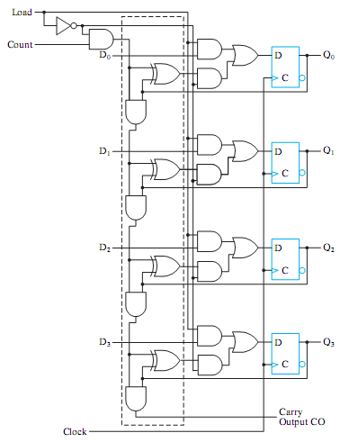
Binary Counter with Parallel Load
Load | Count | Action
0 | 0 | Hold last count (No change)
0 | 1 | Increment current count
1 | X | Parallel Load D0-D3
When Load = 1,
D₀D₁D₂D₃ is loaded
When Count = 1 (and Load = 0)
Current value is incremented
When Load=Count=0
Feedback current value

Slide 27
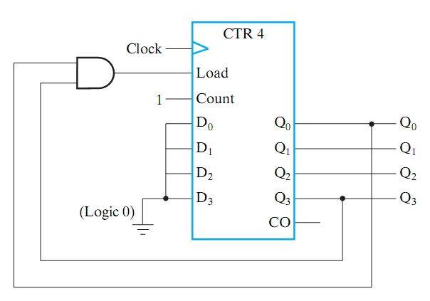
BCD Counter
Q: How can we convert the parallel load binary counter into a BCD counter?

Slide 28
BCD Counter
Q: How can we convert the parallel load binary counter into a BCD counter?

Slide 29
3-to-12 Counter (Modulo 10, Divide by 10)
Q: How can we convert the parallel load binary counter into a 3-to-12 counter?

Slide 30
3-to-12 Counter (Modulo 10, Divide by 10)
Q: How can we convert the parallel load binary counter into a 3-to-12 counter?
1
1
0
0

Slide 31
9-to-69 Counter
Problem: Use two binary counters with parallel load and logic gates to build a binary counter that counts from 9 to 69. Add an additional input to the counter that initializes it synchronously to 9 when the INIT is 1
Solution:
clock
CTR 4 (1)
CTR 4 (2)
INIT
Q0
Q4
Load
Load
Load
Q1
Load
Q5
1
En
Q2
En
Q6
1
D0
Q3
0
D0
Q7
0
D1
CO
0
D1
CO
Converting to Binary
Binary 09 ➔ 0000 1001
Binary 69 ➔ 0100 0101
0
D2
0
D2
1
D3
0
D3
1001 ➔ 0101
0000 ➔ 0100

Slide 32
9-to-69 Counter (cont.)
Notes about the Solution:
The key word in the problem statement is “BINARY”
Counter should count in binary from binary 9 through binary 69 and then back to binary 9 and so on
Binary 09 ➔ 0000 1001
Binary 69 ➔ 0100 0101
Two counters providing 8 Qs are needed
Least significant counter (LSC) ➔ Q3Q2Q1Q0
Most significant counter (MSC) ➔ Q7Q6Q5Q4
The counting sequence is as shown in table
MSC increments only if LSC is equal to 1111; i.e the CO signal of LSC is 1
During count, LSC counts normally from 01001 all the way to 1111 and back to 0000, 0001, etc except when binary 69 is reached – 1001 is reloaded again
During count, MSC counts normally from 0000 all the way to 0100 and then it restarts from 0000 again.
No | Binary Q₇Q₆Q₅Q₄ Q₃Q₂Q₁Q₀
9 | 0000 1001
10 | 0000 1010
11 | 0000 1011
12 | 0000 1100
. | .
15 | 0000 1111
16 | 0001 0000
17 | 0001 0001
18 | 0001 0010
19 | 0001 0011
20 | 0001 0100
21 | 0001 0101
. | .
68 | 0100 0100
69 | 0100 0101
9 | 0000 1001
10 | 0000 1010
. | .

Slide 33
Counter with Clear
clear
clear
Q0
Q1
Q2
Q3
Q0
Q1
Q2
Q3
If synchronous Clear
0000 → 0101
If asynchronous Clear
0000 → 0100

Slide 34
Arbitrary Count Sequence
Problem: Design a counter that has a repeated sequence of 6 states, as listed in table. In this sequence, flip-flops B and C repeat the binary count 00, 01, 10, while flip-flop A alternates between 0 and 1 every three counts.
Notes:
Only 6 states (Module-6)
011, 111 are missing
Follow the usual design procedure
Present State |  |  |  | Next State
A | B | C |  | A | B | C
0 | 0 | 0 |  | 0 | 0 | 1
0 | 0 | 1 |  | 0 | 1 | 0
0 | 1 | 0 |  | 1 | 0 | 0
1 | 0 | 0 |  | 1 | 0 | 1
1 | 0 | 1 |  | 1 | 1 | 0
1 | 1 | 0 |  | 0 | 0 | 0

Slide 35
Arbitrary Count Sequence – State Table
Assuming JK flip-flops
Present State |  |  |  | Next State |  |  |  | Flip-flop Inputs
A | B | C |  | A | B | C |  | JA | KA | JB | KB | JC | KC
0 | 0 | 0 |  | 0 | 0 | 1 |  | 0 | X | 0 | X | 1 | X
0 | 0 | 1 |  | 0 | 1 | 0 |  | 0 | X | 1 | X | X | 1
0 | 1 | 0 |  | 1 | 0 | 0 |  | 1 | X | X | 1 | 0 | X
1 | 0 | 0 |  | 1 | 0 | 1 |  | X | 0 | 0 | X | 1 | X
1 | 0 | 1 |  | 1 | 1 | 0 |  | X | 0 | 1 | X | X | 1
1 | 1 | 0 |  | 0 | 0 | 0 |  | X | 1 | x | 1 | 0 | x

Slide 36
Arbitrary Count Sequence – Input Equations
BC A | 00 | 01 | 11 | 10
0 | 0 | 0 | x | 1
1 | x | x | x | x
BC A | 00 | 01 | 11 | 10
0 | 0 | 1 | x | x
1 | 0 | 1 | x | x
BC A | 00 | 01 | 11 | 10
0 | 1 | x | x | 0
1 | 1 | x | x | 0
JA = B
JB = C
JC = B’
BC A | 00 | 01 | 11 | 10
0 | x | x | x | x
1 | 0 | 0 | x | 1
BC A | 00 | 01 | 11 | 10
0 | x | x | x | 1
1 | x | x | x | 1
BC A | 00 | 01 | 11 | 10
0 | x | 1 | x | x
1 | x | 1 | x | x
KA = B
KB = 1
KC = 1

Slide 37
Arbitrary Count Sequence – Unused States
JA = B
JB = C
JC = B’
KA = B
KB = 1
KC = 1
000
111
001
110
J_{A}
A
C
K_{A}
A’
010
101
J_{B}
B
100
011
C
K_{B}
B’
1) What if the counter “finds itself” in state 111 or state 011? Will the counter be able to proceed (count) normally afterward? How?
2) Is this circuit safe or reliable?
J_{C}
C
C
Logic 1
K_{C}
C’
clock

Slide 38
Summary
Registers and Counters are versatile sequential circuits
Registers
Parallel Load Registers
Shift Registers
Universal Shift Registers
Counters
Ripple counters
Synchronous counters

