Slide 1
COE 202: Digital Logic Design Sequential Circuits Part 3
Courtesy of Dr. Ahmad Almulhem

Slide 2
Objectives
Design of Synchronous Sequential Circuits
Procedure
Examples
Important Design Concepts
State Reduction and Assignment

Slide 3
Design of Synchronous Sequential Circuits
The design of a clocked sequential circuit starts from a set of specifications and ends with a logic diagram (Analysis reversed!)
Building blocks: flip-flops, combinational logic
Need to choose type and number of flip-flops
Need to design combinational logic together with flip-flops to produce the required behavior
The combinational part is
flip-flop input equations
output equations

Slide 4
Design of Synchronous Sequential Circuits
Design Procedure:
Obtain a state diagram from the word description
State reduction if necessary
Obtain State Table
State Assignment
Choose type of flip-flops
Use FF’s excitation table to complete the table
Derive state equations
Obtain the FF input equations and the output equations
Use K-Maps
Draw the circuit diagram

Slide 5
Step1: Obtaining the State Diagram
A very important step in the design procedure.
Requires experience!
Example: Design a circuit that detects a sequence of three consecutive 1’s in a string of bits coming through an input line (serial bit stream)

Slide 6
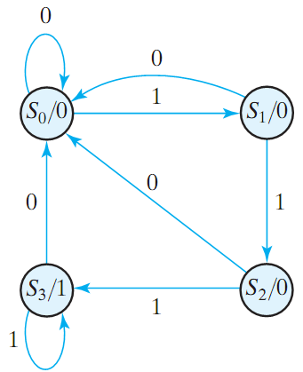
Step1: Obtaining the State Diagram
A very important step in the design procedure.
Requires experience!
Example: Design a circuit that detects a sequence of three consecutive 1’s in a string of bits coming through an input line (serial bit stream)

Slide 7
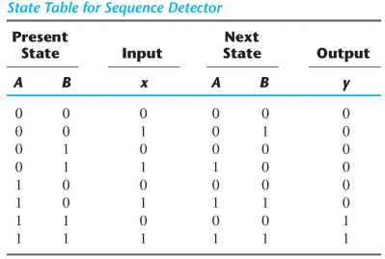
Step2: Obtaining the State Table
Assign binary codes for the states
We choose 2 D-FF
Next state specifies what should be the input to each FF
Example: Design a circuit that detects a sequence of three consecutive 1’s in a string of bits coming through an input line (serial bit stream)

Slide 8
Step3: Obtaining the State Equations
Using K-Maps
A(t + 1) = D_{A} = ∑(3,5,7) = A x + B x
B(t + 1) = D_{B} = ∑(1,5,7) = A x + B’ x
y = ∑(6,7) = A B
Example: Design a circuit that detects a sequence of three consecutive 1’s in a string of bits coming through an input line (serial bit stream)

Slide 9
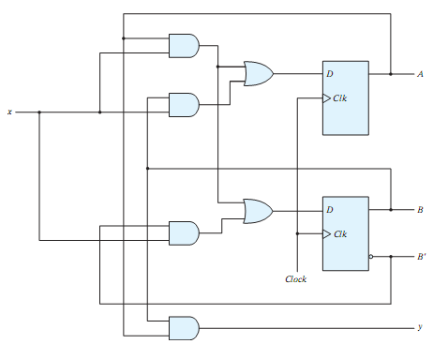
Step4: Draw Circuits
Using K-Maps
A(t + 1) = D_{A} = ∑(3,5,7) = A x + B x
B(t + 1) = D_{B} = ∑(1,5,7) = A x + B’ x
y = ∑(6,7) = A B
Example: Design a circuit that detects a sequence of three consecutive 1’s in a string of bits coming through an input line (serial bit stream)

Slide 10
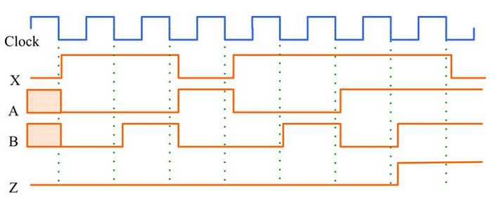
Timing Diagram (Verification)
Question: Does it detect 111 ?

Slide 11
Example 2
Problem: Design of A Sequence Recognizer
Design a circuit that reads as inputs continuous bits, and generates an output of ‘1’ if the sequence (1011) is detected
X
Y
Input 1 1 1 0 0 1 0 0 1 0 0 1 1 0 1 1 0 1 0 1 1 0 1 1 1 1 1 1
Output 0 0 0 0 0 0 0 0 0 0 0 0 0 0 0 1 0 0 0 0 1 0 0 1 0 0 0 0

Slide 12
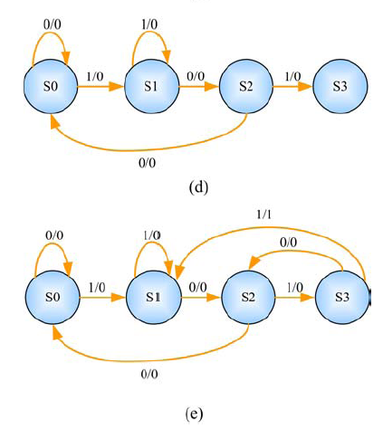
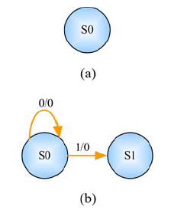
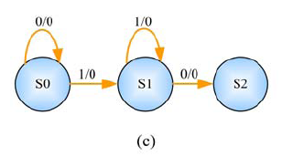
Example 2 (cont.)
Step1: State Diagram
Sequence to be detected:1011

Slide 13
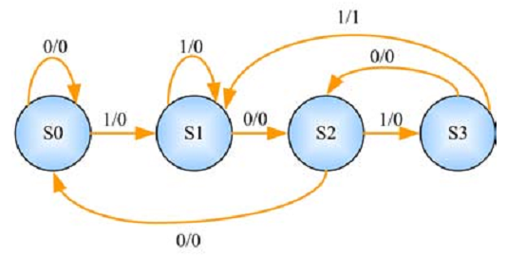
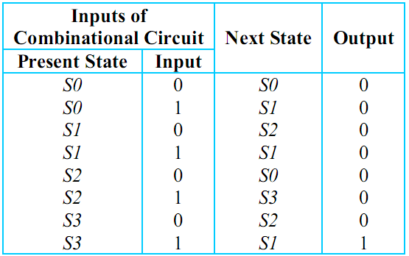
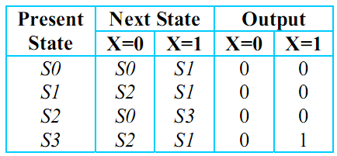
Example 2 (cont.)
Step 2: State Table
OR

Slide 14
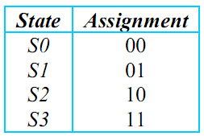
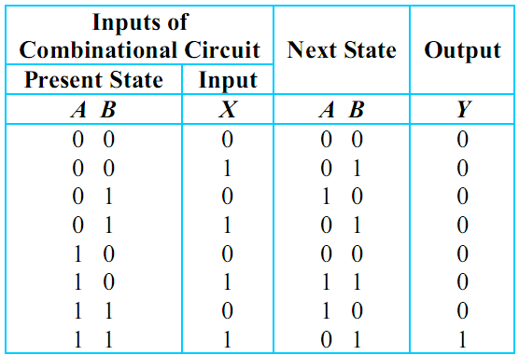
Example 2 (cont.)
Step 2: State Table
state assignment
Q: How many FF?
log₂(no. of states)

Slide 15
Example 2 (cont.)
Step 2: State Table
choose FF
In this example, lets use JK–FF for A and D-FF for B

Slide 16
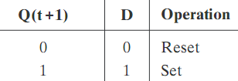
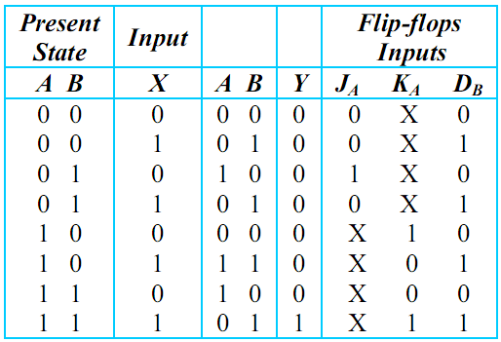
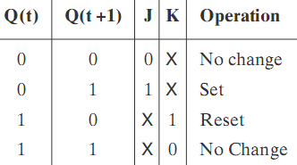
Example 2 (cont.)
Step 2: State Table
complete state table
use excitation tables for JK–FF and D-FF
D–FF excitation table
Next
State
output
JK–FF excitation table

Slide 17
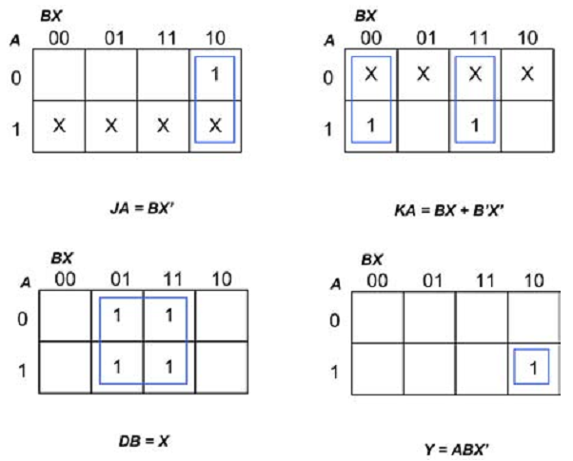
Example 2 (cont.)
Step 3: State Equations
use k-map
J_{A} = BX’
K_{A} = BX + B’X’
D_{B} = X
Y = ABX’

Slide 18
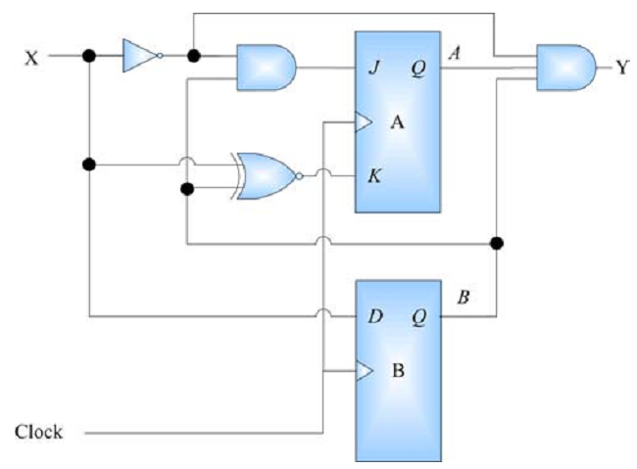
Example 2 (cont.)
Step 4: Draw Circuit
J_{A} = BX’
K_{A} = BX + B’X’
D_{B} = X
Y = ABX’

Slide 19
Example 3
Problem: Design of A 3-bit Counter
Design a circuit that counts in binary form as follows 000, 001, 010, … 111, 000, 001, …

Slide 20
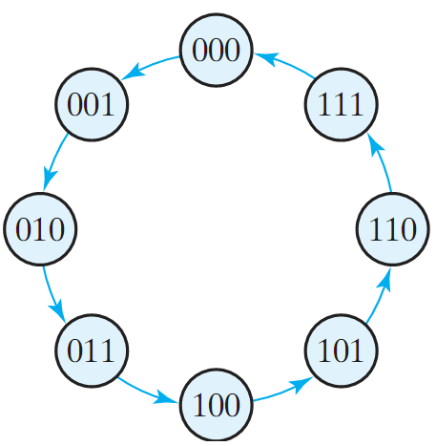
Example 3 (cont.)
Step1: State Diagram
The outputs = the states
Where is the input?
What is the type of this sequential circuit?

Slide 21
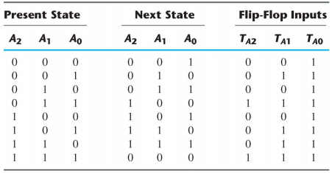
Example 3 (cont.)
Step2: State Table
No need for state assignment here

Slide 22
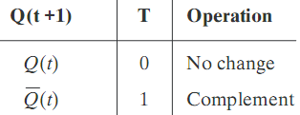
Example 3 (cont.)
Step2: State Table
We choose T-FF
T–FF excitation table
0

Slide 23
Example 3 (cont.)
Step3: State Equations

Slide 24
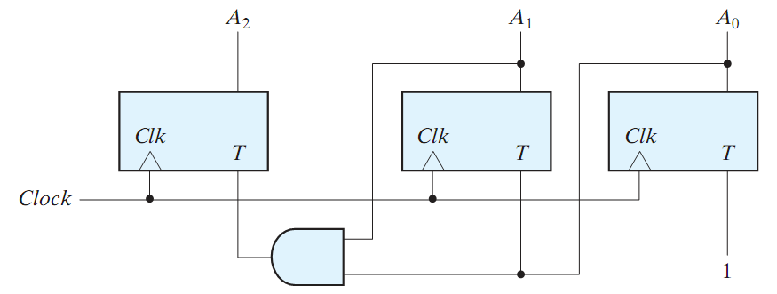
Example 3 (cont.)
Step4: Draw Circuit
T_{A0} = 1
T_{A1} = A₀
T_{A2} = A₁A₀

Slide 25
Example 4
Problem: Design a traffic light controller for a 2-way intersection. In each way, there is a sensor and a light
N
Traffic | Action
EW only | EW Signal green NS Signal red
NS only | NS Signal green EW Signal red
EW & NS | Alternate
No traffic | Previous state
W
E
S

Slide 26
Example 4 (cont.)
Step1: State Diagram
11, 10
00, 01
NS / 01
EW / 10
00, 10
11, 01
INPUTS
Sensors X₁, X₀
X₀: car coming on NS
X₁ : car coming on EW
OUTPUTS
Light S₁, S₀
S₀ : NS is green
S₁ : EW is green
STATES
NS: NS is green
EW: EW is green

Slide 27
Example 4 (cont.)
Exercise: Complete the design using:
D-FF
JK-FF
T-FF

Slide 28
Example 5
Problem: Design Up/Down counter with Enable
Design a sequential circuit with two JK flip-flops A and B and two inputs X and E. If E = 0, the circuit remains in the same state, regardless of the input X. When E = 1 and X = 1, the circuit goes through the state transitions from 00 to 01 to 10 to 11, back to 00, and then repeats. When E = 1 and X = 0, the circuit goes through the state transitions from 00 to 11 to 10 to 01, back to 00 and then repeats.

Slide 29
Example 5 (cont.)
Present State |  |  | Inputs |  |  | Next State |  |  | FF Inputs
A | B |  | E | X |  | A | B |  | J_{A} | K_{A} |  | J_{B} | K_{B}
0 | 0 |  | 0 | 0 |  | 0 | 0 |  | 0 | X |  | 0 | X
0 | 0 |  | 0 | 1 |  | 0 | 0 |  | 0 | X |  | 0 | X
0 | 0 |  | 1 | 0 |  | 1 | 1 |  | 1 | X |  | 1 | X
0 | 0 |  | 1 | 1 |  | 0 | 1 |  | 0 | X |  | 1 | X
0 | 1 |  | 0 | 0 |  | 0 | 1 |  | 0 | X |  | X | 0
0 | 1 |  | 0 | 1 |  | 0 | 1 |  | 0 | X |  | X | 0
0 | 1 |  | 1 | 0 |  | 0 | 0 |  | 0 | X |  | X | 1
0 | 1 |  | 1 | 1 |  | 1 | 0 |  | 1 | X |  | X | 1
1 | 0 |  | 0 | 0 |  | 1 | 0 |  | X | 0 |  | 0 | X
1 | 0 |  | 0 | 1 |  | 1 | 0 |  | X | 0 |  | 0 | X
1 | 0 |  | 1 | 0 |  | 0 | 1 |  | X | 1 |  | 1 | X
1 | 0 |  | 1 | 1 |  | 1 | 1 |  | X | 0 |  | 1 | X
1 | 1 |  | 0 | 0 |  | 1 | 1 |  | X | 0 |  | X | 0
1 | 1 |  | 0 | 1 |  | 1 | 1 |  | X | 0 |  | X | 0
1 | 1 |  | 1 | 0 |  | 1 | 0 |  | X | 0 |  | X | 1
1 | 1 |  | 1 | 1 |  | 0 | 0 |  | X | 1 |  | X | 1
00
01
10
00
01
00
01
11
10
11
11
10
11
11
10
00
01
00
01
10

Slide 30
Example 5 (cont.)
EX AB | 00 | 01 | 11 | 10
00 | 0 | 0 | 0 | 1
01 | 0 | 0 | 1 | 0
11 | x | x | x | x
10 | x | x | x | x
EX AB | 00 | 01 | 11 | 10
00 | x | x | x | x
01 | x | x | x | x
11 | 0 | 0 | 1 | 0
10 | 0 | 0 | 0 | 1
E
X
Y
J_{A}
A
C
J_{A} = BEX + B’EX’
K_{A} = BEX + B’EX’
K_{A}
A’
EX AB | 00 | 01 | 11 | 10
00 | 0 | 0 | 1 | 1
01 | x | x | x | x
11 | x | x | x | x
10 | 0 | 0 | 1 | 1
EX AB | 00 | 01 | 11 | 10
00 | x | x | x | x
01 | 0 | 0 | 1 | 1
11 | 0 | 0 | 1 | 1
10 | x | x | x | X
J_{B}
B
C
K_{B}
B’
clock
J_{B} = E
K_{B} = E

Slide 31
More Design Examples
More design examples can be found at
Homework 5
Textbook
Course CD
Google

Slide 32
Summary
To design a synchronous sequential circuit:
Obtain a state diagram
State reduction if necessary
Obtain State Table
State Assignment
Choose type of flip-flops
Use FF’s excitation table to complete the table
Derive state equations
Use K-Maps
Obtain the FF input equations and the output equations
Draw the circuit diagram

