Slide 1
COE 202: Digital Logic Design Sequential Circuits Part 2
Courtesy of Dr. Ahmad Almulhem

Slide 2
Objectives
Analysis of Synchronous Sequential Circuits
Procedure
Examples

Slide 3
Analysis of Sequential Circuits
Analysis is describing what a given circuit will do
The behavior of a clocked (synchronous) sequential circuit is determined from the inputs, the output, and the states of FF
Steps:
Obtain state equations
FF input equations
Output equations
Fill the state table
Put all combinations of inputs and current states
Fill the next state and output
Draw the state diagram

Slide 4
Analysis of Combinational vs Sequential Circuits
Combinational :
Boolean Equations
Truth Table
Output as a function of inputs
Sequential :
State Equations
State Table
State Diagram
Output as a function of input and current state
Next state as a function of inputs and current state.

Slide 5
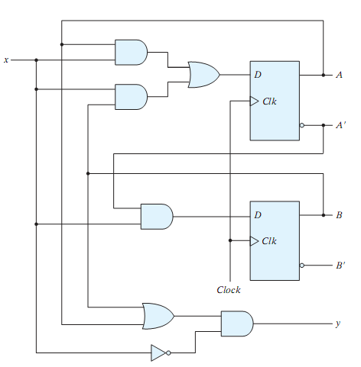
State Equations
A state equation is a Boolean expression which specifies the next state and output as a function of the present state and inputs.
Example:
The shown circuit has two D-FFs (A,B), an input x and output y.
The D input of a FF determines the next state
A(t+1) = A(t)x+B(t)x = Ax+Bx
B(t+1) = A’(t)x = A’x
Output:
y = (A+B)x’

Slide 6
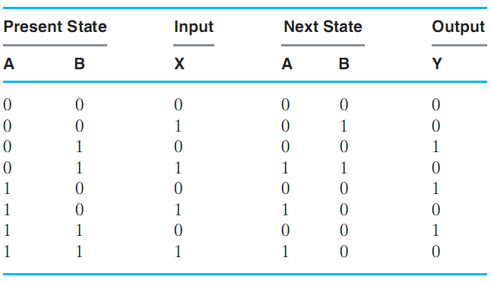
State Table
A state table is a table enumerating all present states, inputs, next states and outputs.
Present state, inputs: list all combinations
Next states, outputs: derived from state equations
4 sections

Slide 7
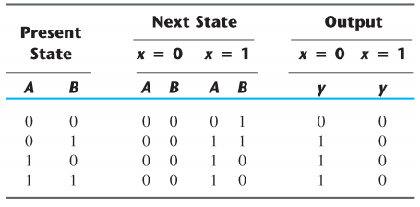
State Table
A state table is a table enumerating all present states, inputs, next states and outputs.
Present state, inputs: list all combinations
Next states, outputs: derived from state equations
2-D Form

Slide 8
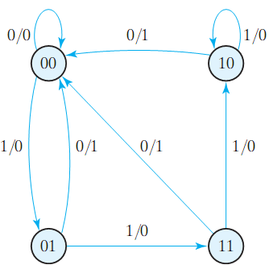
State Diagram
The state diagram is a graphical representation of a state table (provides same information)
Circles are states (FFs), Arrows are transitions between states
Labels of arrows represent inputs and outputs

Slide 9
Analysis of Sequential Circuits
Analysis is describing what a given circuit will do
The behavior of a clocked (synchronous) sequential circuit is determined from the inputs, the output, and the states of FF
Steps:
Obtain state equations
FF input equations
Output equations
Fill the state table
Put all combinations of inputs and current states
Fill the next state and output
Draw the state diagram

Slide 10
Example 1
Analyze this circuit?
Is this a sequential circuit? Why?
How many inputs?
How many outputs?
How many states?
What type of memory?

Slide 11
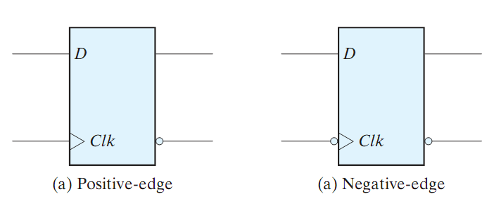
Example 1 (cont.)
D Flip Flop (review)
Characteristic Tables and Equations
Q(t) | D | Q(t+1)
0 | 0 | 0
0 | 1 | 1
1 | 0 | 0
1 | 1 | 1
D | Q(t+1)
0 | 0
1 | 1
Q(t+1) = D

Slide 12
Example 1 (cont.)

Slide 13
Example 1 (cont.)
State equations:
D_{A} = AX + BX
D_{B} = A’ X
Y = (A + B) X’

Slide 14
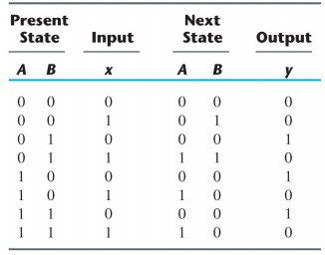
Example 1 (cont.)
State equations:
D_{A} = AX + BX
D_{B} = A’ X
Y = (A + B) X’
State table:

Slide 15
Example 1 (cont.)
State equations:
D_{A} = AX + BX
D_{B} = A’ X
Y = (A + B) X’
State table (2D):

Slide 16
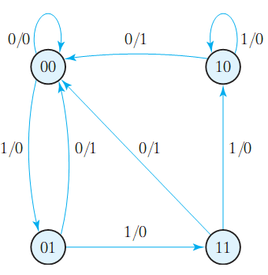
Example 1 (cont.)
State equations:
D_{A} = AX + BX
D_{B} = A’ X
Y = (A + B) X’
State table:
State diagram:

Slide 17
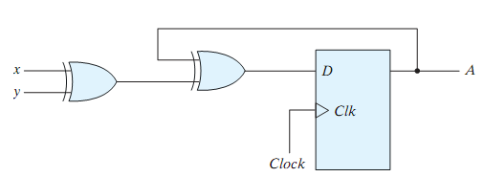
Example 2
Analyze this circuit.
What about the output?
This circuit is an example of a Moore machine (output depends only on current state)
Mealy machines is the other type (output depends on inputs and current states)

Slide 18
Example 2 (cont.)
Equation:
D_{A} = A ⊕ X ⊕ Y

Slide 19
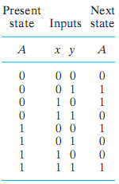
Example 2 (cont.)
Equation:
D_{A} = A ⊕ X ⊕ Y
0/0
1/1

Slide 20
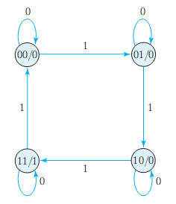
Mealy vs Moore Finite State Machine (FSM)
Mealy FSM:
Output depends on current state and input
Output is not synchronized with the clock
Moore FSM:
Output depends on current state only

Slide 21
Summary
To analyze a sequential circuit:
Obtain state equations
FF input equations
Output equations
Fill the state table
Put all combinations of inputs and current states
Fill the next state and output
For the next state use characteristic table/equation
Draw the state diagram
Two types of synchronous sequential circuits (Mealy and Moore)

