Slide 1
COE 202: Digital Logic Design Combinational Circuits Part 3
Courtesy of Dr. Ahmad Almulhem

Slide 2
Objectives
Decoders
Encoders
Multiplexers
DeMultiplexers

Slide 3
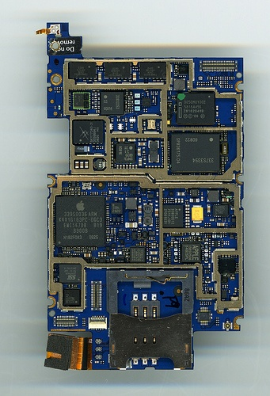
Functional Blocks
Digital systems consists of many components (blocks)
Useful blocks needed in many designs
Arithmetic blocks
Decoders
Encoders
Multiplexers
iPhone motherboard (torontophonerepair.com)

Slide 4
Functional Blocks
Digital systems consists of many components (blocks)
Useful blocks needed in many designs
Arithmetic blocks
Decoders
Encoders
Multiplexers
Examples
of
MSI devices
iPhone motherboard (torontophonerepair.com)

Slide 5
Decoder
n-to-2^{n}
Decoder
.
.
.
n inputs
.
2^{n} outputs
Information is represented by binary codes
Decoding - the conversion of an n-bit input code to an m-bit output code with n <= m <= 2^{n} such that each valid code word produces a unique output code
Circuits that perform decoding are called decoders
A decoder is a minterm generator

Slide 6
Decoder (Uses)
Decode a 3-bit op-codes:
Home automation:
3-to-8
Decoder
Add
Sub
And
Xor
Not
Load
Store
Jump
op0
op1
op2
2-to-4
Decoder
Light
A/C
Door
Light-A/C
C₀
C₁
Load a
Add b
Store c
.
.

Slide 7
Decoder with Enable
A decoder can have an additional input signal called the enable which enables or disables the output generated by the decoder
n-to-2^{n}
Decoder
.
.
.
n inputs
.
2^{n} outputs
Enable bit

Slide 8
2-to-4 Decoder
A 2-to-4 Decoder
2 inputs (A₁, A₀)
2² = 4 outputs (D₃, D₂, D₁, D₀)

Slide 9
2-to-4 Decoder
A 2-to-4 Decoder
2 inputs (A₁, A₀)
2² = 4 outputs (D₃, D₂, D₁, D₀)
Truth Table
A₁ | A₀ | D₀ | D₁ | D₂ | D₃
0 | 0 | 1 | 0 | 0 | 0
0 | 1 | 0 | 1 | 0 | 0
1 | 0 | 0 | 0 | 1 | 0
1 | 1 | 0 | 0 | 0 | 1

Slide 10
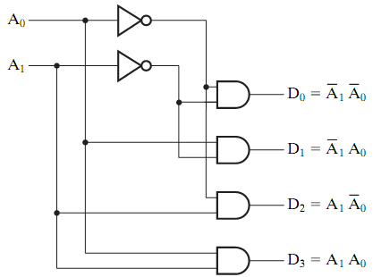
2-to-4 Decoder
A 2-to-4 Decoder
2 inputs (A₁, A₀)
2² = 4 outputs (D₃, D₂, D₁, D₀)
Truth Table
A₁ | A₀ | D₀ | D₁ | D₂ | D₃
0 | 0 | 1 | 0 | 0 | 0
0 | 1 | 0 | 1 | 0 | 0
1 | 0 | 0 | 0 | 1 | 0
1 | 1 | 0 | 0 | 0 | 1
Src: Mano’s book

Slide 11
2-to-4 Decoder with Enable
Truth Table
EN | A₁ | A₀ | D₀ | D₁ | D₂ | D₃
0 | X | X | 0 | 0 | 0 | 0
1 | 0 | 0 | 1 | 0 | 0 | 0
1 | 0 | 1 | 0 | 1 | 0 | 0
1 | 1 | 0 | 0 | 0 | 1 | 0
1 | 1 | 1 | 0 | 0 | 0 | 1

Slide 12
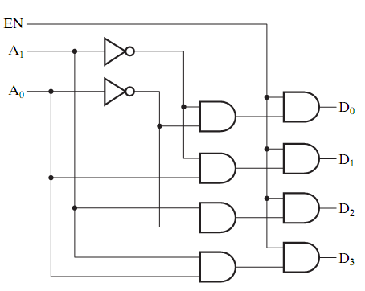
2-to-4 Decoder with Enable
Truth Table
EN | A₁ | A₀ | D₀ | D₁ | D₂ | D₃
0 | X | X | 0 | 0 | 0 | 0
1 | 0 | 0 | 1 | 0 | 0 | 0
1 | 0 | 1 | 0 | 1 | 0 | 0
1 | 1 | 0 | 0 | 0 | 1 | 0
1 | 1 | 1 | 0 | 0 | 0 | 1
Src: Mano’s book

Slide 13
3-to-8 Decoder
3-to-8
Decoder
D₀
D₁
D₂
D₃
D₄
D₅
D₆
D₇
A₀
A₁
A₂

Slide 14
3-to-8 Decoder
A₂ | A₁ | A₀ | D₀ | D₁ | D₂ | D₃ | D₄ | D₅ | D₆ | D₇
0 | 0 | 0 | 1 | 0 | 0 | 0 | 0 | 0 | 0 | 0
0 | 0 | 1 | 0 | 1 | 0 | 0 | 0 | 0 | 0 | 0
0 | 1 | 0 | 0 | 0 | 1 | 0 | 0 | 0 | 0 | 0
0 | 1 | 1 | 0 | 0 | 0 | 1 | 0 | 0 | 0 | 0
1 | 0 | 0 | 0 | 0 | 0 | 0 | 1 | 0 | 0 | 0
1 | 0 | 1 | 0 | 0 | 0 | 0 | 0 | 1 | 0 | 0
1 | 1 | 0 | 0 | 0 | 0 | 0 | 0 | 0 | 1 | 0
1 | 1 | 1 | 0 | 0 | 0 | 0 | 0 | 0 | 0 | 1
3-to-8
Decoder
D₀
D₁
D₂
D₃
D₄
D₅
D₆
D₇
A₀
A₁
A₂

Slide 15
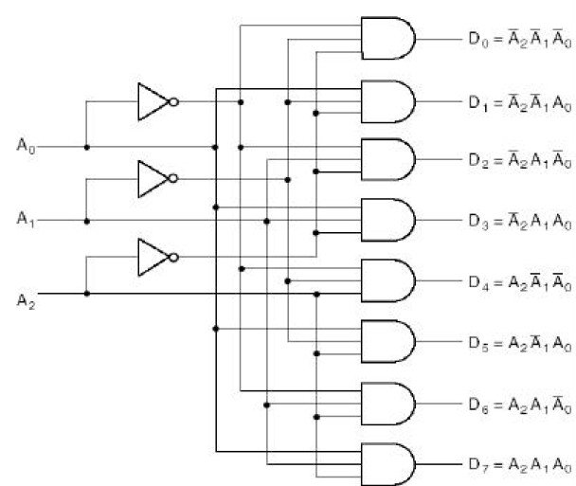
3-to-8 Decoder
3-to-8
Decoder
D₀
D₁
D₂
D₃
D₄
D₅
D₆
D₇
A₀
A₁
A₂

Slide 16
3-to-8 Decoder (using 2 2-to-4 decoders)
2-to-4
Decoder
D₀
D₁
D₂
D₃
3-to-8
Decoder
A₀
A₁
D₀
D₁
D₂
D₃
D₄
D₅
D₆
D₇
A₀
A₁
A₂
E
A₂
2-to-4
Decoder
D₄
D₅
D₆
D₇
A₀
A₁
E

Slide 17
Decoder-Based Combinational Circuits
A Decoder generates all the minterms
A boolean function can be expressed as a sum of minterms
Any boolean function can be implemented using a decoder and an OR gate.
Note: The Boolean function must be represented as minterms (not minimized form)

Slide 18
Decoder-Based Combinational Circuits (Example)
S = ∑m (1,2,4,7)
C = ∑m (3,5,6,7)
3 inputs and 8 possible minterms 3-to-8 decoder can be used for implementing this circuit
X | Y | Z | C | S
0 | 0 | 0 | 0 | 0
0 | 0 | 1 | 0 | 1
0 | 1 | 0 | 0 | 1
0 | 1 | 1 | 1 | 0
1 | 0 | 0 | 0 | 1
1 | 0 | 1 | 1 | 0
1 | 1 | 0 | 1 | 0
1 | 1 | 1 | 1 | 1

Slide 19
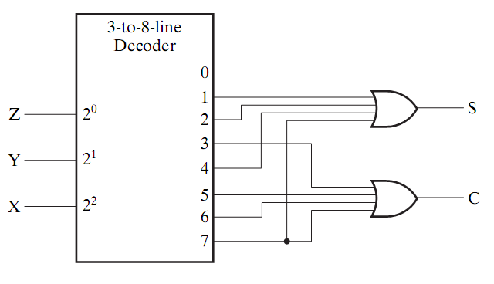
Decoder-Based Combinational Circuits (Example)
S = ∑m (1,2,4,7)
C = ∑m (3,5,6,7)
3 inputs and 8 possible minterms 3-to-8 decoder can be used for implementing this circuit
X | Y | Z | C | S
0 | 0 | 0 | 0 | 0
0 | 0 | 1 | 0 | 1
0 | 1 | 0 | 0 | 1
0 | 1 | 1 | 1 | 0
1 | 0 | 0 | 0 | 1
1 | 0 | 1 | 1 | 0
1 | 1 | 0 | 1 | 0
1 | 1 | 1 | 1 | 1
Src: Mano’s book

Slide 20
Decoder-Based Combinational Circuits (Summary)
Good if:
Many output functions with same inputs
Each output has few minterms
Hint:
Check if the function complement has fewer minterms and use NOR instead of OR.

Slide 21
Encoder
.
.
.
2^{n}-to-n
Encoder
2^{n} inputs
n outputs
.
Encoding - the opposite of decoding - the conversion of an m-bit input code to a n-bit output code with n ≤ m ≤ 2^{n} such that each valid code word produces a unique output code
Circuits that perform encoding are called encoders
An encoder has 2^{n} (or fewer) input lines and n output lines which generate the binary code corresponding to the input values
Typically, an encoder converts a code containing exactly one bit that is 1 to a binary code corresponding to the position in which the 1 appears.

Slide 22
8-to-3 Encoder
Description:
2³ = 8 inputs, 3 outputs
one input =1, others = 0’s
Each input generate unique binary code
8-to-3
Encoder
D₀
D₁
D₂
D₃
D₄
D₅
D₆
D₇
A₀
A₁
A₂

Slide 23
8-to-3 Encoder (truth table)
inputs |  |  |  |  |  |  |  | outputs
D₇ | D₆ | D₅ | D₄ | D₃ | D₂ | D₁ | D₀ | A₂ | A₁ | A₀
0 | 0 | 0 | 0 | 0 | 0 | 0 | 1 | 0 | 0 | 0
0 | 0 | 0 | 0 | 0 | 0 | 1 | 0 | 0 | 0 | 1
0 | 0 | 0 | 0 | 0 | 1 | 0 | 0 | 0 | 1 | 0
0 | 0 | 0 | 0 | 1 | 0 | 0 | 0 | 0 | 1 | 1
0 | 0 | 0 | 1 | 0 | 0 | 0 | 0 | 1 | 0 | 0
0 | 0 | 1 | 0 | 0 | 0 | 0 | 0 | 1 | 0 | 1
0 | 1 | 0 | 0 | 0 | 0 | 0 | 0 | 1 | 1 | 0
1 | 0 | 0 | 0 | 0 | 0 | 0 | 0 | 1 | 1 | 1
8-to-3
Encoder
D₀
D₁
D₂
D₃
D₄
D₅
D₆
D₇
A₀
A₁
A₂

Slide 24
8-to-3 Encoder (truth table)
inputs |  |  |  |  |  |  |  | outputs
D₇ | D₆ | D₅ | D₄ | D₃ | D₂ | D₁ | D₀ | A₂ | A₁ | A₀
0 | 0 | 0 | 0 | 0 | 0 | 0 | 1 | 0 | 0 | 0
0 | 0 | 0 | 0 | 0 | 0 | 1 | 0 | 0 | 0 | 1
0 | 0 | 0 | 0 | 0 | 1 | 0 | 0 | 0 | 1 | 0
0 | 0 | 0 | 0 | 1 | 0 | 0 | 0 | 0 | 1 | 1
0 | 0 | 0 | 1 | 0 | 0 | 0 | 0 | 1 | 0 | 0
0 | 0 | 1 | 0 | 0 | 0 | 0 | 0 | 1 | 0 | 1
0 | 1 | 0 | 0 | 0 | 0 | 0 | 0 | 1 | 1 | 0
1 | 0 | 0 | 0 | 0 | 0 | 0 | 0 | 1 | 1 | 1
8-to-3
Encoder
1
0
0
0
0
0
0
0
D₀
D₁
D₂
D₃
D₄
D₅
D₆
D₇
A₀
A₁
A₂
0
0
0

Slide 25
8-to-3 Encoder (truth table)
inputs |  |  |  |  |  |  |  | outputs
D₇ | D₆ | D₅ | D₄ | D₃ | D₂ | D₁ | D₀ | A₂ | A₁ | A₀
0 | 0 | 0 | 0 | 0 | 0 | 0 | 1 | 0 | 0 | 0
0 | 0 | 0 | 0 | 0 | 0 | 1 | 0 | 0 | 0 | 1
0 | 0 | 0 | 0 | 0 | 1 | 0 | 0 | 0 | 1 | 0
0 | 0 | 0 | 0 | 1 | 0 | 0 | 0 | 0 | 1 | 1
0 | 0 | 0 | 1 | 0 | 0 | 0 | 0 | 1 | 0 | 0
0 | 0 | 1 | 0 | 0 | 0 | 0 | 0 | 1 | 0 | 1
0 | 1 | 0 | 0 | 0 | 0 | 0 | 0 | 1 | 1 | 0
1 | 0 | 0 | 0 | 0 | 0 | 0 | 0 | 1 | 1 | 1
8-to-3
Encoder
0
1
0
0
0
0
0
0
D₀
D₁
D₂
D₃
D₄
D₅
D₆
D₇
A₀
A₁
A₂
1
0
0

Slide 26
8-to-3 Encoder (truth table)
inputs |  |  |  |  |  |  |  | outputs
D₇ | D₆ | D₅ | D₄ | D₃ | D₂ | D₁ | D₀ | A₂ | A₁ | A₀
0 | 0 | 0 | 0 | 0 | 0 | 0 | 1 | 0 | 0 | 0
0 | 0 | 0 | 0 | 0 | 0 | 1 | 0 | 0 | 0 | 1
0 | 0 | 0 | 0 | 0 | 1 | 0 | 0 | 0 | 1 | 0
0 | 0 | 0 | 0 | 1 | 0 | 0 | 0 | 0 | 1 | 1
0 | 0 | 0 | 1 | 0 | 0 | 0 | 0 | 1 | 0 | 0
0 | 0 | 1 | 0 | 0 | 0 | 0 | 0 | 1 | 0 | 1
0 | 1 | 0 | 0 | 0 | 0 | 0 | 0 | 1 | 1 | 0
1 | 0 | 0 | 0 | 0 | 0 | 0 | 0 | 1 | 1 | 1
8-to-3
Encoder
0
0
0
0
0
1
0
0
D₀
D₁
D₂
D₃
D₄
D₅
D₆
D₇
A₀
A₁
A₂
1
0
1

Slide 27
8-to-3 Encoder (truth table)
inputs |  |  |  |  |  |  |  | outputs
D₇ | D₆ | D₅ | D₄ | D₃ | D₂ | D₁ | D₀ | A₂ | A₁ | A₀
0 | 0 | 0 | 0 | 0 | 0 | 0 | 1 | 0 | 0 | 0
0 | 0 | 0 | 0 | 0 | 0 | 1 | 0 | 0 | 0 | 1
0 | 0 | 0 | 0 | 0 | 1 | 0 | 0 | 0 | 1 | 0
0 | 0 | 0 | 0 | 1 | 0 | 0 | 0 | 0 | 1 | 1
0 | 0 | 0 | 1 | 0 | 0 | 0 | 0 | 1 | 0 | 0
0 | 0 | 1 | 0 | 0 | 0 | 0 | 0 | 1 | 0 | 1
0 | 1 | 0 | 0 | 0 | 0 | 0 | 0 | 1 | 1 | 0
1 | 0 | 0 | 0 | 0 | 0 | 0 | 0 | 1 | 1 | 1
8-to-3
Encoder
0
0
0
0
0
0
0
1
D₀
D₁
D₂
D₃
D₄
D₅
D₆
D₇
A₀
A₁
A₂
1
1
1

Slide 28
8-to-3 Encoder (equations)
inputs |  |  |  |  |  |  |  | outputs
D₇ | D₆ | D₅ | D₄ | D₃ | D₂ | D₁ | D₀ | A₂ | A₁ | A₀
0 | 0 | 0 | 0 | 0 | 0 | 0 | 1 | 0 | 0 | 0
0 | 0 | 0 | 0 | 0 | 0 | 1 | 0 | 0 | 0 | 1
0 | 0 | 0 | 0 | 0 | 1 | 0 | 0 | 0 | 1 | 0
0 | 0 | 0 | 0 | 1 | 0 | 0 | 0 | 0 | 1 | 1
0 | 0 | 0 | 1 | 0 | 0 | 0 | 0 | 1 | 0 | 0
0 | 0 | 1 | 0 | 0 | 0 | 0 | 0 | 1 | 0 | 1
0 | 1 | 0 | 0 | 0 | 0 | 0 | 0 | 1 | 1 | 0
1 | 0 | 0 | 0 | 0 | 0 | 0 | 0 | 1 | 1 | 1
8-to-3
Encoder
D₀
D₁
D₂
D₃
D₄
D₅
D₆
D₇
A₀
A₁
A₂
Output equations:
A₀ = ?
A₁ = ?
A₂ = ?
Note: This truth table is not complete! Why?

Slide 29
8-to-3 Encoder (equations)
inputs |  |  |  |  |  |  |  | outputs
D₇ | D₆ | D₅ | D₄ | D₃ | D₂ | D₁ | D₀ | A₂ | A₁ | A₀
0 | 0 | 0 | 0 | 0 | 0 | 0 | 1 | 0 | 0 | 0
0 | 0 | 0 | 0 | 0 | 0 | 1 | 0 | 0 | 0 | 1
0 | 0 | 0 | 0 | 0 | 1 | 0 | 0 | 0 | 1 | 0
0 | 0 | 0 | 0 | 1 | 0 | 0 | 0 | 0 | 1 | 1
0 | 0 | 0 | 1 | 0 | 0 | 0 | 0 | 1 | 0 | 0
0 | 0 | 1 | 0 | 0 | 0 | 0 | 0 | 1 | 0 | 1
0 | 1 | 0 | 0 | 0 | 0 | 0 | 0 | 1 | 1 | 0
1 | 0 | 0 | 0 | 0 | 0 | 0 | 0 | 1 | 1 | 1
8-to-3
Encoder
D₀
D₁
D₂
D₃
D₄
D₅
D₆
D₇
A₀
A₁
A₂
Output equations:
A₀ = D₁ + D₃ + D₅ + D₇
A₁ = ?
A₂ = ?

Slide 30
8-to-3 Encoder (equations)
inputs |  |  |  |  |  |  |  | outputs
D₇ | D₆ | D₅ | D₄ | D₃ | D₂ | D₁ | D₀ | A₂ | A₁ | A₀
0 | 0 | 0 | 0 | 0 | 0 | 0 | 1 | 0 | 0 | 0
0 | 0 | 0 | 0 | 0 | 0 | 1 | 0 | 0 | 0 | 1
0 | 0 | 0 | 0 | 0 | 1 | 0 | 0 | 0 | 1 | 0
0 | 0 | 0 | 0 | 1 | 0 | 0 | 0 | 0 | 1 | 1
0 | 0 | 0 | 1 | 0 | 0 | 0 | 0 | 1 | 0 | 0
0 | 0 | 1 | 0 | 0 | 0 | 0 | 0 | 1 | 0 | 1
0 | 1 | 0 | 0 | 0 | 0 | 0 | 0 | 1 | 1 | 0
1 | 0 | 0 | 0 | 0 | 0 | 0 | 0 | 1 | 1 | 1
8-to-3
Encoder
D₀
D₁
D₂
D₃
D₄
D₅
D₆
D₇
A₀
A₁
A₂
Output equations:
A₀ = D₁ + D₃ + D₅ + D₇
A₁ = D₂ + D₃ + D₆ + D₇
A₂ = ?

Slide 31
8-to-3 Encoder (equations)
inputs |  |  |  |  |  |  |  | outputs
D₇ | D₆ | D₅ | D₄ | D₃ | D₂ | D₁ | D₀ | A₂ | A₁ | A₀
0 | 0 | 0 | 0 | 0 | 0 | 0 | 1 | 0 | 0 | 0
0 | 0 | 0 | 0 | 0 | 0 | 1 | 0 | 0 | 0 | 1
0 | 0 | 0 | 0 | 0 | 1 | 0 | 0 | 0 | 1 | 0
0 | 0 | 0 | 0 | 1 | 0 | 0 | 0 | 0 | 1 | 1
0 | 0 | 0 | 1 | 0 | 0 | 0 | 0 | 1 | 0 | 0
0 | 0 | 1 | 0 | 0 | 0 | 0 | 0 | 1 | 0 | 1
0 | 1 | 0 | 0 | 0 | 0 | 0 | 0 | 1 | 1 | 0
1 | 0 | 0 | 0 | 0 | 0 | 0 | 0 | 1 | 1 | 1
8-to-3
Encoder
D₀
D₁
D₂
D₃
D₄
D₅
D₆
D₇
A₀
A₁
A₂
Output equations:
A₀ = D₁ + D₃ + D₅ + D₇
A₁ = D₂ + D₃ + D₆ + D₇
A₂ = D₄ + D₅ + D₆ + D₇

Slide 32
8-to-3 Encoder (circuit)
8-to-3
Encoder
D₁
D₃
D₅
D₇
D₀
D₁
D₂
D₃
D₄
D₅
D₆
D₇
A₀
A₁
A₂
A₀
A₁
A₂
D₂
D₃
D₆
D₇
D₄
D₅
D₆
D₇
Output equations:
A₀ = D₁ + D₃ + D₅ + D₇
A₁ = D₂ + D₃ + D₆ + D₇
A₂ = D₄ + D₅ + D₆ + D₇

Slide 33
8-to-3 Encoder (limitations)
inputs |  |  |  |  |  |  |  | outputs
D₇ | D₆ | D₅ | D₄ | D₃ | D₂ | D₁ | D₀ | A₂ | A₁ | A₀
0 | 0 | 0 | 0 | 0 | 0 | 0 | 1 | 0 | 0 | 0
0 | 0 | 0 | 0 | 0 | 0 | 1 | 0 | 0 | 0 | 1
0 | 0 | 0 | 0 | 0 | 1 | 0 | 0 | 0 | 1 | 0
0 | 0 | 0 | 0 | 1 | 0 | 0 | 0 | 0 | 1 | 1
0 | 0 | 0 | 1 | 0 | 0 | 0 | 0 | 1 | 0 | 0
0 | 0 | 1 | 0 | 0 | 0 | 0 | 0 | 1 | 0 | 1
0 | 1 | 0 | 0 | 0 | 0 | 0 | 0 | 1 | 1 | 0
1 | 0 | 0 | 0 | 0 | 0 | 0 | 0 | 1 | 1 | 1
Two Limitations:
1. Two or more inputs = 1
Example: D₃ = D₆ = 1
A₂A₁A₀ = 111
All inputs = 0
Same as D₀ =1
Output equations:
A₀ = D₁ + D₃ + D₅ + D₇
A₁ = D₂ + D₃ + D₆ + D₇
A₂ = D₄ + D₅ + D₆ + D₇

Slide 34
Priority Encoder
Address the previous two limitations
Two or more inputs = 1
Consider the bit with highest priority
All inputs = 0
Add another output v to indicate this combination

Slide 35
4-to-2 Priority Encoder
Description:
2² = 4 inputs, 2 + 1 outputs
Two or more 1’s take highest
priority

Slide 36
4-to-2 Priority Encoder
Description:
2² = 4 inputs, 2 + 1 outputs
Two or more 1’s take highest
priority
inputs |  |  |  | outputs
D₃ | D₂ | D₁ | D₀ | A₁ | A₀ | V
0 | 0 | 0 | 0 | X | X | 0
0 | 0 | 0 | 1 | 0 | 0 | 1
0 | 0 | 1 | X | 0 | 1 | 1
0 | 1 | X | X | 1 | 0 | 1
1 | X | X | X | 1 | 1 | 1
This is a condensed truth table!
It has only 5 rows instead of 16!
Row 3 = 2 combinations
Row 4 = 4 combinations
Row 5 = 8 combinations

Slide 37
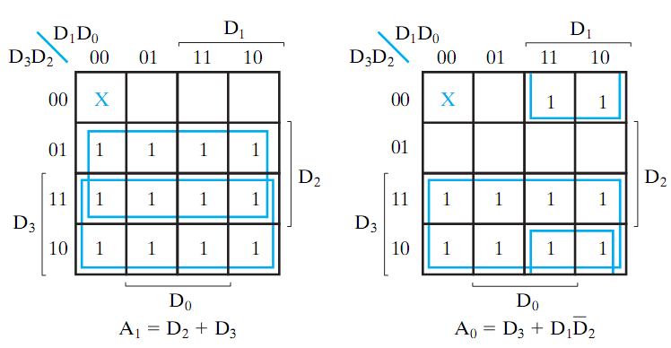
4-to-2 Priority Encoder
Description:
2² = 4 inputs, 2 + 1 outputs
Two or more 1’s take highest
priority
inputs |  |  |  | outputs
D₃ | D₂ | D₁ | D₀ | A₁ | A₀ | V
0 | 0 | 0 | 0 | X | X | 0
0 | 0 | 0 | 1 | 0 | 0 | 1
0 | 0 | 1 | X | 0 | 1 | 1
0 | 1 | X | X | 1 | 0 | 1
1 | X | X | X | 1 | 1 | 1

Slide 38
4-to-2 Priority Encoder
Description:
2² = 4 inputs, 2 + 1 outputs
Two or more 1’s take highest
priority
inputs |  |  |  | outputs
D₃ | D₂ | D₁ | D₀ | A₁ | A₀ | V
0 | 0 | 0 | 0 | X | X | 0
0 | 0 | 0 | 1 | 0 | 0 | 1
0 | 0 | 1 | X | 0 | 1 | 1
0 | 1 | X | X | 1 | 0 | 1
1 | X | X | X | 1 | 1 | 1
Equations:
A₀ = D₃ + D₁ D₂’
A₁ = D₂ + D₃
V = D₀ + D₁ + D₂ + D₃

Slide 39
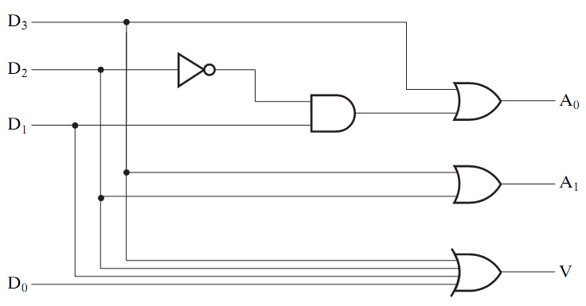
4-to-2 Priority Encoder
Description:
2² = 4 inputs, 2 + 1 outputs
Two or more 1’s take highest
priority
inputs |  |  |  | outputs
D₃ | D₂ | D₁ | D₀ | A₁ | A₀ | V
0 | 0 | 0 | 0 | X | X | 0
0 | 0 | 0 | 1 | 0 | 0 | 1
0 | 0 | 1 | X | 0 | 1 | 1
0 | 1 | X | X | 1 | 0 | 1
1 | X | X | X | 1 | 1 | 1
Equations:
A₀ = D₃ + D₁ D₂’
A₁ = D₂ + D₃
V = D₀ + D₁ + D₂ + D₃

Slide 40
Multiplexers
A combinational circuit
Has a single output
Directs one of 2^{n} input to the output
Choosing which input is done using n select lines
2^{n} inputs
2^{n} x 1
MUX
one output
n select lines

Slide 41
2x1 MUX
A 2x1 multiplexer (MUX) has 2 inputs, 1 output and 1 select line
Y=D₀ for S₀=0, and Y=D₁ for S₀=1
Minimizing will result in: Y = S₀’.D₀ + S₀.D₁
Exercise: Draw the circuit?
D₀
D₁
2x1 MUX
Y
S₀

Slide 42
2x1 MUX
A 2x1 multiplexer (MUX) has 2 inputs, 1 output and 1 select line
Y=D₀ for S₀=0, and Y=D₁ for S₀=1
Minimizing will result in: Y = S₀’.D₀ + S₀.D₁
Exercise: Draw the circuit?
D₀
D₁
2x1 MUX
Y
S₀

Slide 43
4x1 MUX
A 4x1 MUX has 4 input lines (D₀, D₁, D₂, D₃) , 1 output Y, and 2 Select Lines (S₀, S₁)
The output for different select values is defined as:
S₀S₁ = 00, Y = D₀
S₀S₁ = 01, Y = D₁
S₀S₁ = 10, Y = D₂
S₀S₁ = 11, Y = D₃
Y = S₁S₀D₀ + S₁S₀D₁ + S₁S₀D₂ + S₁S₀D₃
The output Y depends on the minterms of the Select lines
Exercise: Draw the circuit?
D₀
D₁
D₂
D₃
4x1 MUX
Y
S₁ S₀

Slide 44
4x1 MUX
A 4x1 MUX has 4 input lines (D₀, D₁, D₂, D₃) , 1 output Y, and 2 Select Lines (S₀, S₁)
The output for different select values is defined as:
S₀S₁ = 00, Y = D₀
S₀S₁ = 01, Y = D₁
S₀S₁ = 10, Y = D₂
S₀S₁ = 11, Y = D₃
Y = S₁S₀D₀ + S₁S₀D₁ + S₁S₀D₂ + S₁S₀D₃
The output Y depends on the minterms of the Select lines
Exercise: Draw the circuit?
D₀
D₁
D₂
D₃
4x1 MUX
Y
S₁ S₀

Slide 45
Quad 2x1 MUX
A MUX for two 4-bit numbers.
Has a 4-bit output and a single select line
Y = A If S₀ = 0
Y = B if S₀ = 1
A₀
A₁
A₂
A₃
Y₀
Y₁
Y₂
Y₃
QUAD
2X1
MUX
B₀
B₁
B₂
B₃
S₀

Slide 46
Quad 2x1 MUX
Can be built using four 2x1 MUXes
A₀
B₀
A₁
B₁
2x1 MUX
Y₀
2x1 MUX
Y₁
S₀
S₀
A₂
B₂
A₃
B₃
2x1 MUX
Y₂
2x1 MUX
Y₃
S₀
S₀

Slide 47
MUX-based Design
A MUX can be used to implement any function expressed using its minterms
Example: Implement F(A,B,C)=∑(1,2,6,7) using MUXes
Solution1:
We can use a MUX with the number of select lines equal to the number of input variables of the function. Since this function has 3 input variables, it will require 3 select lines, i.e. an 8x1 MUX

Slide 48
MUX-based Design (n-Select lines)
F(A,B,C)=∑(1,2,6,7)
A | B | C | F
0 | 0 | 0 | 0
0 | 0 | 1 | 1
0 | 1 | 0 | 1
0 | 1 | 1 | 0
1 | 0 | 0 | 0
1 | 0 | 1 | 0
1 | 1 | 0 | 1
1 | 1 | 1 | 1

Slide 49
MUX-based Design (n-Select lines)
F(A,B,C)=∑(1,2,6,7)
A | B | C | F
0 | 0 | 0 | 0
0 | 0 | 1 | 1
0 | 1 | 0 | 1
0 | 1 | 1 | 0
1 | 0 | 0 | 0
1 | 0 | 1 | 0
1 | 1 | 0 | 1
1 | 1 | 1 | 1
D₀
D₁
D₂
D₃
D₄
D₅
D₆
D₇
S₀
S₁
S₂

Slide 50
MUX-based Design (n-Select lines)
F(A,B,C)=∑(1,2,6,7)
A | B | C | F
0 | 0 | 0 | 0
0 | 0 | 1 | 1
0 | 1 | 0 | 1
0 | 1 | 1 | 0
1 | 0 | 0 | 0
1 | 0 | 1 | 0
1 | 1 | 0 | 1
1 | 1 | 1 | 1
0
1
1
0
0
0
1
1
D₀
D₁
D₂
D₃
D₄
D₅
D₆
D₇
F
S₀
S₁
S₂
A B C

Slide 51
MUX-based Design (n-1 Select lines)
Implement the function F(A,B,C) =∑(1,2,6,7)
We will use 2 select lines instead of the 3 required for the three input variables
A → S₁, B → S₀
The third variable C and its complement will serve as two of the inputs to the MUX

Slide 52
MUX-based Design (n-1 Select lines)
A | B | C | F
0 | 0 | 0 | 0 | F = C
0 | 0 | 1 | 1
0 | 1 | 0 | 1 | F = C’
0 | 1 | 1 | 0
1 | 0 | 0 | 0 | F = 0
1 | 0 | 1 | 0
1 | 1 | 0 | 1 | F = 1
1 | 1 | 1 | 1
F(A,B,C)=∑(1,2,6,7)
C
C’
0
1
D₀
D₁
D₂
D₃
F
S₁
S₀
A B

Slide 53
Example 2
Implement the function F(A,B,C,D)=∑(1,3,4,11,12,13,14,15)
We can implement this function with 3 Select lines => an 8x1 MUX is required

Slide 54
Example 2 (cont.)
F(A,B,C,D)=∑(1,3,4,11,12,13,14,15)
A | B | C | D | F
0 | 0 | 0 | 0 | 0 | F = D
0 | 0 | 0 | 1 | 1
0 | 0 | 1 | 0 | 0 | F = D
0 | 0 | 1 | 1 | 1
0 | 1 | 0 | 0 | 1 | F = D’
0 | 1 | 0 | 1 | 0
0 | 1 | 1 | 0 | 0 | F = 0
0 | 1 | 1 | 1 | 0
1 | 0 | 0 | 0 | 0 | F = 0
1 | 0 | 0 | 1 | 0
1 | 0 | 1 | 0 | 0 | F = D
1 | 0 | 1 | 1 | 1
1 | 1 | 0 | 0 | 1 | F = 1
1 | 1 | 0 | 1 | 1
1 | 1 | 1 | 0 | 1 | F = 1
1 | 1 | 1 | 1 | 1
D
D₀
D₁
D₂
D₃
8x1
MUX
F
0
D₄
D₅
D₆
D₇
1
S₂
S₁
S₀
A B C

Slide 55
DeMultiplexer
Performs the inverse operation of a MUX
It has one input and 2^{n} outputs
The input is passed to one of the outputs based on the n select line
one input
1 x 2^{n} DeMUX
2^{n} outputs
n select lines

Slide 56
1x2 DeMUX
E
1 x 2 DeMUX
D₀ D₁
S
The circuit has an input E, the outputs are given by:
D₀ = E, if S=0 D₀ = S E
D₁ = E, if S=1 D₁ = S E

Slide 57
1x4 DeMUX
D₀ D₁ D₂ D₃
1 x 4 DeMUX
E
S₁ S₀
The circuit has an input E, the outputs are given by:
D₀ = E, if S₀S₁=00 D₀ = S₁’S₀’ E
D₁ = E, if S₀S₁=01 D₁ = S₁’S₀ E
D₂ = E, if S₀S₁=10 D₂ = S₁S₀’ E
D₃ = E, if S₀S₁=11 D₃ = S₁S₀ E

Slide 58
DeMUX vs Decoder
D₀ D₁ D₂ D₃
1 x 4 DeMUX
E
S₁ S₀
A 1x4 DeMUX is equivalent to a 2x4 Decoder with an Enable
Think of S₁S₀ a the decoder’s input
Think of E as the decoder’s enable
In general, a DeMux is equivalent to a Decoder with an Enable

Slide 59
DeMUX vs Decoder
2x4 Decoder Truth Table
EN | A₁ | A₀ | D₀ | D₁ | D₂ | D₃
0 | X | X | 0 | 0 | 0 | 0
1 | 0 | 0 | 1 | 0 | 0 | 0
1 | 0 | 1 | 0 | 1 | 0 | 0
1 | 1 | 0 | 0 | 0 | 1 | 0
1 | 1 | 1 | 0 | 0 | 0 | 1
Src: Mano’s book

Slide 60
DeMUX vs Decoder
2x4 Decoder Truth Table
EN | A₁ | A₀ | D₀ | D₁ | D₂ | D₃
0 | X | X | 0 | 0 | 0 | 0
1 | 0 | 0 | 1 | 0 | 0 | 0
1 | 0 | 1 | 0 | 1 | 0 | 0
1 | 1 | 0 | 0 | 0 | 1 | 0
1 | 1 | 1 | 0 | 0 | 0 | 1
Data/
S₁/
S₀/
To convert a 2x4 Decoder with an Enable to a 1x4 DeMux:
Assign DeMux’s input (actual data) to EN
Assign DeMux’s selection lines (S₁,S₀) to the inputs A₁, A₀
Src: Mano’s book

Slide 61
Summary
Useful Functional Blocks
Decoders
Encoders
Multiplexers
DeMultiplexers
All are examples of MSI devices
Can be used to build bigger systems

