Slide 1
COE 202: Digital Logic Design Combinational Circuits Part 2
Courtesy of Dr. Ahmad Almulhem

Slide 2
Objectives
Arithmetic Circuits
Adder
Subtractor
Carry Look Ahead Adder
BCD Adder
Multiplier

Slide 3
Adder
Design an Adder for 1-bit numbers?

Slide 4
Adder
Design an Adder for 1-bit numbers?
1. Specification: 2 inputs (X,Y) 2 outputs (C,S)

Slide 5
Adder
Design an Adder for 1-bit numbers?
1. Specification: 2 inputs (X,Y) 2 outputs (C,S)
2. Formulation:
X | Y | C | S
0 | 0 | 0 | 0
0 | 1 | 0 | 1
1 | 0 | 0 | 1
1 | 1 | 1 | 0

Slide 6
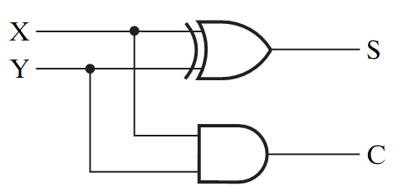
Adder
Design an Adder for 1-bit numbers?
1. Specification: 3. Optimization/Circuit 2 inputs (X,Y) 2 outputs (C,S)
2. Formulation:
X | Y | C | S
0 | 0 | 0 | 0
0 | 1 | 0 | 1
1 | 0 | 0 | 1
1 | 1 | 1 | 0

Slide 7
Half Adder
This adder is called a Half Adder
Q: Why?
X | Y | C | S
0 | 0 | 0 | 0
0 | 1 | 0 | 1
1 | 0 | 0 | 1
1 | 1 | 1 | 0

Slide 8
Full Adder
A combinational circuit that adds 3 input bits to generate a Sum bit and a Carry bit

Slide 9
Full Adder
A combinational circuit that adds 3 input bits to generate a Sum bit and a Carry bit
X | Y | Z | C | S
0 | 0 | 0 | 0 | 0
0 | 0 | 1 | 0 | 1
0 | 1 | 0 | 0 | 1
0 | 1 | 1 | 1 | 0
1 | 0 | 0 | 0 | 1
1 | 0 | 1 | 1 | 0
1 | 1 | 0 | 1 | 0
1 | 1 | 1 | 1 | 1

Slide 10
Full Adder
A combinational circuit that adds 3 input bits to generate a Sum bit and a Carry bit
Sum
YZ
X | Y | Z | C | S
0 | 0 | 0 | 0 | 0
0 | 0 | 1 | 0 | 1
0 | 1 | 0 | 0 | 1
0 | 1 | 1 | 1 | 0
1 | 0 | 0 | 0 | 1
1 | 0 | 1 | 1 | 0
1 | 1 | 0 | 1 | 0
1 | 1 | 1 | 1 | 1
X
00 01 11 10
0
1
0 1 0 1
1 0 1 0
S = X’Y’Z + X’YZ’ + XY’Z’ +XYZ
= X ⊕ Y ⊕ Z
Carry
YZ
X
00 01 11 10
0
1
0 0 1 0
0 1 1 1
C = XY + YZ + XZ

Slide 11
Full Adder = 2 Half Adders
Manipulating the Equations:
S = X ⊕ Y ⊕ Z
C = XY + XZ + YZ

Slide 12
Full Adder = 2 Half Adders
Manipulating the Equations:
S = ( X ⊕ Y ) ⊕ Z
C = XY + XZ + YZ
= XY + XYZ + XY’Z + X’YZ + XYZ
= XY( 1 + Z) + Z(XY’ + X’Y)
= XY + Z(X ⊕ Y )

Slide 13
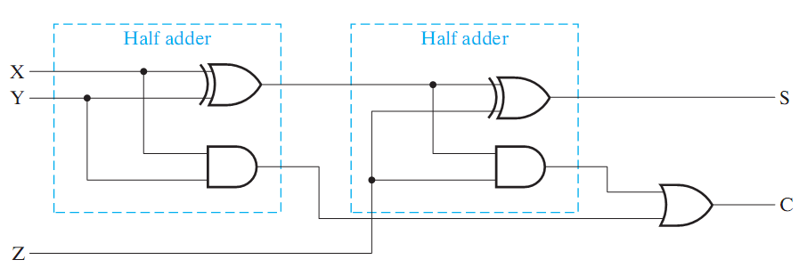
Full Adder = 2 Half Adders
Manipulating the Equations:
S = ( X ⊕ Y ) ⊕ Z
C = XY + XZ + YZ = XY + Z(X ⊕ Y )
Think of Z as a carry in
Src: Mano’s Book

Slide 14
Bigger Adders
How to build an adder for n-bit numbers?
Example: 4-Bit Adder
Inputs ?
Outputs ?
What is the size of the truth table?
How many functions to optimize?

Slide 15
Bigger Adders
How to build an adder for n-bit numbers?
Example: 4-Bit Adder
Inputs ? 9 inputs
Outputs ? 5 outputs
What is the size of the truth table? 512 rows!
How many functions to optimize? 5 functions

Slide 16
Binary Parallel Adder
1 0 0 0
0 1 0 1
+ 0 1 1 0
1 0 1 1
To add n-bit numbers:
Use n Full-Adders in parallel
The carries propagates as in addition by hand
This is an example of a hierarchical design
The circuit is broken into small blocks
Carry in

Slide 17
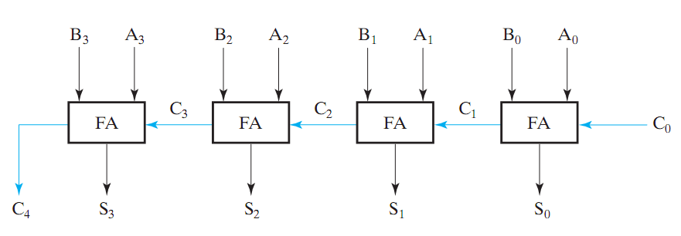
Binary Parallel Adder
To add n-bit numbers:
Use n Full-Adders in parallel
The carries propagates as in addition by hand
Src: Mano’s Book
This adder is called ripple carry adder

Slide 18
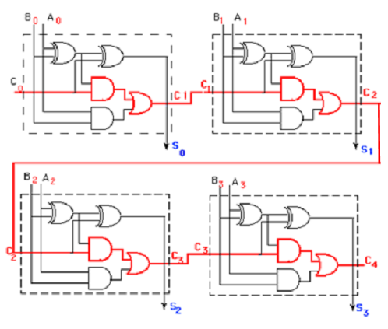
Ripple Adder Delay
Assume gate delay = T
8 T to compute the last carry
Total delay = 8 + 1 = 9T
1 delay form first half adder
Delay = (2n+1)T
Src: Course CD

Slide 19
Subtraction (2’s Complement)
How to build a subtractor using 2’s complement?

Slide 20
Subtraction (2’s Complement)
How to build a subtractor using 2’s complement?
1
Src: Mano’s Book
S = A + ( -B)

Slide 21
Adder/Subtractor
How to build a circuit that performs both addition and subtraction?

Slide 22
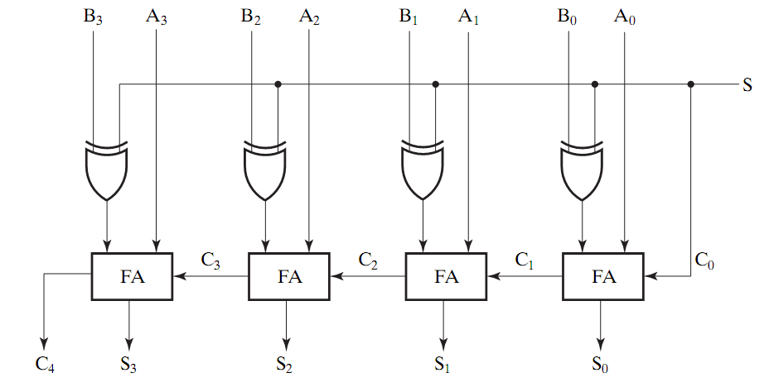
Adder/Subtractor
0 : Add
1: subtract
Src: Mano’s Book
Using full adders and XOR we can build an Adder/Subtractor!

Slide 23
Binary Parallel Adder (Again)
To add n-bit numbers:
Use n Full-Adders in parallel
The carries propagates as in addition by hand
Src: Mano’s Book
This adder is called ripple carry adder

Slide 24
Ripple Adder Delay
Assume gate delay = T
8 T to compute the last carry
Total delay = 8 + 1 = 9T
1 delay form first half adder
Delay = (2n+1)T
How to improve?
Src: Course CD

Slide 25
Carry Look Ahead Adder
How to reduce propagation delay of ripple carry adders?
Carry look ahead adder: All carries are computed as a function of C₀ (independent of n !)
It works on the following standard principles:
A carry bit is generated when both input bits Ai and Bi are 1, or
When one of input bits is 1, and a carry in bit exists
Carry bits
C_{n} C_{n-1}…….C_{i}……….C₂C₁C₀
A_{n-1}…….A_{i}……….A₂A₁A₀
B_{n-1}…….B_{i}……….B₂B₁B₀
Carry Out
S_{n} S_{n-1}…….S_{i}……….S₂S₁S₀

Slide 26
Carry Look Ahead Adder
A_{i}
B_{i}
P_{i}
S_{i}
G_{i}
C_{i}
C_{i+1}
Carry Generate Gi : C_{i+1} = 1 when G_{i} = 1, regardless of the input carry C_{i}
Carry Propagate Pi : Propagates C_{i} to C_{i+1}
Note: P_{i} and G_{i} depend only on A_{i} and B_{i} !
The internal signals are given by:
Pi = Ai Bi
Gi = Ai.Bi

Slide 27
Carry Look Ahead Adder
A_{i}
B_{i}
P_{i}
S_{i}
G_{i}
C_{i}
C_{i+1}
The internal signals are given by:
Pi = Ai Bi
Gi = Ai.Bi
The output signals are given by:
Si = Pi Ci
Ci+1 = Gi + PiCi

Slide 28
Carry Look Ahead Adder
A_{i}
B_{i}
P_{i}
S_{i}
G_{i}
C_{i}
C_{i+1}
The carry outputs for various stages can be written as:
C1 = Go + PoCo
C2 = G1 + P1C1 = G1 + P1(Go + PoCo) = G1 + P1Go + P1PoCo
C3 = G2 + P2C2 = G2 + P2G1 + P2P1G0 + P2P1P0C0
C4 = G3 + P3C3 = G3 + P3G2 + P3P2G1 + P3P2P1G0 + P3P2P1P0C0

Slide 29
Carry Look Ahead Adder
Conclusion: Each carry bit can be expressed in terms of the input carry Co, and not based on its preceding carry bit
Each carry bit can be expressed as a SOP, and can be implemented using a two-level circuit, i.e. a gate delay of 2T

Slide 30
Carry Look Ahead Adder
C0
A0
B0
P0
G0
P1
P2
G2
G3
S0
Carry Look Ahead Block
A1
B1
C1
S1
G1
A2
B2
C2
S2
A3
B3
C3
P3
S3
C4
C4

Slide 31
Carry Look Ahead Adder
Steps of operation:
All P and G signals are initially generated. Since both XOR and AND can be executed in parallel. Total delay = 1T
The Carry Look Ahead block will generate the four carry signals C4, C3, C2, C1. Total delay = 2T
The four XOR gates will generate the Sums. Total delay = 1T
Total delay before the output can be seen = 4T
Compared with the Ripple Adder delay of 9T, this is an improvement of more than 100%
CLA adders are implemented as 4-bit modules, that can together be used for implementing larger circuits

Slide 32
Binary Multiplication
Similar to decimal multiplication
Multiplying 2 bits will generate a 1 if both bits are equal to 1, and will be 0 otherwise. Resembles an AND operation
Multiplying two 2-bit numbers is done as follows:
B₁ B₀
x A₁ A₀
----------------
A₀B₁ A₀B₀
A₁B₁ A₁B₀ +
----------------------------------
C3 C2 C1 C0
This operation is an addition, requires an ADDER

Slide 33
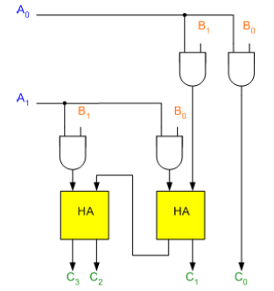
Binary Multiplication
Therefore, for multiplying two 2-bit numbers, AND gates and ADDERS will be sufficient
Half Adders

