Slide 1
COE 202: Digital Logic Design Signed Numbers
Courtesy of Dr. Ahmad Almulhem

Slide 2
Objectives
Number representation in computers
Unsigned numbers
Signed numbers
Signed number representation
Signed-magnitude representation
Complement representation
Signed numbers arithmetic
Overflow
Shift operations
Complements for other bases

Slide 3
Machine representation of numbers
Digital computers store numbers in a special electronic device (memory) called registers
Registers have fixed size = n storage elements; each element holds 0 or 1
The register size is typically a power of 2. e.g. 2, 4, 8, 16,…
An n-bit register can represent one of 2^{n} distinct values e.g. for n=4, distinct values = 16 {0000, 0001, ….., 1111}
Numbers stored in a register can be signed or unsigned e.g. -9 or +9 are signed numbers. 9 is an unsigned number

Slide 4
Example
Q. How the value (13)₁₀ (or D in Hexadecimal) is stored in a 4-bit register and in an 8-bit register
ZEROS are used to pad
Q: Is this a signed or unsigned number?

Slide 5
Signed Number Representation
A signed number has:
Magnitude (or absolute value)
Sign (positive or negative)
Everything has to be in binary (0s and 1s)
Two common techniques for representing signed numbers are:
Signed-magnitude representation
Complement representation

Slide 6
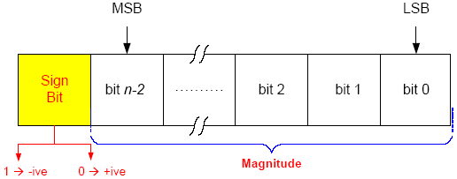
Signed magnitude representation
The most significant bit is the sign bit.
‘0’ --> positive number
‘1’ --> negative number
The remaining (n-1) bits represent the magnitude
Total possible numbers representable by an n-bit register using signed magnitude is equal to: 2^{n-1}, as the MSB is always reserved for the sign
Largest representable magnitude, in this method, is (2^{n-1}-1)
Range of numbers: -(2^{n-1}-1), … , -1, -0, +0, +1, …, +(2^{n-1}-1)

Slide 7
Examples
Q: Show the signed magnitude representations of +6, -6, +13 and -13 using a 4-bit register and an 8-bit register
Note that: (6)₁₀ = (110)₂ , (13)₁₀ = (1101)₂
For a 4-bit register, the leftmost bit is reserved for the sign, which leaves 3 bits only to represent the magnitude
The largest magnitude that can be represented = 2⁽⁴⁻¹⁾ –1 = 7
Because 13 > 7, the numbers +13 and –13 can NOT be represented using the 4-bit register

Slide 8
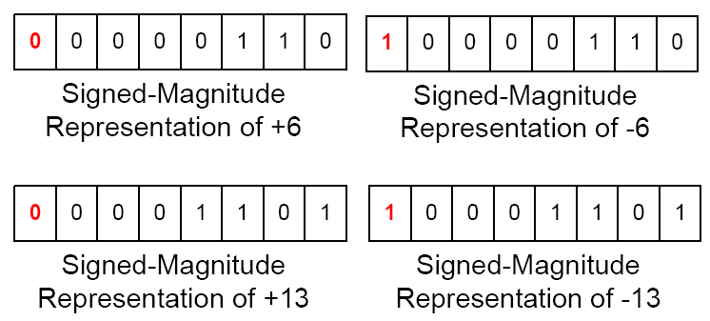
Examples (cont.)
Q: Show the signed magnitude representations of +6, -6, +13 and -13 using a 4-bit register and an 8-bit register
For an 8-bit register, the leftmost bit is a sign bit, which leaves 7 bits to represent the magnitude.
The largest magnitude representable in 7-bits =127 =2⁽⁸⁻¹⁾-1

Slide 9
Signed-Magnitude Arithmetic
If sign is the same, just add the magnitude

Slide 10
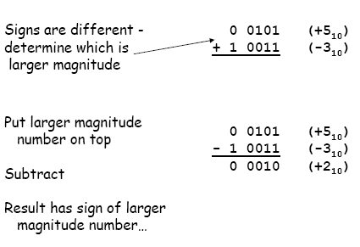
Signed-Magnitude Arithmetic

Slide 11
Signed-Magnitude Arithmetic

Slide 12
Signed-Magnitude Representation
Need two separate operations
Addition
Subtraction
Several decisions:
Signs same or different?
Which operand is larger?
What is the sign of final result?
Two zeroes (+0, -0)
Advantages
Easy to understand
Disadvantages
–Two different 0s
– Hard to implement in logic

Slide 13
Complement representation
Subtraction: A – B = A + (-B) = A + B’
A negative number is represented with its complement
Note that B = (B’)’
Two types of complements for each base-r
(r-1)’s complement
1’s complement
r’s complement
2’s complement

Slide 14
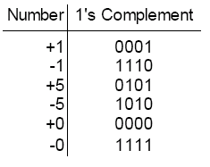
1’s Complement
A positive number is as in signed-magnitude
For a negative number, flip all bits !
Q: What do you observe about this representation?

Slide 15
1’s Complement
A positive number is as in signed-magnitude
For a negative number, flip all bits !
Negative numbers always have a 1 in the MSB
Two 0s !
4 bits represent the range: -7 to +7

Slide 16
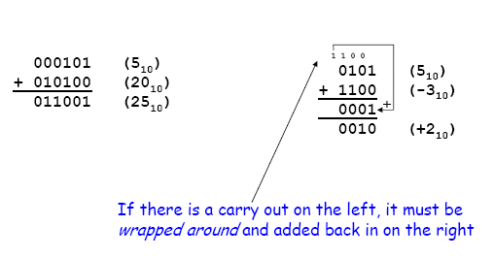
1’s Complement Arithmetic
Q: What if there is no last carry?
A: If there is no carry, the result is negative
in 1’s complement

Slide 17
Example: Binary subtraction using 1’s complement
Regular Approach:
M - N
M = 0 1 0 1 0 1 0 0
N = 0 1 0 0 0 1 0 0 -
-------------------
0 0 0 1 0 0 0 0
1’s complement:
M – N = M + N’
M = 0 1 0 1 0 1 0 0
N = 1 0 1 1 1 0 1 1 +
-------------------
1 0 0 0 0 1 1 1 1
1 +
0 0 0 1 0 0 0 0
End Around Carry
Regular Approach:
N - M
N = 0 1 0 0 0 1 0 0
M = 0 1 0 1 0 1 0 0 -
-------------------
- 0 0 0 1 0 0 0 0
1’s complement:
N + M’
N = 0 1 0 0 0 1 0 0
M = 1 0 1 0 1 0 1 1 +
-------------------
1 1 1 0 1 1 1 1
Correction Step Required:
-(1’s complement of 11101111) =
-(00010000)
No End Carry

Slide 18
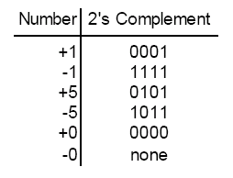
2’s Complement
A positive number is as in signed-magnitude
For a negative number, two way to get the 2’s complement:
add 1 to 1’s complement, or
Starting from right find first ‘1’, invert all bit to the left of that one
Q: What do you observe about this representation?

Slide 19
2’s Complement
A positive number is as in signed-magnitude
For a negative number, two way to get the 2’s complement:
add 1 to 1’s complement, or
Starting from right find first ‘1’, invert all bit to the left of that one
Negative numbers always have a 1 in the MSB
One 0s !
4 bits represent the range: -8 to +7

Slide 20
2’s Complement Arithmetic
- If there is an end carry, then discard
- If there is no end carry, the result is negative in 2’s complement

Slide 21
Example: Binary subtraction using 2’s complement
Regular Approach:
M - N
M = 0 1 0 1 0 1 0 0
N = 0 1 0 0 0 1 0 0 -
-------------------
0 0 0 1 0 0 0 0
2’s complement:
M – N = M + N’
M = 0 1 0 1 0 1 0 0
N = 1 0 1 1 1 1 0 0 +
-------------------
1 0 0 0 1 0 0 0 0
Discard End Carry
Regular Approach:
N - M
N = 0 1 0 0 0 1 0 0
M = 0 1 0 1 0 1 0 0 -
-------------------
- 0 0 0 1 0 0 0 0
2’s complement:
N + M’
N = 0 1 0 0 0 1 0 0
M = 1 0 1 0 1 1 0 0 +
-------------------
1 1 1 1 0 0 0 0
Correction Step Required:
-(2’s complement of 11110000) =
-(00010000)
No End Carry

Slide 22
Summary (1’s Complement vs 2’s Complement)
1’s Complement
2’s Complement
Advantages
Easy to generate the complement
Only one addition process
Disadvantages
Handling last carry out
Two different 0s!
Disadvantages
Harder to generate the complement
Advantages
Only One zero !
Only one addition process
No end around carry
Usually, the 2’s complement is the preferred way

Slide 23
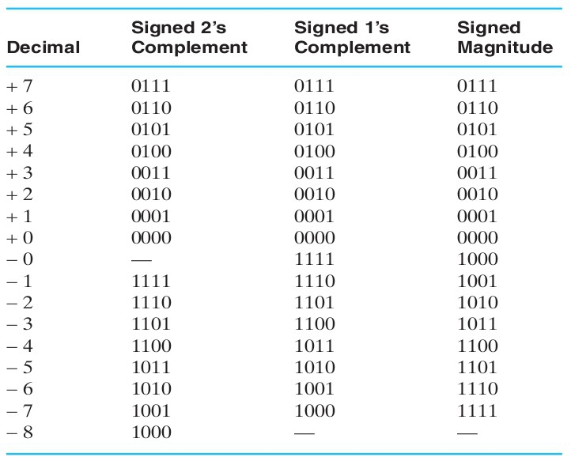
Summary (Signed-Magnitude vs Complements)
Positive numbers are identical in all representations and have 0 in the MSB
2’s complement has only one 0; the others have 2 0s
All negative numbers have 1 in the MSB
2’s complement has one more negative number!

Slide 24
Range of values of unsigned and signed integers represented using n bits
Unsigned integer values range: 0 to 2^{n}-1
For n = 8 bits ⇒ Range: 0 to 2⁸-1 = 0 to 255
Signed-magnitude integer values range: -(2^{n-1}-1) to +(2^{n-1}-1)
For n = 8 bits ⇒ Range: -2⁷-1 to 2⁷-1 = -127 to +127
Signed 1’s complement integer values range: -(2^{n-1}-1) to +(2^{n-1}-1)
For n = 8 bits ⇒ Range: -2⁷-1 to 2⁷-1 = -127 to +127
Signed 2’s complement integer values range: -(2^{n-1}) to +(2^{n-1}-1)
For n = 8 bits ⇒ Range: -2⁷ to 2⁷-1 = -128 to +127

Slide 25
Overflow
Number’s sizes in computers are fixed
Overflows can occur when the result of an operation does not fit.
Q: When can an overflow occur?
Unsigned numbers | Signed numbers
Subtracting two numbers | Adding a positive number to a negative number
Adding two numbers | Adding two negative numbers or two positive numbers

Slide 26
Overflow (2’s Complement)
Q: Add +5 and +4 in 2’s complement.
A: An overflow happened. The correct answer +9 (1001) cannot be represented by 4 bits.
Detection:
Adding two positive numbers result in a negative number!
Carry in sign bit is different from carry out of sign bit
Solution:
Use one more bit, extend the sign bit
0 1 0 0
0101 + 5₁₀
+ 0100 + 4₁₀
0 1001 - 7₁₀ ??
0 0 1 0
00101 + 5₁₀
+ 00100 + 4₁₀
01001 + 9₁₀

Slide 27
Overflow (2’s Complement)
Q: Add -5 and -4 in 2’s complement.
A: An overflow happened. The correct answer -9 (10111) cannot be represented by 4 bits.
Detection:
Adding two negative numbers result in a positive number!
Carry in sign bit is different from carry out of sign bit
Solution:
Use one more bit, extend the sign bit
1 0 0 0
1011 - 5₁₀
+ 1100 - 4₁₀
1 0111 + 7₁₀ ??
1 1 0 0
11011 - 5₁₀
+ 11100 - 4₁₀
10111 - 9₁₀

Slide 28
Range Extensions
To extend the representation of a 2’s complement number possibly for storage and use in a larger-sized register
If the number is positive, pad 0’s to the left of the integral number (sign bit extension), and 0’s to the right of the fractional number
If the number is negative, pad 1’s to the left of the integral number (sign bit extension), and 0’s to the right of the fractional number
0 1 0 0 1
0 0 0 0 0 1 0 0 1
5-bit register (+9)
9-bit register
(+9) – sign bit extended
1 0 1 1 1
1 1 1 1 1 0 1 1 1
5-bit register (-9)
9-bit register
(-9) – sign bit extended

Slide 29
Arithmetic Shift
A binary number can be shifted right or left
To shift an unsigned numbers (right or left), pad with 0s.
Example:
Left Shift
0001 1₁₀
0010 2₁₀
0100 4₁₀
1000 8₁₀
Q1: What is the effect of left-shifting?
Q2: What is the effect of right-shifting?

Slide 30
Arithmetic Shift
To shift a signed number
Left-Shift: pad with 0s
Right-Shift: Extend sign bit
Example (2’s complement):
Right Shift
1000 - 8₁₀
1100 - 4₁₀
1110 - 2₁₀
1111 - 1₁₀
In General
left-shifting = multiply by r
right-shifting = divide by r

Slide 31
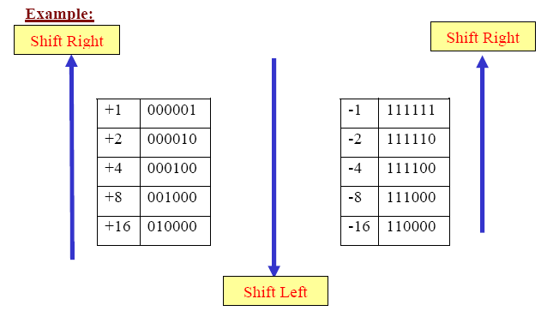
Arithmetic Shifts

Slide 32
Complements for other bases
Complements apply to other bases!
Two types of complements for each radix (base)
Diminished radix (r-1)’s complement
1’s complement
Radix r’s complement
2’s complement

Slide 33
Diminished Radix (r -1)’s complement
In general the (r-1)’s complement of a number Q in base-r is given by
Q_{r-1}’ = (r ^{n} – r ^{–m}) – Q
where n is the number of integral digits in Q and m is the number of fractional digits in Q.
Examples:
- For Q = 12.3₁₀, Q’₉ = 99.9 – 12.3 = 87.6₁₀
- For Q = 22₈, Q’₇ = 77 – 22 = 55₈

Slide 34
Examples
Find the 9’s complement of the following decimal numbers:
a. Q = 2357
Here, n = 4, m = 0 [no fractional digits]
M₉ = 10⁴ - 1
Q₉’ = M₉ – 2357 = 9999 – 2357 = 7642 [9’s complement of Q]
b. Q = 2895.786
Here, n = 4, m = 3
M₉ = 10⁴ – 10⁻³
Q₉’ = M₉ – 2895.786 = 9999.999 – 2895.786 = 7104.213

Slide 35
Examples
Find the 1’s complement of the following binary numbers:
a. Q = 110101010
Here, n = 9, m = 0 [no fractional digits]
M₁ = 2⁹ - 1
Q₁’ = M₁ – 110101010 = 111111111 - 110101010
= 001010101 [1’s complement of Q]
a. Q = 1010.001
Here, n = 4, m = 3
M₁ = 2⁴ – 2⁻³
Q₁’ = M₁ – 110101010 = 1111.111 – 1010.001
= 0101.110 [1’s complement of Q]
Hint: Flip all the bits of a binary number to compute its 1’s complement!

Slide 36
Radix (r’s) Complement
In general the r’s complement of a number Q in base-r is given by
Q_{r}’ = r ^{n} – Q
where n is the number of integral digits in Q.
Examples:
- For Q = 12.3₁₀, Q’₁₀ = 100 – 12.3 = 87.7₁₀
- For Q = 22₈, Q’₈ = 100 – 22 = 56₈

Slide 37
Examples
Find the 10’s complement of the following decimal numbers:
a. Q = 2357
Here, n = 4
M₁₀ = 10⁴
Q₁₀’ = M₁₀ – 2357 = 10⁴ – 2357 = 7643 [10’s complement of Q]
b. Q = 2895.786
Here, n = 4, m = 3
M₁₀ = 10⁴
Q₁₀’ = M₁₀ – 2895.786 = 10000 – 2895.786 = 7104.214

Slide 38
Examples
Find the 2’s complement of the following binary numbers:
a. Q = 110101010
Here, n = 9
M₂ = 2⁹
Q₂’ = M₂ – 110101010 = 1000000000 - 110101010
= 001010110 [2’s complement of Q]
a. Q = 1010.001
Here, n = 4
M₂ = 2⁴
Q₂’ = M₂ – 110101010 = 10000 – 1010.001
= 0101.111 [2’s complement of Q]
Hint: Move from rightmost bit to the leftmost and find the first 1, all the remaining bits are flipped until the MSB is reached
Example:
1100011000
2’s complement = 0011101000

Slide 39
Octal Examples
Find the 7’s and 8’s complement of the following:
a. Q = (6770)₈
n = 4, m = 0,
Q₇’ = 8⁴ – 1 – 6770 = (1007)₈
Q₈’ = 8⁴ – 6770 = (1010)₈
b. Q = 541.736
n = 3, m = 3,
Q₇’ = 8³ – 8⁻³ – 541.736 = 777.777 – 541.736= (236.041)₈
Q₈’ = 8³ – 541.736 = (236.042)₈

Slide 40
Hexadecimal Examples
Find the F’s and 16’s complement of the following:
a. Q = (3FA9)₁₆
n = 4, m = 0,
Q_{F}’ = 16⁴ – 1 – 3FA9 = (C056)₁₆
Q₁₆’ = 16⁴ – 3FA9 = (C057)₁₆
b. Q = 9B1.C70
n = 3, m = 3,
Q_{F}’ =16³ – 16⁻³ – 9B1.C70 = FFF.FFF – 9B 1.C70 = (64E.38F)₁₆
Q₁₆’ = 16³ – 9B1.C70 = 1000 – 9B1.C70 = (64E.390)₁₆

Slide 41
Decimal Arithmetic Example
Q: Compute 43₁₀ – 12₁₀ using 9’s and 10’s complements.
SM subtraction 9’s complement 10’s complement
43 43 43
- 12 + 87 + 88
---------- ----------- -----------
31 1 30 1 31
+ 1
----------
31
Q = 12
Q’₉ = 99 -12 = 87
Q’₁₀ = 100 - 12 = 88
discard

Slide 42
Conclusions
Digital computers store numbers in a special electronic device (memory) called registers
To represent a “signed” number, you need to specify its:
Magnitude (or absolute value)
Sign (positive or negative)
Two common techniques for representing signed numbers are:
Signed magnitude representation
Complement representation:
r’s complement (known as radix complement)
(r-1)’s complement (also known as diminished radix complement)

