Slide 1
COE 202: Digital Logic Design Combinational Logic Part 4
Courtesy of Dr. Ahmad Almulhem

Slide 2
Objectives
Other Gate Types
NAND
NOR
More Gates Types
XOR
XNOR

Slide 3
More Gates: NAND - NOR
X | Y | Z=(XY)’
0 | 0 | 1
0 | 1 | 1
1 | 0 | 1
1 | 1 | 0
X
NAND
Z
F = (XY)’
Y
X | Y | Z=(X+Y)’
0 | 0 | 1
0 | 1 | 0
1 | 0 | 0
1 | 1 | 0
X
Z
NOR
F = (X+Y)’
Y
Sometimes it is desirable to build circuits using NAND gates only or NOR gates only

Slide 4
NAND Gate is Universal
NOT
X
X’
X
X’
X
X
X
XY
AND
XY
Y
Y
X
X
X+Y
OR
X+Y
Y
Y
Therefore, we can build all functions we learned so far using NAND gates ONLY (Exercise: Prove that NOT can be built with NAND)
NAND is a UNIVERSAL gate

Slide 5
Graphic Symbols for NAND Gate
Two equivalent graphic symbols or shapes for the SAME function
X
AND-NOT
Y
(XYZ)’
Z
X
NOT-OR
Y
X’+Y’+Z’ = (XYZ)’
Z
AND-NOT = NOT-OR

Slide 6
Implementation using NANDs
Example: Consider F = AB + CD
NAND
A
A
B
F
B
F
C
C
D
D
NAND
Proof:
F = ((AB)’.(CD)’)’
= ((AB)’)’ + ((CD)’)’
= AB + CD
A
B
F
C
D

Slide 7
Implementation using NANDs
Consider F =Σm(1,2,3,4,5,7) – Implement using NAND gates
X
Y=1
Y’
F
YZ X | 00 | 01 | 11 | 10
0 |  | 1 | 1 | 1
1 | 1 | 1 | 1
X’
Y
Z
X=1
X
Z=1
Y’
F
X’
F(X,Y) = Z+XY’+X’Y
Y
Z’

Slide 8
Rules for 2-Level NAND Implementations
Simplify the function and express it in sum-of-products form
Draw a NAND gate for each product term (with 2 literals or more)
Draw a single NAND gate at the 2nd level (in place of the OR gate)
A term with single literal requires a NOT
What about multi-level circuits?

Slide 9
NOR Gate is Universal
NOT
X
X’
X
X’
X
X
X
(X’+Y’)’ = XY
AND
XY
Y
Y
X
X
(X+Y)’’ = X+Y
OR
X+Y
Y
Y
Therefore, we can build all functions we learned so far using NOR gates ONLY (Exercise: Prove that NOT can be built with NOR)
NOR is a UNIVERSAL gate

Slide 10
Graphic Symbols for NOR Gate
Two equivalent graphic symbols or shapes for the SAME function
X
(X+Y+Z)’
Y
OR-NOT
Z
X
(X’Y’Z’)=(X+Y+Z)’
NOT-AND
Y
Z
OR-NOT = NOT-AND

Slide 11
Implementation using NOR gates
Consider F = (A+B)(C+D)E
NOR
NOR
A
A
B
B
F
F
C
C
D
D
E
E’

Slide 12
Implementation using NOR gates
Consider F =Σm(1,2,3,5,7) – Implement using NOR gates
X’
Y=1
Z
F
YZ X | 00 | 01 | 11 | 10
0 |  | 1 | 1 | 1
1 |  | 1 | 1
Y
Z
X=1
X’
Z=1
Z
F
Y
F’(X,Y) = Y’Z’+XZ’, or
F(X,Y) = (Y+Z)(X’+Z)
Z

Slide 13
Rules for 2-Level NOR Implementations
Simplify the function and express it in product of sums form
Draw a NOR gate (using OR-NOT symbol) for each sum term (with 2 literals or more)
Draw a single NOR gate (using NOT-AND symbol) the 2nd level (in place of the AND gate)
A term with single literal requires a NOT
What about multi-level circuits?

Slide 14
More Gates: XOR - XNOR
X | Y | Z=X⊕Y
0 | 0 | 0
0 | 1 | 1
1 | 0 | 1
1 | 1 | 0
Exclusive OR
(XOR)
X
F = X’Y + XY’
= X ⊕ Y
Z
Y
Exclusive NOR
(XNOR)
X
F = XY + X’Y’
= (X ⊕ Y)’
= X ⊗ Y
= X Y
X | Y | Z=(X⊕Y)’
0 | 0 | 1
0 | 1 | 0
1 | 0 | 0
1 | 1 | 1
Z
Y
Different symbols for XNOR

Slide 15
XOR/XNOR Properties
X ⊕ 0 = X X ⊗ 0 = X’
X ⊕ 1 = X’ X ⊗ 1 = X
X ⊕ X = 0 X ⊗ X = 1
X ⊕ X’ = 1 X ⊗ X’ = 0
X ⊕ Y’ = X’ ⊕ Y = (X ⊕ Y)’ = X ⊗ Y
X ⊕ Y = X’ ⊕ Y’ (same with XNOR)
X ⊕ Y = Y ⊕ X (commutative, same with XNOR)
X ⊕ (Y ⊕ Z) = (X ⊕ Y) ⊕ Z (associative, same with XNOR)

Slide 16
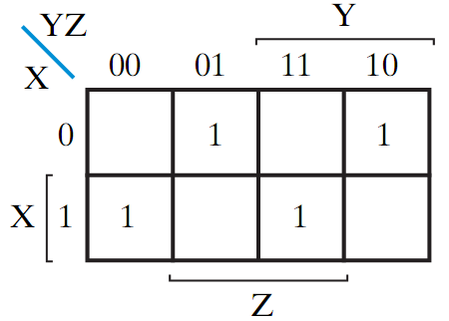
Odd Parity Function
The XOR of an n-input function: F = X⊕Y⊕ Z is equal to 1 if and only if an odd number of variables of the function have a value of 1
The Exclusive OR of a function acts as an ODD detector. It is 1 only if the number of 1’s in the input is odd.
X | Y | Z | F
0 | 0 | 0 | 0
0 | 0 | 1 | 1
0 | 1 | 0 | 1
0 | 1 | 1 | 0
1 | 0 | 0 | 1
1 | 0 | 1 | 0
1 | 1 | 0 | 0
1 | 1 | 1 | 1
X
Y
Z

Slide 17
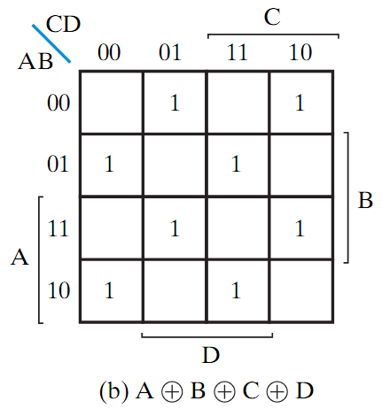
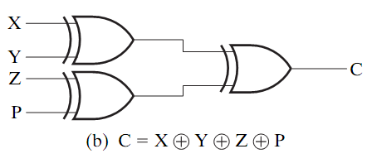
Odd Parity Function
4-Input XOR = 4-input odd parity checker

Slide 18
Even Parity function
Is equal to 1 if and only if the total number of 1’s in the input is an even number
Obtained by placing an inverter in front of the odd function
X | Y | Z | F
0 | 0 | 0 | 1
0 | 0 | 1 | 0
0 | 1 | 0 | 0
0 | 1 | 1 | 1
1 | 0 | 0 | 0
1 | 0 | 1 | 1
1 | 1 | 0 | 1
1 | 1 | 1 | 0
X
Y
Z

Slide 19
Conclusion
The universal gates NAND and NOR can implement any Boolean expression
NAND gates (2-level SOP)
NOR gates (2-level POS)
XOR and OR gates

