Slide 1
COE 202: Digital Logic Design Combinational Logic Part 3
Courtesy of Dr. Ahmad Almulhem

Slide 2
Objectives
Karnaugh Maps (K-Maps)
Learn to minimize a function using K-Maps
2-Variables
3-Variables
4-Variables
Don’t care conditions
Important Definitions
5-Variables K-Maps

Slide 3
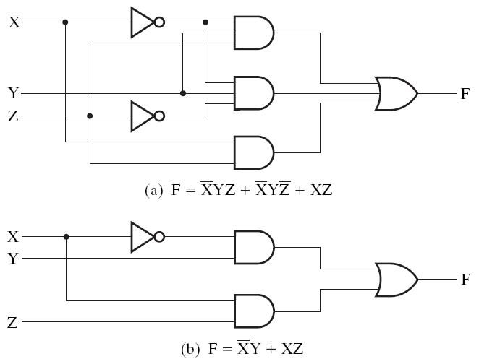
Simplification using Algebra
F = X’YZ + X’YZ’ + XZ
= X’Y(Z+Z’) + XZ (id 14)
= X’Y.1 + XZ (id 7)
= X’Y + XZ (id 2)
Simplification may
mean different things
here it means less
number of literals

Slide 4
Simplification Revisited
Algebraic methods for minimization is limited:
No formal steps (id 10 first, then id 4, etc?), need experience.
No guarantee that a minimum is reached
Easy to make mistakes
Karnaugh maps (k-maps) is an alternative convenient way for minimization:
A graphical technique
Introduced by Maurice Karnaugh in 1953
K-maps for up to 4 variables are straightforward to build
Building higher order K-maps (5 or 6 variable) are a bit more cumbersome
Simplified expression produced by K-maps are in SOP or POS forms

Slide 5
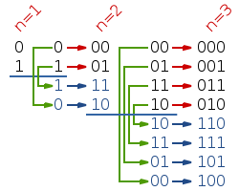
Gray Codes (review)
Only one bit changes with each number increment
Build using recursive reflection
To translate a binary value into the corresponding Gray code, each bit is inverted if the next higher bit of the input value is set to one.
src: wikipedia.org

Slide 6
Truth Table Adjacencies
A | B | F
0 | 0 | 1
0 | 1 | 1
1 | 0 | 0
1 | 1 | 0
These minterms are adjacent in a gray code sense – they differ by only one bit.
We can apply XY+XY’=X
F = A’B’ + A’B = A’(B’+B) = A’ (1)
= A’
A | B | F
0 | 0 | 0
0 | 1 | 1
1 | 0 | 0
1 | 1 | 1
Same idea:
F = A’B + AB = B
Keep common literal only!

Slide 7
K-Map
A | B | F
0 | 0 | 0
0 | 1 | 1
1 | 0 | 0
1 | 1 | 1
A different way to draw a truth table !
Take advantage of adjacency
B
B A | 0 | 1
0 | 0 A’ B’ | 1 A’ B
1 | 0 A B’ | 1 A B
F = A’B + AB = B
A
Keep common literal only!

Slide 8
Minimization with K-maps
Draw a K-map
Combine maximum number of 1’s following rules:
Only adjacent squares can be combined
All 1’s must be covered
Covering rectangles must be of size 1,2,4,8, … 2^{n}
Check if all covering are really needed
Read off the SOP expression

Slide 9
2-variable K-map
Given a function with 2 variables: F(X,Y), the total number of minterms are equal to 4:
m₀, m₁, m₂, m₃
The size of the k-map is always equal to the total number of minterms.
Y
X
0 1
Each entry of the k-map corresponds to one minterm for the function:
Row 0 represents: X’Y’, X’Y
Row 1 represents: XY’, XY’
0
1
m₀ m₁
m₂ m₃
Y
X
0 1
0
1
₀ ₁
₂ ₃

Slide 10
Example 1
For a given function F(X,Y) with the following truth table, minimize it using k-maps
X | Y | F
0 | 0 | 0
0 | 1 | 0
1 | 0 | 1
1 | 1 | 1
Y
X
0 1
0 0
1 1
Combining all the 1’s in only the adjacent squares
0
1
The final reduced expression is given by the common literals from the combination:
Therefore, since for the combination, Y has different values (0, 1), and X has a fixed value of 1,
The reduced function is: F(X,Y) = X

Slide 11
Example 2
Q. Simplify the function F(X,Y) = ∑m(1,2,3)
Sol. This function has 2 variables, and three 1-squares (three minterms where function is 1)
F = m₁ + m₂ + m₃
Y
X
0 1
Y is the common literal in the adjacent 1-squares
0
1
0 1
1 1
Note: The 1-squares can be combined more than once
X is the common literal
Minimized expression: F = X + Y

Slide 12
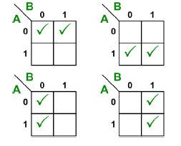
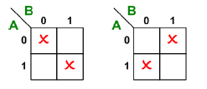
2 variable K-Maps (Adjacency)
In an n-variable k-map, each square is adjacent to exactly n other squares
Q: What if you have 1 in all squares?

Slide 13
3-variable K-maps
For 3-variable functions, the k-maps are larger and look different.
Total number of minterms that need to be accommodated in the k-map = 8
To maintain adjacency neighbors don’t have more than 1 different bit
BC
B
A
00 01 11 10
0
1
m₀ m₁ m₃ m₂
m₄ m₅ m₇ m₆
A
C

Slide 14
3-variable K-maps
BC
A
00 01 11 10
0
1
m₀ m₁ m₃ m₂
m₄ m₅ m₇ m₆
Note: You can only combine a power of 2 adjacent 1-squares. For e.g. 2, 4, 8, 16 squares. You cannot combine 3, 7 or 5 squares
BC
A
00 01 11 10
0
1
m₀ m₁ m₃ m₂
m₄ m₅ m₇ m₆
Minterms m_{o}, m₂, m₄, m₆ can be combined as m₀ and m₂ are adjacent to each other, m₄ and m₆ are adjacent to each other
m_{o} and m₄ are also adjacent to each other, m₂ and m₆ are also adjacent to each other

Slide 15
Example 1
Simplify F = ∑m(1, 3, 4, 6) using K-map
B
BC A | 00 | 01 | 11 | 10
0 | 0 | 1 1 | 3 1 | 2
1 | 4 1 | 5 | 7 | 6 1
A
C

Slide 16
Example 1
Simplify F = ∑m(1, 3, 4, 6) using K-map
B
BC A | 00 | 01 | 11 | 10
0 | 0 | 1 1 | 3 1 | 2
1 | 4 1 | 5 | 7 | 6 1
F = A’C + AC’
A
C

Slide 17
Example 2
Simplify F = ∑m(0,1, 2, 4, 6) using K-map
B
BC A | 00 | 01 | 11 | 10
0 | 0 1 | 1 1 | 3 | 2 1
1 | 4 1 | 5 | 7 | 6 1
A
C

Slide 18
Example 2
Simplify F = ∑m(0,1, 2, 4, 6) using K-map
B
BC A | 00 | 01 | 11 | 10
0 | 0 1 | 1 1 | 3 | 2 1
1 | 4 1 | 5 | 7 | 6 1
F = A’ B’ + C’
A
C

Slide 19
3 variable K-Maps (Adjacency)
A 3-variable map has 12 possible groups of 2 minterms
They become product terms with 2 literals
 | 00 | 01 | 11 | 10
0
1
 | 00 | 01 | 11 | 10
0
1
 | 00 | 01 | 11 | 10
0
1

Slide 20
3 variable K-Maps (Adjacency)
A 3-variable map has 6 possible groups of 4 minterms
They become product terms with 1 literals
 | 00 | 01 | 11 | 10
0
1
 | 00 | 01 | 11 | 10
0
1
 | 00 | 01 | 11 | 10
0
1

Slide 21
4-variable K-maps
A 4-variable function will consist of 16 minterms and therefore a size 16 k-map is needed
Each square is adjacent to 4 other squares
A square by itself will represent a minterm with 4 literals
Combining 2 squares will generate a 3-literal output
Combining 4 squares will generate a 2-literal output
Combining 8 squares will generate a 1-literal output
CD
C
AB
00 01 11 10
00
01
11
10
m₀ m₁ m₃ m₂
m₄ m₅ m₇ m₆
B
m₁₂ m₁₃ m₁₅ m₁₄
m₈ m₉ m₁₁ m₁₀
A
D

Slide 22
4-variable K-maps (Adjacency)
CD
AB
00 01 11 10
00
01
11
10
m₀ m₁ m₃ m₂
m₄ m₅ m₇ m₆
Note: You can only combine a power of 2 adjacent 1-squares. For e.g. 2, 4, 8, 16 squares. You cannot combine 3, 7 or 5 squares
m₁₂ m₁₃ m₁₅ m₁₄
m₈ m₉ m₁₁ m₁₀
Right column and left column are adjacent; can be combined
Top row and bottom column are adjacent; can be combined
Many possible 2, 4, 8 groupings

Slide 23
Example
Minimize the function F(A,B,C,D)=∑m(1,3,5,6,7,8,9,11,14,15)
C
CD
AB
00 01 11 10
00
01
11
10
1
1
1
1
1
B
1
1
A
1
1
1
D
F = CD + A’D + BC + AB’C’

Slide 24
Example
F(A,B,C,D) = Σm(0,1,2,5,8,9,10)
CD AB | 00 | 01 | 11 | 10
00 | 1 | 1 |  | 1
01 |  | 1
11
10 | 1 | 1 |  | 1
C=1
B=1
A=1
D=1

Slide 25
Example
F(A,B,C,D) = Σm(0,1,2,5,8,9,10)
Solution:
F = B’ D’ + B’ C’ + A’ C’ D
CD AB | 00 | 01 | 11 | 10
00 | 1 | 1 |  | 1
01 |  | 1
11
10 | 1 | 1 |  | 1
C=1
B=1
A=1
D=1

Slide 26
Example (POS)
F(A,B,C,D) = Σm(0,1,2,5,8,9,10)
Write F in the simplified product of sums (POS)
Two methods?
You already know one!
CD AB | 00 | 01 | 11 | 10
00 | 1 | 1 |  | 1
01 |  | 1
11
10 | 1 | 1 |  | 1
C=1
B=1
A=1
D=1

Slide 27
Example (POS)
F(A,B,C,D) = Σm(0,1,2,5,8,9,10)
Write F in the simplified product of sums (POS)
Method 2:
Follow same rule as before but for the ZEROs
F’ = AB + CD + BD’
Therefore,
F’’ = F = (A’+B’)(C’+D’)(B’+D)
CD AB | 00 | 01 | 11 | 10
00 | 1 | 1 |  | 1
01 |  | 1
11
10 | 1 | 1 |  | 1
C=1
B=1
A=1
D=1

Slide 28
Don’t Cares
In some cases, the output of the function (1 or 0) is not specified for certain input combinations either because
The input combination never occurs (Example BCD codes), or
We don’t care about the output of this particular combination
Such functions are called incompletely specified functions
Unspecified minterms for these functions are called don’t cares
While minimizing a k-map with don’t care minterms, their values can be selected to be either 1 or 0 depending on what is needed for achieving a minimized output.

Slide 29
Example
F = ∑m(1, 3, 7) + ∑d(0, 5)
B
BC A | 00 | 01 | 11 | 10
0 | 0 X | 1 1 | 3 1 | 2
1 | 4 | 5 X | 7 1 | 6
Circle the x’s that help get bigger groups of 1’s (or 0’s if POS).
Don’t circle the x’s that don’t help.
A
C

Slide 30
Example
F = ∑m(1, 3, 7) + ∑d(0, 5)
B
BC A | 00 | 01 | 11 | 10
0 | 0 X | 1 1 | 3 1 | 2
1 | 4 | 5 X | 7 1 | 6
Circle the x’s that help get bigger groups of 1’s (or 0’s if POS).
Don’t circle the x’s that don’t help.
A
F = C
C

Slide 31
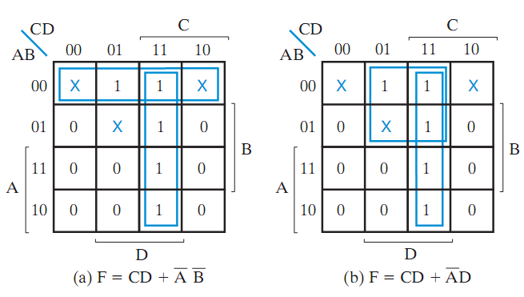
Example 2
F(A, B, C, D) = ∑ m(1, 3, 7, 11, 15) + ∑ d(0, 2, 5)
Two possible solutions!
Both acceptable.
All 1’s covered
Src: Mano’s Textbook

Slide 32
Definitions
An implicant is a product term of a function
Any group of 1’s in a K-Map
A prime implicant is a product term obtained by combining the maximum possible number of adjacent 1’s in a k-map
Biggest groups of 1’s
Not all prime implicants are needed!
If a minterm is covered by exactly one prime implicant then this prime implicant is called an essential prime implicant

Slide 33
Example
Y=1
Consider F(X,Y,Z) = Σm(1,3,4,5,6)
List all implicants, prime implicants and essential prime implicants
Solution:
Implicants: XY’Z’, XZ’, XY’, XY’Z, X’Y’Z, Y’Z, …
P.Is: XY’, XZ’, Y’Z, X’Z
EPIs: X’Z, XZ’
YZ X | 00 | 01 | 11 | 10
0 |  | 1 | 1
1 | 1 | 1 |  | 1
X=1
Z=1
Y=1
YZ X | 00 | 01 | 11 | 10
0 |  | 1 | 1
1 | 1 | 1 |  | 1
X=1
The simplest expression is NOT unique!
Z=1

Slide 34
Finding minimum SOP
Find each essential prime implicant and include it in the solution
If any minterms are not yet covered, find minimum number of prime implicants to cover them (minimize overlap).

Slide 35
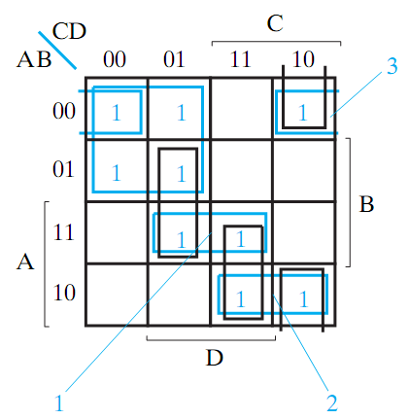
Example 2
Simplify F(A, B, C, D) = ∑ m(0, 1, 2, 4, 5, 10,11,13, 15)
Note:
Only A’C’ is E.P.I
For the remaining minterms:
Choose 1 and 2 (minimize overlap)
For m₂, choose either A’B’D’ or B’CD’
F = A’C’ + ABD + AB’C + A’B’D’
Src: Mano’s Textbook

Slide 36
5-variable K-maps
DE
A=0
A=1
BC
00 01 11 10
00 01 11 10
00
01
11
10
m₀ m₁ m₃ m₂
m₄ m₅ m₇ m₆
m₁₆ m₁₇ m₁₉ m₁₈
m₂₀ m₂₁ m₂₃ m₂₂
m₁₂ m₁₃ m₁₅ m₁₄
m₈ m₉ m₁₁ m₁₀
m₂₈ m₂₉ m₃₁ m₃₀
m₂₄ m₂₅ m₂₇ m₂₆
32 minterms require 32 squares in the k-map
Minterms 0-15 belong to the squares with variable A=0, and minterms 16-32 belong to the squares with variable A=1
Each square in A’ is also adjacent to a square in A (one is above the other)
Minterm 4 is adjacent to 20, and minterm 15 is to 31

Slide 37
Conclusion
A K-Map is simply a folded truth table, where physical adjacency implies logical adjacency
K-Maps are most commonly used hand method for logic minimization.

