Slide 1
COE 202: Digital Logic Design Combinational Logic Part 2
Courtesy of Dr. Ahmad Almulhem

Slide 2
Objectives
Minterms and Maxterms
From truth table to Boolean expression
Sum of minterms
Product of Maxterms
Standard and Canonical Forms
Implementation of Standard Forms
Practical Aspects of Logic Gates

Slide 3
Minterms
A product term is a term where literals are ANDed.
Example: x’y’, xz, xyz, …
A minterm is a product term in which all variables appear exactly once, in normal or complemented form
Example: F(x,y,z) has 8 minterms: x’y’z’, x’y’z, x’yz’, ...
In general, a function with n variables has 2^{n} minterms
A minterm equals 1 at exactly one input combination and is equal to 0 otherwise
Example: x’y’z’ = 1 only when x=0, y=0, z=0
A minterm is denoted as m_{i} where i corresponds the input combination at which this minterm is equal to 1

Slide 4
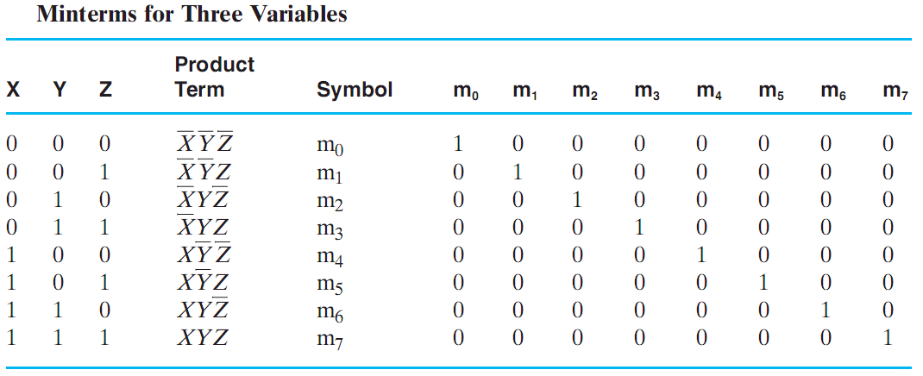
Minterms
Src: Mano’s book
m_{i} indicated the i^{th} minterm
i indicates the binary combination
m_{i} is equal to 1 for ONLY THAT combination
Variable complemented if 0
Variable uncomplemented if 1

Slide 5
Maxterms
A sum term is a term where literals are ORed.
Example: x’+y’, x+z, x+y+z, …
A maxterm is a sum term in which all variables appear exactly once, in normal or complemented form
Example: F(x,y,z) has 8 maxterms: (x+y+z), (x+y+z’), (x+y’+z), ...
In general, a function with n variables has 2^{n} maxterms
A maxterm equals 0 at exactly one input combination and is equal to 1 otherwise
Example: (x+y+z) = 0 only when x=0, y=0, z=0
A maxterm is denoted as M_{i} where i corresponds the input combination at which this maxterm is equal to 0

Slide 6
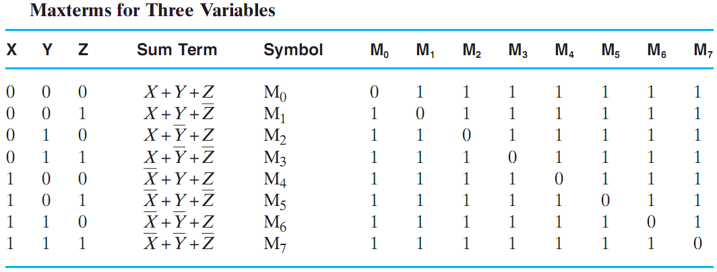
Maxterms
Src: Mano’s book
M_{i} indicated the i^{th} maxterm
i indicates the binary combination
M_{i} is equal to 0 for ONLY THAT combination
Variable complemented if 1
Variable not complemented if 0

Slide 7
Minterms and Maxterms
In general, a function of n variables has
2^{n} minterms: m₀, m₁, …, m₂^{n}₋₁
2^{n} maxterms: M₀, M₁, …, M₂^{n}₋₁
Minterms and maxterms are the complement of each other!
Example: F(X,Y):
m₂ = XY’ ➔ m₂’ = X’+Y = M₂

Slide 8
Expressing Functions with Minterms
A Boolean function can be expressed algebraically from a give truth table by forming the logical sum (OR) of ALL the minterms that produce 1 in the function
Example:
X | Y | Z | m | F
0 | 0 | 0 | m₀ | 1
0 | 0 | 1 | m₁ | 0
0 | 1 | 0 | m₂ | 1
0 | 1 | 1 | m₃ | 0
1 | 0 | 0 | m₄ | 0
1 | 0 | 1 | m₅ | 1
1 | 1 | 0 | m₆ | 0
1 | 1 | 1 | m₇ | 1
Consider the function defined by the truth table
F(X,Y,Z) = X’Y’Z’ + X’YZ’ + XY’Z + XYZ
= m₀ + m₂ + m₅ + m₇
= Σm(0,2,5,7)

Slide 9
Expressing Functions with Maxterms
A Boolean function can be expressed algebraically from a give truth table by forming the logical product (AND) of ALL the maxterms that produce 0 in the function
Example:
Consider the function defined by the truth table
F(X,Y,Z) = Π M(1,3,4,6)
Applying DeMorgan
F’ = m₁ + m₃ + m₄ + m₆
= Σm(1,3,4,6)
F = F’’ = [m₁ + m₃ + m₄ + m₆]’
= m₁’.m₃’.m₄’.m₆’
= M₁.M₃.M₄.M₆
= Π M(1,3,4,6)
X | Y | Z | M | F | F’
0 | 0 | 0 | M₀ | 1 | 0
0 | 0 | 1 | M₁ | 0 | 1
0 | 1 | 0 | M₂ | 1 | 0
0 | 1 | 1 | M₃ | 0 | 1
1 | 0 | 0 | M4 | 0 | 1
1 | 0 | 1 | M₅ | 1 | 0
1 | 1 | 0 | M₆ | 0 | 1
1 | 1 | 1 | M₇ | 1 | 0
Note the indices in this list are those that are
missing from the previous list in Σm(0,2,5,7)

Slide 10
Sum of Minterms vs Product of Maxterms
A Boolean function can be expressed algebraically as:
The sum of minterms
The product of maxterms
Given the truth table, writing F as
∑m_{i} – for all minterms that produce 1 in the table, or
ΠM_{i} – for all maxterms that produce 0 in the table
Minterms and Maxterms are complement of each other.

Slide 11
Example
Write E = Y’ + X’Z’ in the form of Σm_{i} and ΠM_{i}?
Solution: Method1
First construct the Truth Table as shown
Second:
E = Σm(0,1,2,4,5), and
E = ΠM(3,6,7)
X | Y | Z | m | M | E
0 | 0 | 0 | m₀ | M₀ | 1
0 | 0 | 1 | m₁ | M₁ | 1
0 | 1 | 0 | m₂ | M₂ | 1
0 | 1 | 1 | m₃ | M₃ | 0
1 | 0 | 0 | m₄ | M4 | 1
1 | 0 | 1 | m₅ | M₅ | 1
1 | 1 | 0 | m₆ | M₆ | 0
1 | 1 | 1 | m₇ | M₇ | 0

Slide 12
Example (Cont.)
Solution: Method2_a
E = Y’ + X’Z’
= Y’(X+X’)(Z+Z’) + X’Z’(Y+Y’)
= (XY’+X’Y’)(Z+Z’) + X’YZ’+X’Z’Y’
= XY’Z+X’Y’Z+XY’Z’+X’Y’Z’+ X’YZ’+X’Z’Y’
= m₅ + m₁ + m₄ + m₀ + m₂ + m₀
= m₀ + m₁ + m₂ + m₄ + m₅
= Σm(0,1,2,4,5)
To find the form ΠMi, consider the remaining indices
E = ΠM(3,6,7)
Solution: Method2_b
E = Y’ + X’Z’
E’ = Y(X+Z)
= YX + YZ
= YX(Z+Z’) + YZ(X+X’)
= XYZ+XYZ’+X’YZ
E = (X’+Y’+Z’)(X’+Y’+Z)(X+Y’+Z’)
= M₇ . M₆ . M₃
= ΠM(3,6,7)
To find the form Σm_{i}, consider the remaining indices
E = Σm(0,1,2,4,5)

Slide 13
Example
Question: F (a,b,c,d) = ∑m(0,1,2,4,5,7), What are the minterms and maxterms of F and and its complement F?
Solution:
F has 4 variables; 24 possible minterms/maxterms
F (a,b,c,d) = ∑m(0,1,2,4,5,7)
= Π M(3,6,8,9,10,11,12,13,14,15)
F (a,b,c,d) = ∑m(3,6,8,9,10,11,12,13,14,15)
= Π M(0,1,2,4,5,7)

Slide 14
Example
Question: F (a,b,c,d) = ∑m(0,1,2,4,5,7), What are the minterms and maxterms of F and and its complement F?
Solution:
F has 4 variables; 2⁴ = 16 possible minterms/maxterms
F (a,b,c,d) = ∑m(0,1,2,4,5,7)
= Π M(3,6,8,9,10,11,12,13,14,15)
F (a,b,c,d) = ∑m(3,6,8,9,10,11,12,13,14,15)
= Π M(0,1,2,4,5,7)

Slide 15
Canonical Forms
The sum of minterms and the product of maxterms forms are known as the canonical forms (الصيغ القانونية) of a function.

Slide 16
Standard Forms
Sum of Products (SOP) and Product of Sums (POS) are also standard forms
AB+CD = (A+C)(B+C)(A+D)(B+D)
The sum of minterms is a special case of the SOP form, where all product terms are minterms
The product of maxterms is a special case of the POS form, where all sum terms are maxterms

Slide 17
SOP and POS Conversion
SOP → POS
F = AB + CD
= (AB+C)(AB+D)
= (A+C)(B+C)(AB+D)
= (A+C)(B+C)(A+D)(B+D)
Hint 1: Use id15: X+YZ=(X+Y)(X+Z)
Hint 2: Factor
POS → SOP
F = (A’+B)(A’+C)(C+D)
= (A’+BC)(C+D)
= A’C+A’D+BCC+BCD
= A’C+A’D+BC+BCD
= A’C+A’D+BC
Hint 1: Use id15 (X+Y)(X+Z)=X+YZ
Hint 2: Multiply

Slide 18
SOP and POS Conversion
SOP → POS
F = AB + CD
= (AB+C)(AB+D)
= (A+C)(B+C)(AB+D)
= (A+C)(B+C)(A+D)(B+D)
Hint 1: Use id15: X+YZ=(X+Y)(X+Z)
Hint 2: Factor
POS → SOP
F = (A’+B)(A’+C)(C+D)
= (A’+BC)(C+D)
= A’C+A’D+BCC+BCD
= A’C+A’D+BC+BCD
= A’C+A’D+BC
Hint 1: Use id15 (X+Y)(X+Z)=X+YZ
Hint 2: Multiply
Question1: How to convert SOP to sum of minterms?
Question2: How to convert POS to product of maxterms?

Slide 19
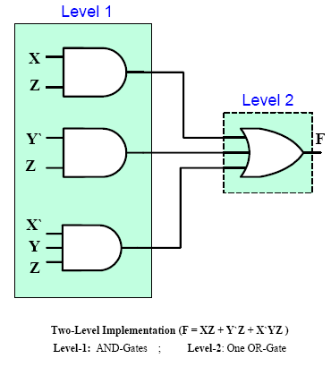
Implementation of SOP
Any SOP expression can be implemented using 2-levels of gates
The 1st level consists of AND gates, and the 2nd level consists of a single OR gate
Also called 2-level Circuit

Slide 20
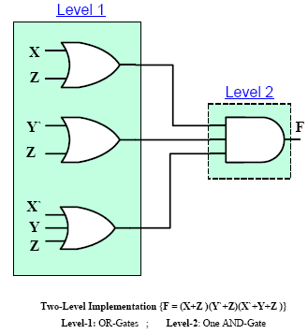
Implementation of POS
Any POS expression can be implemented using 2-levels of gates
The 1st level consists of OR gates, and the 2nd level consists of a single AND gate
Also called 2-level Circuit

Slide 21
Implementation of SOP
Consider F = AB + C(D+E)
This expression is NOT in the sum-of-products form
Use the identities/algebraic manipulation to convert to a standard form (sum of products), as in F = AB + CD + CE
Logic Diagrams:
A
A
B
B
C
F
F
C
D
C
D
E
E
3-level circuit
2-level circuit

Slide 22
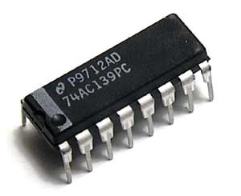
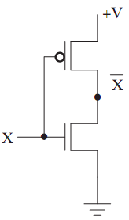
Practical Aspects of Logic Gates
Logic gates are built with transistors as integrated circuits (IC) or chips.
ICs are digital devices built using various technologies.
Complementary metal oxide semiconductor (CMOS) technology
Levels of Integration:
Small Scale Integrated (SSI) < 10 gates
Medium Scale Integrated (MSI) < 100 gates
Large Scale Integrated (LSI) < 1000 gates
Very Large Scale Integrated (VLSI) < 10⁶ gates
NOT gate

Slide 23
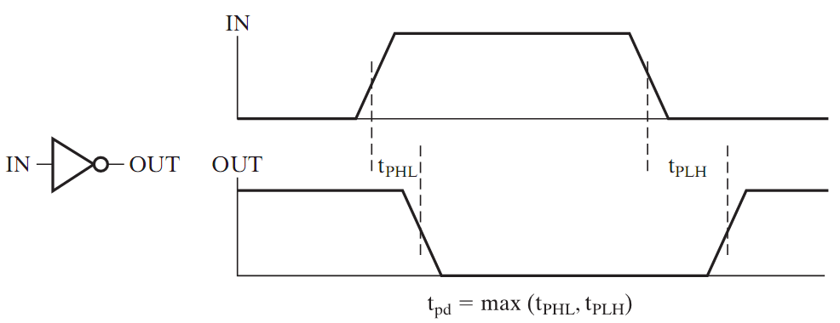
Propagation Delay
Propagation delay (t_{pd}) is the time for a change in the input of a gate to propagate to the output
High-to-low (t_{phl}) and low-to-high (t_{plh}) output signal changes may have different propagation delays
t_{pd} = max {t_{phl}, t_{phl})
A circuit is considered to be fast, if its propagation delay is less (ideally as close to 0 as possible)
Delay is usually measured
between the 50% levels
of the signal

Slide 24
Timing Diagram
The timing diagram shows the input and output signals in the form of a waveform
It also shows delays
X
Y
Z
Propagation Delay of the Circuit = τ
Inputs
Output
Timing Diagram for an AND gate
Time

Slide 25
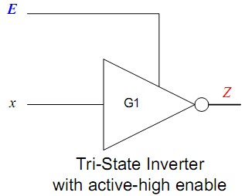
Tristate Gates
Gates with 3 output values 0, 1, Hi-Z
Hi-Z behaves like an open circuit.
E | X | Z
1 | 0 | 1
1 | 1 | 0
0 | 0 | High Z
0 | 1 | High Z

Slide 26
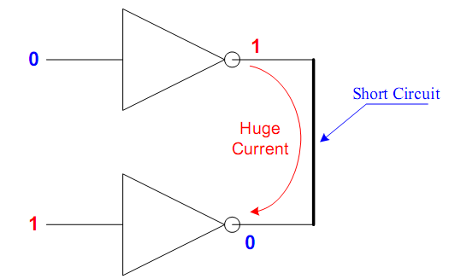
Tristate Gates
Q: Can we connect the outputs
of two gates?

Slide 27
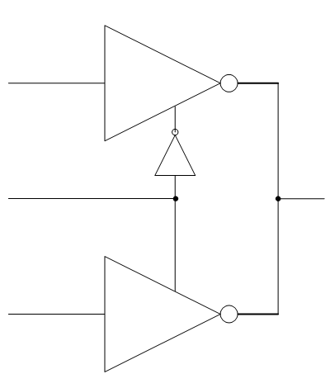
Tristate Gates
Q: Can we connect the outputs
of two gates?

Slide 28
Tristate Gates
Q: Can we connect the outputs
of two gates?
Two or more tri-state outputs may be
connected provided that only one
of these outputs is enabled while all
others are in the Hi-Z state.

