Slide 1
COE 202: Digital Logic Design Number Systems Part 1
Courtesy of Dr. Ahmad Almulhem

Slide 2
Objectives
Weighted (positional) number systems
Features of weighted number systems
Commonly used number systems
Important properties

Slide 3
Introduction
A number system is a set of numbers together with one or more operations (e.g. add, subtract).
Before digital computers, the only known number system is the decimal number system (النظام العشري)
It has a total of ten digits: {0,1,2,….,9}
From the previous lecture:
Digital systems deal with the binary system of numbering (i.e. only 0’s and 1’s)
Binary system has more reliability than decimal
All these numbering systems are also referred to as weighted numbering systems

Slide 4
Weighted Number System
A number D consists of n digits and each digit has a position.
Every digit position is associated with a fixed weight.
If the weight associated with the ith. position is w_{i}, then the value of D is given by:
D = d_{n-1} w_{n-1} + d_{n-2} w_{n-2} + ……+ d₁ w₁ + d₀ w₀
Also called positional number system

Slide 5
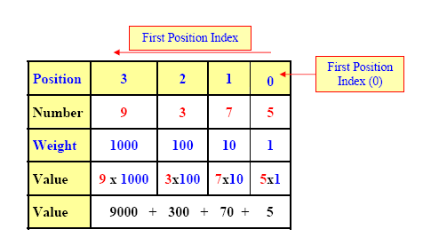
Example
9375
The Decimal number system is a weighted number system.
For integer decimal numbers, the weight of the rightmost digit (at position 0) is 1, the weight of position 1 digit is 10, that of position 2 digit is 100, position 3 is 1000, etc.

Slide 6
The Radix (Base)
A digit d_{i}, has a weight which is a power of some constant value called radix (r) or base such that w_{i} = r^{i}.
A number system of radix r, has r allowed digits {0,1,… (r-1)}
The leftmost digit has the highest weight and called Most Significant Digit (MSD)
The rightmost digit has the lowest weight and called Least Significant Digit (LSD)

Slide 7
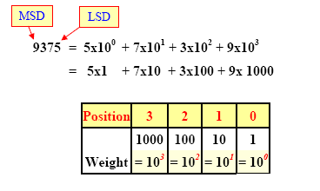
Example
Decimal Number System
Radix (base) = 10
w_{i} = r^{i}, so
w₀ = 10⁰ = 1,
w₁ = 10¹ = 10
…
w_{n} = r^{n}
Only 10 allowed digits {0,1,2,3,4,5,6,7,8,9}

Slide 8
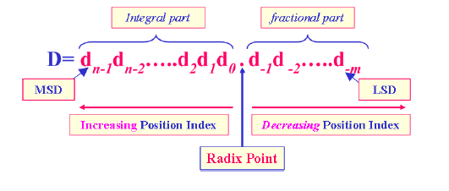
Fractions (Radix point)
A number D has n integral digits and m fractional digits
Digits to the left of the radix point (integral digits) have positive position indices, while digits to the right of the radix point (fractional digits) have negative position indices
The weight for a digit position i is given by w_{i} = r^{i}

Slide 9
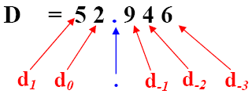
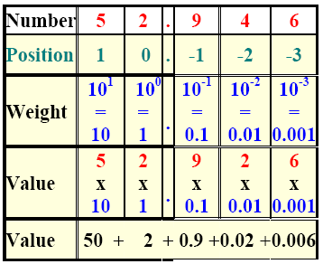
Example
For D = 52.946
n = 2
m = 3
r = 10 (decimal number)
The weighted representation for D is:
i = -3 d_{i}r^{i} = 6 x 10⁻³
i = -2 d_{i}r^{i} = 4 x 10⁻²
i = -1 d_{i}r^{i} = 9 x 10⁻¹
i = 0 d_{i}r^{i} = 2 x 10⁰
i = 1 d_{i}r^{i} = 5 x 10¹
4
+ 0.04 +

Slide 10
Notation
A number D with base r can be denoted as (D)_{r,}
Decimal number 128 can be written as (128)₁₀
Similarly a binary number is written as (10011)₂
Question: Are these valid numbers?
(9478)₁₀
(1289)₂
(111000)₂
(55)₅

Slide 11
Common Number Systems
Decimal Number System (base-10)
Binary Number System (base-2)
Octal Number System (base-8)
Hexadecimal Number System (base-16)

Slide 12
Binary Number System (base-2)
r = 2 = 2¹
Two allowed digits {0,1}
A Binary Digit is referred to as a bit
Examples: 1100111, 01, 0001, 11110
The left most bit is called the Most Significant Bit (MSB)
The rightmost bit is called the Least Significant Bit (LSB)
11110
Most Significant Bit
Least Significant Bit

Slide 13
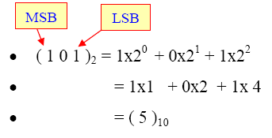
Binary Number System (base-2)
The decimal equivalent of a binary number can be found by expanding the number into a power series:
Question:
What is the decimal equivalent
of (110.11)₂ ?
Example

Slide 14
Binary Number System (base-2)
The decimal equivalent of a binary number can be found by expanding the number into a power series:
Question:
What is the decimal equivalent
of (110.11)₂ ?
Answer: (6.75)₁₀
Example

Slide 15
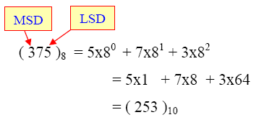
Octal Number System (base-8)
r = 8 = 2³
Eight allowed digits {0,1,2,3,4,5,6,7}
Useful to represent binary numbers indirectly
Octal and binary are nicely related; i.e. 8 = 2³
Each octal digit represent 3 binary digits (bits)
Example: (101)₂ = (5)₈
Getting the decimal equivalent is as usual
Example

Slide 16
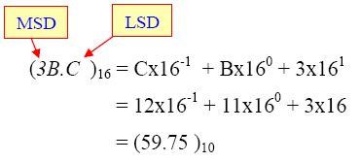
Hexadecimal (HEX) Number System (base-16)
r = 16 = 2⁴
16 allowed digits {0,1,2,3,4,5,6,7,8,9,A,B,C,D,E,F}
Useful to represent binary numbers indirectly
Hex and binary are nicely related; i.e. 16 = 2⁴
Each hex digit represent 4 binary digits (bits)
Example: (1010)₂ = (A)₁₆
Getting the decimal equivalent is as usual
Question:
(9E1)₁₆ = (?)₁₀
Example

Slide 17
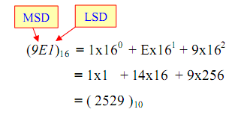
Hexadecimal (HEX) Number System (base-16)
r = 16 = 2⁴
16 allowed digits {0,1,2,3,4,5,6,7,8,9,A,B,C,D,E,F}
Useful to represent binary numbers indirectly
Hex and binary are nicely related; i.e. 16 = 2⁴
Each hex digit represent 4 binary digits (bits)
Example: (1010)₂ = (A)₁₆
Getting the decimal equivalent is as usual
Question:
(9E1)₁₆ = (?)₁₀
Example

Slide 18
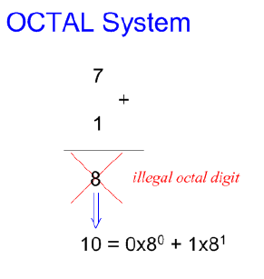
Examples
Question: What is the result of adding 1 to the largest digit of some number system?
(9)₁₀ + 1 = (10)₁₀
(7)₈ + 1 = (10)₈
(1)₂ + 1 = (10)₂
(F)₁₆ + 1 = (10)₁₆
Conclusion: Adding 1 to the largest digit in any number system always has a result of (10) in that number system.

Slide 19
Examples
Question: What is the largest value representable using 3 integral digits?
Answer: The largest value results when all 3 positions are filled with the largest digit in the number system.
For the decimal system, it is (999)₁₀
For the octal system, it is (777)₈
For the hex system, it is (FFF)₁₆
For the binary system, it is (111)₂

Slide 20
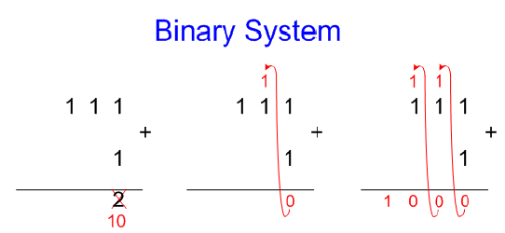
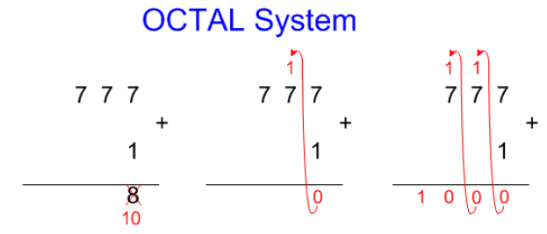
Examples
Question: What is the result of adding 1 to the largest 3-digit number?
For the decimal system, (1)₁₀ + (999)₁₀ = (1000)₁₀ = (10³)₁₀
For the octal system, (1)₈ + (777)₈ = (1000)₈ = (8³)₁₀
In general, for a number system of radix r, adding 1 to the largest n-digit number = r^{n}
Accordingly, the value of largest n-digit number = r^{n} -1

Slide 21
Important Properties
The number of possible digits in any number system with radix r equals r.
The smallest digit is 0 and the largest digit has a value (r - 1)
Example: Octal system, r = 8, smallest digit = 0, largest digit = 8 – 1 = 7
The Largest value that can be expressed in n integral digits is (r ^{n} - 1)
Example: n = 3, r = 10, largest value = 10³ -1 = 999

Slide 22
Important Properties
The Largest value that can be expressed in m fractional digits is (1 - r ^{-m})
Example: n=3, r = 10, largest value = 1-10⁻³ = 0.999
Largest value that can be expressed in n integral digits and m fractional digits is equal to (r ^{n} – r ^{-m})
Total number of values (patterns) representable in n digits is r ^{n}
Example: r = 2, n = 5 will generate 32 possible unique combinations of binary digits such as (00000 →11111)
Question: What about Intel 32-bit & 64-bit processors?

Slide 23
Conclusions
A weighted (positional) number system has a radix (base) and each digit has a position and weight
Commonly used number systems are decimal, binary, octal, hexadecimal (HEX)
A number D with base r can be denoted as (D)_{r,}
To convert from base-r to decimal, use
Weighted (positional) number systems have several important properties

