Slide 1
Intruders
&
Intrusion Detection Systems

Slide 2
Intruders
Three classes of intruders:
Masquerader
An individual who is not authorized to use the computer and who penetrates a system’s access controls to exploit a legitimate user’s account
Misfeasor
A legitimate user who accesses data, programs, or resources for which such access is not authorized, or who is authorized for such access but misuses his or her privileges
Clandestine user
An individual who seizes supervisory control of the system and uses this control to evade auditing and access controls or to suppress audit collection
Notes:
One of the two most publicized threats to security is the intruder (the other is
viruses), often referred to as a hacker or cracker. In an important early study of
intrusion, Anderson [ANDE80] identified three classes of intruders:
• Masquerader: An individual who is not authorized to use the computer and
who penetrates a system’s access controls to exploit a legitimate user’s account
• Misfeasor: A legitimate user who accesses data, programs, or resources for
which such access is not authorized, or who is authorized for such access but
misuses his or her privileges
• Clandestine user: An individual who seizes supervisory control of the system
and uses this control to evade auditing and access controls or to suppress audit
collection
The masquerader is likely to be an outsider, the misfeasor generally is an insider,
and the clandestine user can be either an outsider or an insider.

Slide 3
Examples of Intrusion
Performing a remote root compromise of an e-mail server
Defacing a Web server
Guessing and cracking passwords
Copying a database containing credit card numbers
Viewing sensitive data, including payroll records and medical information, without authorization
Running a packet sniffer on a workstation to capture usernames and passwords
Using a permission error on an anonymous FTP server to distribute pirated software and music files
Dialing into an unsecured modem and gaining internal network access
Posing as an executive, calling the help desk, resetting the executive’s e-mail password, and learning the new password
Using an unattended, logged-in workstation without permission
Notes:
Intruder attacks range from the benign to the serious. At the benign end of the
scale, there are many people who simply wish to explore internets and see what is
out there. At the serious end are individuals who are attempting to read privileged
data, perform unauthorized modifications to data, or disrupt the system.
[GRAN04] lists the following examples of intrusion:
• Performing a remote root compromise of an e-mail server
• Defacing a Web server
• Guessing and cracking passwords
• Copying a database containing credit card numbers
• Viewing sensitive data, including payroll records and medical information,
without authorization
• Running a packet sniffer on a workstation to capture usernames and passwords
• Using a permission error on an anonymous FTP server to distribute pirated
software and music files
• Dialing into an unsecured modem and gaining internal network access
• Posing as an executive, calling the help desk, resetting the executive’s e-mail
password, and learning the new password
• Using an unattended, logged-in workstation without permission

Slide 4
Hackers
Traditionally, those who hack into computers do so for the thrill of it or for status
Intrusion detection systems (IDSs) and intrusion prevention systems (IPSs) are designed to counter hacker threats
  In addition to using such systems, organizations can consider restricting remote logons to specific IP addresses and/or use virtual private network technology
CERTs
  Computer emergency response teams
  These cooperative ventures collect information about system vulnerabilities and disseminate it to systems managers
  Hackers also routinely read CERT reports
  It is important for system administrators to quickly insert all software patches to discovered vulnerabilities
Notes:
Traditionally, those who hack into computers do so for the thrill
of it or for status. The hacking community is a strong meritocracy in which status
is determined by level of competence. Thus, attackers often look for targets
of opportunity and then share the information with others. A typical example is a
break-in at a large financial institution reported in [RADC04]. The intruder took
advantage of the fact that the corporate network was running unprotected services,
some of which were not even needed. In this case, the key to the break-in was the
pcAnywhere application. The manufacturer, Symantec, advertises this program as
a remote control solution that enables secure connection to remote devices. But the
attacker had an easy time gaining access to pcAnywhere; the administrator used the
same three-letter username and password for the program. In this case, there was
no intrusion detection system on the 700-node corporate network. The intruder was
only discovered when a vice-president walked into her office and saw the cursor
moving files around on her Windows workstation.
Benign intruders might be tolerable, although they do consume resources and
may slow performance for legitimate users. However, there is no way in advance to
know whether an intruder will be benign or malign. Consequently, even for systems
with no particularly sensitive resources, there is a motivation to control this problem.
Intrusion detection systems (IDSs) and intrusion prevention systems (IPSs)
are designed to counter this type of hacker threat. In addition to using such systems,
organizations can consider restricting remote logons to specific IP addresses and/or
use virtual private network technology.
One of the results of the growing awareness of the intruder problem has been
the establishment of a number of computer emergency response teams (CERTs).
These cooperative ventures collect information about system vulnerabilities and disseminate
it to systems managers. Hackers also routinely read CERT reports. Thus,
it is important for system administrators to quickly insert all software patches to
discovered vulnerabilities. Unfortunately, given the complexity of many IT systems,
and the rate at which patches are released, this is increasingly difficult to achieve
without automated updating. Even then, there are problems caused by incompatibilities
resulting from the updated software. Hence the need for multiple layers of
defense in managing security threats to IT systems.

Slide 5
Criminal hackers
Organized groups of hackers
Usually have specific targets, or at least classes of targets in mind
Once a site is penetrated, the attacker acts quickly, scooping up as much valuable information as possible and exiting
IDSs and IPSs can be used for these types of attackers, but may be less effective because of the quick in-and-out nature of the attack
Notes:
Organized groups of hackers have become a widespread and common
threat to Internet-based systems. These groups can be in the employ of a corporation
or government but often are loosely affiliated gangs of hackers. Typically, these gangs
are young, often Eastern European, Russian, or southeast Asian hackers who do
business on the Web [ANTE06]. They meet in underground forums with names like
DarkMarket.org and theftservices.com to trade tips and data and coordinate attacks.
A common target is a credit card file at an e-commerce server. Attackers attempt to
gain root access. The card numbers are used by organized crime gangs to purchase
expensive items and are then posted to carder sites, where others can access and use
the account numbers; this obscures usage patterns and complicates investigation.
Whereas traditional hackers look for targets of opportunity, criminal hackers
usually have specific targets, or at least classes of targets in mind. Once a site
is penetrated, the attacker acts quickly, scooping up as much valuable information as
possible and exiting.
IDSs and IPSs can also be used for these types of attackers, but may be less
effective because of the quick in-and-out nature of the attack. For e-commerce
sites, database encryption should be used for sensitive customer information, especially
credit cards. For hosted e-commerce sites (provided by an outsider service),
the e-commerce organization should make use of a dedicated server (not used to
support multiple customers) and closely monitor the provider’s security services.

Slide 6
Insider Attacks
Among the most difficult to detect and prevent
Can be motivated by revenge or simply a feeling of entitlement
Countermeasures:
Enforce least privilege, only allowing access to the resources employees need to do their job
Set logs to see what users access and what commands they are entering
Protect sensitive resources with strong authentication
Upon termination, delete employee’s computer and network access
Upon termination, make a mirror image of employee’s hard drive before reissuing it (used as evidence if your company information turns up at a competitor)
Notes:
Insider attacks are among the most difficult to detect and prevent.
Employees already have access and knowledge about the structure and content of
corporate databases. Insider attacks can be motivated by revenge or simply a feeling
of entitlement. An example of the former is the case of Kenneth Patterson, fired
from his position as data communications manager for American Eagle Outfitters.
Patterson disabled the company’s ability to process credit card purchases during
five days of the holiday season of 2002. As for a sense of entitlement, there have
always been many employees who felt entitled to take extra office supplies for home
use, but this now extends to corporate data. An example is that of a vice-president
of sales for a stock analysis firm who quit to go to a competitor. Before she left, she
copied the customer database to take with her. The offender reported feeling no
animus toward her former employee; she simply wanted the data because it would
be useful to her.
Although IDS and IPS facilities can be useful in countering insider attacks,
other more direct approaches are of higher priority. Examples include the
following:
• Enforce least privilege, only allowing access to the resources employees need
to do their job.
• Set logs to see what users access and what commands they are entering.
• Protect sensitive resources with strong authentication.
• Upon termination, delete employee’s computer and network access.
• Upon termination, make a mirror image of employee’s hard drive before reissuing
it. That evidence might be needed if your company information turns up
at a competitor.
In this section, we look at the techniques used for intrusion. Then we examine
ways to detect intrusion.

Slide 7
Intrusion Techniques
Objective of the intruder is to gain access to a system or to increase the range of privileges accessible on a system
Most initial attacks use system or software vulnerabilities that allow a user to execute code that opens a backdoor into the system
Notes:
The objective of the intruder is to gain access to a system or to increase the range of
privileges accessible on a system. Most initial attacks use system or software vulnerabilities
that allow a user to execute code that opens a backdoor into the system.
Alternatively, the intruder attempts to acquire information that should have been
protected. In some cases, this information is in the form of a user password. With
knowledge of some other user’s password, an intruder can log in to a system and
exercise all the privileges accorded to the legitimate user.
Typically, a system must maintain a file that associates a password with each
authorized user. If such a file is stored with no protection, then it is an easy matter
to gain access to it and learn passwords. The password file can be protected in one
of two ways:
• One-way function: The system stores only the value of a function based on the
user’s password. When the user presents a password, the system transforms
that password and compares it with the stored value. In practice, the system
usually performs a one-way transformation (not reversible), in which the password
is used to generate a key for the one-way function and in which a fixed length
output is produced.
• Access control: Access to the password file is limited to one or a very few
accounts.

Slide 8
Intrusion Prevention
Want to keep bad guys out
Intrusion prevention is a traditional focus of computer security
  Authentication is to prevent intrusions
  Firewalls a form of intrusion prevention
  Virus defenses aimed at intrusion prevention
  Like locking the door on your car

Slide 9
Intrusion Detection
In spite of intrusion prevention, bad guys will sometime get in
Intrusion detection systems (IDS)
  Detect attacks in progress (or soon after)
  Look for unusual or suspicious activity
IDS evolved from log file analysis
IDS is currently a hot research topic
How to respond when intrusion detected?
  We don’t deal with this topic here…

Slide 10

Intrusion Detection
A system’s second line of defense
Is based on the assumption that the behavior of the intruder differs from that of a legitimate user in ways that can be quantified
Considerations:
  If an intrusion is detected quickly enough, the intruder can be identified and ejected from the system before any damage is done or any data are compromised
  An effective intrusion detection system can serve as a deterrent, so acting to prevent intrusions
  Intrusion detection enables the collection of information about intrusion techniques that can be used to strengthen the intrusion prevention facility
Notes:
Inevitably, the best intrusion prevention system will fail. A system’s second line
of defense is intrusion detection, and this has been the focus of much research in
recent years. This interest is motivated by a number of considerations, including the
following:
1. If an intrusion is detected quickly enough, the intruder can be identified and
ejected from the system before any damage is done or any data are compromised.
Even if the detection is not sufficiently timely to preempt the intruder,
the sooner that the intrusion is detected, the less the amount of damage and
the more quickly that recovery can be achieved.
2. An effective intrusion detection system can serve as a deterrent, so acting to
prevent intrusions.
3. Intrusion detection enables the collection of information about intrusion techniques
that can be used to strengthen the intrusion prevention facility.
Intrusion detection is based on the assumption that the behavior of the
intruder differs from that of a legitimate user in ways that can be quantified. Of
course, we cannot expect that there will be a crisp, exact distinction between an
attack by an intruder and the normal use of resources by an authorized user. Rather,
we must expect that there will be some overlap.

Slide 11
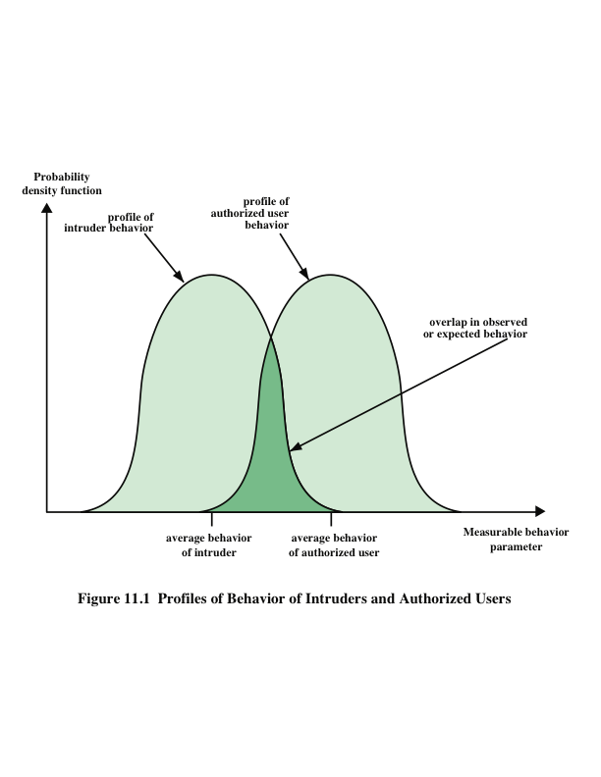
Notes:
Figure 11.1 suggests, in very abstract terms, the nature of the task confronting
the designer of an intrusion detection system. Although the typical behavior of an
intruder differs from the typical behavior of an authorized user, there is an overlap
in these behaviors. Thus, a loose interpretation of intruder behavior, which will catch
more intruders, will also lead to a number of false positives , or authorized users
identified as intruders. On the other hand, an attempt to limit false positives by a
tight interpretation of intruder behavior will lead to an increase in false negatives ,
or intruders not identified as intruders. Thus, there is an element of compromise and
art in the practice of intrusion detection.
In Anderson’s study [ANDE80], it was postulated that one could, with reasonable
confidence, distinguish between a masquerader and a legitimate user. Patterns
of legitimate user behavior can be established by observing past history, and significant
deviation from such patterns can be detected. Anderson suggests that the task
of detecting a misfeasor (legitimate user performing in an unauthorized fashion) is
more difficult, in that the distinction between abnormal and normal behavior may
be small. Anderson concluded that such violations would be undetectable solely
through the search for anomalous behavior. However, misfeasor behavior might
nevertheless be detectable by intelligent definition of the class of conditions that
suggest unauthorized use. Finally, the detection of the clandestine user was felt to
be beyond the scope of purely automated techniques. These observations, which
were made in 1980, remain true today.

Slide 12
Intrusion Detection Systems
Who is likely intruder?
  May be outsider who got thru firewall
  May be evil insider
What do intruders do?
  Launch well-known attacks
  Launch variations on well-known attacks
  Launch new/little-known attacks
  “Borrow” system resources
  Use compromised system to attack others
  etc.

Slide 13
IDS
Intrusion detection approaches
  Signature-based IDS
  Anomaly-based IDS
Intrusion detection architectures
  Host-based IDS
  Network-based IDS
Any IDS can be classified as above
  In spite of marketing claims to the contrary!

Slide 14
Host-Based IDS
Monitor activities on hosts for
  Known attacks
  Suspicious behavior
Designed to detect attacks such as
  Buffer overflow
  Escalation of privilege, …
Little or no view of network activities

Slide 15
Network-Based IDS
Monitor activity on the network for…
  Known attacks
  Suspicious network activity
Designed to detect attacks such as
  Denial of service
  Network probes
  Malformed packets, etc.
Some overlap with firewall
Little or no view of host-base attacks
Can have both host and network IDS

Slide 16
Signature Detection Example
Failed login attempts may indicate password cracking attack
IDS could use the rule “N failed login attempts in M seconds” as signature
If N or more failed login attempts in M seconds, IDS warns of attack
Note that such a warning is specific
  Admin knows what attack is suspected
  Easy to verify attack (or false alarm)

Slide 17
Signature Detection
Suppose IDS warns whenever N or more failed logins in M seconds
  Set N and M so false alarms not common
  Can do this based on “normal” behavior
But, if Trudy knows the signature, she can try N − 1 logins every M seconds…
Then signature detection slows down Trudy, but might not stop her

Slide 18
Signature Detection
Many techniques used to make signature detection more robust
Goal is to detect “almost” signatures
For example, if “about” N login attempts in “about” M seconds
  Warn of possible password cracking attempt
  What are reasonable values for “about”?
  Can use statistical analysis, heuristics, etc.
  Must not increase false alarm rate too much

Slide 19
Signature Detection
Advantages of signature detection
  Simple
  Detect known attacks
  Know which attack at time of detection
  Efficient (if reasonable number of signatures)
Disadvantages of signature detection
  Signature files must be kept up to date
  Number of signatures may become large
  Can only detect known attacks
  Variation on known attack may not be detected

Slide 20
Anomaly Detection
Anomaly detection systems look for unusual or abnormal behavior
There are (at least) two challenges
  What is normal for this system?
  How “far” from normal is abnormal?
No avoiding statistics here!
  mean defines normal
  variance gives distance from normal to abnormal

Slide 21
How to Measure Normal?
How to measure normal?
  Must measure during “representative” behavior
  Must not measure during an attack…
  …or else attack will seem normal!
  Normal is statistical mean
  Must also compute variance to have any reasonable idea of abnormal

Slide 22
How to Measure Abnormal?
Abnormal is relative to some “normal”
  Abnormal indicates possible attack
Statistical discrimination techniques include
  Bayesian statistics
  Linear discriminant analysis (LDA)
  Quadratic discriminant analysis (QDA)
  Neural nets, hidden Markov models (HMMs), etc.
Fancy modeling techniques also used
  Artificial intelligence
  Artificial immune system principles
  Many, many, many others

Slide 23
Anomaly Detection (1)
Suppose we monitor use of three commands:
open, read, close
Under normal use we observe Alice:
open, read, close, open, open, read, close, …
Of the six possible ordered pairs, we see four pairs are normal for Alice,
(open,read), (read,close), (close,open), (open,open)
Can we use this to identify unusual activity?

Slide 24
Anomaly Detection (1)
We monitor use of the three commands
open, read, close
If the ratio of abnormal to normal pairs is “too high”, warn of possible attack
Could improve this approach by
  Also use expected frequency of each pair
  Use more than two consecutive commands
  Include more commands/behavior in the model
  More sophisticated statistical discrimination

Slide 25
Anomaly Detection (2)
Over time, Alice has accessed file F_{n} at rate H_{n}
Recently, “Alice” has accessed F_{n} at rate A_{n}
H₀ | H₁ | H₂ | H₃
.10 | .40 | .40 | .10
A₀ | A₁ | A₂ | A₃
.10 | .40 | .30 | .20
Is this normal use for Alice?
We compute S = (H₀−A₀)²+(H₁−A₁)²+…+(H₃−A₃)² = .02
  We consider S < 0.1 to be normal, so this is normal
How to account for use that varies over time?

Slide 26
Anomaly Detection (2)
To allow “normal” to adapt to new use, we update averages: H_{n} = 0.2A_{n} + 0.8H_{n}
In this example, H_{n} are updated… H₂=.2∗.3+.8∗.4=.38 and H₃=.2∗.2+.8∗.1=.12
And we now have
H₀ | H₁ | H₂ | H₃
.10 | .40 | .38 | .12

Slide 27
Anomaly Detection (2)
The updated long term average is
Suppose new observed rates…
H₀ | H₁ | H₂ | H₃
.10 | .40 | .38 | .12
A₀ | A₁ | A₂ | A₃
.10 | .30 | .30 | .30
Is this normal use?
Compute S = (H₀−A₀)²+…+(H₃−A₃)² = .0488
  Since S = .0488 < 0.1 we consider this normal
And we again update the long term averages:
H_{n} = 0.2A_{n} + 0.8H_{n}

Slide 28
Anomaly Detection (2)
The starting averages were:
After 2 iterations, averages are:
H₀ | H₁ | H₂ | H₃
.10 | .40 | .40 | .10
H₀ | H₁ | H₂ | H₃
.10 | .38 | .364 | .156
Statistics slowly evolve to match behavior
This reduces false alarms for SA
But also opens an avenue for attack…
  Suppose Trudy always wants to access F₃
  Can she convince IDS this is normal for Alice?

Slide 29
Anomaly Detection (2)
To make this approach more robust, must incorporate the variance
Can also combine N stats S_{i} as, say,
T = (S₁ + S₂ + S₃ + … + S_{N}) / N
to obtain a more complete view of “normal”
Similar (but more sophisticated) approach is used in an IDS known as NIDES
NIDES combines anomaly & signature IDS

Slide 30
Anomaly Detection Issues
Systems constantly evolve and so must IDS
  Static system would place huge burden on admin
  But evolving IDS makes it possible for attacker to (slowly) convince IDS that an attack is normal
  Attacker may win simply by “going slow”
What does “abnormal” really mean?
  Indicates there may be an attack
  Might not be any specific info about “attack”
  How to respond to such vague information?
  In contrast, signature detection is very specific

Slide 31
Anomaly Detection
Advantages?
  Chance of detecting unknown attacks
Disadvantages?
  Cannot use anomaly detection alone…
  …must be used with signature detection
  Reliability is unclear
  Anomaly detection indicates “something unusual”, but lacks specific info on possible attack

Slide 32
Anomaly Detection: The Bottom Line
Anomaly-based IDS is active research topic
Many security experts have high hopes for its ultimate success
Often cited as key future security technology
Hackers are not convinced!
  Title of a talk at Defcon: “Why Anomaly-based IDS is an Attacker’s Best Friend”
Anomaly detection is difficult and tricky
As hard as AI?

Slide 33
Honeypots
Decoy systems that are designed to lure a potential attacker away from critical systems
Because any attack against the honeypot is made to seem successful, administrators have time to mobilize and log and track the attacker without ever exposing productive systems
Recent research has focused on building entire honeypot networks that emulate an enterprise, possible with actual or simulated traffic and data
Has no production value
These systems are filled with fabricated information designed to appear valuable but that a legitimate user of the system wouldn’t access
Thus, any attempt to communicate with the system is most likely a probe, scan, or attack
Designed to:
Divert an attacker from accessing critical systems
Collect information about the attacker’s activity
Encourage the attacker to stay on the system long enough for administrators to respond
Notes:
A relatively recent innovation in intrusion detection technology is the honeypot.
Honeypots are decoy systems that are designed to lure a potential attacker away
from critical systems. Honeypots are designed to
• divert an attacker from accessing critical systems
• collect information about the attacker’s activity
• encourage the attacker to stay on the system long enough for administrators
to respond
These systems are filled with fabricated information designed to appear valuable
but that a legitimate user of the system wouldn’t access. Thus, any access to
the honeypot is suspect. The system is instrumented with sensitive monitors and
event loggers that detect these accesses and collect information about the attacker’s
activities. Because any attack against the honeypot is made to seem successful,
administrators have time to mobilize and log and track the attacker without ever
exposing productive systems.
The honeypot is a resource that has no production value. There is no legitimate
reason for anyone outside the network to interact with a honeypot. Thus, any
attempt to communicate with the system is most likely a probe, scan, or attack.
Conversely, if a honeypot initiates outbound communication, the system has probably
been compromised.
Initial efforts involved a single honeypot computer with IP addresses designed
to attract hackers. More recent research has focused on building entire honeypot networks
that emulate an enterprise, possibly with actual or simulated traffic and data.
Once hackers are within the network, administrators can observe their behavior
in detail and figure out defenses.

Slide 34
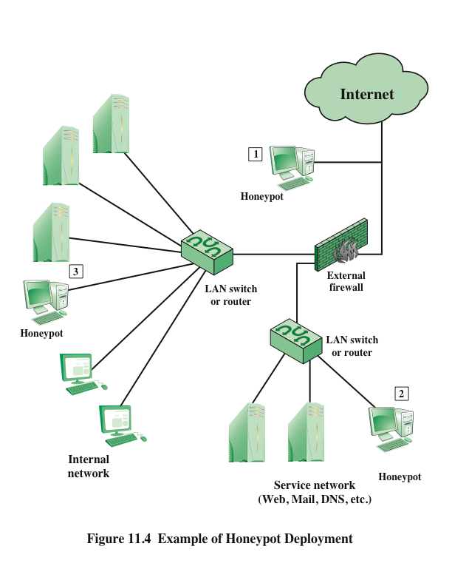
Notes:
Honeypots can be deployed in a variety of locations. Figure 11.4 illustrates
some possibilities. The location depends on a number of factors, such as the type
of information the organization is interested in gathering and the level of risk that
organizations can tolerate to obtain the maximum amount of data.
A honeypot outside the external firewall (location 1 ) is useful for tracking
attempts to connect to unused IP addresses within the scope of the network.
A honeypot at this location does not increase the risk for the internal network. The
danger of having a compromised system behind the firewall is avoided. Further,
because the honeypot attracts many potential attacks, it reduces the alerts issued
by the firewall and by internal IDS sensors, easing the management burden. The
disadvantage of an external honeypot is that it has little or no ability to trap internal
attackers, especially if the external firewall filters traffic in both directions.
The network of externally available services, such as Web and mail, often
called the DMZ (demilitarized zone), is another candidate for locating a honeypot
(location 2 ). The security administrator must assure that the other systems in the
DMZ are secure against any activity generated by the honeypot. A disadvantage of
this location is that a typical DMZ is not fully accessible, and the firewall typically
blocks traffic to the DMZ that attempts to access unneeded services. Thus, the firewall
either has to open up the traffic beyond what is permissible, which is risky, or
limit the effectiveness of the honeypot.
A fully internal honeypot (location 3 ) has several advantages. Its most important
advantage is that it can catch internal attacks. A honeypot at this location can
also detect a misconfigured firewall that forwards impermissible traffic from the
Internet to the internal network. There are several disadvantages. The most serious
of these is if the honeypot is compromised so that it can attack other internal
systems. Any further traffic from the Internet to the attacker is not blocked by the
firewall because it is regarded as traffic to the honeypot only. Another difficulty for
this honeypot location is that, as with location 2, the firewall must adjust its filtering
to allow traffic to the honeypot, thus complicating firewall configuration and potentially
compromising the internal network.

