Slide 1
COE 561 Digital System Design & Synthesis Introduction
Dr. Aiman H. El-Maleh
Computer Engineering Department
King Fahd University of Petroleum & Minerals
[Adapted from slides of Prof. G. De Micheli: Synthesis & Optimization of Digital Circuits]

Slide 2
Outline
Welcome to COE 561
Course Topics
Microelectronics
Design Styles
Design Domains and Levels of Abstractions
Digital System Design
Synthesis Process
Design Optimization

Slide 3
Welcome to COE 561
Instructor: Dr. Aiman H. El-Maleh
Office: Building 22, Room 407-5
Office Phone: 2811
Office Hours: SMW 11:00-12:00
Email:
aimane@kfupm.edu.sa

Slide 4
Course Objectives …
After successfully completing the course, students will be able to:
Represent Boolean functions using binary decision diagrams and other canonical representations.
Solve covering and satisfiability problems.
Employ heuristic and exact two-level logic minimization techniques and understand testability properties of two-level logic circuits.
Employ multi-level logic synthesis and optimization techniques targeting both area and speed and understand testability properties of multi-level circuits.

Slide 5
… Course Objectives
Employ sequential logic synthesis techniques including state minimization, state encoding and retiming.
Employ technology mapping techniques for mapping circuits to a target library optimizing both area and speed.
Employ high-level synthesis techniques including scheduling and allocation for architectural synthesis of circuits.

Slide 6
Grading Policy
Discussions 5%
Assignments 10%
Paper Presentations 10%
Project 20%
Exam I 15% (Th. Oct. 20, 2011)
Exam II 20% (Th. Dec. 08, 2011)
Final 20%
Late assignments will be accepted (up to 3 days) but you will be penalized 10% per each late day.
A student caught cheating in any of the assignments will get 0 out of 10%.
No makeup will be made for missing Exams.

Slide 7
Course Topics …
INTRODUCTION (1.5 week)
Microelectronics, semiconductor technologies, microelectronic design styles, design representations, levels of abstraction & domains, Y-chart, system synthesis and optimization, issues in system synthesis.
LOGIC SYNTHESIS (11.5 weeks)
Introduction to logic synthesis (2 weeks)
Boolean functions representation, Binary Decision Diagrams, Satisfiability and Cover problems

Slide 8
… Course Topics …
Two-level logic synthesis and optimization (3 weeks)
Logic minimization principles, Exact logic minimization, Heuristic logic minimization, The Espresso minimizer, Testability properties of two-level circuits.
Multi-level logic synthesis and optimization (3 .5 week)
Models and transformations of combinational networks: elimination, decomposition, extraction.
The algebraic model: algebraic divisors, kernel set computation, algebraic extraction and decomposition.
The Boolean model: Don’t care conditions and their computations, input controllability and output observability don’t care sets, Boolean simplification and substitution.
Testability properties of multilevel circuits.
Synthesis of minimal delay circuits. Rule-based systems for logic optimization.

Slide 9
… Course Topics …
Sequential Logic Synthesis (2 weeks)
Introduction to FSM Networks, Finite state minimization, state encoding: state encoding for two-level circuits, state encoding for multilevel circuits, Finite state machine decomposition, Retiming, and Testability consideration for synchronous sequential circuits.
Technology Mapping (1 week)
Problem formulation and analysis, Library binding approaches – Structural matching, Boolean matching, Covering & Rule based approach.

Slide 10
… Course Topics …
HIGH LEVEL SYNTHESIS (2 weeks)
Design representation and transformations (0.5 week)
Design flow in high level synthesis, HDL compilation, internal representation (CDFG), data flow and control sequencing graphs, data-flow based transformations.
Architectural Synthesis (0.5 week)
Circuit specifications: resources and constraints, scheduling, binding, area and performance optimization, datapath synthesis, control unit synthesis.

Slide 11
… Course Topics
Scheduling (0.5 week)
Unconstrained scheduling: ASAP scheduling, Latency-constrained scheduling: ALAP scheduling, time-constrained scheduling, resource constrained scheduling, Heuristic scheduling algorithms: List scheduling, force-directed scheduling.
Allocation and Binding (0.5 week)
resource sharing, register sharing, multi-port memory binding, bus sharing and binding, unconstrained minimum-performance-constrained binding, concurrent binding and scheduling.

Slide 12
Microelectronics
Enabling and strategic technology for development of hardware and software.
Primary markets
Information systems.
Telecommunications.
Consumer.
Trends in microelectronics
Improvements in device technology
Smaller circuits.
Higher performance.
More devices on a chip.
Higher degree of integration
More complex systems.
Lower cost in packaging and interconnect.
Higher performance.
Higher reliability.

Slide 13
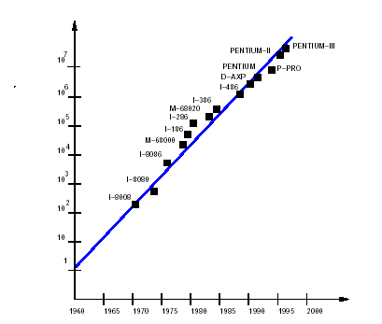
Moore’s Law
Moore's Law states that the number of transistors on a chip doubles every 18 months.

Slide 14
Microelectronic Design Problems
Use most recent technologies: to be competitive in performance.
Reduce design cost: to be competitive in price.
Speed-up design time: Time-to-market is critical.
Design Cost
Design time and fabrication cost.
Large capital investment on refining manufacturing process.
Near impossibility to repair integrated circuits.
Recapture costs
Large volume production is beneficial.
Zero-defect designs are essential.

Slide 15
Microelectronic Circuits
General-purpose processors
High-volume sales.
High performance.
Application-Specific Integrated Circuits (ASICs)
Varying volumes and performances.
Large market share.
Prototypes.
Special applications (e.g. space).

Slide 16
Computer-Aided Design
Enabling design methodology.
Makes electronic design possible
Large scale design management.
Design optimization
Feasible implementation choices grow rapidly with circuit size.
Reduced design time.
CAD tools have reached good level of maturity.
Continuous growth in circuit size and advances in technology requires CAD tools with increased capability.
CAD tools affected by
Semiconductor technology
Circuit type

Slide 17
Microelectronics Design Styles
Adapt circuit design style to market requirements.
Parameters
Cost.
Performance.
Volume.
Full custom
Maximal freedom
High performance blocks
Slow design time
Semi-custom
Standard Cells
Gate Arrays
Mask Programmable (MPGAs)
Field Programmable (FPGAs)
Silicon Compilers & Parametrizable Modules (adder, multiplier, memories)

Slide 18
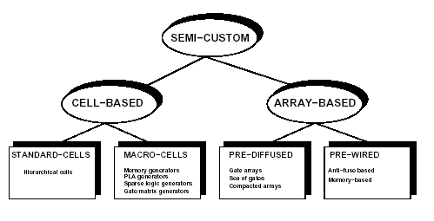
Semi-Custom Design Styles

Slide 19
Standard Cells
Cell library
Cells are designed once.
Cells are highly optimized.
Layout style
Cells are placed in rows.
Channels are used for wiring.
Over the cell routing.
Compatible with macro-cells (e.g. RAMs).

Slide 20
Macro Cells
Module generators
Synthesized layout.
Variable area and aspect-ratio.
Examples
RAMs, ROMs, PLAs, general logic blocks.
Features
Layout can be highly optimized.
Structured-custom design.

Slide 21
Array-Based Design
Pre-diffused arrays
Personalization by metallization/contacts.
Mask-Programmable Gate-Arrays (MPGAs).
Pre-wired arrays
Personalization on the field.
Field-Programmable Gate-Arrays (FPGAs).

Slide 22
MPGAs & FPGAs
MPGAs
Array of sites
Each site is a set of transistors.
Batches of wafers can be pre-fabricated.
Few masks to personalize chip.
Lower cost than cell-based design.
FPGAs
Array of cells
Each cell performs a logic function.
Personalization
Soft: memory cell (e.g. Xilinx).
Hard: Anti-fuse (e.g. Actel).
Immediate turn-around (for low volumes).
Inferior performances and density.
Good for prototyping.

Slide 23
Semi-Custom Style Trade-off
 | Custom | Cell-based | Pre-Diff. | Pre-Wired
Density | Very High | High | High | Medium-Low
Performance | Very High | High | High | Medium-Low
Flexibility | Very High | High | Medium | Low
Design Time | Very Long | Short | Short | Very Short
Man. Time | Medium | Medium | Short | Very Short
Cost - lv | Very High | High | High | Low
Cost - hv | Low | Low | Low | Medium-High

Slide 24
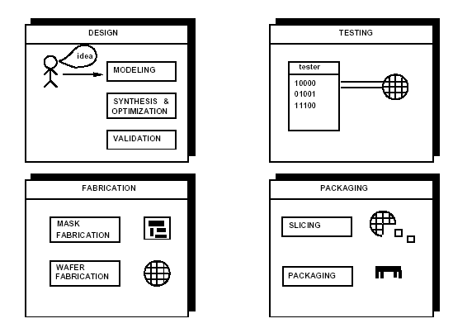
Microelectronic Circuit Design and Production

Slide 25
How to Deal with Design Complexity?
Moore’s Law: Number of transistors that can be packed on a chip doubles every 18 months while the price stays the same.
Hierarchy: structure of a design at different levels of description.
Abstraction: hiding the lower level details.

Slide 26
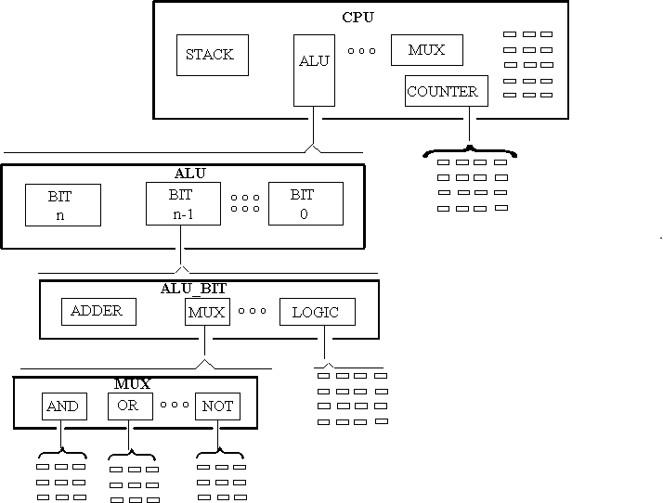
Design Hierarchy
Bottom
–
UP
Top
–
Down

Slide 27
Abstractions
An Abstraction is a simplified model of some Entity which hides certain amount of the internal details of this Entity.
Lower Level abstractions give more details of the modeled Entity.
Several levels of abstractions (details) are commonly used:
System Level
Chip Level
Register Level
Gate Level
Circuit (Transistor) Level
Layout (Geometric) Level
More Details
(Less Abstract)

Slide 28
Design Domains & Levels of Abstraction
Designs can be expressed / viewed in one of three possible domains
Behavioral Domain (Behavioral View)
Structural/Component Domain (Structural View)
Physical Domain (Physical View)
A design modeled in a given domain can be represented at several levels of abstraction (Details).

Slide 29
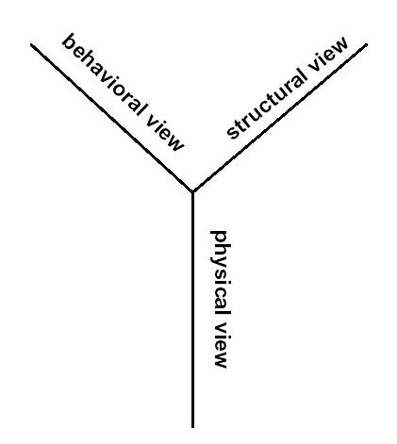
Modeling Views
Behavioral view
Abstract function.
Structural view
An interconnection of parts.
Physical view
Physical objects with size
and positions.

Slide 30
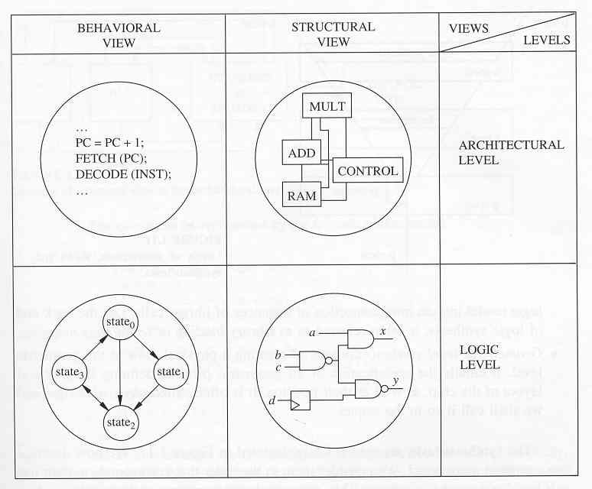
Levels of Abstractions & Corresponding Views

Slide 31
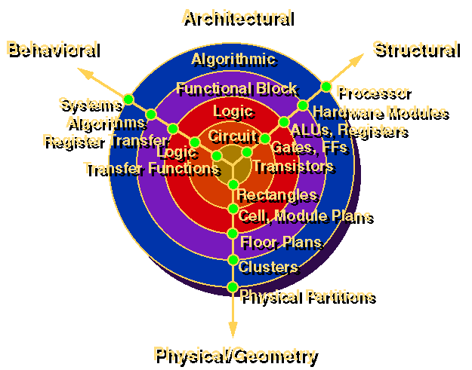
Gajski and Kuhn's Y Chart

Slide 32
Design Domains & Levels of Abstraction

Slide 33
Digital System Design
Realization of a specification subject to the optimization of
Area (Chip, PCB)
Lower manufacturing cost
Increase manufacturing yield
Reduce packaging cost
Performance
Propagation delay (combinational circuits)
Cycle time and latency (sequential circuits)
Throughput (pipelined circuits)
Power dissipation
Testability
Earlier detection of manufacturing defects lowers overall cost
Design time (time-to-market)
Cost reduction
Be competitive

Slide 34
Design vs. Synthesis
Design
A sequence of synthesis steps down to a level of abstraction which is manufacturable.
Synthesis
Process of transforming H/W from one level of abstraction to a lower one.
Synthesis may occur at many different levels of abstraction
Behavioral or High-level synthesis
Logic synthesis
Layout synthesis

Slide 35
Digital System Design Cycle
Design Idea → System Specification
Behavioral (Functional) Design
Pseudo Code, Flow Charts
Architecture Design
Bus & Register Structure
Logic Design
Netlist (Gate & Wire Lists)
Circuit Design
Transistor List
Physical Design
VLSI / PCB Layout
Fabrication & Packaging

Slide 36
Synthesis Process

Slide 37
Circuit Synthesis
Architectural-level synthesis
Determine the macroscopic structure
Interconnection of major building blocks.
Logic-level synthesis
Determine the microscopic structure
Interconnection of logic gates.
Geometrical-level synthesis (Physical design)
Placement and routing.
Determine positions and connections.

Slide 38
Architecture Design

Slide 39
Behavioral or High-Level Synthesis
The automatic generation of data path and control unit is known as high-level synthesis.
Tasks involved in HLS are scheduling and allocation.
Scheduling distributes the execution of operations throughout time steps.
Allocation assigns hardware to operations and values.
Allocation of hardware cells includes functional unit allocation, register allocation and bus allocation.
Allocation determines the interconnections required.

Slide 40
Behavioral Description and its Control Data Flow Graph (CDFG)
X = W + ( S * T )
Y = ( S * T ) + ( U * V )
Scheduled CDFG
W S T U V
(a)
CDFG
1
*
W S T U V
*
*
2
+
*
+
+
3
+
X Y
X Y
(b)
(c)

Slide 41
Resulting Architecture Design
Bus 1
Data Path
X
Y
W
S
U
T
V
MUX
Z
MUX
MUX
+
*

Slide 42
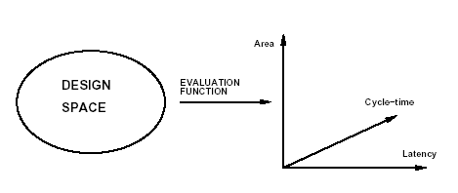
Design Space and Evaluation Space
Design space: All feasible implementations of a circuit.
Each design point has values for objective evaluation functions e.g. area.
The multidimensional space spanned by the different objectives is called design evaluation space.

Slide 43
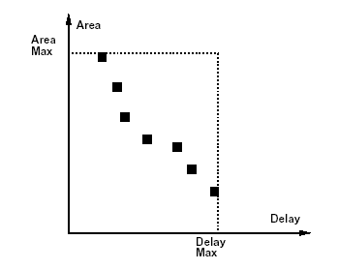
Optimization Trade-Off in Combinational Circuits

Slide 44
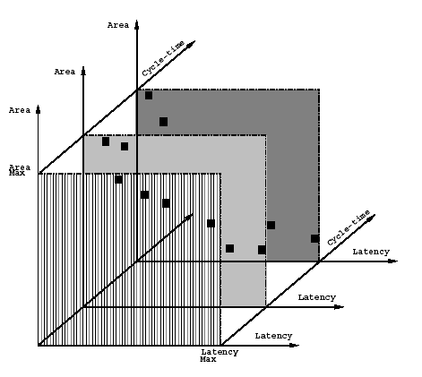
Optimization Trade-Off in Sequential Circuits

Slide 45
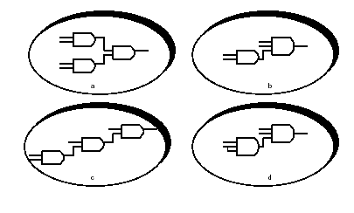
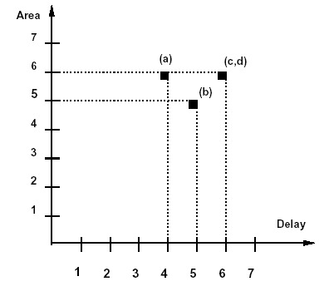
Combinational Circuit Design Space Example
Implement f = p q r s with 2-input or 3-input AND gates.
Area and delay proportional to number of inputs.

Slide 46
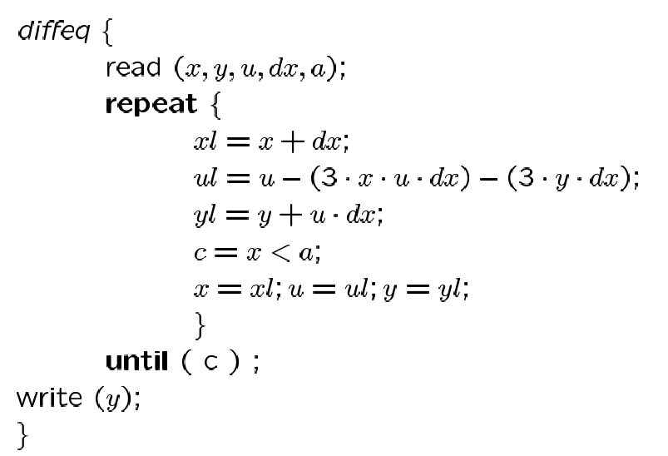
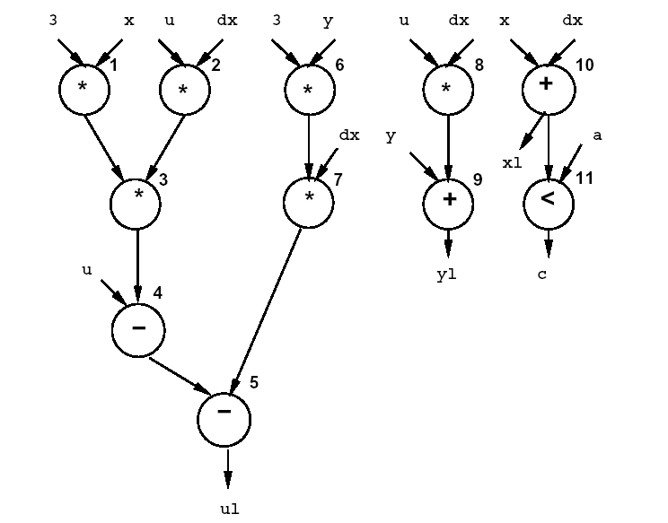
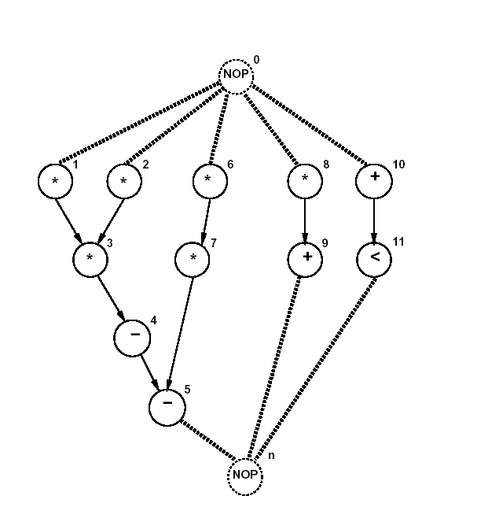
Architectural Design Space Example …

Slide 47
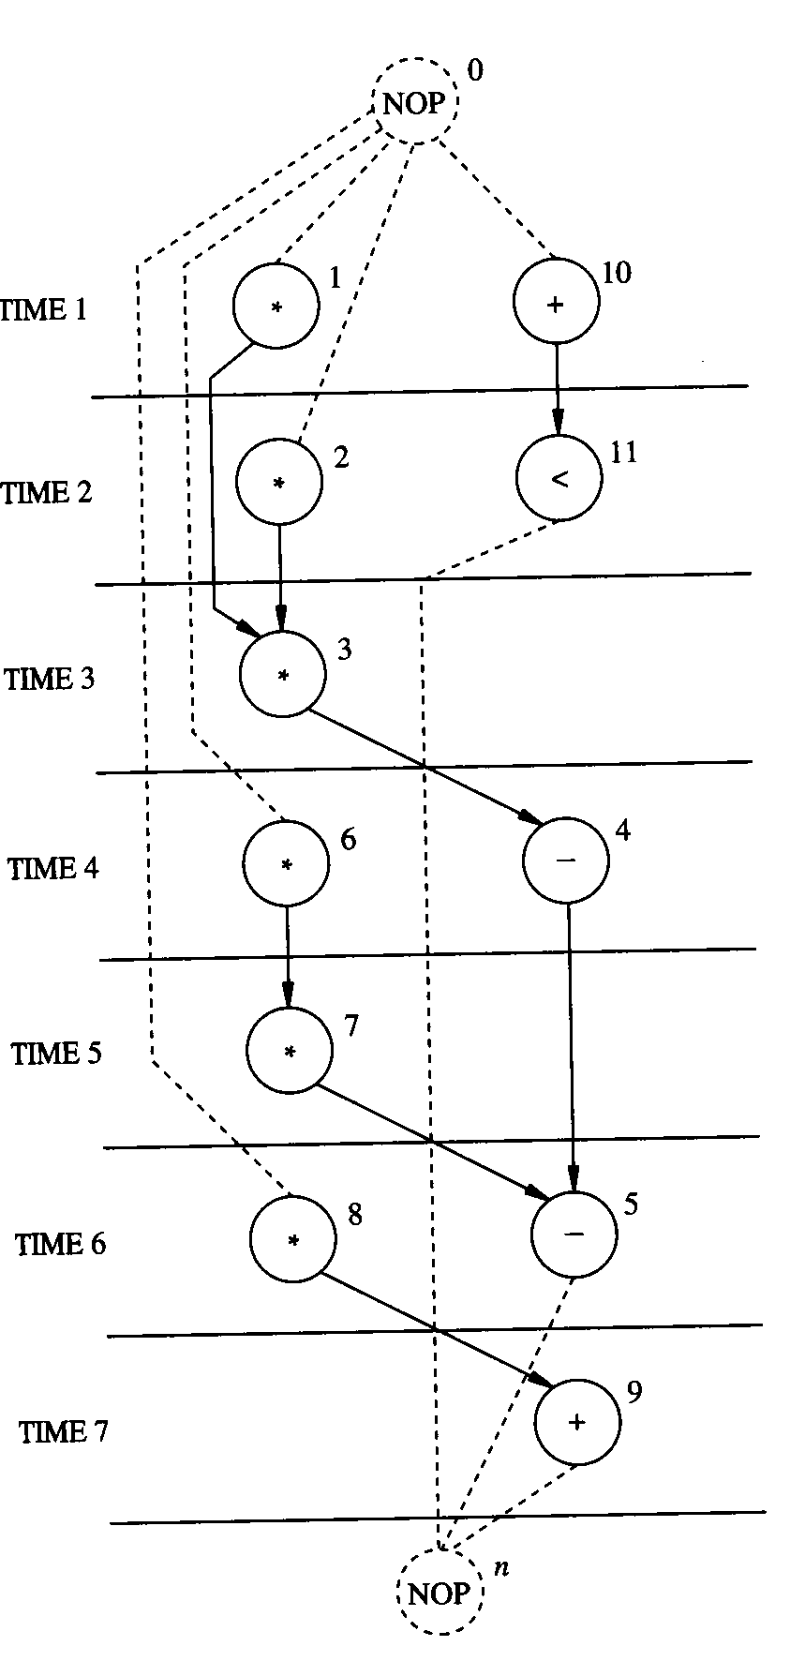
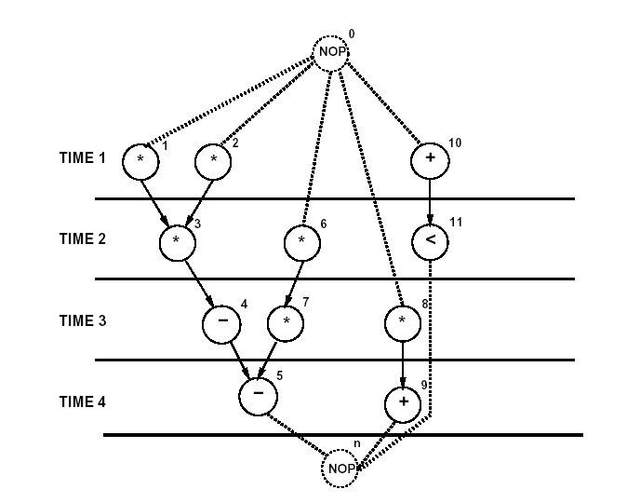
… Architectural Design Space Example …
1 Multiplier , 1 ALU
2 Multipliers, 2 ALUs

Slide 48
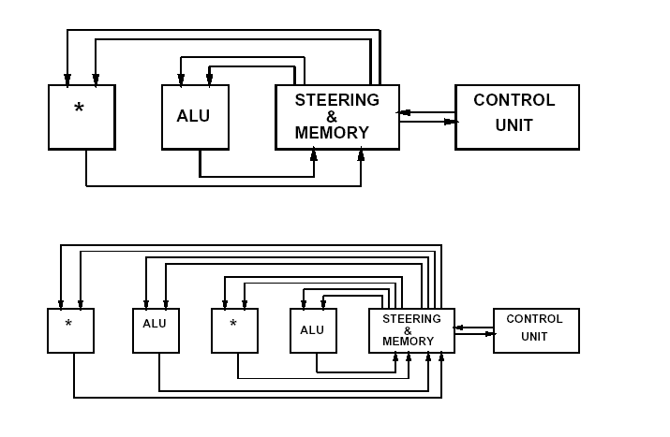
… Architectural Design Space Example …

Slide 49
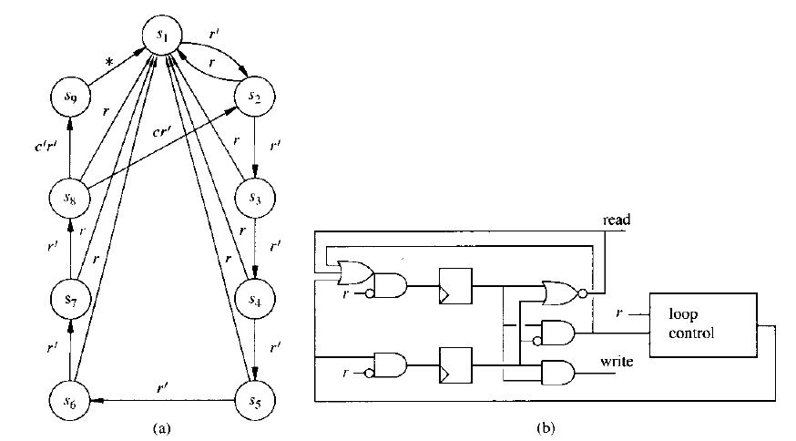
… Architectural Design Space Example
Control Unit for first architecture (9 control steps)
One state for reading data
One state for writing data
7 states for loop execution

Slide 50
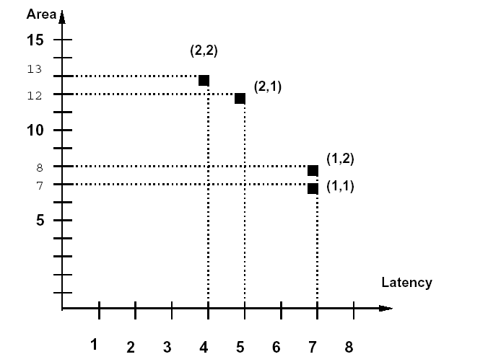
Area vs. Latency Tradeoffs
Multiplier Area: 5
Adder Area: 1
Other logic Area: 1

Slide 51
Pareto Optimality
A point of a design is called a Pareto Point if there is no other point in the design space with all objectives having lower value.
Pareto points represent the set of solutions where there are no other solutions for which simultaneous improvements in all objectives can occur.
Pareto points represent the set of solutions that are not dominated by any other solution.
A solution is selected from the set of pareto points.

Slide 52
Design Automation & CAD Tools
Design Entry (Description) Tools
Schematic Capture
Hardware Description Language (HDL)
Simulation (Design Verification) Tools
Simulators (Logic level, Transistor Level, High Level Language “HLL”)
Synthesis Tools (logic level synthesis, high-level synthesis, layout synthesis)
Formal Verification Tools
Design for Testability Tools
Test Vector Generation Tools

