Slide 1
COE 561 Synthesis of Combinational Circuits
Dr. Aiman H. El-Maleh
Computer Engineering Department
King Fahd University of Petroleum & Minerals

Slide 2
Outline
Circuit Synthesis
Multilevel Logic Synthesis
Fast Extraction Algorithm
Synthesis and Testability
Timing Issues in Multiple-Level Logic Optimization
Algorithms for Delay Minimization

Slide 3
Circuit Synthesis
Architectural-level synthesis
Determine the macroscopic structure
Interconnection of major building blocks.
Logic-level synthesis
Determine the microscopic structure
Interconnection of logic gates.
Geometrical-level synthesis (Physical design)
Placement and routing.
Determine positions and connections.

Slide 4
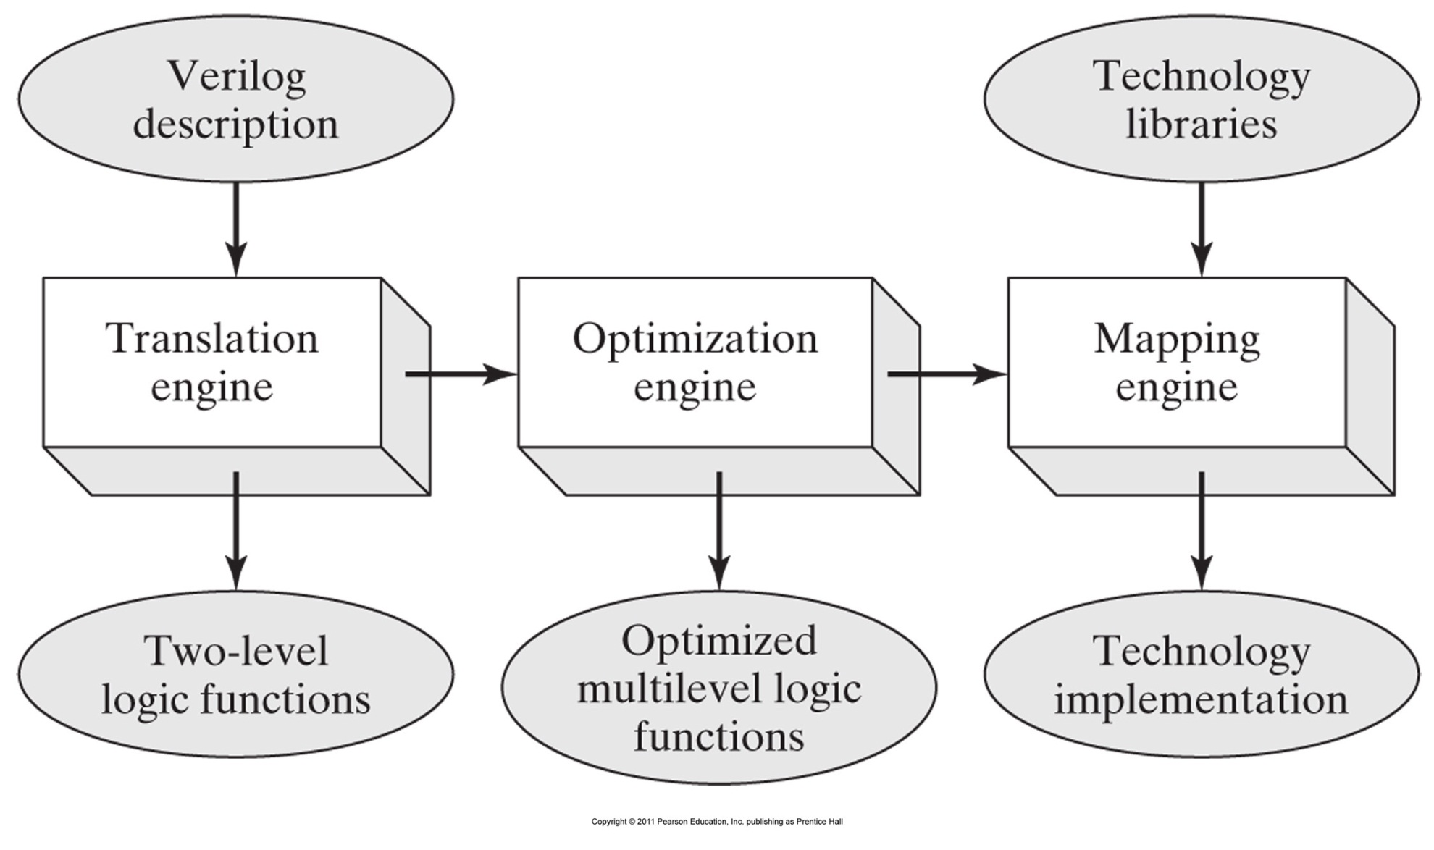
Logic Synthesis Flow

Slide 5
Multilevel Logic Synthesis
Combinational logic circuits very often implemented as multiple-level networks of logic gates.
Provides several degrees of freedom in logic design
Exploited in optimizing area and delay.
Different timing requirements on input/output paths.
Multiple-level networks viewed as interconnection of single-output gates
Single type of gate (e.g. NANDs or NORs).
Instances of a cell library.
Macro cells.
Multilevel optimization is divided into two tasks
Optimization neglecting implementation constraints assuming loose models of area and delay.
Constraints on the usable gates are taken into account during optimization.

Slide 6
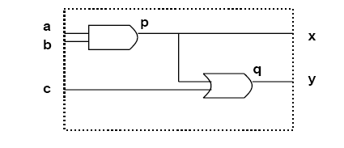
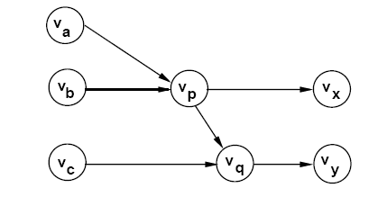
Circuit Modeling
Logic network
Interconnection of logic functions.
Hybrid structural/behavioral model.
Bound (mapped) networks
Interconnection of logic gates.
Structural model.
Example of Bound Network

Slide 7
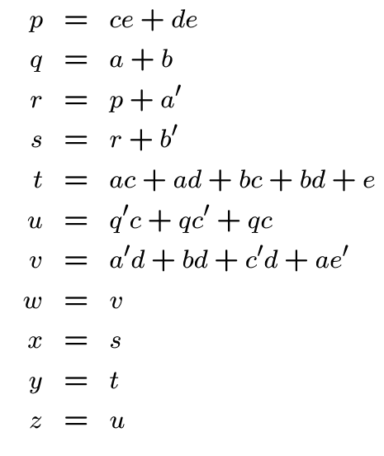
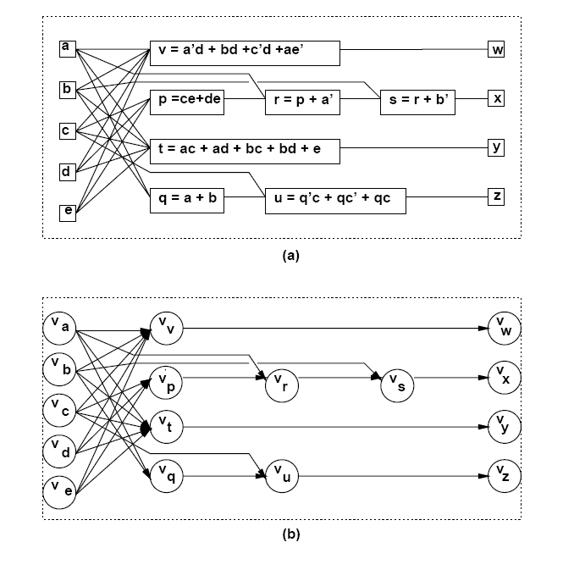
Example of a Logic Network

Slide 8
Network Optimization
Two-level logic
Area and delay proportional to cover size.
Achieving minimum (or irredundant) covers corresponds to optimizing area and speed.
Achieving irredundant cover corresponds to maximizing testability.
Multiple-level logic
Minimal-area implementations do not correspond in general to minimum-delay implementations and vice versa.
Minimize area (power) estimate
subject to delay constraints.
Minimize maximum delay
subject to area (power) constraints.
Minimize power consumption.
subject to delay constraints.
Maximize testability.

Slide 9
Estimation
Area
Number of literals
Corresponds to number of polysilicon strips (transistors)
Number of functions/gates.
Delay
Number of stages (unit delay per stage).
Refined gate delay models (relating delay to function complexity and fanout).
Sensitizable paths (detection of false paths).
Wiring delays estimated using statistical models.

Slide 10
Problem Analysis
Multiple-level optimization is hard.
Exact methods
Exponential complexity.
Impractical.
Approximate methods
Heuristic algorithms.
Rule-based methods.
Strategies for optimization
Improve circuit step by step based on circuit transformations.
Preserve network behavior.
Methods differ in
Types of transformations.
Selection and order of transformations.

Slide 11
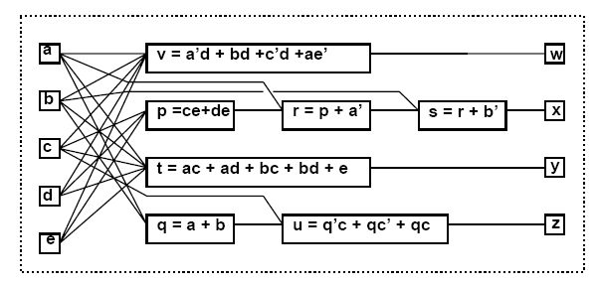
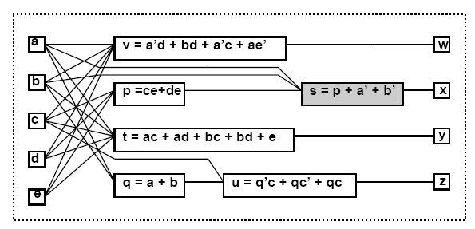
Elimination
Eliminate one function from the network.
Perform variable substitution.
Example
s = r +b’; r = p+a’
⇒ s = p+a’+b’.

Slide 12
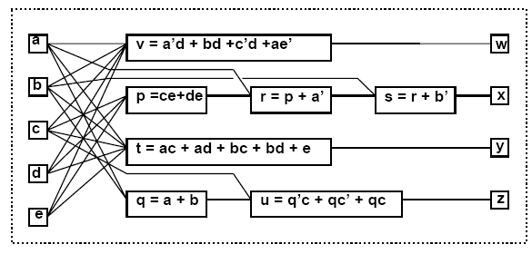
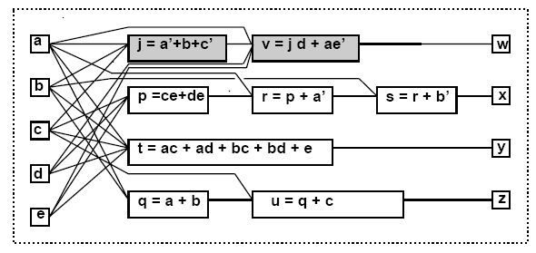
Decomposition
Break one function into smaller ones.
Introduce new vertices in the network.
Example
v = a’d+bd+c’d+ae’.
⇒ j = a’+b+c’; v = jd+ae’

Slide 13
Factoring
Factoring is the process of deriving a factored form from a sum-of-products form of a function.
Factoring is like decomposition except that no additional nodes are created.
Example
F = abc+abd+a’b’c+a’b’d+ab’e+ab’f+a’be+a’bf (24 literals)
After factorization
F=(ab+a’b’)(c+d) + (ab’+a’b)(e+f) (12 literals)

Slide 14
Extraction …
Find a common sub-expression of two (or more) expressions.
Extract sub-expression as new function.
Introduce new vertex in the network.
Example
p = ce+de; t = ac+ad+bc+bd+e; (13 literals)
p = (c+d)e; t = (c+d)(a+b)+e; (Factoring:8 literals)
⇒ k = c+d; p = ke; t = ka+ kb +e; (Extraction:9 literals)

Slide 15
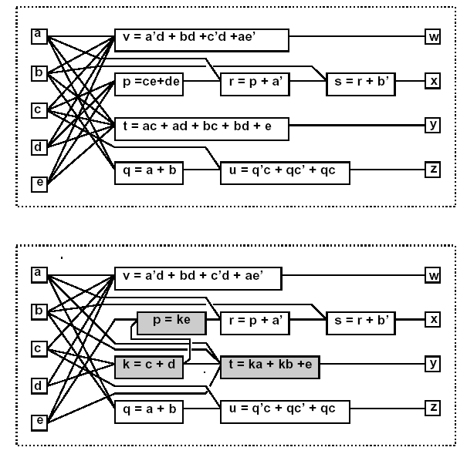
… Extraction

Slide 16
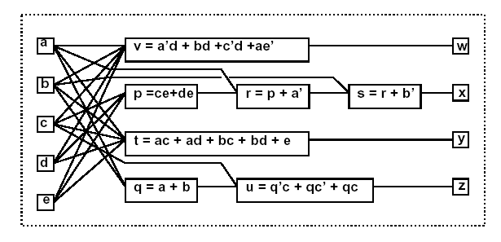
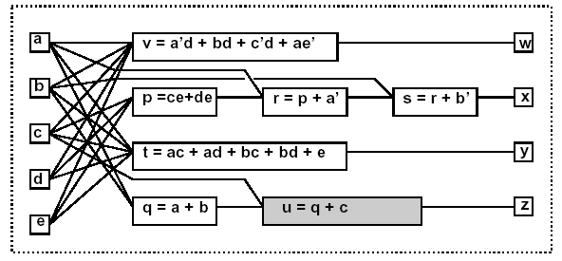
Simplification
Simplify a local function (using Espresso).
Example
u = q’c+qc’ +qc;
⇒ u = q +c;

Slide 17
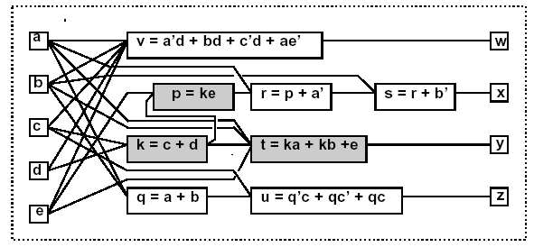
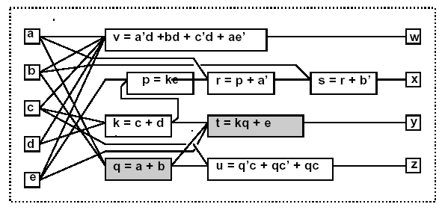
Substitution
Simplify a local function by using an additional input that was not previously in its support set.
Example
t = ka+kb+e.
⇒ t = kq +e; because q = a+b.

Slide 18
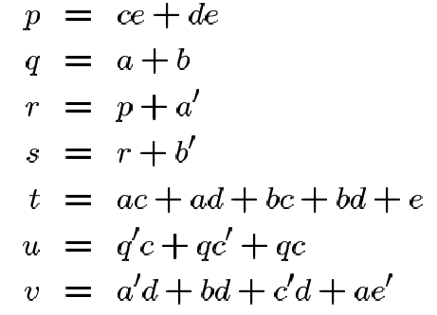
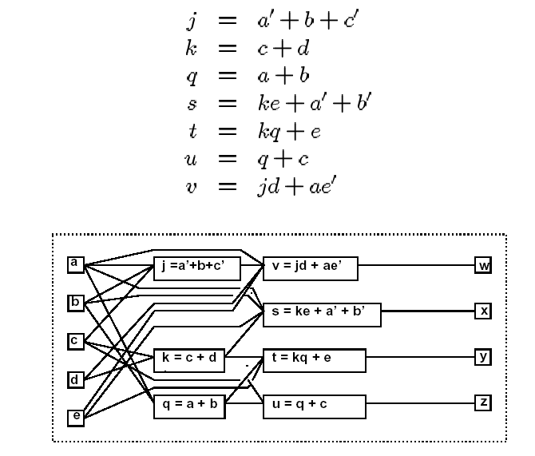
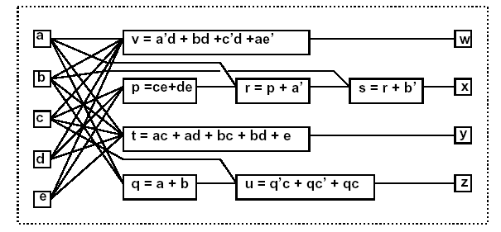
Example: Sequence of Transformations
Original Network (33 lit.)
Transformed Network (20 lit.)

Slide 19
Optimization Approaches
Algorithmic approach
Define an algorithm for each transformation type.
Algorithm is an operator on the network.
Each operator has well-defined properties
Heuristic methods still used.
Weak optimality properties.
Sequence of operators
Defined by scripts.
Based on experience.
Rule-based approach (IBM Logic Synthesis System)
Rule-data base
Set of pattern pairs.
Pattern replacement driven by rules.

Slide 20
MIS/SIS Rugged Script
sweep; eliminate -1
simplify -m nocomp
eliminate -1
sweep; eliminate 5
simplify -m nocomp
resub -a
fx
resub -a; sweep
eliminate -1; sweep
full-simplify -m nocomp
Sweep eliminates single-input Vertices and those with a constant function.
resub –a performs algebraic substitution of all vertex pairs
fx extracts double-cube and single-cube expression.

Slide 21
Fast Extraction (FX) …
Very efficient extraction method
Based on extraction of double-cube divisors along with their complements and,
Single-cube divisors with two literals.
Number of divisors in polynomial domain.
Preserves single stuck-at fault testability.
[Rajski and Vasudevamurthy 1992].
Double-cube divisors are cube-free multiple-cube divisors having exactly two cubes.
The set of double-cube divisors of a function f, denoted D(f) = {d | d= {c_{i} \ (c_{i} ∩ c_{j}), c_{j} \ (c_{i} ∩ c_{j}) } } for i,j=1,..n, i≠j
n is number of cubes in f.
(c_{i} ∩ c_{j}) is called the base of a double-cube divisor.
Empty base is allowed.

Slide 22
… Fast Extraction (FX) …
Example: f = ade + ag + bcde +bcg.
Double-cube divisors and their bases:
A subset of double-cube divisors is represented by D_{x,y,s}
x is number of literals in first cube
y is number of literals in second cube
s is number of variables in support of D
A subset of single-cube divisors is denoted by S_{k} where k is number of literals in single-cube divisor.
Double-cube divisors | Base
de+g | a, bc
a+bc | g, de
ade+bcg | {}
ag+bcde | {}

Slide 23
Properties of Double-Cube and Single-Cube Divisors
Example:
xy+y’zp ∈ D_{2,3,4}
ab ∈ S₂
D_{1,1,1} and D_{1,2,2} are null set.
For any d ∈ D_{1,1,2} , d’∈S₂.
For any d ∈ D_{1,2,3} , d’∉D.
For any d ∈ D_{2,2,2} , d is either XOR or XNOR and d’ ∈ D_{2,2,2} .
For any d ∈ D_{2,2,3} , d’ ∈ D_{2,2,3}.
For any d ∈ D_{2,2,4} , d’∉D.

Slide 24
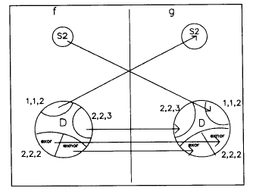
Extraction of Double-cube Divisor along with its Complement
Theorem: Let f and g be two expressions. Then, f has neither a complement double-cube divisor nor a complement single-cube divisor in g if
d_{i} ≠ s_{j}’ for every d_{i} ∈ D_{1,1,2} (f) , s_{j} ∈ S₂(g)
d_{i} ≠ s_{j}’ for every d_{i} ∈ D_{1,1,2} (g) , s_{j} ∈ S₂(f)
d_{i} ≠ d_{j}’ for every d_{i} ∈ D_{xor} (f) , d_{j} ∈ D_{xnor} (g)
d_{i} ≠ d_{j}’ for every d_{i} ∈ D_{xnor} (f) , d_{j} ∈ D_{xor} (g)
d_{i} ≠ d_{j}’ for every d_{i} ∈ D_{2,2,3} (f) , d_{j} ∈ D_{2,2,3} (g)

Slide 25
Weights of Double-cube Divisors and Single-Cube Divisors
Divisor weight represents literal savings.
Weight of a double-cube divisor d ∈ D_{x,y,s} is
w(d) = (p-1)(x+y) – p + ∑_{i=1 to p} |b_{i}| + C
p is the number of times double-cube divisor is used
Includes complements that are also double-cube divisors
|b_{i}| is the number of literals in base of double-cube divisor
C is the number of cubes containing both a and b in case cube ab is a complement of d ∈ D_{1,1,2}
(p-1)(x+y) accounts for the number of literals saved by implementing d of size (x+y) once
-p accounts for number of literals needed to connect d in its p occurrences
Weight of a single-cube divisor c ∈ S₂ is k – 2
K is the number of cubes containing c.

Slide 26
Fast Extraction Algorithm
Generate double-cube divisors with weights
Repeat
Select a double-cube divisor d that has a maximum weight W_{dmax}
Select a single-cube divisor s having a maximum weight W_{smax}
If W_{dmax} > W_{smax} select d else select s
W = max(W_{dmax}, W_{smax})
If W > 0 then substitute selected divisor
Recompute weights of affected double-cube divisors
Until (W<=0)

Slide 27
Fast Extraction Example
F = abc + a’b’c + ab’d + a’bd + acd + a’b’d’ (18 literals)
d | Base | Weight
ab+a’b’ | c | 4
bc+b’d | a | 0
ac+a’d | b | 0
b+d | ac | 2
abc+a’b’d’ | {} | -1
a’c+ad | b’ | 0
b’c+bd | a’ | 0
a’b’+ad | c | 0
c+d’ | a’b’ | 1
ab’+a’b | d | 4
b’+c | ad | 1
ad+a’d’ | b’ | 0
a’b+ac | d | 0
bd+b’d’ | a’ | 0
acd+a’b’d’ | {} | -1
Single-cube divisors with W_{smax} are either ac or a’b’ or ad with weight of 0
Double-cube divisor=ab + a’b’ is selected
[1]=ab + a’b’
F= [1]c + [1]’d + acd + a’b’d’
(14 literals)

Slide 28
Synthesis and Testability
Testability
Ease of testing a circuit.
Assumptions
Combinational circuit.
Single or multiple stuck-at faults.
Full testability
Possible to generate test set for all faults.
Synergy between synthesis and testing.
Testable networks correlate to small-area networks.
Don't care conditions play a major role.

Slide 29
Test for Stuck-at-Faults
Net y stuck-at 0
Input pattern that sets y to true.
Observe output.
Output of faulty circuit differs.
{t | y(t) . ODC’_{y}(t) = 1}.
Net y stuck-at 1
Same, but set y to false.
{t | y’(t) . ODC’_{y}(t) = 1}.
Need controllability and observability.

Slide 30
Using Testing Methods for Synthesis …
Redundancy removal.
Use ATPG to search for untestable faults.
If stuck-at 0 on net y is untestable
Set y = 0.
Propagate constant.
If stuck-at 1 on y is untestable
Set y = 1.
Propagate constant.

Slide 31
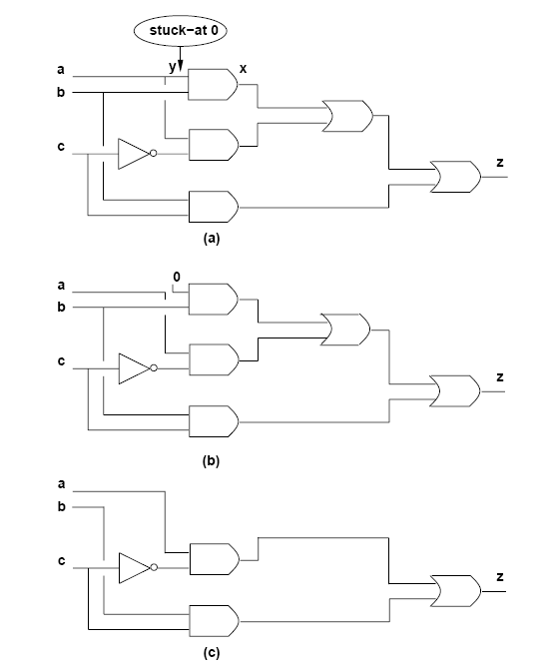
… Using Testing Methods for Synthesis

Slide 32
Synthesis for Testability
Synthesize networks that are fully testable.
Single stuck-at faults.
Multiple stuck-at faults.
Two-level forms
Full testability for single stuck-at faults
Prime and irredundant cover.
Full testability for multiple stuck-at faults
Prime and irredundant cover when
Single-output function.
No product term sharing in case of multiple outputs i.e. each output is prime and irredundant.

Slide 33
… Synthesis for Testability
A complete single-stuck-at fault test set for a single-output sum-of-product circuit is a complete test set for all multiple stuck-at faults.
Single stuck-at fault testability of multiple-level network does not imply multiple stuck-at fault testability.
Fast extraction transformations are single stuck-at fault test-set preserving transformations.
Algebraic transformations preserve multiple stuck-at fault testability but not single stuck-at fault testability
Factorization
Substitution (without complement)
Cube and kernel extraction

Slide 34
Timing Issues in Multiple-Level Logic Optimization
Timing optimization is crucial for achieving competitive logic design.
Timing verification: Check that a circuit runs at speed
Satisfies I/O delay constraints.
Satisfies cycle-time constraints.
Delay modeling.
Critical paths.
The false path problem.
Algorithms for timing optimization.
Minimum area subject to delay constraints.
Minimum delay (subject to area constraints).

Slide 35
Delay Modeling
Gate delay modeling
Straightforward for bound networks.
Approximations for unbound networks.
Network delay modeling
Compute signal propagation
Topological methods.
Logic/topological methods.
Gate delay modeling for unbound networks
Virtual gates: Logic expressions.
Stage delay model: Unit delay per vertex.
Refined models: Depending on size and fanout.

Slide 36
Network Delay Modeling …
For each vertex v_{i}.
Propagation delay d_{i}.
Data-ready time t_{i}.
Denotes the time at which the data is ready at the output.
Input data-ready times denote when inputs are available.
Computed elsewhere by forward traversal
The maximum data-ready time occurring at an output vertex
Corresponds to the longest propagation delay path
Called topological critical path

Slide 37
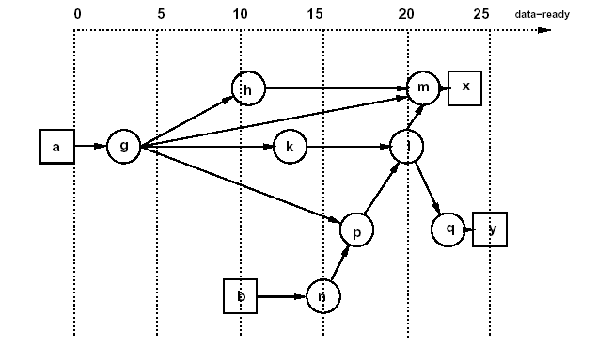
… Network Delay Modeling …
t_{g}= 3+0=3
t_{h}= 8+3=11
t_{k}= 10+3=13
t_{n}= 5+10=15
t_{p}= 2+max{15,3}=17
t_{l}= 3+max{13,17}=20
t_{m}= 1+max{3,11,20}=21
t_{x}= 2+21=23
t_{q}= 2+20=22
t_{y}= 3+22=25
Assume t_{a}=0 and t_{b}=10.
Propagation delays
d_{g} = 3; d_{h} = 8; d_{m} = 1; d_{k} = 10; d_{l} = 3;
d_{n} = 5; d_{p} = 2; d_{q} = 2; d_{x} = 2; d_{y} = 3;
Maximum data-ready time is t_{y}=25
Topological critical path: (v_{b}, v_{n}, v_{p}, v_{l}, v_{q}, v_{y}).

Slide 38
… Network Delay Modeling …
For each vertex v_{i}.
Required data-ready time t_{i}.
Specified at the primary outputs.
Computed elsewhere by backward traversal
Slack s_{i}.
Difference between required and actual data-ready times

Slide 39
… Network Delay Modeling
Required data-ready times
t_{x} = 25 and t_{y} = 25.
Propagation Delays :
d_{g} = 3; d_{h} = 8; d_{m} = 1; d_{k} = 10;
d_{l} = 3; d_{n} = 5; d_{p} = 2; d_{q} = 2;
d_{x} = 2; d_{y} = 3
Required Times & Slack:
s_{x}= 2; s_{y}=0
t_{m}= 25-2=23; s_{m}=23-21=2
t_{q}= 25-3=22; s_{q}=22-22=0
t_{l}= min{23-1,22-2}=20; s_{l}=0
t_{h}= 23-1=22; s_{h}=22-11=11
t_{k}= 20-3=17; s_{k}=17-13=4
t_{p}= 20-3=17; s_{p}=17-17=0
t_{n}= 17-2=15; s_{n}=15-15=0
t_{b}= 15-5=10; s_{b}=10-10=0
t_{g}= min{22-8;17-10;17-2}=7; s_{g}=4
t_{a}=7-3=4; s_{a}=4-0=4
Data-Ready Times:
t_{g}= 3+0=3
t_{h}= 8+3=11
t_{k}= 10+3=13
t_{n}= 5+10=15
t_{p}= 2+max{15,3}=17
t_{l}= 3+max{13,17}=20
t_{m}= 1+max{3,11,20}=21
t_{x}= 2+21=23
t_{q}= 2+20=22
t_{y}= 3+22=25

Slide 40
Topological Critical Path …
Assume topologic computation of
Data-ready by forward traversal.
Required data-ready by backward traversal.
Topological critical path
Input/output path with zero slacks.
Any increase in the vertex propagation delay affects the output data-ready time.
A topological critical path may be false.
No event can propagate along that path.
False path does not affect performance

Slide 41
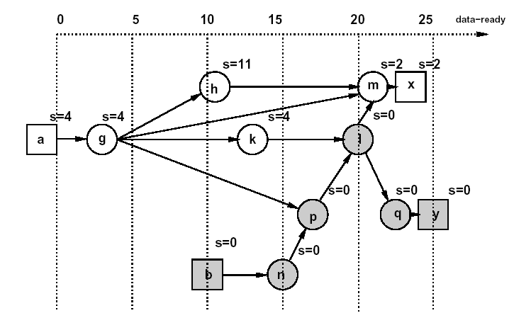
… Topological Critical Path
Topological critical path: (v_{b}, v_{n}, v_{p}, v_{l}, v_{q}, v_{y}).

Slide 42
False Path Example
All gates have unit delay.
All inputs ready at time 0.
Longest topological path: (v_{a}, v_{c}, v_{d}, v_{y}, v_{z}).
Path delay: 4 units.
False path: event cannot propagate through it
Critical true path: (v_{a}, v_{c}, v_{d}, v_{y}).
Path delay: 3 units.

Slide 43
Algorithms for Delay Minimization …
Alternate
Critical path computation.
Logic transformation on critical vertices.
Consider quasi critical paths
Paths with near-critical delay.
Small slacks.
Small difference between critical paths and largest delay of a non-critical path leads to smaller gain in speeding up critical paths only.

Slide 44
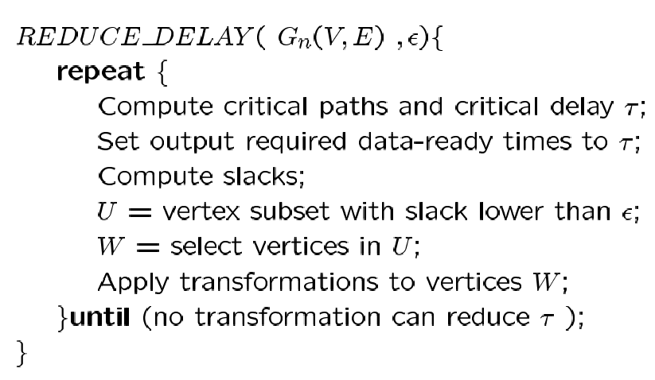
… Algorithms for Delay Minimization
Most critical delay optimization algorithms have the following framework:

Slide 45
Transformations for Delay Reduction …
Reduce propagation delay.
Reduce dependencies from critical inputs.
Favorable transformation
Reduces local data-ready time.
Any data-ready time increase at other vertices is bounded by the local slack.
Example
Unit gate delay.
Transformation: Elimination.
Always favorable.
Obtain several area/delay trade-off points.

Slide 46
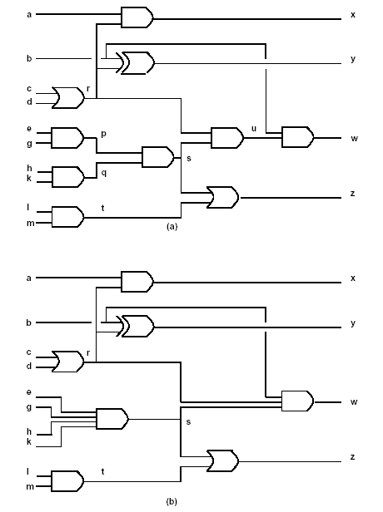
… Transformations for Delay Reduction
W is a minimum-weight separation set from U.
Iteration 1
Values of v_{p}, v_{q}, v_{u} = -1
Value of v_{s}=0.
Eliminate v_{p}, v_{q}. (No literal increase.)
Iteration 2
Value of v_{s}=2, v_{r}=0, v_{u}=-1.
Eliminate v_{u}. (No literal increase.)
Iteration 3
Eliminate v_{r} , v_{s}, v_{t}. (Literals increase.)

Slide 47
Speed-Up Algorithm …
Decompose network into two-input NAND gates and inverters.
Determine a subnetwork W of depth d.
Collapse subnetwork by elimination.
Duplicate input vertices with successors outside W
Record area penalty.
Resynthesize W by timing-driven decomposition.
Heuristics
Choice of W.
Monitor area penalty and potential speed-up.

Slide 48
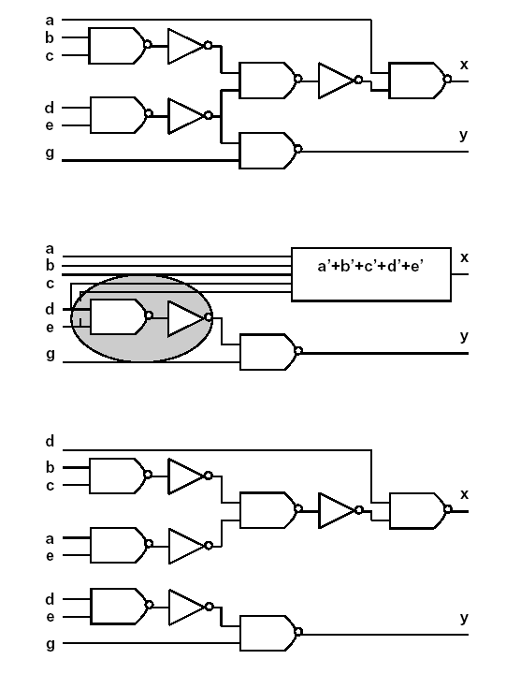
… Speed-Up Algorithm
Example
NAND delay =2.
INVERTER delay =1.
All input data-ready=0 except t_{d}=3.
Critical Path: from V_{d} to V_{x} (11 delay units)
Assume V_{x} is selected and d=5.
New critical path: 8 delay units.

Slide 49
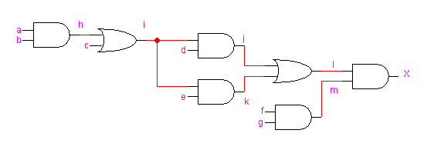
Example
Consider the logic network below with inputs {a, b, c, d, e, f, g} and output {X}:
Assume that the delay of a gate is related to the number of its inputs i.e., the delay of a 2-input AND gate is 2. Also, assume that the input data-ready times are zero for all inputs.

Slide 50
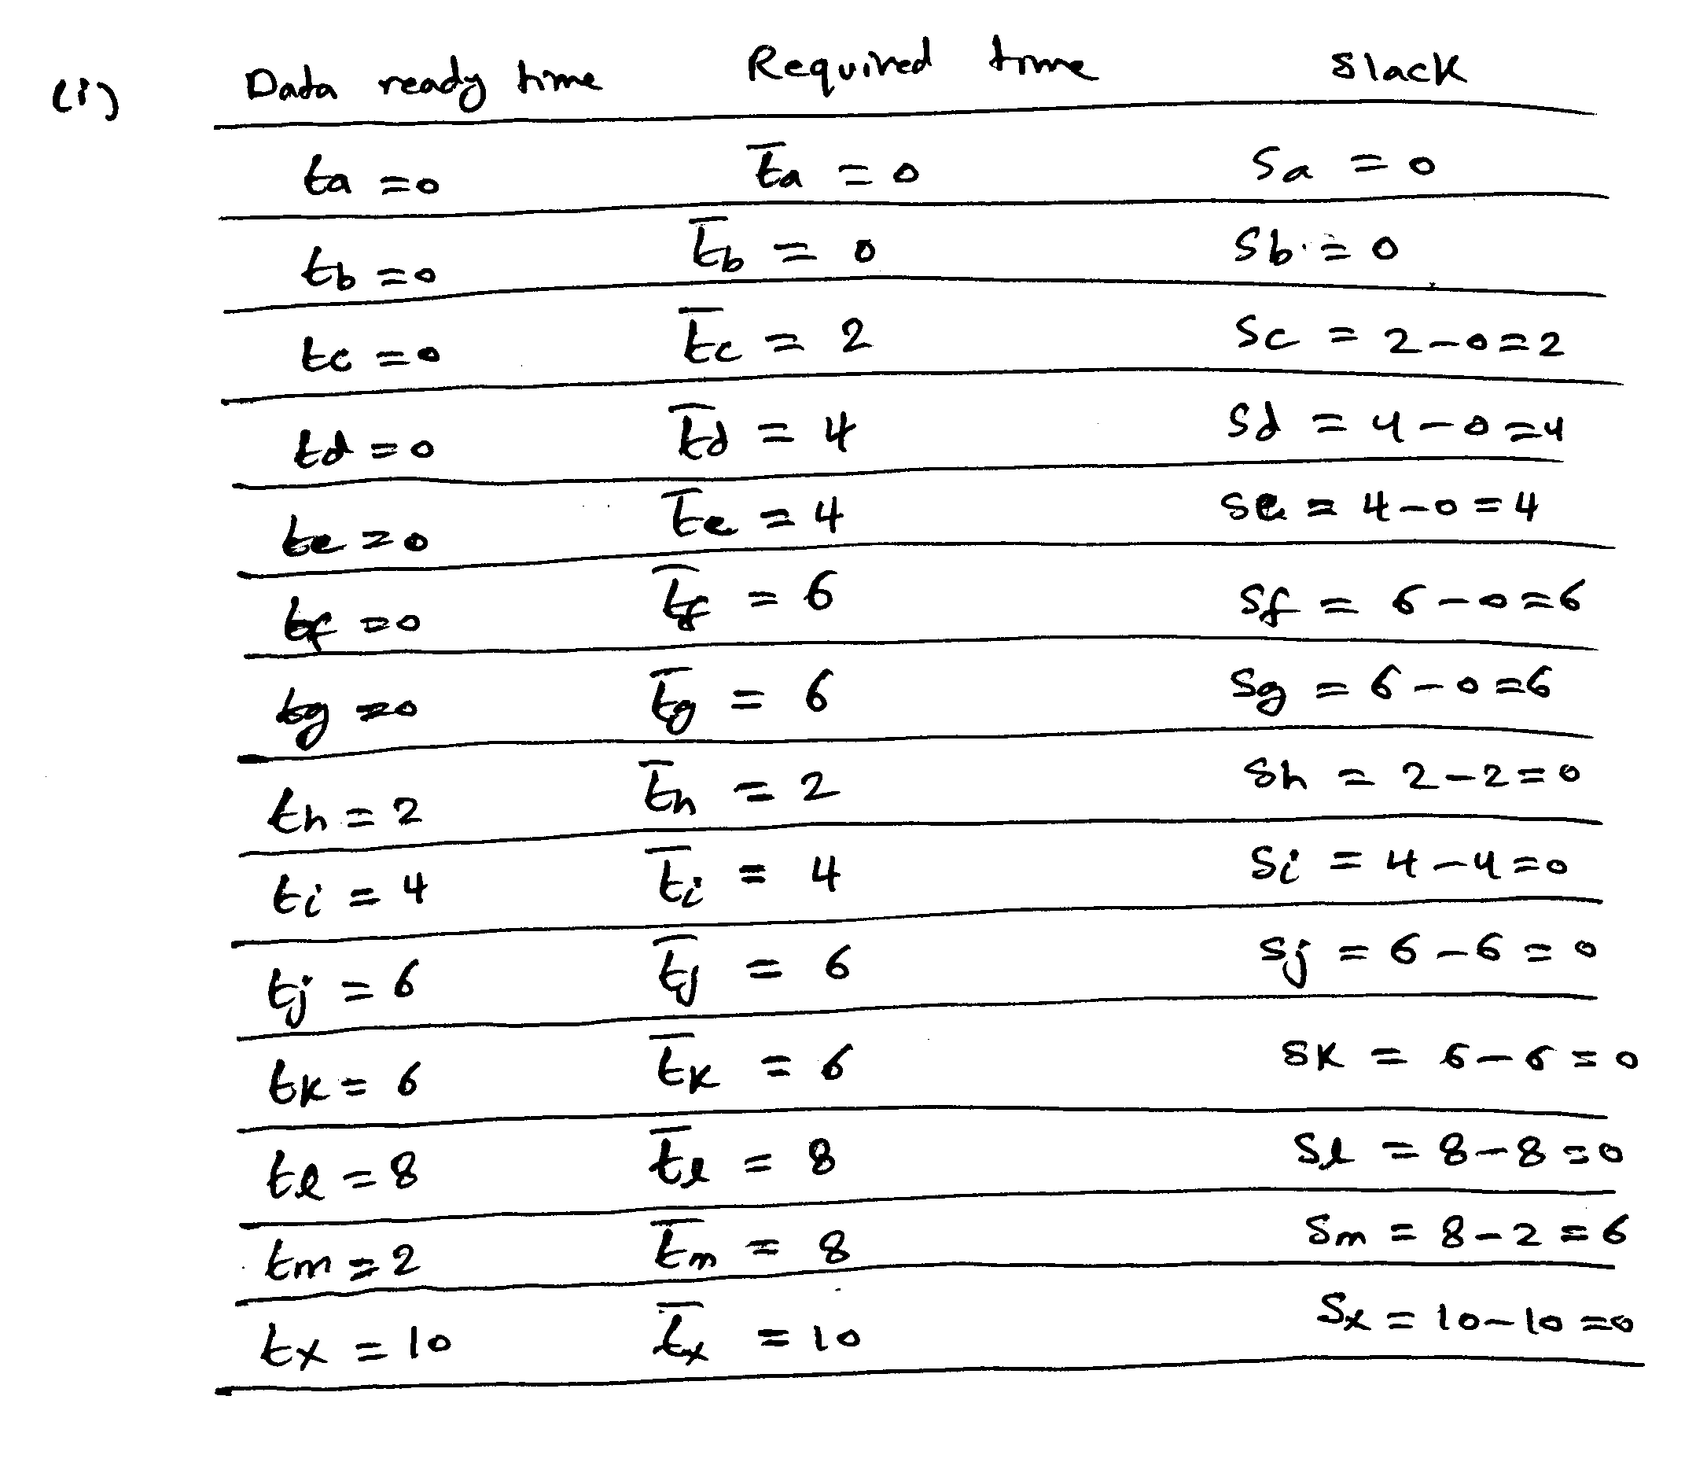
Example
Compute data ready times and slacks for all gates.

Slide 51
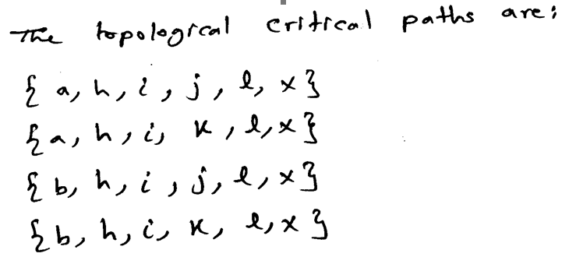
Example
Determine the topological critical path.
Suggest an implementation of the function X using only 2-input gates to reduce the delay of the circuit to the minimum possible and determine the maximum propagation delay in the optimized circuit. Has the area been affected?

Slide 52
Example

