Slide 1
COE 561
Digital System Design & Synthesis
Introduction
Dr. Aiman H. El-Maleh
Computer Engineering Department
King Fahd University of Petroleum & Minerals
[Adapted from slides of Prof. G. De Micheli: Synthesis & Optimization of Digital Circuits]

Slide 2
Outline
Microelectronics
Design Styles
Design Domains and Levels of Abstractions
Digital System Design
Synthesis Process
Design Optimization

Slide 3
Microelectronics
Enabling and strategic technology for development of hardware and software.
Primary markets
  Information systems.
  Telecommunications.
  Consumer.
Trends in microelectronics
  Improvements in device technology
    Smaller circuits.
    Higher performance.
    More devices on a chip.
  Higher degree of integration
    More complex systems.
    Lower cost in packaging and interconnect.
    Higher performance.
    Higher reliability.

Slide 4
Moore’s Law and Technology Scaling
The performance of an IC, including the number components on it, doubles every 18-24 months with the same chip price ... - Gordon Moore - 1960.

Slide 5
The Productivity Gap

Slide 6
Microelectronic Design Problems
Use most recent technologies: to be competitive in performance.
Reduce design cost: to be competitive in price.
Speed-up design time: Time-to-market is critical.
Design Cost
  Design time and fabrication cost.
  Large capital investment on refining manufacturing process.
  Near impossibility to repair integrated circuits.
Recapture costs
  Large volume production is beneficial.
  Zero-defect designs are essential.

Slide 7
Microelectronic Circuits
General-purpose processors
  High-volume sales.
  High performance.
Application-Specific Integrated Circuits (ASICs)
  Varying volumes and performances.
  Large market share.
Prototypes.
Special applications (e.g. space).

Slide 8
Computer-Aided Design
Enabling design methodology.
Makes electronic design possible
  Large scale design management.
  Design optimization
    Feasible implementation choices grow rapidly with circuit size.
  Reduced design time.
CAD tools have reached good level of maturity.
Continuous growth in circuit size and advances in technology requires CAD tools with increased capability.
CAD tools affected by
  Semiconductor technology
  Circuit type

Slide 9
Microelectronics Design Styles
Adapt circuit design style to market requirements.
Parameters
  Cost.
  Performance.
  Volume.
Full custom
  Maximal freedom
  High performance blocks
  Slow design time
Semi-custom
  Standard Cells
  Gate Arrays
    Mask Programmable (MPGAs)
    Field Programmable (FPGAs)
  Silicon Compilers & Parametrizable Modules (adder, multiplier, memories)

Slide 10
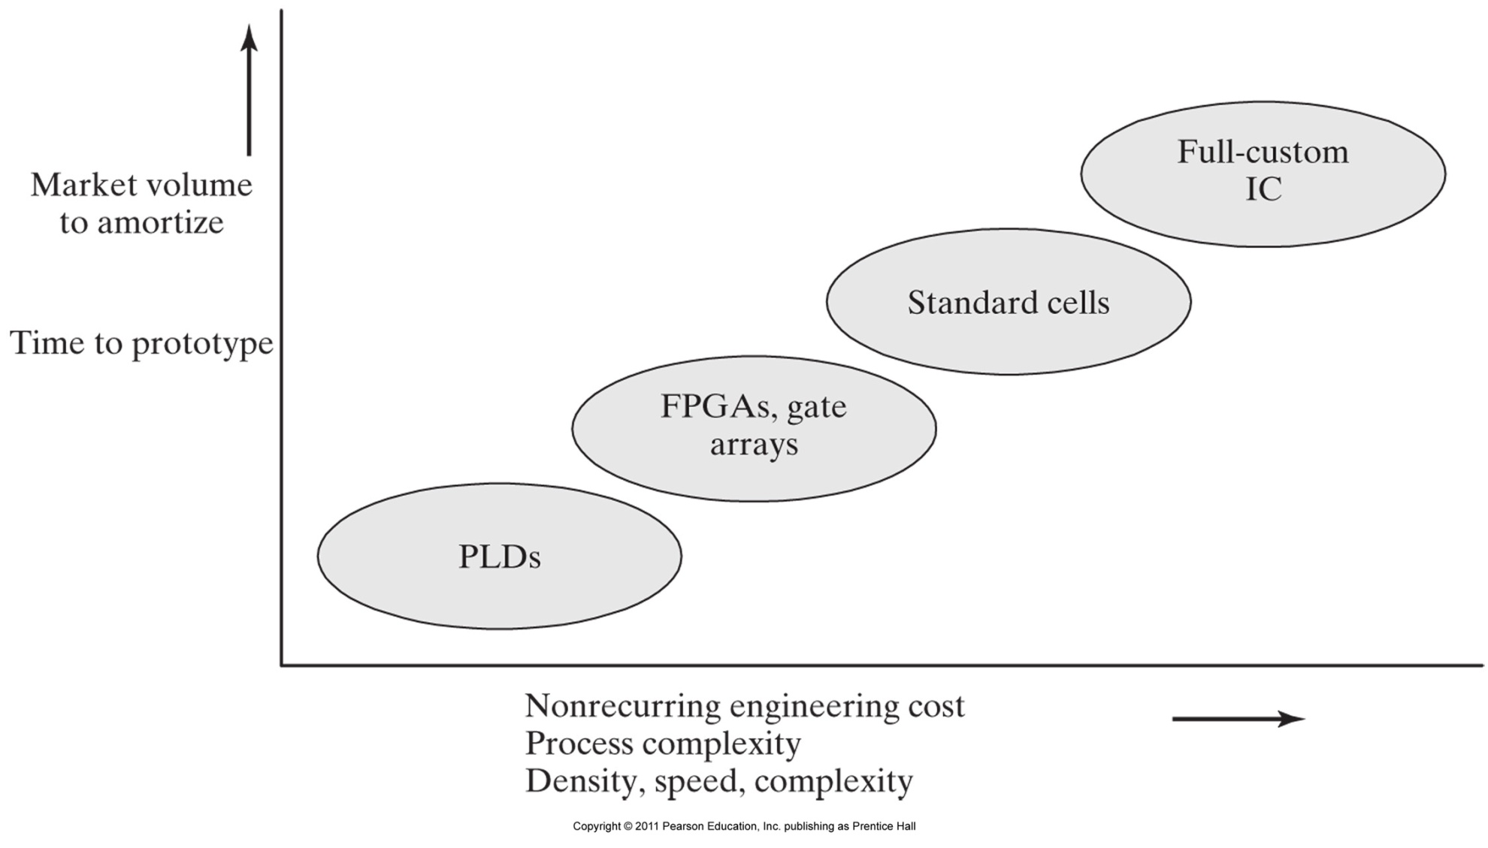
Microelectronics Design Technologies

Slide 11
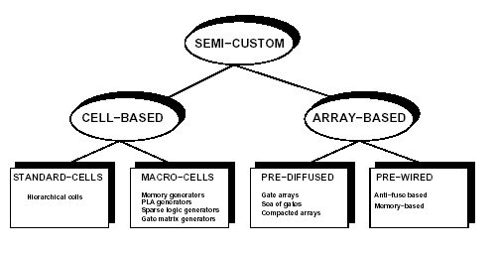
Semi-Custom Design Styles

Slide 12
Standard Cells
Cell library
  Cells are designed once.
  Cells are highly optimized.
  Cells have standard height but vary in width.
Layout style
  Cells are placed in rows.
  Channels are used for wiring.
  Over the cell routing.
Compatible with macro-cells (e.g. RAMs).

Slide 13
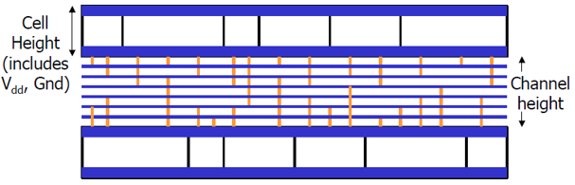
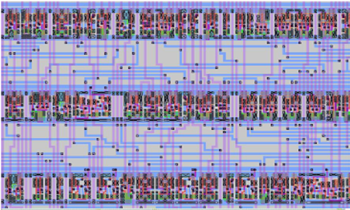
Standard Cells
PWR
CELL
1
CELL
2
CELL
3
CELL
4
CELL
5
CELL
6
GND
PWR
CELL 7
CELL
8
CELL
9
CELL
10
GND
PWR
CELL
11
CELL
12
CELL
13
CELL
14
CELL
15
CELL
16
GND

Slide 14
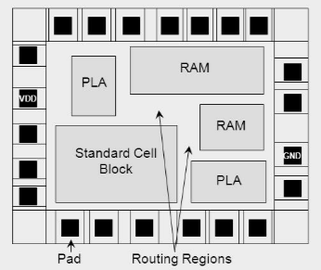
Macro Cells
Module generators
  Synthesized layout.
  Variable area and aspect-ratio.
Examples
  RAMs, ROMs, PLAs, general logic blocks.
Features
  Layout can be highly optimized.
  Structured-custom design.

Slide 15
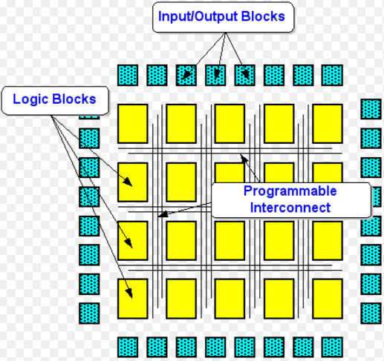
Array-Based Design
Pre-diffused arrays
  Personalization by metallization/contacts.
  Mask-Programmable Gate-Arrays (MPGAs).
Pre-wired arrays
  Personalization on the field.
  Field-Programmable Gate-Arrays (FPGAs).

Slide 16
MPGAs & FPGAs
MPGAs
  Array of sites
    Each site is a set of transistors.
  Batches of wafers can be pre-fabricated.
  Few masks to personalize chip.
  Lower cost than cell-based design.
FPGAs
  Array of cells
    Each cell performs a logic function.
  Personalization
    Soft: memory cell (e.g. Xilinx).
    Hard: Anti-fuse (e.g. Actel).
  Immediate turn-around (for low volumes).
  Inferior performances and density.
  Good for prototyping.

Slide 17
Semi-Custom Style Trade-off
 | Custom | Cell-based | Pre-Diff. | Pre-Wired
Density | Very High | High | High | Medium-Low
Performance | Very High | High | High | Medium-Low
Flexibility | Very High | High | Medium | Low
Design Time | Very Long | Short | Short | Very Short
Man. Time | Medium | Medium | Short | Very Short
Cost - lv | Very High | High | High | Low
Cost - hv | Low | Low | Low | Medium-High

Slide 18
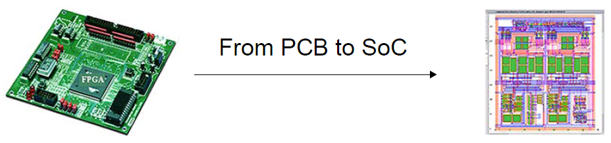
Systems-on-a-Chip (SOC) Design
Technological Advances
  Today’s chip can contains 30 billion transistors.
  Transistor gate lengths are now in term of nano meters.
  Approximately every 18 months the number of transistors on a chip doubles – Moore’s law .
The Consequences
  Components connected on a Printed Circuit Board can now be integrated onto single chip.
  Hence the development of System-On-Chip design.

Slide 19
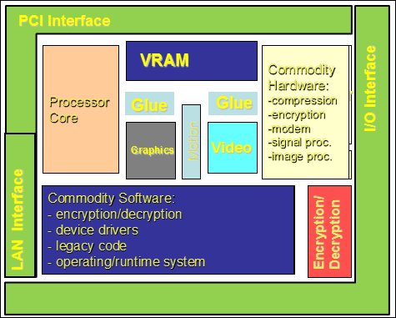
Systems-on-a-Chip using Cores
Design Using “Virtual Cores” or “Intellectual Property” (IP) modules

Slide 20
What Is A Virtual Core (IP) Cell?
At least 5K gates
Pre-designed
Pre-verified
“re-usable”
Examples:
  Processor: ARM 7-10, NEC 85x, Motorola 680x0, IBM PPC
  DSP cores: TI TMS320C54X, Pine, Oak
  Encryption: AES, DES
  Controllers: USB, PCI, UART
  Multimedia: JPEG comp., MPEG decoder, DAC
  Networking: Ethernet, ATM SAR

Slide 21
Core Types
Soft cores (“code”)
  HDL description
  Flexible/Parameterized , i.e., can be changed to suit an application
  Technology independent → may be re-synthesized across processes
  Significant IP protection risks
Firm cores → gate-level netlist and registers → portable to different libraries with technology mapping for placement &routing
  Timing depends on placement, routing and fabrication process
Hard cores (“physical”)
  Defined at the mask level (layout) for a particular fabrication process
  Fixed floor-plan, size and timing (technology dependent)
  Ready for “drop in”
  IP is easily protected
  Mostly processors and memory
  Functional test vectors or ATPG vectors available.

Slide 22
Trade-Offs Among Core Types
Soft
core
Resusability
portability
flexibility
Firm
core
Hard
core
Predictability, performance, time to market

Slide 23
Comparison of Different IP Formats
IP Format | Representation | Optimization | Technology | Reusability
Hard | GDSII | Very High | Technology Dependent | Low
Soft | RTL | Low | Technology Independent | Very High
Firm | Target Netlist | High | Technology Generic | High

Slide 24
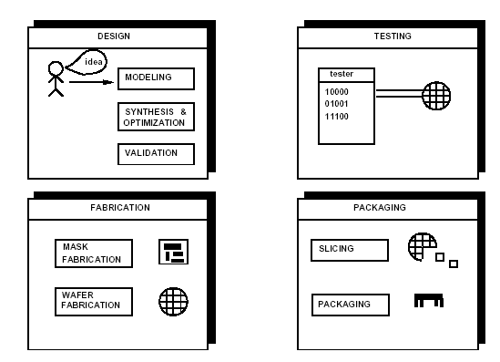
Microelectronic Circuit Design and
Production

Slide 25
How to Deal with Design Complexity?
Moore’s Law: Number of transistors that can be packed on a chip doubles every 18 months while the price stays the same.
Hierarchy: structure of a design at different levels of description.
Abstraction: hiding the lower level details.

Slide 26
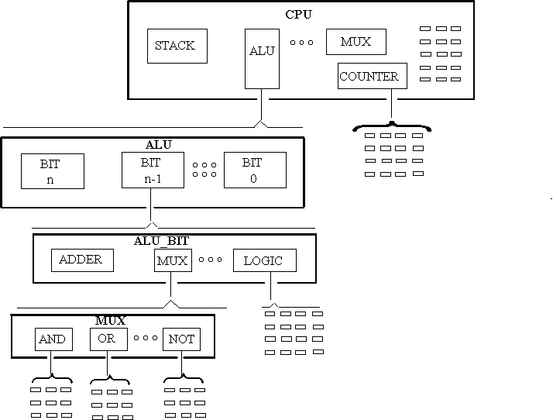
Design Hierarchy
Bottom
–
UP
Top
–
Down

Slide 27
Abstractions
An Abstraction is a simplified model of some Entity which hides certain amount of the internal details of this Entity.
Lower Level abstractions give more details of the modeled Entity.
Several levels of abstractions (details) are commonly used:
  System Level
  Chip Level
  Register Level
  Gate Level
  Circuit (Transistor) Level
  Layout (Geometric) Level
More Details
(Less Abstract)

Slide 28
Design Domains & Levels of Abstraction
Designs can be expressed / viewed in one of three possible domains
  Behavioral Domain (Behavioral View)
  Structural/Component Domain (Structural View)
  Physical Domain (Physical View)
A design modeled in a given domain can be represented at several levels of abstraction (Details).

Slide 29
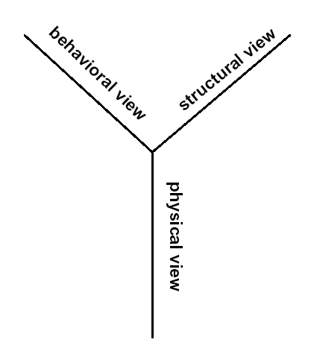
Modeling Views
Behavioral view
  Abstract function.
Structural view
  An interconnection of parts.
Physical view
  Physical objects with size
  and positions.

Slide 30
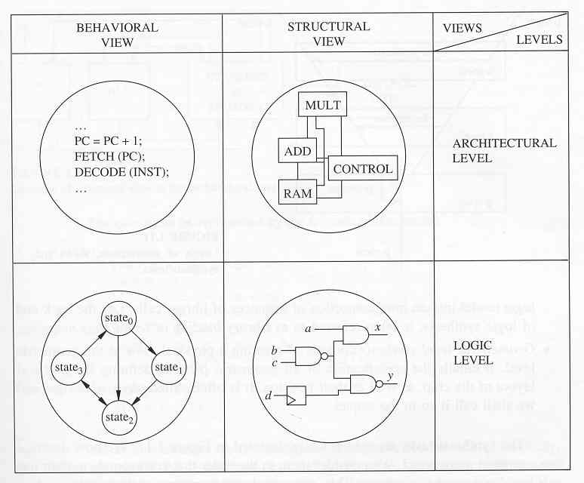
Levels of Abstractions & Corresponding Views

Slide 31
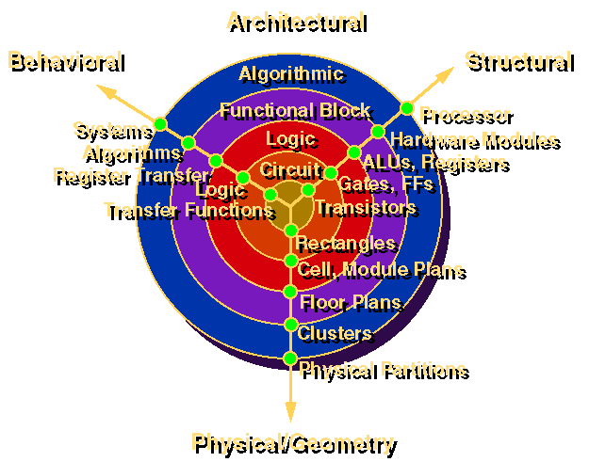
Gajski and Kuhn's Y Chart

Slide 32
Design Domains & Levels of Abstraction

Slide 33
Digital System Design
Realization of a specification subject to the optimization of
  Area (Chip, PCB)
    Lower manufacturing cost
    Increase manufacturing yield
    Reduce packaging cost
  Performance
    Propagation delay (combinational circuits)
    Cycle time and latency (sequential circuits)
    Throughput (pipelined circuits)
  Power dissipation
  Testability
    Earlier detection of manufacturing defects lowers overall cost
  Design time (time-to-market)
    Cost reduction
    Be competitive

Slide 34
Design vs. Synthesis
Design
  A sequence of synthesis steps down to a level of abstraction which is manufacturable.
Synthesis
  Process of transforming H/W from one level of abstraction to a lower one.
Synthesis may occur at many different levels of abstraction
  Behavioral or High-level synthesis
  Logic synthesis
  Layout synthesis

Slide 35
Digital System Design Cycle
Design Idea → System Specification
Behavioral (Functional) Design
Pseudo Code, Flow Charts
Architecture Design
Bus & Register Structure
Logic Design
Netlist (Gate & Wire Lists)
Circuit Design
Transistor List
Physical Design
VLSI / PCB Layout
Fabrication & Packaging

Slide 36
Synthesis Process

Slide 37
Circuit Synthesis
Architectural-level synthesis
  Determine the macroscopic structure
    Interconnection of major building blocks.
Logic-level synthesis
  Determine the microscopic structure
    Interconnection of logic gates.
Geometrical-level synthesis (Physical design)
  Placement and routing.
  Determine positions and connections.

Slide 38
Architecture Design

Slide 39
Behavioral or High-Level Synthesis
The automatic generation of data path and control unit is known as high-level synthesis.
Tasks involved in HLS are scheduling and allocation.
Scheduling distributes the execution of operations throughout time steps.
Allocation assigns hardware to operations and values.
    Allocation of hardware cells includes functional unit allocation, register allocation and bus allocation.
    Allocation determines the interconnections required.

Slide 40
Behavioral Description and its Control Data Flow Graph (CDFG)
X = W + ( S * T )
Y = ( S * T ) + ( U * V )
Scheduled CDFG
W S T U V
(a)
CDFG
1
*
W S T U V
*
*
2
+
*
+
+
3
+
X Y
X Y
(b)
(c)

Slide 41
Resulting Architecture Design
Bus 1
Data Path
X
Y
W
S
U
T
V
MUX
Z
MUX
MUX
+
*

Slide 42
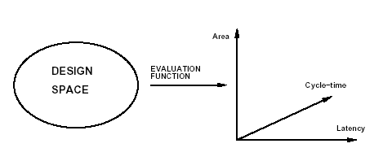
Design Space and Evaluation Space
Design space: All feasible implementations of a circuit.
Each design point has values for objective evaluation functions e.g. area.
The multidimensional space spanned by the different objectives is called design evaluation space.

Slide 43
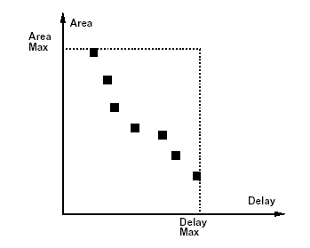
Optimization Trade-Off in Combinational
Circuits

Slide 44
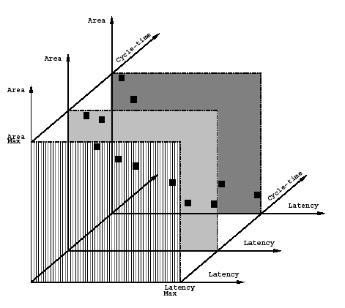
Optimization Trade-Off in Sequential
Circuits

Slide 45
Pareto Optimality
A point of a design is called a Pareto Point if there is no other point in the design space with all objectives having lower value.
Pareto points represent the set of solutions where there are no other solutions for which simultaneous improvements in all objectives can occur.
Pareto points represent the set of solutions that are not dominated by any other solution.
A solution is selected from the set of pareto points.

Slide 46
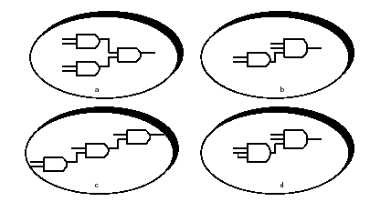
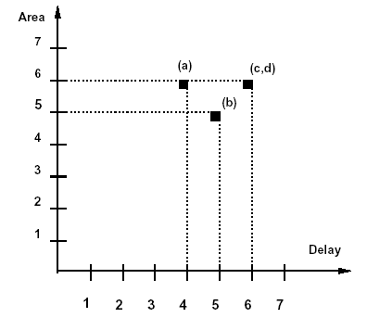
Combinational Circuit Design Space Example
Implement f = p q r s with 2-input or 3-input AND gates.
Area and delay proportional to number of inputs.

Slide 47
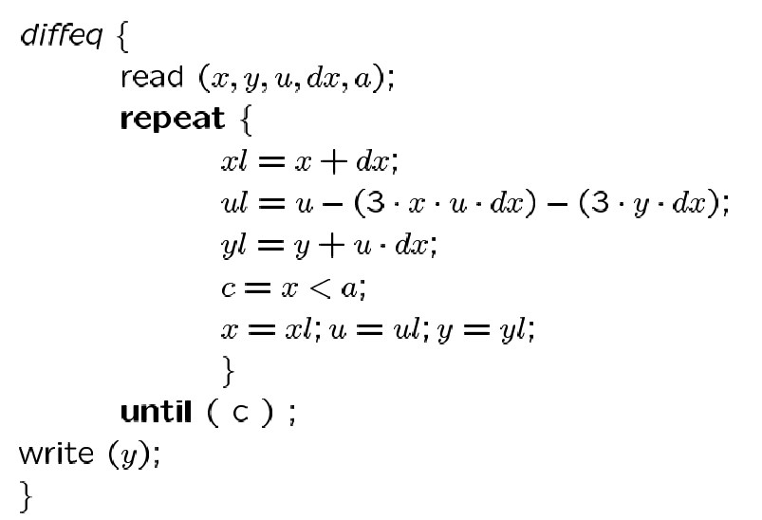
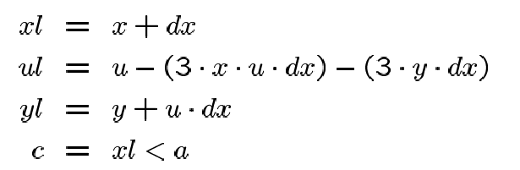
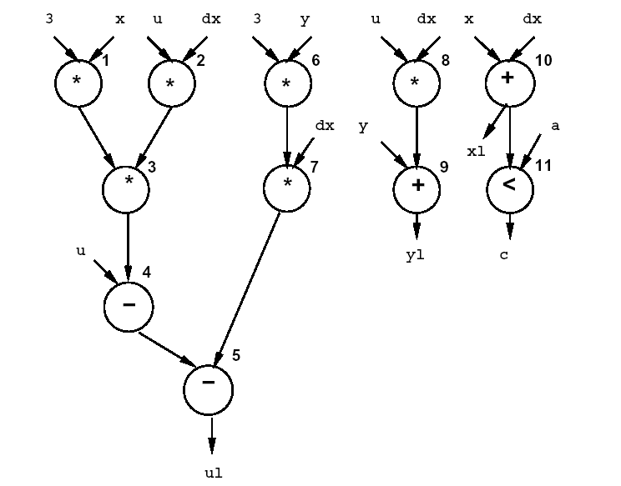
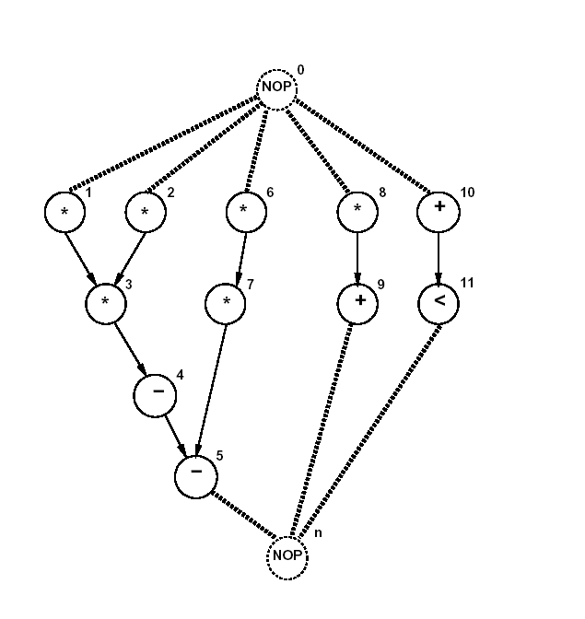
Architectural Design Space Example …

Slide 48
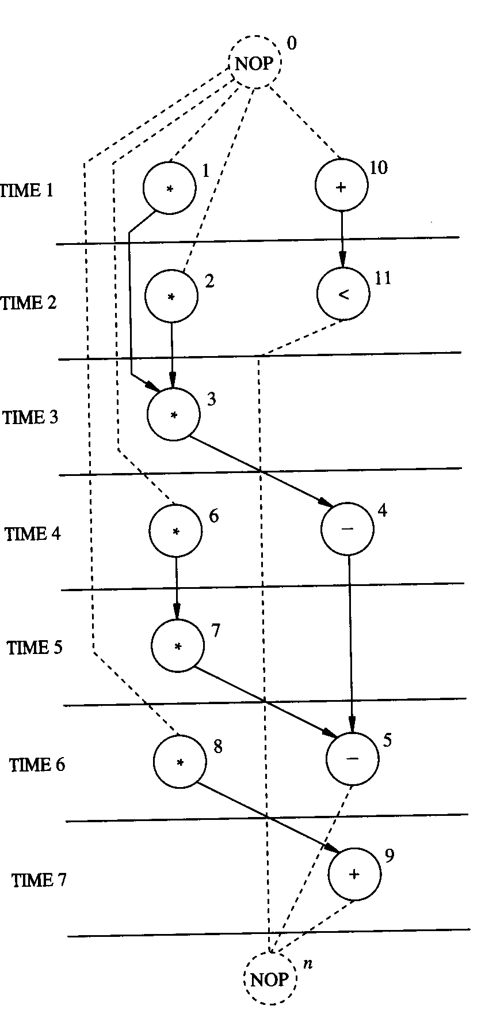
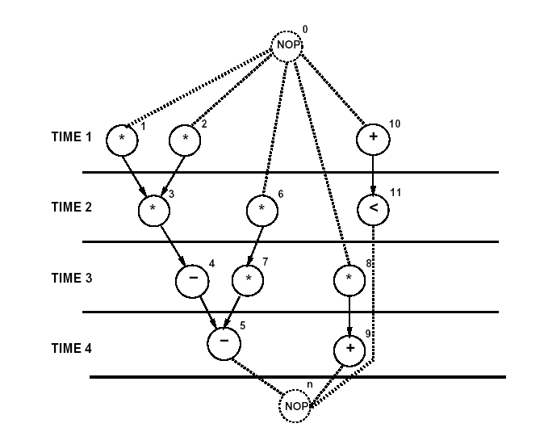
… Architectural Design Space Example …
1 Multiplier , 1 ALU
2 Multipliers, 2 ALUs

Slide 49
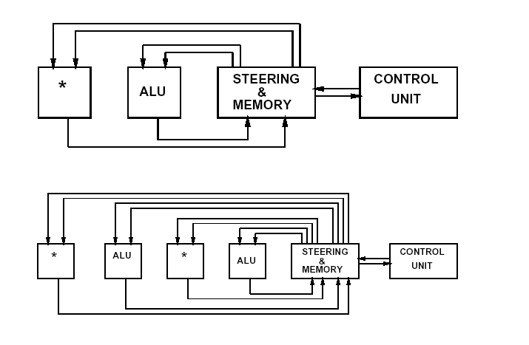
… Architectural Design Space Example

Slide 50
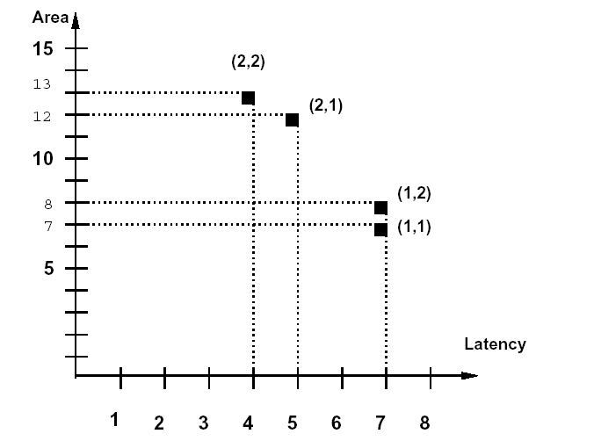
Area vs. Latency Tradeoffs
Multiplier Area: 5
Adder Area: 1
Other logic Area: 1

Slide 51
Design Automation & CAD Tools
Design Entry (Description) Tools
  Schematic Capture
  Hardware Description Language (HDL)
Simulation (Design Verification) Tools
  Simulators (Logic level, Transistor Level, High Level Language “HLL”)
Synthesis Tools (logic level synthesis, high-level synthesis, layout synthesis)
Formal Verification Tools
Design for Testability Tools
Test Vector Generation Tools

