Slide 1
Asynchronous and Synchronous Serial Communication
COE 306: Introduction to Embedded Systems
Dr. Aiman El-Maleh
Computer Engineering Department
College of Computer Sciences and Engineering
King Fahd University of Petroleum and Minerals

Slide 2
Next . . .
Types of Data Transmission
Serial Transmission
Synchronous vs. Asynchronous Transmission
Serial Peripheral Interface (SPI)
Inter Integrated Circuit (I²C)
Universal Asynchronous Receiver Transmitter (UART)

Slide 3
Types of Data Transmission
Serial
Parallel
Receiver
Receiver
1 bit
1 word
Transmitter
Transmitter

Slide 4
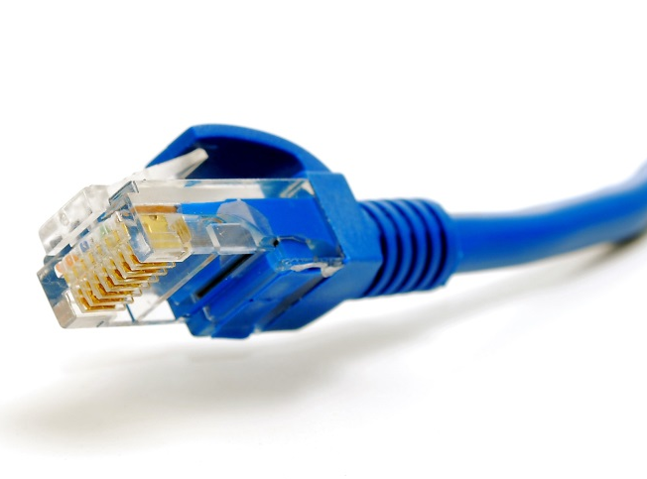
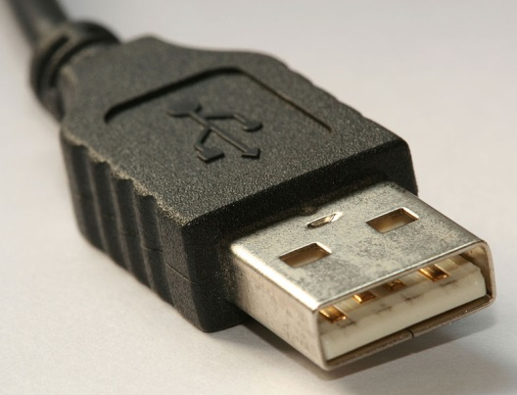
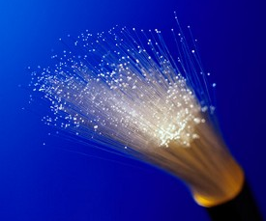
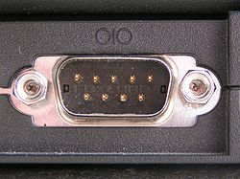
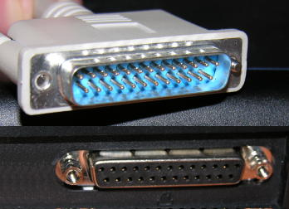
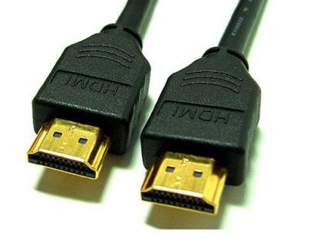
Which of these Does not Send Data in a Serial Stream?
Ethernet
USB
Fiber Optic Cable
Serial Port
Parallel Port
HDMI

Slide 5
Which Type Should I Use?
Serial
Parallel
Cost
Speed
Transmission Amount
TransmissionLines
TransmissionDistance
Example
Cheap
Slow
Single bit
One line to transmit one to receive
Long distance
Modem
Expensive
Fast
8 bits (8 data lines) Transmitter & Receiver
8 lines for simultaneous transmission
Short distance (synchronization)
Printer Connection

Slide 6
Issues with Parallel Transmission
Inter-symbol interference (ISI) and noise cause corruption over long distances
If data is carried over multiple lines (parallel) it is possible that the data may arrive at different times at the receiver (skew); problem increases with higher frequencies
Bandwidth of parallel wires is much lower than bandwidth of serial wires
Parallel communication is faster than serial for short distances

Slide 7
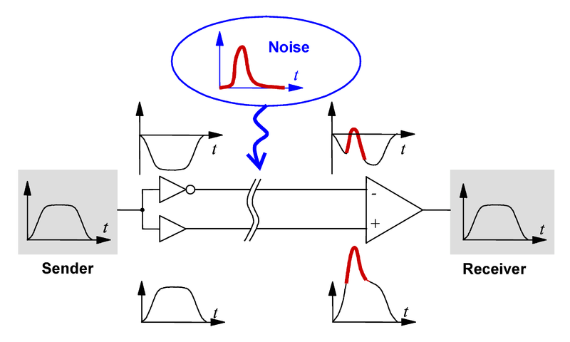
Serial Transmission for Long Distances
Differential signals are used to increase power
  Double the signal to noise ratio (SNR): it takes twice as much noise to cause an error with the differential system as with the single-ended system
  Reach higher bitrate without noise
  USB 2.0 is capable of 480Mbits/sec!
Vs
2Vs
Differential Signal

Slide 8
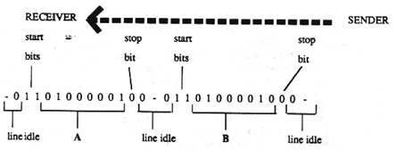
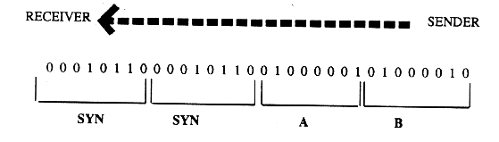
Synchronous vs. Asynchronous Transmission
Synchronous Serial Transmission
Asynchronous Serial Transmission
Stream of data is encoded in chunks
Various bytes at the beginning of the data provide an embedded clock
The data stream can also be synchronized by an external clock
Data transmitted one character at a time
Each character contains its own clock
  Start bits and stop bits
Resynchronizes with each character

Slide 9

Synchronous Transmission
Synchronous Serial Transmission
Advantages
Amount of overhead information restricted to few characters for each block
Can be used at higher speeds
Disadvantages
If error were to occur, whole block of data is lost (100+characters)
User cannot transmit characters instantaneously
  Requires storage
Synchronous used for high-speed communication between computers

Slide 10
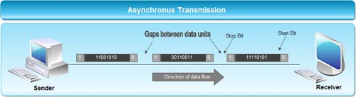
Asynchronous Transmission
Advantages
Each character is its own complete timer system
  Corruption will not spread
Good for irregular interval character generation
  Keyboards
Disadvantages
Dependence on recognition of start bits
Many bits are used only for control purpose and carry no useful information
  Limits transmission speed
Used for speeds up to 3000 bits/second with only simple single-character error detection

Slide 11
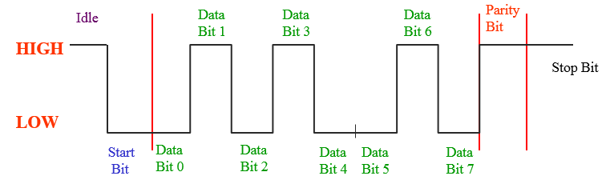
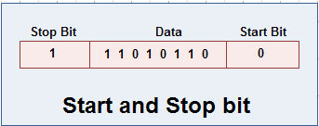
Data Word and Control Bits
Asynchronous Serial Transmission
Start Bit
Signals start of transmission of data bits
Transition from logic 1 to logic 0
Data Bits
Typically 7 data bits (not including parity bit)
Least significant bit is transmitted and received first
Stop Bit
Signals end of data word = 1
Parity Bit
Even or Odd; used for error detection

Slide 12
Example
Sending character ‘A’ with one start bit, one stop bit, even parity, and 8 bit data
  Binary Data is 0100 0001
  Parity Bit is 0 : as number of 1’s is even
Parity Bit
0
1
0
0
0
0
0
1
0
0
1
Start Bit
Data Bits
Stop Bit
Direction of Transmission

Slide 13
Simplex vs Duplex
Simplex
  Data flow in only one direction
    Such as from a PC to its peripheral
Full duplex
  Data flow in both directions simultaneously
    Such as a telephone conversation or communication via a modem
Half duplex
  Data flow in both directions, only one direction at a time
    Such as a conversation over a CB radio

Slide 14
BAUD Rates
Baud Rate: the rate at which symbols are sent
Measured in symbols per second (Bd)
Also known as baud or modulation rate
Often incorrectly referred to as bits per second
Important Baud Variables
  Bd – Baud rate
  M – Number of symbols used (voltages, tones, etc.)
    Number of symbols used (M) = 2^{N} where N = bits / symbol
  N – Bits per symbol (binary = 1)

Slide 15
Bit Rates
Bit Rate: the rate at which bits are transmitted
  Bit Rate = Baud * Bits / Symbol
Measured in bits per second (bps) NOT bytes per second (Bps)
Often incorrectly referred to as data rate
Gross Bit Rate – total number of bits transmitted per second
  Includes protocol overhead bits and data bits
  Rb = 1 / Tb where Tb is the bit transmission time
  Symbol Rate ≤ Gross Bit Rate
    Only equal when 1 bit per symbol (binary)

Slide 16
Bit Rates
Information Rate – rate at which useful data is transmitted
  Information rate ≤ Gross Bit Rate
  I_{R} = R_{b} * Data Bit Number / Total Bit Number
Examples
  Bit Rate
    At 9,600 Baud with 4 voltage levels what is the bit rate?
    Bit Rate= 9,600 * 2 = 19,200 bps
  Information Rate
    Given a protocol with 3 bits of protocol, 8 bits of data, 9600 baud, and 1 bit per symbol (binary) what is the I_{R}?
    I_{R} = 9600 * 1 * 8/11 = 6981 data bits per second

Slide 17
Serial Transmission Interfaces
Synchronous
  Serial Peripheral Interface (SPI)
  Inter-Integrated Circuit (I²C)
Asynchronous
  Universal Asynchronous Receiver Transmitter (UART)

Slide 18
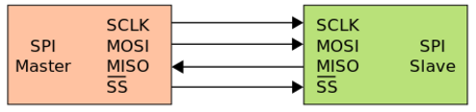
  Serial Peripheral Interface (SPI)
The Serial Peripheral Interface (SPI) bus is a 4-wire synchronous serial communication interface used for short distance communication
Developed by Motorola in the late eighties and has become a de facto standard
SPI devices communicate in full duplex mode using a master-slave architecture with a single master
Multiple slave devices are supported through selection with individual slave select (SS) lines

Slide 19
SPI Interface
The SPI bus specifies four logic signals:
  SCLK : Serial Clock (output from master)
  MOSI : Master Output, Slave Input (output from master)
  MISO : Master Input, Slave Output (output from slave)
  SS : Slave Select (active low, output from master)

Slide 20
SPI Operation
To begin communication, the bus master configures the clock, using a frequency supported by the slave device, typically up to a few MHz
The master then selects the slave device with a logic level 0 on the select line
During each SPI clock cycle, a full duplex data transmission occurs
  The master sends a bit on the MOSI line and the slave reads it
  The slave sends a bit on the MISO line and the master reads it
  This sequence is maintained even when only one-directional data transfer is intended.

Slide 21
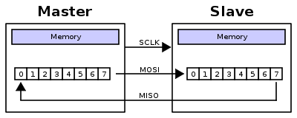
SPI Operation
Transmission involves two shift registers one in master and one in slave connected in a virtual ring topology
  Data is usually shifted out with most-significant bit first, while shifting a new least-significant bit into same register
  After register bits have been shifted out and in, master and slave have exchanged register values
  If more data needs to be exchanged, the shift registers are reloaded and the process repeats
  When complete, master stops toggling clock signal

Slide 22
SPI Clock Polarity and Phase
In addition to setting clock frequency, master must also configure clock polarity (CPOL) and phase (CPHA)
  At CPOL=0 the base value of the clock is zero, i.e. the idle state is 0 and active state is 1
    For CPHA=0, data are captured on the clock's rising edge (low→high transition) and data is output on a falling edge (high→low clock transition)
    For CPHA=1, data are captured on the clock's falling edge and data is output on a rising edge
  At CPOL=1 the base value of the clock is one (inversion of CPOL=0), i.e. the idle state is 1 and active state is 0
    For CPHA=0, data are captured on clock's falling edge and data is output on a rising edge
    For CPHA=1, data are captured on clock's rising edge and data is output on a falling edge

Slide 23
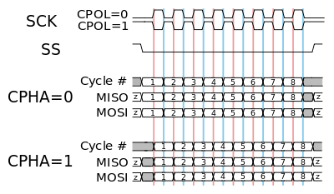
SPI Clock Polarity and Phase
red vertical line represents CPHA=0; blue vertical line represents CPHA=1
CPHA=0 sampling on 1st clock edge; CPHA=1 sampling on 2nd clock edge

Slide 24
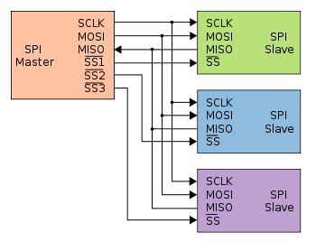
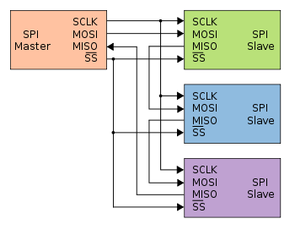
SPI Slave Configurations
Independent slave configuration
  There is an independent chip select line for each slave
  Slaves not selected should have high-impedance in MISO pins
Daisy chain configuration
  Some products that implement SPI may be connected in a daisy chain configuration
  The whole chain acts as a communication shift register
  Can be used to propagate commands through a string of slaves; reduces HW cost

Slide 25
SPI Applications
SPI is used to talk to a variety of peripherals, such as
  Sensors: temperature, pressure, touchscreens
  Control devices: audio codecs, digital potentiometers, DAC
  Camera lenses: Canon EF lens mount
  Memory: flash and EEPROM
  Real-time clocks
  LCD, sometimes even for managing image data
  Any MMC or SD card

Slide 26
SPI Advantages
Full duplex communication
Higher throughput than I²C or SMBus
Complete protocol flexibility for the bits transferred
Extremely simple hardware interfacing
Uses only four pins on IC packages
At most one unique bus signal per device (chip select)
Not limited to any maximum clock speed, enabling potentially high speed
Simple software implementation

Slide 27
SPI Disadvantages
Requires more pins on IC packages than I²C
No hardware flow control by the slave (but the master can delay the next clock edge to slow the transfer rate)
No hardware slave acknowledgment (the master could be transmitting to nowhere and not know it)
Typically supports only one master device (depends on device's hardware implementation)
No error-checking protocol is defined
Only handles short distances compared to RS-232, RS-485, or CAN-bus

Slide 28
LPC176x/5x SPI Interface (SSP0/1)
The SSP is a Synchronous Serial Port (SSP) controller capable of operation on a SPI, 4-wire SSI, or Microwire bus.
It can interact with multiple masters and slaves on bus.
Only a single master and a single slave can communicate on the bus during a given data transfer.
Data transfers are in principle full duplex, with frames of 4 to 16 bits of data flowing from the master to the slave and from the slave to the master.
Maximum data bit rate of one eighth of the peripheral clock rate.
8 frame FIFOs for both transmit and receive.

Slide 29
Clock Polarity (CPOL) and Phase (CPHA) control
When the CPOL clock polarity control bit is 0, it produces a steady state low value on the SCK pin.
If the CPOL clock polarity control bit is 1, a steady state high value is placed on the CLK pin when data is not being transferred.
The CPHA control bit selects the clock edge that captures data and allows it to change state.
When the CPHA phase control bit is 0, data is captured on the first clock edge transition.
If the CPHA clock phase control bit is 1, data is captured on the second clock edge transition.

Slide 30
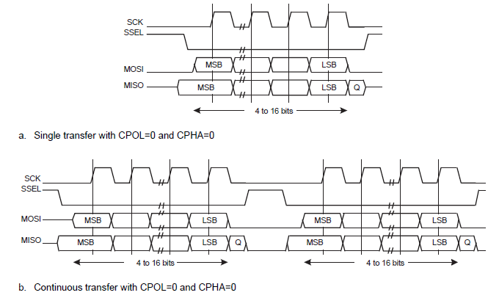
SPI format with CPOL=0,CPHA=0

Slide 31
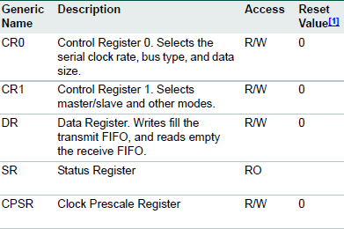
Register description

Slide 32
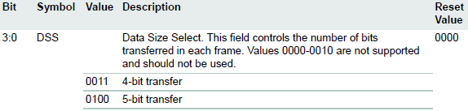
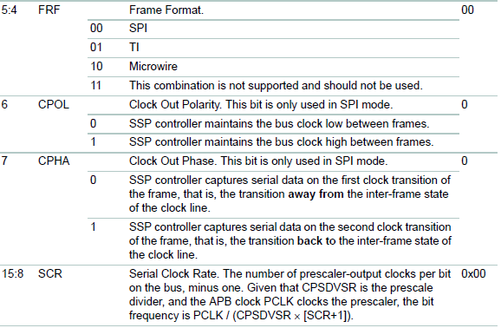
SSPn Control Register 0 (SSP0CR0)
LPC_SSP0 -> CR0 |= 0x0707; // 8-bit transfer; clk frequency divided by (7+1)

Slide 33
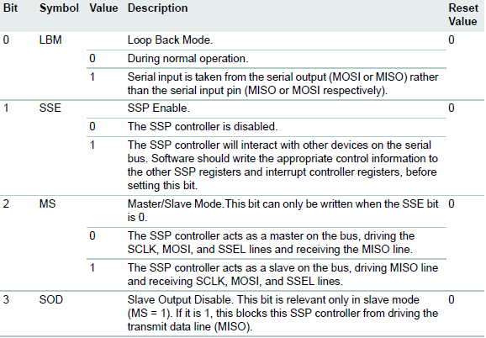
SSPn Control Register 1 (SSP0CR1)
LPC_SSP0 -> CR1 |= (1 << 1); //SSP Enable

Slide 34
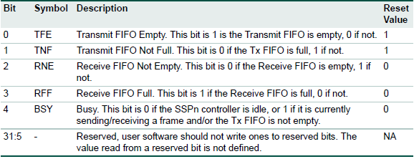
SSPn Status Register (SSP0SR)

Slide 35
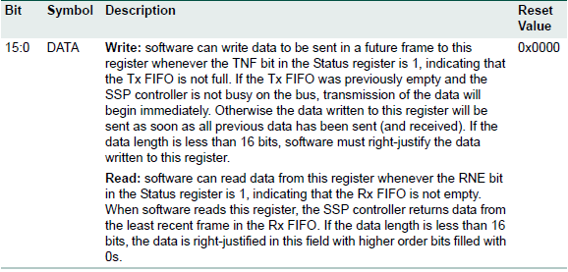
SSPn Data Register (SSP0DR)
LPC_SSP0 -> DR=0;
while ( (LPC_SSP0 -> SR & (1<<4)) );
data = LPC_SSP0->DR;

Slide 36
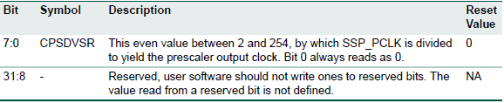
SSPn Clock Prescale Register (SSP0CPSR)
This register controls the factor by which the Prescaler divides the SSP peripheral clock SSP_PCLK to yield the prescaler clock that is, in turn, divided by the SCR factor in SSPnCR0, to determine the clock.
LPC_SSP0 -> CPSR |= 0x5E; // slave dependent

Slide 37
SSP Initialization
LPC_SC -> PCONP |= 1 << 21; //SSP0 interface power/clock control bit.
LPC_SC -> PCLKSEL1 |= (1 << 10) | (1<<11); //Peripheral clock selection for SSP0.
LPC_PINCON -> PINSEL0 |= 1 << 31; //Configure P0.15 to SPP0 CLK pin
LPC_GPIO0 -> FIODIR |= 1 << 16; // Configure P0.16 to SSEL
LPC_PINCON -> PINSEL1 |= 1 << 3; //Configure P0.17 to MISO0
LPC_PINCON -> PINSEL1 |= 1 << 5; //Configure P0.18 to MOSI0
//ENABLING PULL DOWN RESISTORS
LPC_PINCON -> PINMODE0 |= 0x3 << 30; // P0.15
LPC_PINCON -> PINMODE1 |= (0x3) | (0x3 << 2) | (0x3<<4); // P0.16, P0.17, P0.18
LPC_SSP0 -> CR1 |= (1 << 1); //SSP Enable
LPC_SSP0 -> CR0 |= 0x0707; // 8-bit transfer; clk frequency divided by (7+1)
LPC_SSP0 -> CPSR |= 0x5E; // depends on the slave

Slide 38

Inter-Integrated Circuit (I²C) Bus
I²C (Inter-Integrated Circuit), is a multi-master, multi-slave, synchronous serial bus
  invented in 1982 by Philips Semiconductor (now NXP Semiconductors)
Originally intended for operation on single board / PCB
  Two wires carry information between a number of devices
    One wire used for the data (SDA)
    One wire used for the clock (SCL)
  Half-Duplex; The speed grades (standard mode: 100 Kbit/s, full speed: 400 Kbit/s, fast mode: 1Mbit/s, high speed: 3.2 Mbit/s).
  Variety of devices are available with I²C Interfaces
    Microcontroller, EEPROM, Real-Timer, interface chips, LCD driver, A/D converter

Slide 39
I²C Bus Characteristics
I²C uses only two bidirectional open-drain lines, Serial Data Line (SDA) and Serial Clock Line (SCL), pulled up with resistors
Unique start and stop condition
Slave selection protocol uses a 7-Bit slave address
  The bus specification allows an extension to 10 bits
Acknowledgement after each transferred byte
No fixed length of transfer
Max. line capacitance of 400pF, approximately 4 meters (12 feet)
True multi-master capability: Clock synch., Arbitration

Slide 40
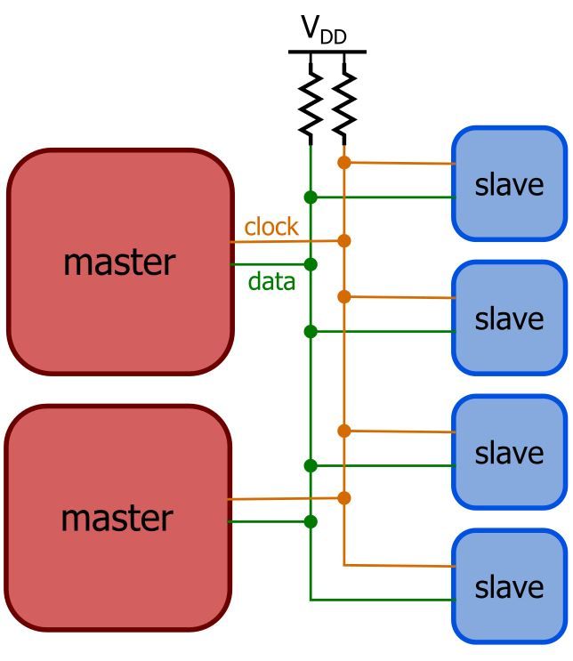
I²C Bus Definitions
Master
  Initiates a transfer by generating
  start and stop conditions
  Generates the clock
  Transmits the slave address
  Determines data transfer direction
Slave
  Responds only when addressed
  Timing is controlled by the clock line
Bus State
  Quiescent (Idle), or in Master transmit mode or in Master receive mode

Slide 41
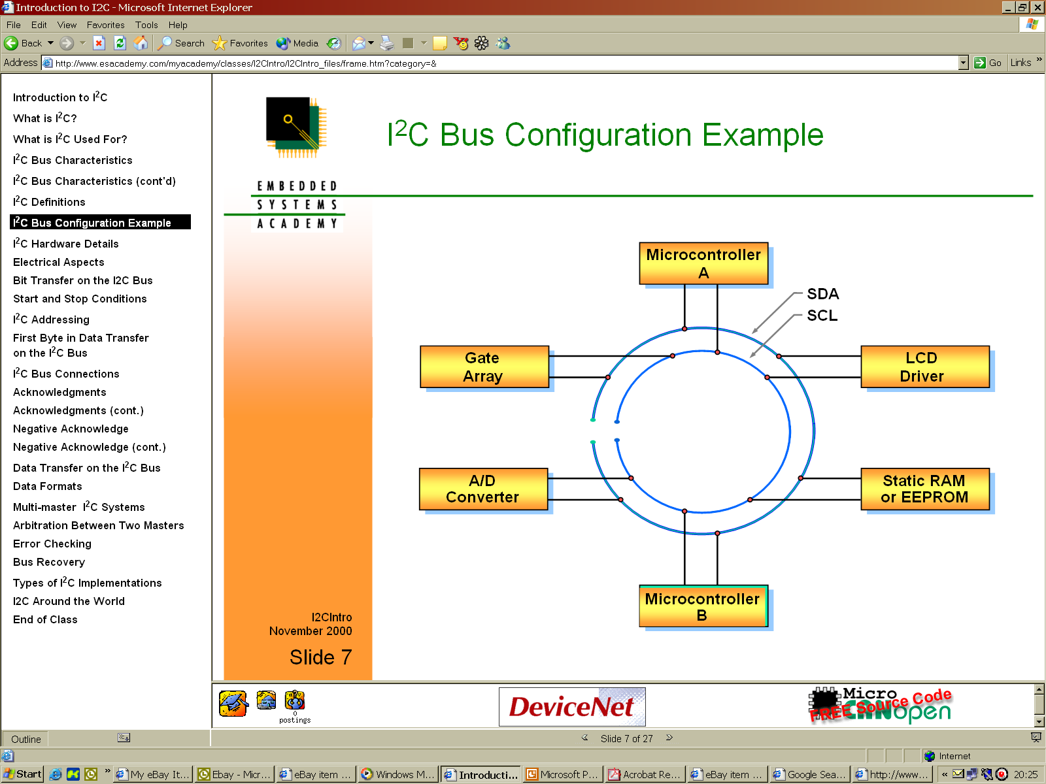
I²C Bus Configuration Example

Slide 42
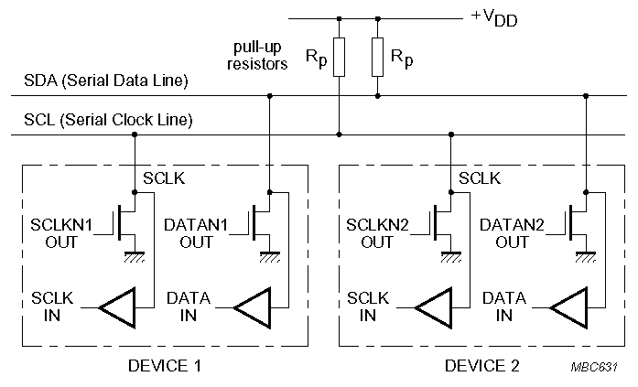
I²C Electrical Aspects
I²C devices are wire ANDed together
If any single node writes a zero, the entire line is zero

Slide 43
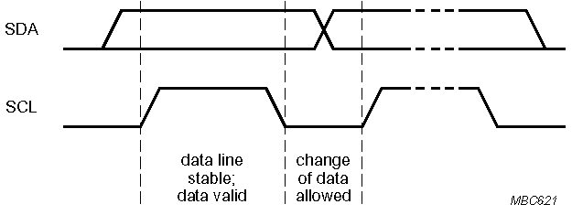
Bit Transfer on the I²C Bus
In normal data transfer, the data line only changes state when the clock is low
SDA
SCL
Data line stable; Data valid
Change of data allowed

Slide 44
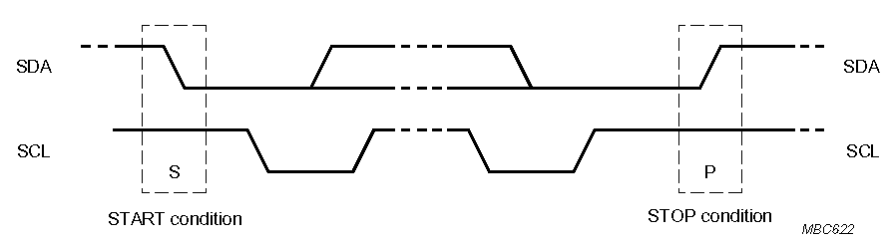
Start and Stop Conditions
A transition of the data line while the clock line is high is defined as either a start or a stop condition.
Start and Stop conditions are generated by bus master
The bus is considered busy after a start condition, until a stop condition occurs
SDA
SDA
SCL
SCL
Start Condition
Stop Condition

Slide 45
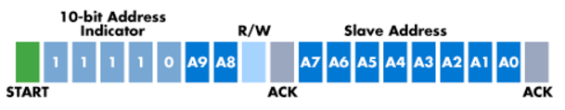
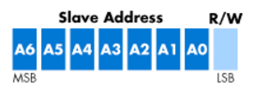
I²C Addressing
Each node has a unique 7 (or 10) bit address
Peripherals often have fixed and programmable address portions
Addresses starting with 0000 or 1111 have special functions:-
  0000000 is a General Call Address (addresses all slaves)
  11110XX is 10-bit Slave Addressing
7-bit Addressing
10-bit Addressing

Slide 46
1st Byte in Data Transfer on I²C Bus
Each node has a unique 7 (or 10) bit address
MSB
LSB
R / W
7 – Bit Slave Address
ACK
R/W’
0 – Slave written to by Master
1 – Slave read by Master
ACK – Generated by the slave whose address has been output

Slide 47
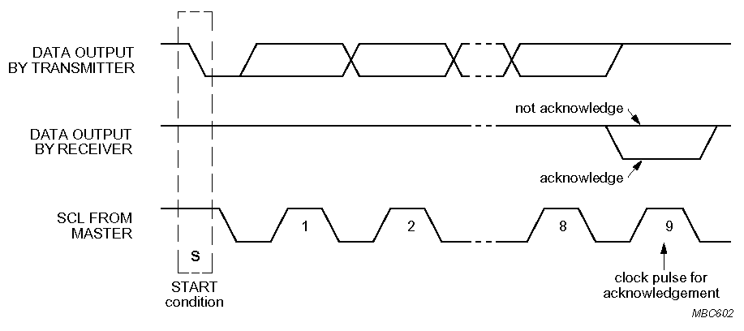
Acknowledgements
Master/slave receivers pull data line low for one clock pulse after reception of a byte
Master receiver leaves data line high after receipt of the last byte requested
Transmitter releases SDA line during 9th clock pulse.
Acknowledgement from receiver

Slide 48
Negative Acknowledge
NACK: Receiver leaves data line high for one clock pulse after reception of a byte
From Slave to Master Transmitter
  After address not received correctly
  After data byte not received correctly
  Slave is not connected to the bus
From Master Receiver to Slave
  After last data byte received correctly
Transmitter releases SDA line during 9th clock pulse
Not acknowledgement (NACK) from receiver

Slide 49
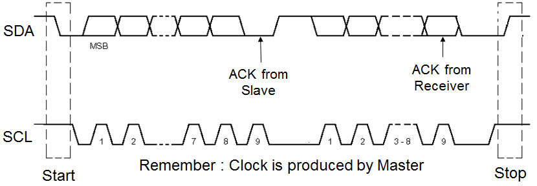
Data Transfer on the I²C Bus
Start Condition
Slave address + R/W
  Slave acknowledges with ACK
All data bytes
  Each followed by ACK
Stop Condition

Slide 50
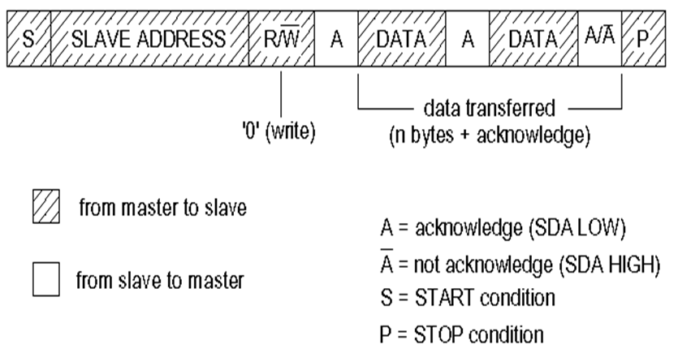
Data Formats
Master Writing to a Slave

Slide 51
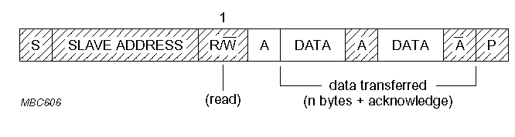
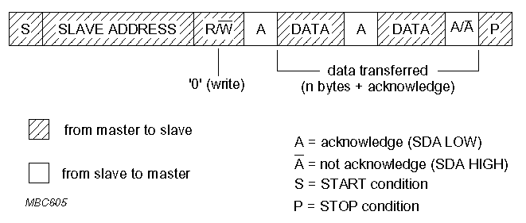
Data Formats
Master Reading from a Slave
  Master is Receiver of data and Slave is Transmitter of data
1

Slide 52
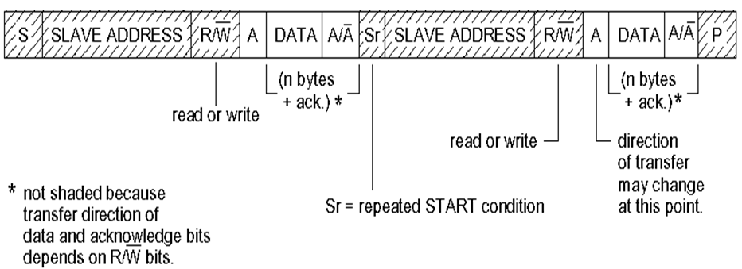
Data Formats
Combined Format: a master issues at least two reads and/or writes to one or more slaves
A repeated start avoids releasing the bus and therefore prevents another
master from taking over the bus

Slide 53
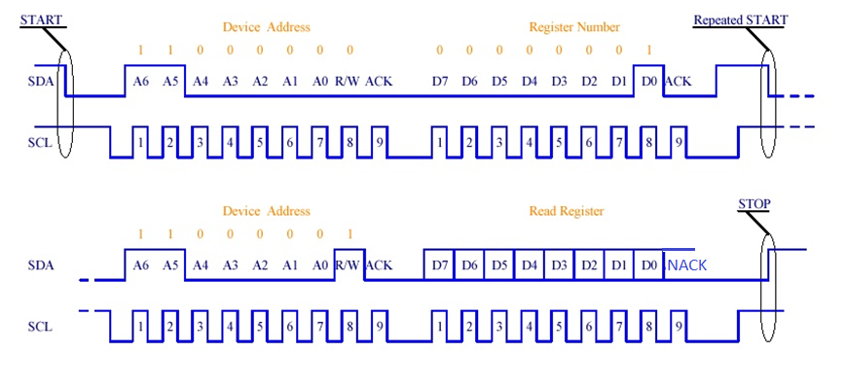
Combined Format Example
I²C Read example using device address 1100000 and reading register number 1

Slide 54
Multi-Master I²C Systems
Every master monitors the bus for start and stop bits, and does not start a message while another master is keeping the bus busy
However, two masters may start transmission at about the same time; in this case, arbitration occurs
Each transmitter checks the level of the data line (SDA) and compares it with the levels it expects; if they do not match, that transmitter has lost arbitration, and drops out of this protocol interaction
If two masters are sending a message to two different slaves, the one sending lower slave address always "wins" arbitration in the address stage

Slide 55
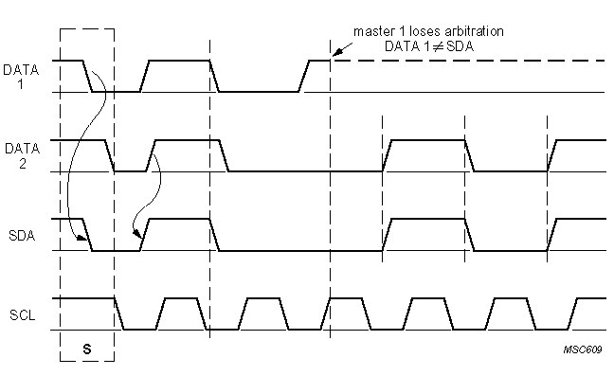
Arbitration Between Two Masters
As the data line is like a wired AND, a 0 address bit overwrites a 1
The node detecting that it has been overwritten stops transmitting and waits for the Stop Condition before it retries to arbitrate the bus

Slide 56
I²C Bus Advantages
Simple 2-wire serial I²C-bus minimizes interconnections
ICs can be added to or removed from a system without affecting any other circuits on the bus
The multi-master capability of the I²C-bus allows rapid testing/alignment of end-user equipment via external connections to an assembly-line
Incorporates ACK/NACK functionality for improved error handling
The I²C-bus is a de facto world standard that is implemented in over 1000 different ICs (Philips has > 400) and licensed to more than 70 companies

Slide 57
I²C Bus Disadvantages
The assignment of slave addresses is one weakness of I²C
Imposes protocol overhead that reduces throughput
Because I²C is a shared bus, there is the potential for any device to have a fault and hang the entire bus
I²C supports a limited range of speeds
Requires pull-up resistors, which
  limit clock speed
  consume valuable PCB real estate in extremely space-constrained systems
  increase power dissipation

Slide 58
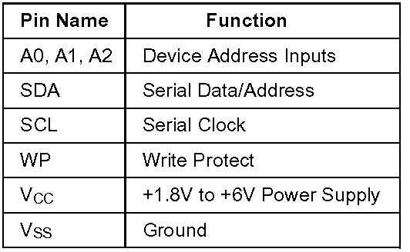
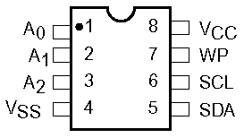
Example – EEPROM (Part 24WC32)
400 KHz I²C Bus Compatible*
1.8 to 6 Volt Read and Write Operation
Cascadable for up to Eight Devices
32-Byte Page Write Buffer
Self-Timed Write Cycle with Auto-Clear
Zero Standby Current
Commercial, Industrial and Automotive Temperature Ranges
Write Protection– Entire Array Protected When WP at VIH
1,000,000 Program/Erase Cycles
100 Year Data Retention

Slide 59

24WC32 Characteristics
32KBit memory organised as 4K x 8bit
12 address bits (2^12 = 4K)
Device Address :
Writing
  Byte Write
  Page Write
  Write time 10ms maximum
Reading
  Immediate/Current address reading
  Selective/Random Read, Sequential Read

Slide 60
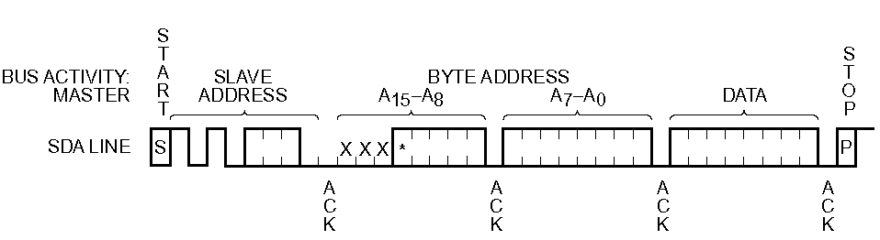
Writing a Single Data Byte
After the STOP bit is received the device internally programs the EEPROM with the received data byte
The programming can take up to 10ms (max.). The device will be busy during this period and will not respond to its slave address

Slide 61
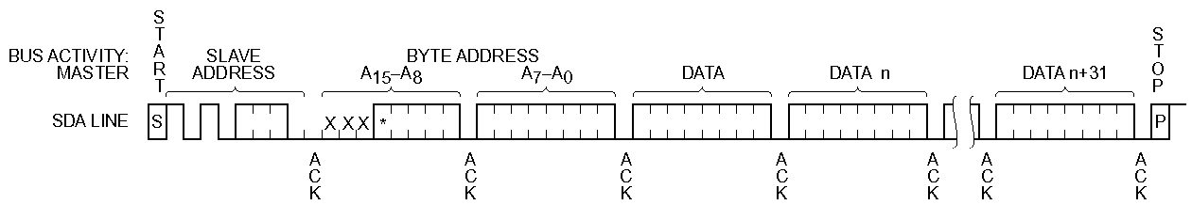
Writing Multiple Bytes (Page Write)
The bytes are received by the device and stored internally in a buffer before being programmed into the EEPROM
A maximum of 32 bytes (one page = 32 bytes) may be written at one time for the 24WC32 device

Slide 62
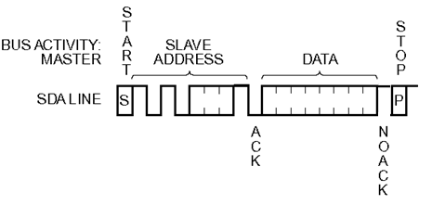
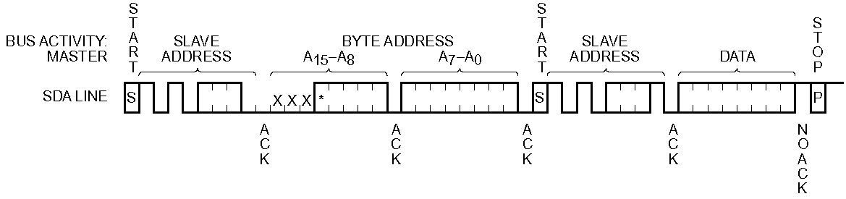
Reading EEPROM
Read current location
Read specified location – Note repeated start to prevent loss of bus during read process.

Slide 63
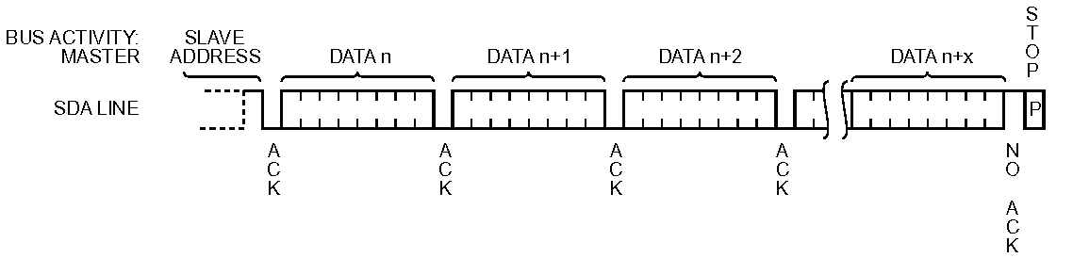
Reading EEPROM
Sequential Read

Slide 64
LPC176x/5x I²C Interface
Three I²C interfaces are provided: I²C0, I²C1, I²C2
Standard I²C compliant bus interfaces may be configured as Master, Slave, or Master/Slave
Arbitration is handled between simultaneously transmitting masters without corruption of data on bus
Program. clock allows adjustment of I²C transfer rates
Supports Fast Mode Plus (I²C0 only)
Optional recognition of up to 4 distinct slave addresses
Monitor mode allows observing all I²C-bus traffic, regardless of slave address, without affecting actual I²C-bus traffic

Slide 65
LPC176x/5x I²C Registers
Each I²C interface contains 16 registers
Address Registers, I2ADR0 to I2ADR3
  These registers may be loaded with the 7-bit slave address (7 most significant bits)
  The LSB (GC) is used to enable General Call address (0x00)
Address mask registers, I2MASK0 to I2MASK3
  The four mask registers each contain seven active bits (7:1)
  Any bit in these registers set to ‘1’ will cause an automatic compare on the corresponding bit of the received address with I2ADRn register
  When an address-match interrupt occurs, the processor will have to read the data register (I2DAT) to determine which received address actually caused the match

Slide 66
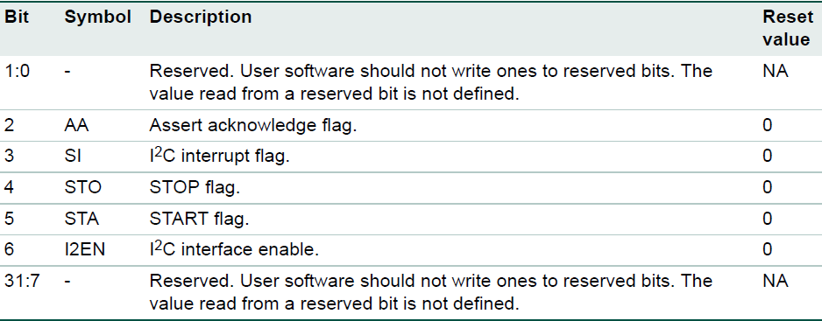
LPC176x/5x I²C Registers
I2C Control Set register: I2C0CONSET, I2C1CONSET, I2C2CONSET
  Writing a 1 to a bit of this register causes the corresponding bit in the I2C control register to be set. Writing a 0 has no effect

Slide 67
LPC176x/5x I²C Registers
I2EN I²C Interface Enable. When I2EN is 1, the I2C interface is enabled
STA is START flag. Setting this bit causes the I2C interface to enter master mode and transmit a START condition or transmit a repeated START condition
STO is the STOP flag. Setting this bit causes the I2C interface to transmit a STOP condition in master mode or recover from an error condition in slave mode
SI is the I2C Interrupt Flag (set when I²C changes state)
AA is the Assert Acknowledge Flag. When set to 1, an acknowledge (low level to SDA) will be returned during the acknowledge clock pulse

Slide 68
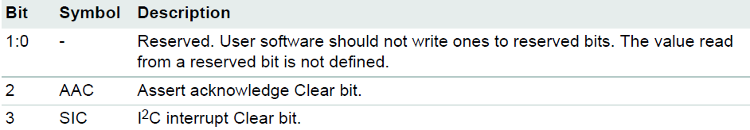
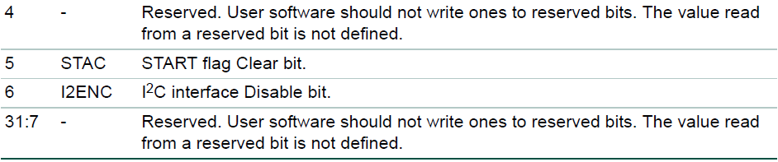
LPC176x/5x I²C Registers
I2C Control Clear register: I2C0CONCLR, I2C1CONCLR, I2C2CONCLR
  Writing a 1 to a bit of this register causes the corresponding bit in the I2C control register to be cleared. Writing a 0 has no effect

Slide 69

LPC176x/5x I²C Registers
I2C Status register: I2C0STAT, I2C1STAT, I2C2STAT
  I2C Status register is read-only.
  The three least significant bits are always 0
  Taken as a byte, the status register contents represent a status code. There are 26 possible status codes
  Status codes correspond to defined I2C states

Slide 70

LPC176x/5x I²C Registers
I2C Data register: I2C0DAT, I2C1DAT, I2C2DAT
  This register contains the data to be transmitted or the data just received
  The CPU can read and write to this register only while it is not in the process of shifting a byte, i.e., when the SI bit is set
  Data in I2DAT remains stable as long as the SI bit is set
  Data in I2DAT is always shifted from right to left

Slide 71


LPC176x/5x I²C Registers
I2C SCL HIGH duty cycle register: I2C0SCLH, I2C1SCLH, I2C2SCLH
I2C SCL LOW duty cycle register: I2C0SCLL, I2C1SCLL, I2C2SCLL

Slide 72


I2C Data Rate and Duty Cycle
Software must set values for the registers I2SCLH and I2SCLL to select the appropriate data rate and duty cycle
PCLK_I2C is the frequency of the peripheral bus APB

Slide 73


LPC176x/5x I²C Operating Modes
Master Transmitter Mode
  A number of data bytes are transmitted to a slave receiver
  Before the master transmitter mode can be entered, I2CON must be initialized as follows:

Slide 74
LPC176x/5x I²C Operating Modes
  Master transmitter mode may now be entered by setting STA bit
  The I2C logic will now test the I2C-bus and generate a START condition as soon as the bus becomes free
  When a START condition is transmitted, serial interrupt flag (SI) is set, and status code in status register (I2STAT) will be 0x08
  This status code is used by the interrupt service routine to enter the appropriate state service routine that loads I2DAT with the slave address and the data direction bit (SLA+W)
  SI bit in I2CON must be reset before serial transfer can continue
  When slave address and direction bit have been transmitted and an acknowledgment bit has been received, serial interrupt flag (SI) is set, and a number of status codes in I2STAT are possible
    0x18, 0x20, or 0x38 for the master mode
    0x68, 0x78, or 0xB0 if the slave mode was enabled (AA=1)

Slide 75


LPC176x/5x I²C Operating Modes

Slide 76

LPC176x/5x I²C Operating Modes
Master Receiver Mode
  Data is received from a slave transmitter
  Transfer is initiated in the same way as in the master transmitter mode
  When START condition is transmitted, ISR must load slave address and data direction bit to I2C Data register (I2DAT) and then clear the SI bit. Data direction bit (R/W) should be 1 to indicate a read

Slide 77
LPC176x/5x I²C Operating Modes
  When the slave address and data direction bit have been transmitted and an acknowledge bit has been received, the SI bit is set, and the Status Register will show the status code
    For master mode, the possible status codes are 0x40, 0x48, or 0x38
    For slave mode, the possible status codes are 0x68, 0x78, or 0xB0
  When LPC176x/5x needs to acknowledge a received byte, AA bit needs to be set prior to clearing SI bit and initiating byte read
  When LPC176x/5x needs to not acknowledge a received byte, AA bit needs to be cleared prior to clearing SI bit and initiating byte read
  Note that last received byte is always followed by a "Not Acknowledge" from the LPC176x/5x so that master can signal slave that reading sequence is finished and that it needs to issue a STOP or repeated START Command

Slide 78

LPC176x/5x I²C Operating Modes
After a repeated START condition, I²C may switch to the master transmitter mode

Slide 79

LPC176x/5x I²C Operating Modes

Slide 80
Using LPC176x/5x I²C
Initialization
  Example to initialize I²C Interface as a Slave and/or Master
    Load the I2ADR registers and I2MASK registers with values to configure the own Slave Address, enable General Call recognition if needed
    Enable I2C interrupt
    Write 0x44 to I2CONSET to set the I2EN and AA bits, enabling Slave functions. For Master only functions, write 0x40 to I2CONSET
    The serial clock frequency (for master modes) is defined by loading the I2SCLH and I2SCLL registers
  The I2C hardware now begins checking the I2C-bus for its own slave address and if detected an interrupt is requested and I2STAT is loaded with the appropriate state information

Slide 81
Using LPC176x/5x I²C
I²C interrupt service
  When the I2C interrupt is entered, I2STAT contains a status code which identifies one of the 26 state services to be executed
    Read the I2C status from I2STA
    Use the status value to branch to one of 26 possible state routines
Start Master Transmit function
  Begin a Master Transmit operation by setting up the buffer, pointer, and data count, then initiating a START
    Set up Slave Address to which data will be transmitted, add Write bit
    Set up data to be transmitted in Master Transmit buffer
    Initialize the Master data counter to match the length of the message being sent
    Write 0x20 to I2CONSET to set the STA bit

Slide 82

Using LPC176x/5x I²C
Start Master Receive function
  Begin a Master Receive operation by setting up the buffer, pointer, and data count, then initiating a START
    Set up the Slave Address to which data will be transmitted, and add Read bit
    Set up the Master Receive buffer.
    Initialize the Master data counter to match the length of the message to be received
    Write 0x20 to I2CONSET to set the STA bit
State: 0x08
  Write Slave Address with R/W bit to I2DAT
  Write (1<<3)|(1<<5) to I2CONCLR to clear the SI flag & Start flag

Slide 83


Using LPC176x/5x I²C
State: 0x18
  Previous state was State 0x08 or State 0x10, Slave Address + Write has been transmitted, ACK has been received. The first data byte will be transmitted
    Load I2DAT with first data byte from Master Transmit buffer
    Increment Master Transmit buffer pointer
    Write 0x08 to I2CONCLR to clear the SI flag
State: 0x28
  If there is still data to be written
    Load I2DAT with next data byte from Master Transmit buffer
    Increment Master Transmit buffer pointer
    Write 0x08 to I2CONCLR to clear the SI flag

Slide 84

Using LPC176x/5x I²C
  If there is no data to be written and there is data to be read
    Write 0x20 to I2CONSET to set the STA bit
    Write 0x08 to I2CONCLR to clear the SI flag
  Otherwise
    Write 0x10 to I2CONSET to set the STOP bit
    Write 0x08 to I2CONCLR to clear the SI flag
For C code example:
https://github.com/una1veritas/LPCxpresso/tree/master/workspace/i2c/src

Slide 85
Universal Asynchronous Receiver Transmitter (UART)
A universal asynchronous receiver/transmitter (UART) is a device for asynchronous serial communication with configurable data format and transmission speeds
The electric signaling levels and methods (such as differential signaling, etc.) are handled by a driver circuit external to the UART
UARTs are commonly used with communication standards such as TIA (formerly EIA) RS-232, RS-422 or RS-485
Communication may be simplex, full duplex or half duplex

Slide 86
Universal Asynchronous Receiver Transmitter (UART)
Based around shift registers and a clock signal
UART clock determines baud rate
UART frames the data bits with
  a start bit to provide synchronisation to the receiver
  one or more (usually one) stop bits to signal end of data
Most UARTs can also optionally generate parity bits on transmission and parity checking on reception to provide simple error detection
UARTs often have receive and transmit buffers (FIFO's) as well as the serial shift registers
This allows host processor more time to handle an interrupt from the UART and prevents loss of received data at high rates

Slide 87
UART - Transmitter
Transmitter (Tx) - converts data from parallel to serial format
  inserts start and stop bits
  calculates and inserts parity bit if required
  output bit rate is determined by the UART clock
Status information
Parallel data
Serial output
UART Clock from
baud rate generator

Slide 88

Asynchronous Serial Transmission
1
0
Serial transmission is little endian (least significant bit first)

Slide 89
UART - The Receiver
  Synchronises with transmitter using falling edge of start bit
  Samples input data line at a clock rate that is normally a multiple of baud rate, typically 16 times the baud rate
  Reads each bit in middle of bit period (many modern UARTs use a majority decision of the several samples to determine the bit value)
  Removes start and stop bits, optionally calculates and checks parity bit. Presents received data value in parallel form
Status information
Serial input
Parallel data
UART Clock from
baud rate generator

Slide 90
Asynchronous Serial Reception
Idle
Start bit
etc.
waiting for start bit
1
First data bit
Start detected
0

Slide 91
UART Error Conditions
Overrun Error: When a new character is assembled while the receiver buffer or FIFO is full
Parity Error: When the parity bit of a received character is in the wrong state, a parity error occurs
Framing Error: When the stop bit of a received character is a logic 0, a framing error occurs
Break Condition: When Rx is held in the spacing state (all zeroes) for one full character transmission

Slide 92


DCE and DTE
Original purpose of UART was for PCs to communicate via telephone network
Telephones were for voice communication (analog signals) whereas computers need to exchange discrete data (digital signals)
Special ‘communication equipment’ was needed for doing signal conversions (i.e., modulator/demodulator, or modem)

Slide 93

Normal 9-Wire Serial Cable
1
Carrier Detect
1
6
6
Data Set Ready
Rx data
Request To Send
Tx data
Clear To Send
Data Terminal Ready
9
Ring Indicator
Signal Ground
9
5
5

Slide 94
Signal Functions
CD (Carrier Detect): modem has established a communication link and data may be exchanged
RI (Ring Indicator): a telephone ringing signal has been detected by modem
DSR (Data Set Ready): modem is ready to establish a communications link with PC
DTR (Data Terminal Ready): PC is ready to establish connection with modem
RTS (Request To Send): PC would like to transmit data to modem
CTS (Clear To Send): modem is ready to accept data from PC

Slide 95

UART Use Examples
UARTs can be used to interface to a wide variety of other peripherals
  Widely available GSM/GPRS cell phone modems
  Bluetooth modems can be interfaced to a microcontroller UART
  GPS receivers frequently support UART interfaces

Slide 96
LPC176x/5x UART Interface
Four UARTs: UART0/2/3 and UART1 (modem interface)
  Data sizes of 5, 6, 7, and 8 bits
  Parity generation and checking: odd, even, mark, space or none
  One or two stop bits
  16 byte Receive and Transmit FIFOs
  Built-in baud rate generator, including a fractional rate divider for great versatility; Auto-baud capability
  Supports DMA for both transmit and receive
  IrDA mode to support infrared communication
  Either software or hardware flow control can be implemented
  Standard modem interface signals included (CTS, DCD, DSR, DTR, RI, RTS) in UART1

Slide 97

LPC176x/5x UART Block Diagram

Slide 98


LPC176x/5x UART Registers
UARTn Pin description
UARTn registers
RBR is the top byte of RX FIFO (oldest char); THR is top byte of TX FIFO (newest)

Slide 99


LPC176x/5x UART Registers

Slide 100

LPC176x/5x UART Registers
UARTn Interrupt Enable Register (U0IER, U2IER, U3IER)

Slide 101

LPC176x/5x UART Registers
UARTn Interrupt Identification Register (U0IIR, U2IIR, U3IIR)

Slide 102
LPC176x/5x UART Registers
The UARTn RLS interrupt (UnIIR[3:1] = 011)
  highest priority interrupt
  set whenever any one of four error conditions occur on UARTn Rx input: overrun error (OE), parity error (PE), framing error (FE) and break interrupt (BI)
  UARTn Rx error condition that sets the interrupt can be observed via UnLSR[4:1]
  The interrupt is cleared upon an UnLSR read
The CTI interrupt (UnIIR[3:1] = 110)
  a second level interrupt
  set when the UARTn Rx FIFO contains at least one character and no UARTn Rx FIFO activity has occurred in 3.5 to 4.5 character times

Slide 103
LPC176x/5x UART Registers
  Any UARTn Rx FIFO activity (read or write of UARTn LSR) will clear the interrupt
The UARTn RDA interrupt (UnIIR[3:1] = 010)
  shares second level priority with the CTI interrupt (UnIIR[3:1] = 110)
  activated when the UARTn Rx FIFO reaches the trigger level defined in UnFCR[7:6]
  reset when the UARTn Rx FIFO depth falls below the trigger level
The UARTn THRE interrupt (UnIIR[3:1] = 001)
  a third level interrupt
  activated when the UARTn THR FIFO is empty provided certain initialization conditions have been met

Slide 104

LPC176x/5x UART Registers
UARTn FIFO Control Register (U0FCR, U2FCR, U3FCR)

Slide 105

LPC176x/5x UART Registers
UARTn Line Control Register (U0LCR, U2LCR, U3LCR)

Slide 106

LPC176x/5x UART Registers
UARTn Line Status Register (U0LSR, U2LSR, U3LSR)

Slide 107


LPC176x/5x UART Registers

Slide 108


LPC176x/5x UART Registers
UARTn Divisor Latch LSB register (U0DLL, U2DLL, U3DLL)
UARTn Divisor Latch MSB register (U0DLM, U2DLM,U3DLM)

Slide 109


LPC176x/5x UART Registers
UARTn Fractional Divider Register (U0FDR, U2FDR, U3FDR)
UART0/2/3 baud rate can be calculated as:

Slide 110
Steps for Configuring UART0
Below are the steps for configuring the UART0:
  Step1: Configure GPIO pin for UART0 function using PINSEL register (TXD0=P0.02, RXD0=P0.03)
  Step2: Configure FCR for enabling FIFO and Reset both Rx/Tx FIFOs
  Step3: Configure LCR for 8-data bits, 1 Stop bit, Disable Parity and Enable DLAB
  Step4: Get PCLK from PCLKSELx register 7-6 bits
  Step5: Calculate DLM,DLL values for required baudrate from PCLK
  Step6: Update DLM,DLL with calculated values
  Step7: Finally clear DLAB to disable access to DLM,DLL
After this UART will be ready to Transmit/Receive Data

Slide 111
UART Initialization Example
void init_UART(uint32_t baud_rate) {
LPC_PINCON->PINSEL0 |= (1 << 4) | (1 << 6); // Pin 0.2 is TX, Pin 0.3 is RX
LPC_UART0->FCR |= (1 << 0) | (1 << 1) | (1 << 2); // Enable FIFO,
reset RX FIFO, and reset TX FIFO
LPC_UART0->LCR |= (1 << 0) | (1 << 1); // 8-bit word
uint32_t pclk_value, temp;
pclk_value = 25E6; // PCLK is 25 MHz
LPC_UART0->LCR |= (1 << 7); // Enable Access to Divisor Latches
// The Equation
// baud_rate = (pclk_value) / (16 * ((256 * DLM) + DLL) * (1+(DivAddVal/MulVal)))
// Assuming (DivAddVal/MulVal) is equal to 0
temp = (pclk_value / (16 * baud_rate));
LPC_UART0->DLL = temp & 0xFF;
LPC_UART0->DLM = (temp >> 0x08) & 0xFF;
LPC_UART0->LCR &= ~(1 << 7); // Clear Access to Divisor Latches
}

Slide 112
Using UART0
Steps for Transmitting a char
  Step1: Wait till previous char is transmitted i.e. till THRE in LSR becomes high
  Step2: Load the new char to be transmitted into THR
Steps for Receiving a char
  Step1: Wait till a char is received i.e. till RDR in LSR becomes high
  Step2: Copy the received data from receive buffer (RBR)
For C code examples:
https://exploreembedded.com/wiki/LPC1768:_UART_Programming

Slide 113
UART Send & Receive Examples
void sendByte(uint8_t ch) {
while (!(LPC_UART0->LSR & (1 << 5))); // wait until transmit signal is available
LPC_UART0->THR = ch;
}
uint8_t getByte() {
volatile uint8_t ch;
while (!(LPC_UART0->LSR & 1)) ; // wait until data is ready
ch = LPC_UART0->RBR;
return ch;
}

