Slide 1
Computing Platforms
Chapter 4
COE 306: Introduction to Embedded Systems
Dr. Aiman El-Maleh
Computer Engineering Department
College of Computer Sciences and Engineering
King Fahd University of Petroleum and Minerals

Slide 2
Next . . .
Basic Computing Platforms
The CPU bus
Direct Memory Access (DMA)
System Bus Configurations
ARM Bus: AMBA 2.0
Memory Components
Embedded Platforms
Platform-Level Performance

Slide 3
Computing Platforms
Computing platforms are created using microprocessors, I/O devices, and memory components
A CPU bus is required to connect the CPU to other devices
Software is required to implement an application
Embedded system software is closely tied to the hardware
Computing Platform: hardware and software

Slide 4
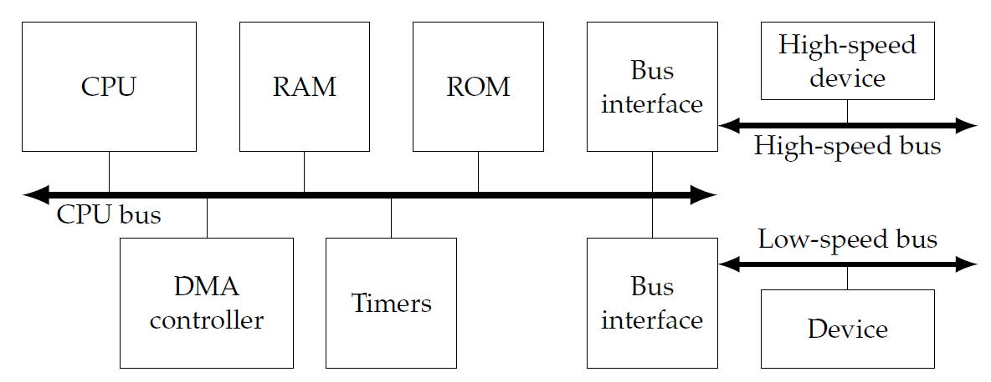
Platform Hardware Components
  DMA controller provides direct memory access
  Timers are used by operating system
  A high-speed bus, connected to CPU bus through a bridge, allows fast devices to communicate efficiently
  A low-speed bus provides an inexpensive way to connect simpler devices

Slide 5
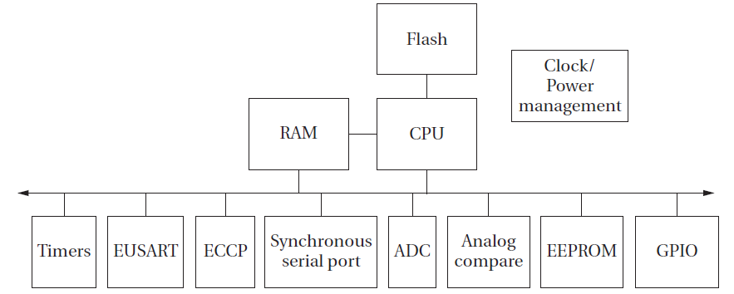
Example: PIC16F882
Harvard architecture---flash memory separately programmed.
Multiple I/O devices

Slide 6
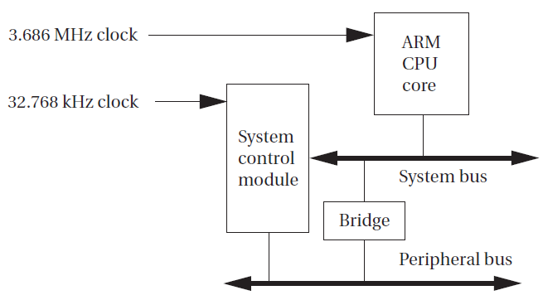
Example: Intel StrongARM SA-1100
The system control module contains:
  a real-time clock
  an operating system timer
  28 general-purpose I/Os
  an interrupt controller
  a power manager controller
  a reset controller that handles resetting the processor.
The SA-1111 is a companion chip that provides a suite of I/O functions: USB host controller; PS/2 ports; PCMCIA interface; SSP serial port

Slide 7
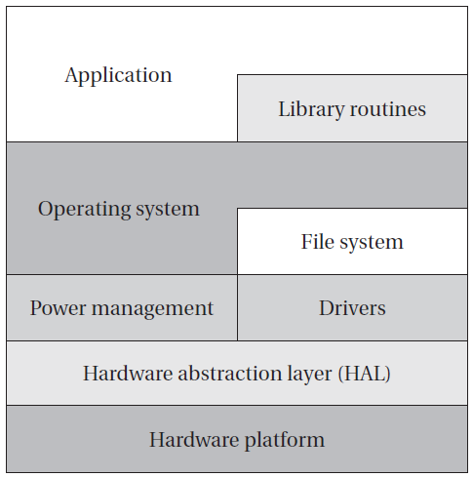
Platform Software Components
Hardware abstraction layer (HAL) provides basic level of abstraction from hardware
Operating system and file system provide basic abstractions required to build complex applications
Library routines used to perform complex kernel functions
Application makes use of all these layers, either directly or indirectly

Slide 8
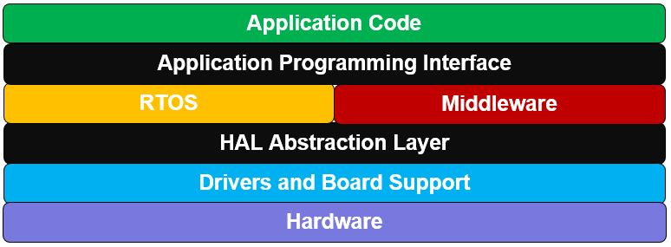
Embedded Software Stack
A HAL (Hardware Abstraction Layer)
  defines a set of routines, protocols and tools for interacting with the hardware
  focused on creating high level functions that can be used to make hardware do something without having detailed knowledge of how it is doing it
  allows changing hardware without changing application
  Example: Cortex Microcontroller Software Interface Standard

Slide 9
Embedded Software Stack
An API (Application Programming Interface)
  is an application programming interface that defines a set of routines, protocols and tools for creating an application
  defines the high level interface of the behavior and capabilities of the component and its inputs and outputs
  acts as a toolkit to help high level developers quickly generate application code
  provides common interface code for controlling the real-time behavior of the system and accessing common components such as serial communication and file accesses
Using a layered software architecture can dramatically increase the re-usability of embedded software

Slide 10
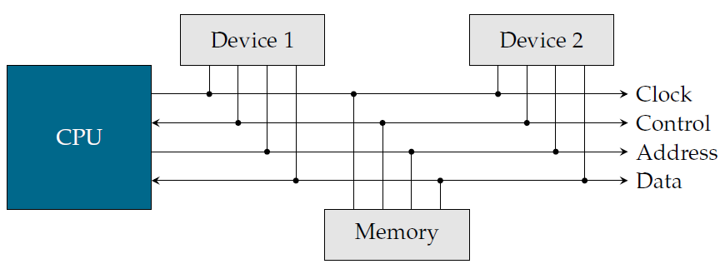
The CPU bus
CPU Bus is collection of wires, and the protocol, by which the CPU communicates with memory and devices
The CPU is the bus master: it initiates all transfers
Control: e.g. data ready, read/write

Slide 11

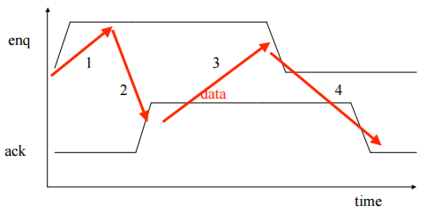
Bus Protocols
Bus protocol determines how devices communicate
The basic building block of most bus protocols is the four-cycle handshake
  1. Device 1 raises enq
  2. Device 2 responds with ack
  3. Device 1 lowers enq once it
  has finished.
  4. Device 2 lowers ack

Slide 12
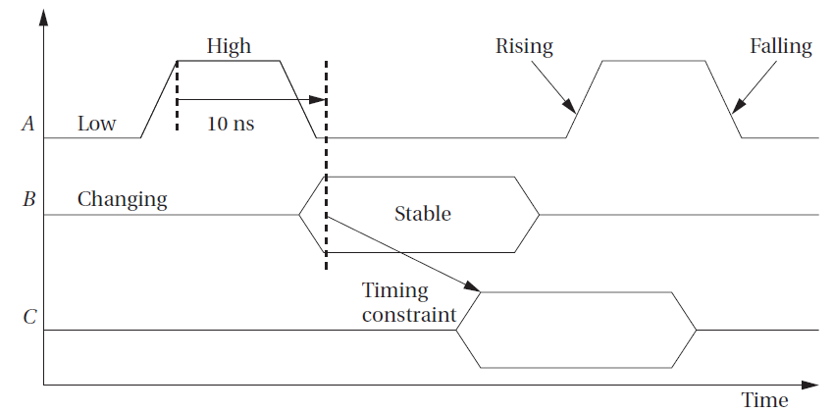
Timing Diagrams
Behavior of a bus is most often specified as a timing diagram

Slide 13
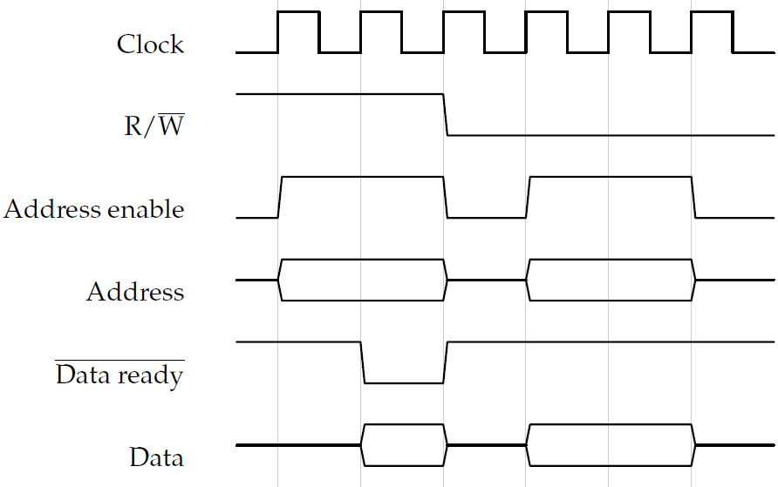
Read Followed by Write

Slide 14
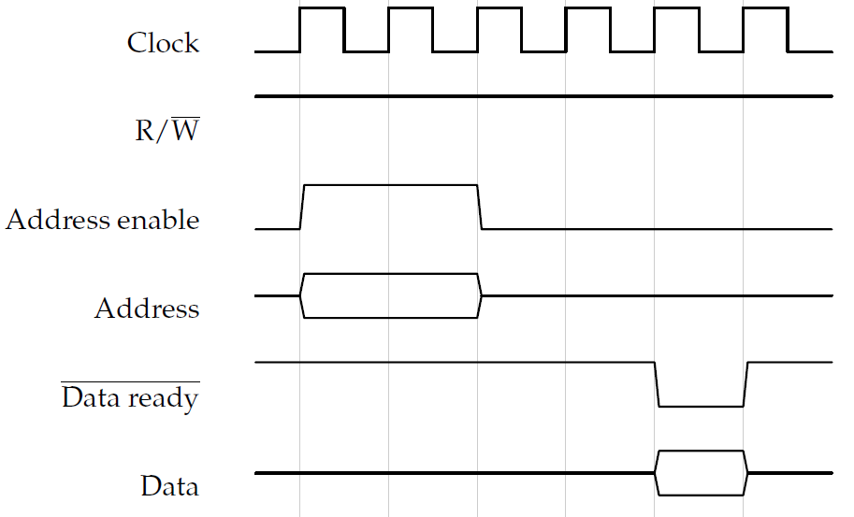
Reading From A Slow Device

Slide 15
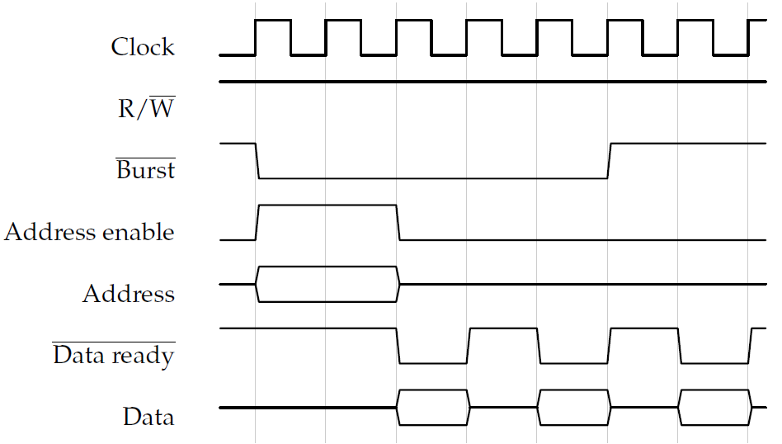
Burst Read

Slide 16
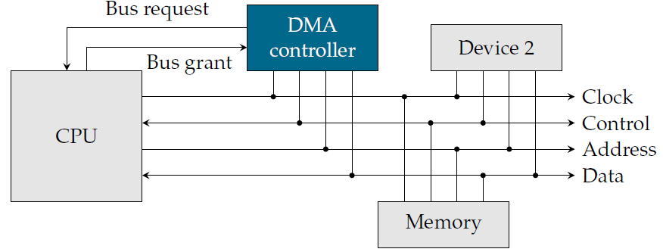
Direct Memory Access (DMA)
Direct Memory Access performs data transfers without executing instructions
  CPU sets up transfer
  DMA controller fetches, writes
Allows hardware subsystems to access main memory without involving the CPU

Slide 17
DMA Controller
The CPU controls the DMA controller by setting 3 registers:
  Starting address: where the transfer begins
  Length: number of words to be transferred
  Status: to operate the DMA controller
To start a transfer, the CPU sets the 3 registers
Once done, the DMA controller interrupts the CPU
During a DMA transfer, the CPU cannot use the bus
  It can still use the cache and its registers

Slide 18
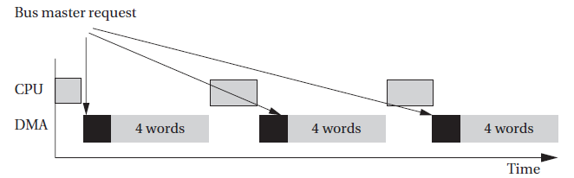
DMA Controller
Once DMA is bus master, it transfers automatically
  May run continuously until complete
  May use every n^{th} bus cycle
To prevent the CPU from idling for too long, most DMA controllers return control to the CPU after transferring a preset number of words, e.g. 4, 8, or 16

Slide 19
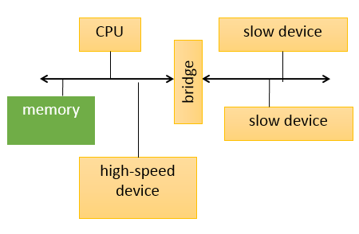
System Bus Configurations
A microprocessor system often has more than one bus
  High-speed devices connected to a high-performance bus
  Lower-speed devices are connected to a different bus
  a bridge allows the buses to connect to each other

Slide 20
Multiple Buses
Reasons for using multiple system buses:
  Higher-speed buses may use wider data connections
  Higher-speed buses require more expensive circuits and connectors
  Lower-speed devices can use lower-speed circuits and connectors, lowering their prices
  Bridges connecting two buses may allow them to operate independently
    I/O parallelism

Slide 21
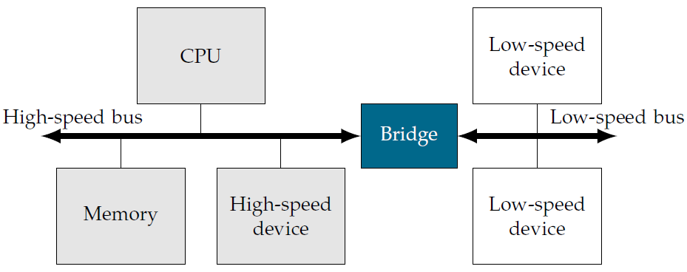
Bus Bridge
Slave on the fast bus
Master on the slow bus
Protocol translator

Slide 22
Standard Bus Architectures
AMBA (ARM)
CoreConnect (IBM)
Sonics Smart Interconnect (Sonics)
STBus (STMicroelectronics)
Wishbone (Opencores)
Avalon (Altera)
PI Bus (OMI)
MARBLE (Univ. of Manchester)
CoreFrame (PalmChip)
widely used

Slide 23
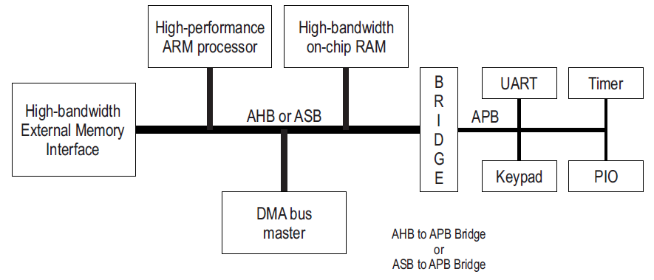
ARM Bus: AMBA 2.0
Advanced Microcontroller Bus Architecture (AMBA)
  Open standard specification for the connection and management of functional blocks in a System-on-Chip (SoC)
  Supports CPUs, memories, and peripherals in a SoC
  Defines multiple buses, e.g. AHB, ASB, APB, . . . etc.
  Features: pipelining, burst transfers, split transactions, multiple masters, . . . etc.

Slide 24
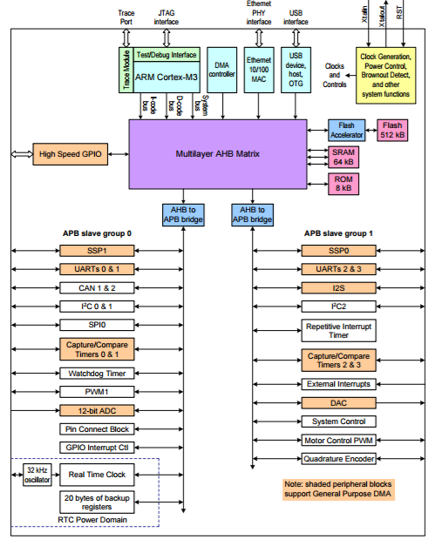
AMBA Example: LPC1768

Slide 25
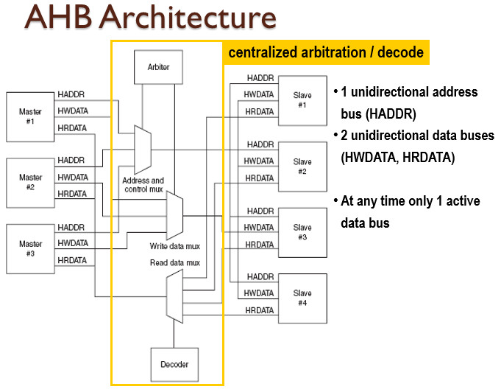
Advanced High-Performance Bus (AHB)
High performance, pipelined operation, burst transfers, multiple bus masters, split transactions

Slide 26
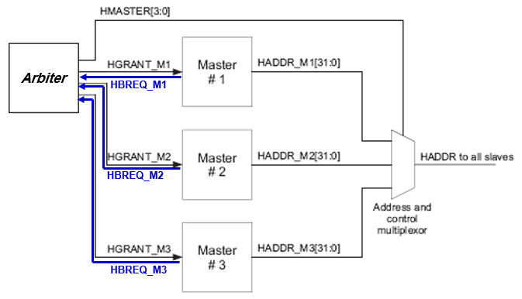
AHB Arbitration
Arbitration protocol is specified, but not the arbitration policy

Slide 27
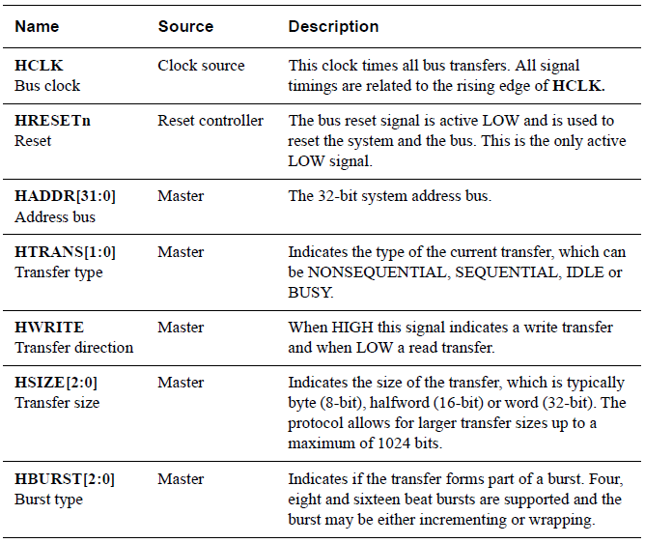
AHB Signals

Slide 28
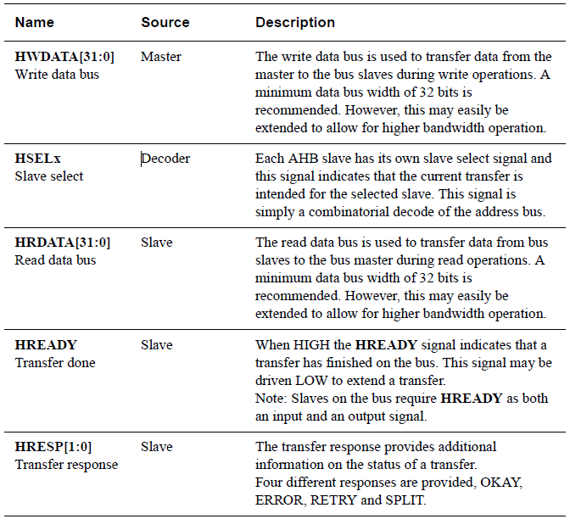
AHB Signals

Slide 29
Overview of AMBA AHB operation
Every transfer consists of
  an address and control cycle
  one or more cycles for the data
The data can be extended using the HREADY signal
  When LOW this signal causes wait states to be inserted
During a transfer the slave shows the status using the response signals, HRESP[1:0]
  OKAY: transfer is progressing normally
  ERROR: indicates that a transfer error has occurred
  RETRY and SPLIT: indicate that the transfer cannot complete immediately but bus master should continue to attempt transfer

Slide 30
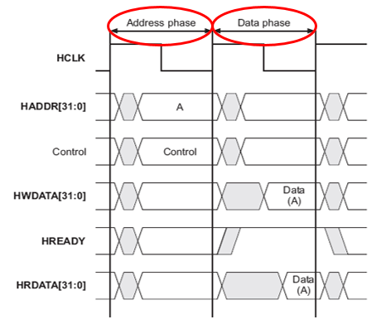
AHB Basic Transfer
An AHB transfer consists of two distinct sections:
  The address phase, which lasts only a single cycle
  The data phase, which may require several cycles. This is achieved using the HREADY signal

Slide 31
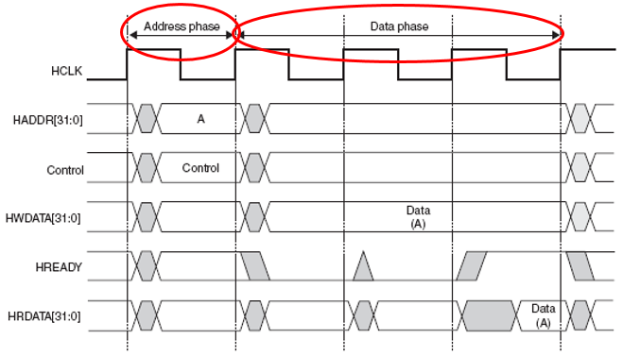
AHB Basic Transfer
Data transfer with slave wait states

Slide 32
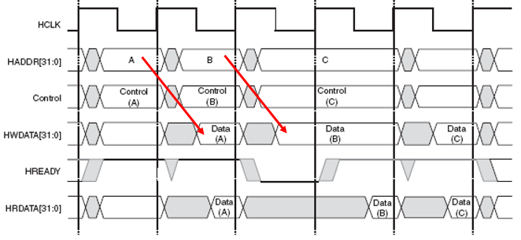
AHB Pipelining
Transaction pipelining increases bus bandwidth

Slide 33
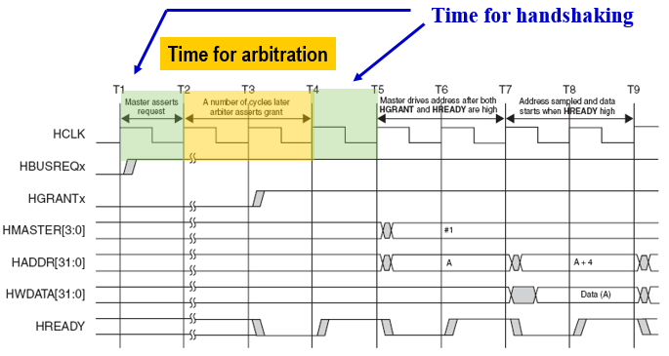
Cost of Arbitration in AHB
A master gains ownership of the address bus when HGRANTx is HIGH and HREADY is HIGH at the rising edge of HCLK

Slide 34
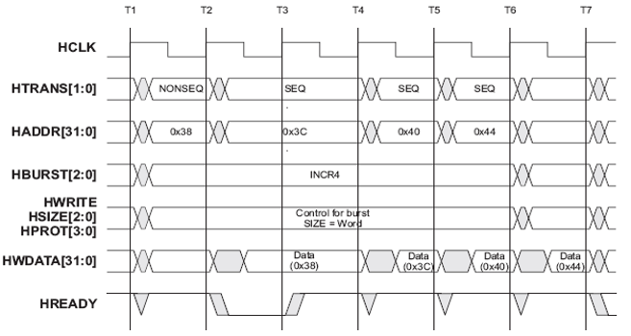
AHB Pipelined Burst Transfers
Bursts cut down on arbitration, handshaking time, improving performance

Slide 35
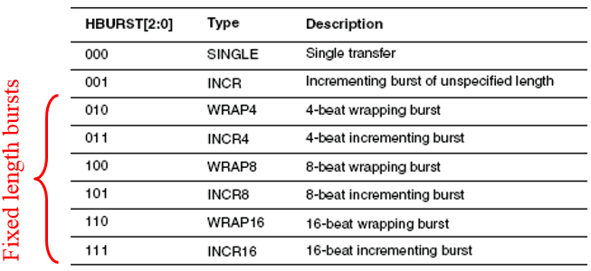
AHB Burst Types
Incremental bursts access sequential locations
  e.g. 0x64, 0x68, 0x6C, 0x70 for INCR4, transferring 4 byte data
Wrapping bursts “wrap around” address if starting address is not aligned to total no. of bytes in transfer
  e.g. 0x64, 0x68, 0x6C, 0x60 for WRAP4, transferring 4 byte data

Slide 36
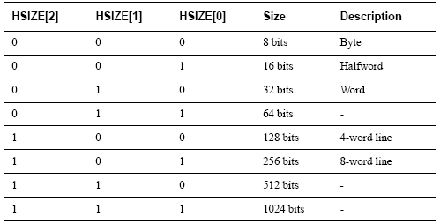
AHB Control Signals
Transfer direction
  HWRITE – write transfer when high, read transfer when low
Transfer size
  HSIZE[2:0] indicates the size of the transfer

Slide 37
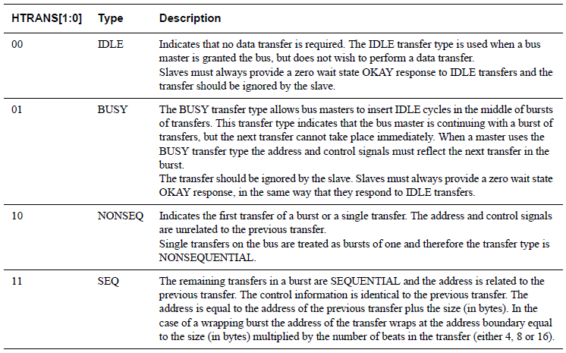
AHB Transfer Type

Slide 38
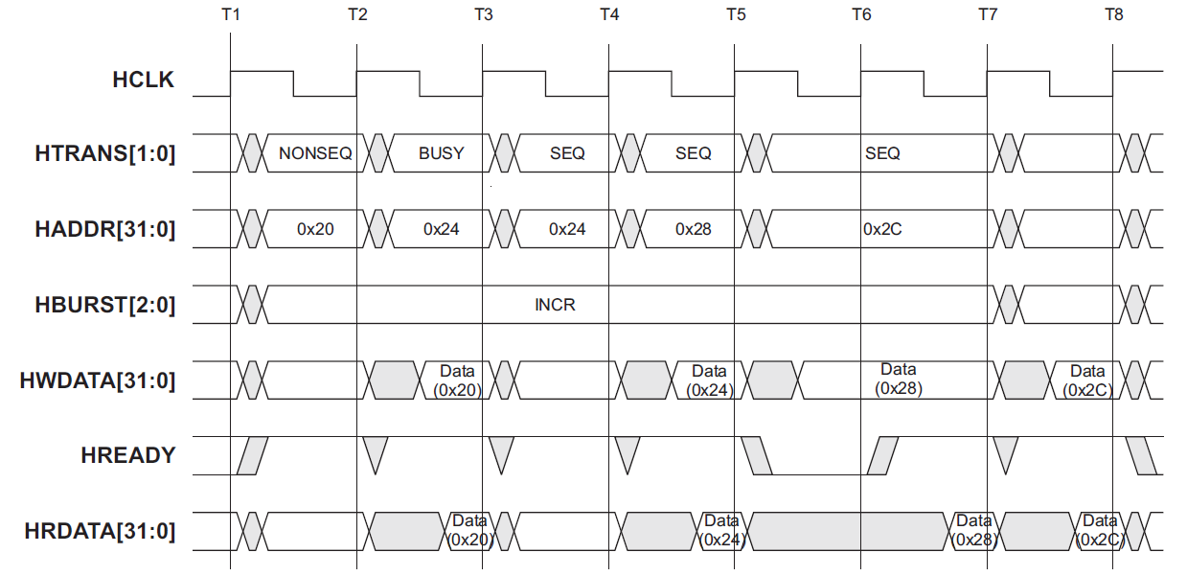
Different Transfer Types

Slide 39
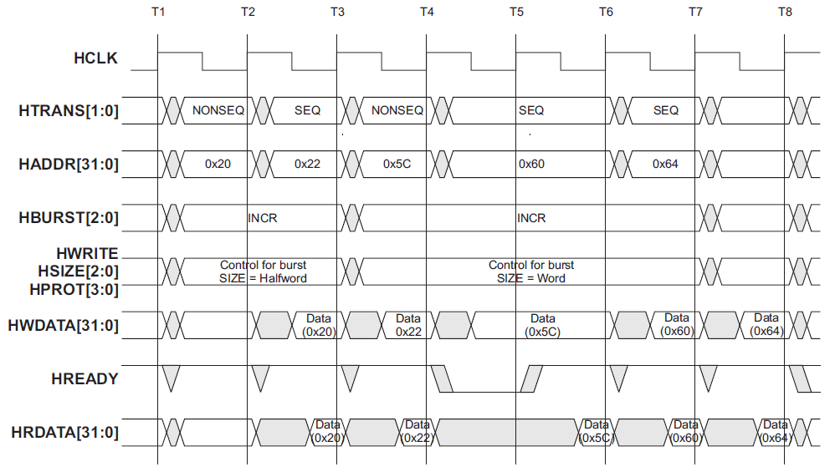
Undefined-Length Bursts

Slide 40
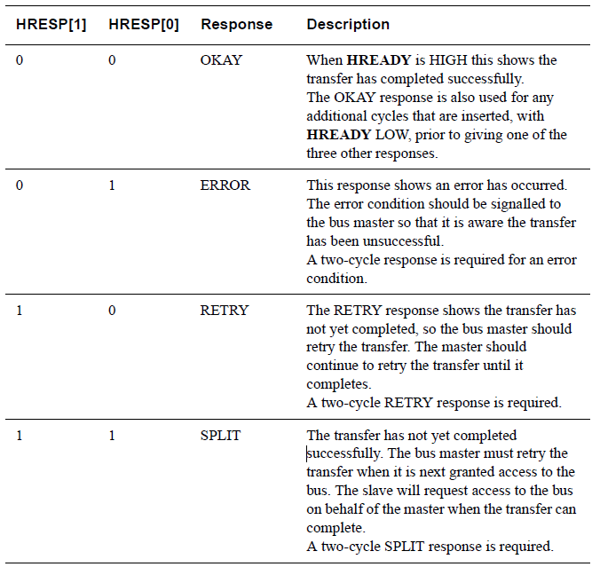
AHB Transfer Response

Slide 41
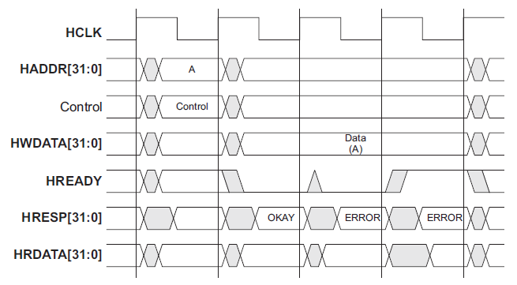
AHP Transfer with Error Response

Slide 42
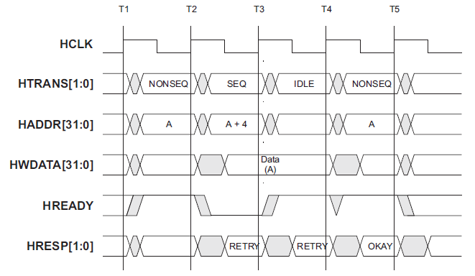
AHP Transfer with Retry Response

Slide 43
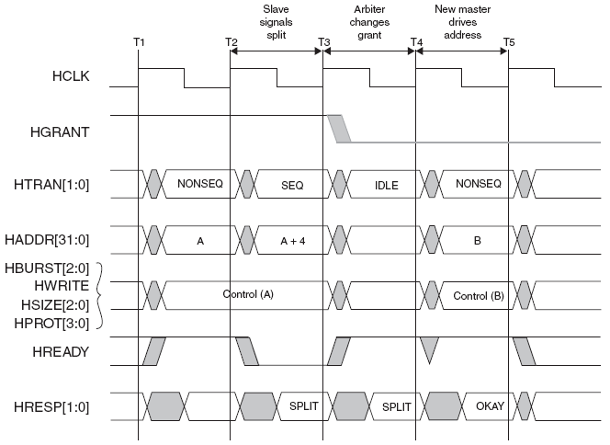
AHB Split Transfers
The SPLIT response provides a mechanism for slaves to release the bus when they are unable to supply data for a transfer

Slide 44
Retry and Split Transfers
The SPLIT and RETRY response combinations allow slaves to delay the completion of a transfer, but free up the bus for use by other masters.
For RETRY the arbiter will continue to use the normal priority scheme and therefore only masters having a higher priority will gain access to the bus.
For a SPLIT transfer the arbiter will adjust the priority scheme so that any other master requesting the bus will get access, even if it is a lower priority.
In order for a SPLIT transfer to complete the arbiter must be informed when the slave has the data available.

Slide 45
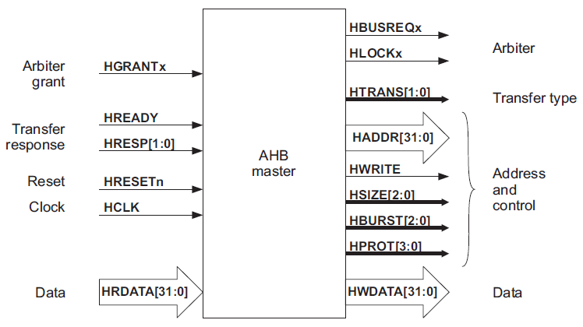
AHB Bus Master Interface

Slide 46
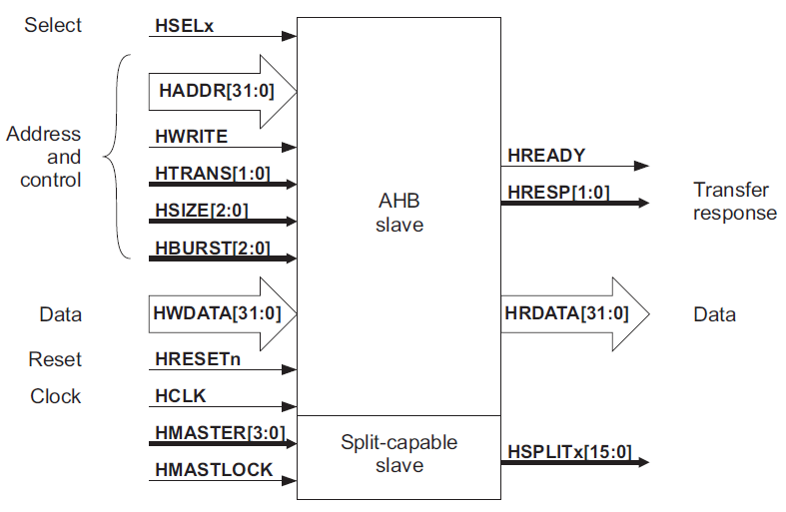
AHB Bus Slave Interface

Slide 47
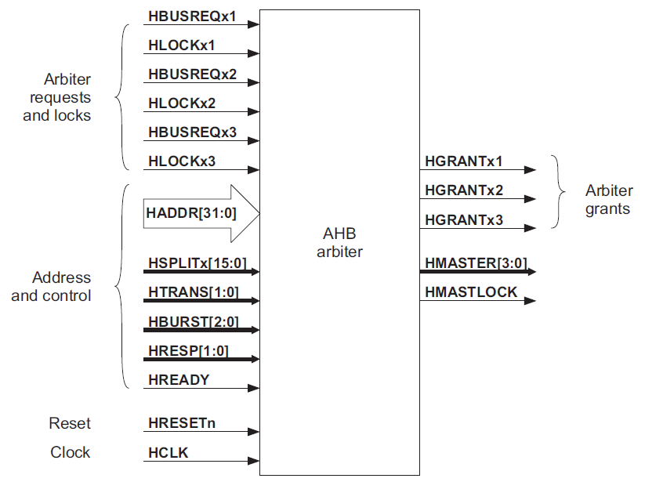
AHB Arbiter Interface

Slide 48
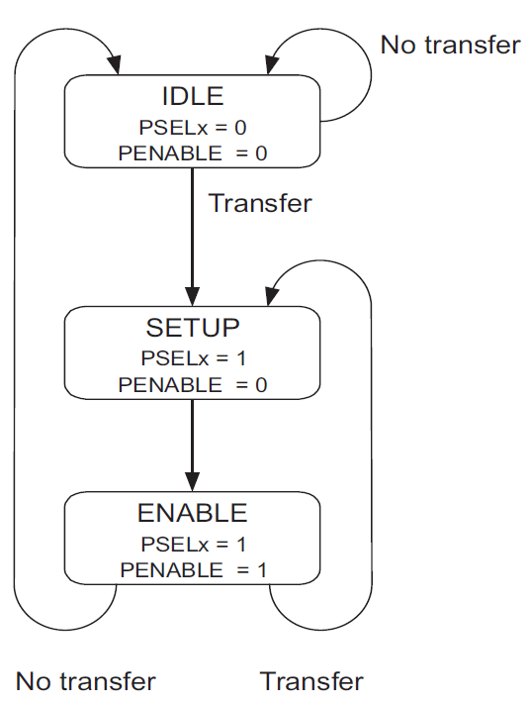
AMBA Advanced Peripheral Bus (APB)
Low power, latched address and control, simple interface, suitable for many peripherals
No (multi-cycle) bursts, no pipelined transfers
Bus activity described by a state diagram
  IDLE: The default state for peripheral bus
  SETUP: When a transfer is required, bus moves into SETUP state, PSELx, is asserted
  ENABLE: PENABLE is asserted, address, write and select signals remain stable during transition from SETUP to ENABLE state

Slide 49
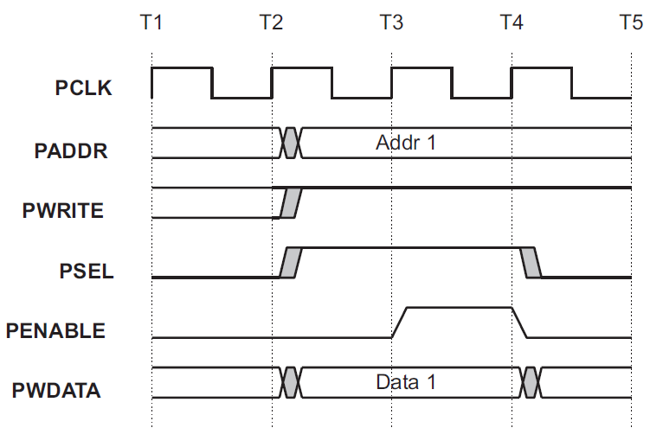
APB Write Transfer
To reduce power consumption, address and write signals will not change after a transfer until the next access occurs

Slide 50
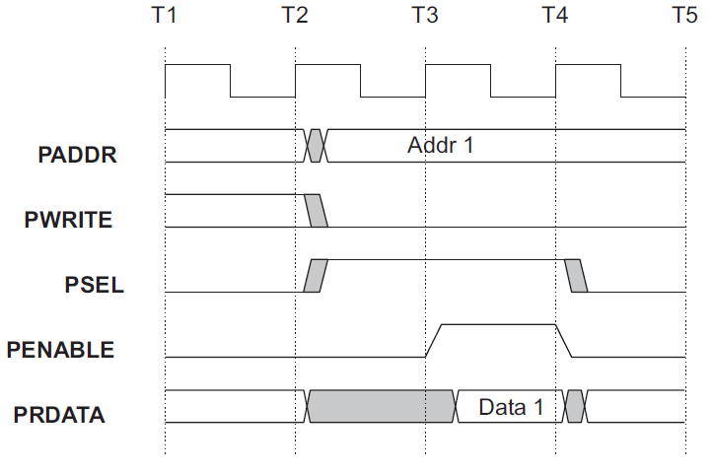
APB Read Transfer

Slide 51
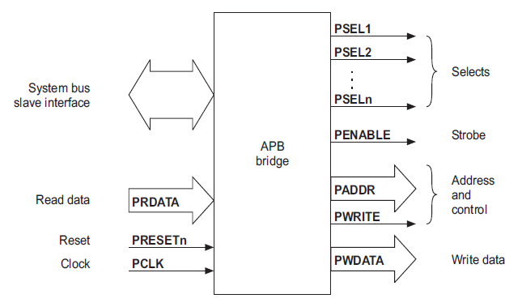
AHB-APB Bridge
The bridge converts system bus transfers into APB transfers and performs the following functions:
  Latches the address and holds it valid throughout the transfer
  Decodes the address and generates a peripheral select, PSELx
  Drives the data onto the APB for write transfer
  Drives the APB data onto the system bus for a read transfer
  Generates a timing strobe, PENABLE, for the transfer

Slide 52
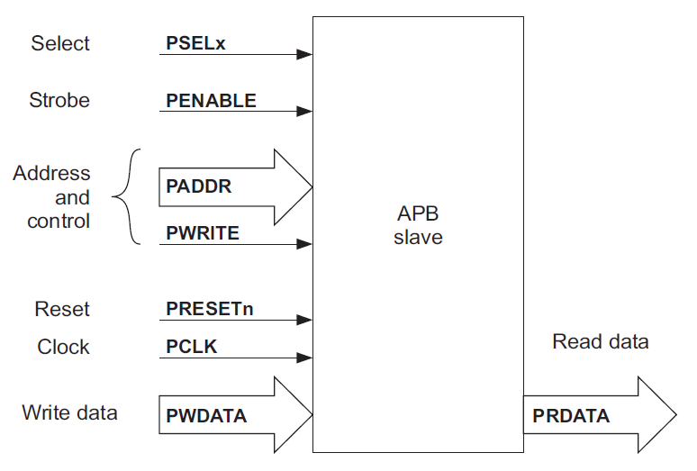
APB Slave Interface
The APB slave interface is very flexible.
For a write transfer the data can be latched at the following points:
  on either rising edge of PCLK, when PSEL is HIGH
  on the rising edge of PENABLE, when PSEL is HIGH.
For read transfers the data can be driven on to the data bus when PWRITE is LOW and both PSELx and PENABLE are HIGH.

Slide 53
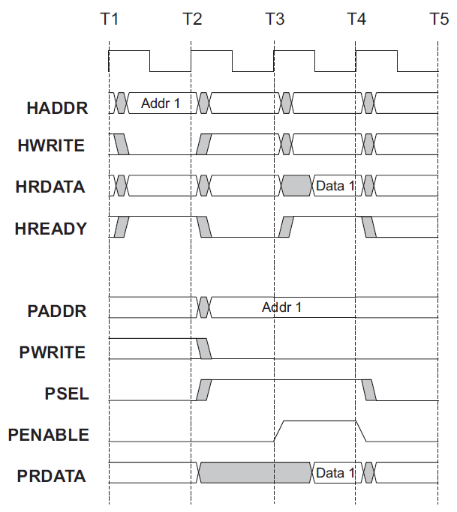
Interfacing APB to AHB: Read Transfer

Slide 54
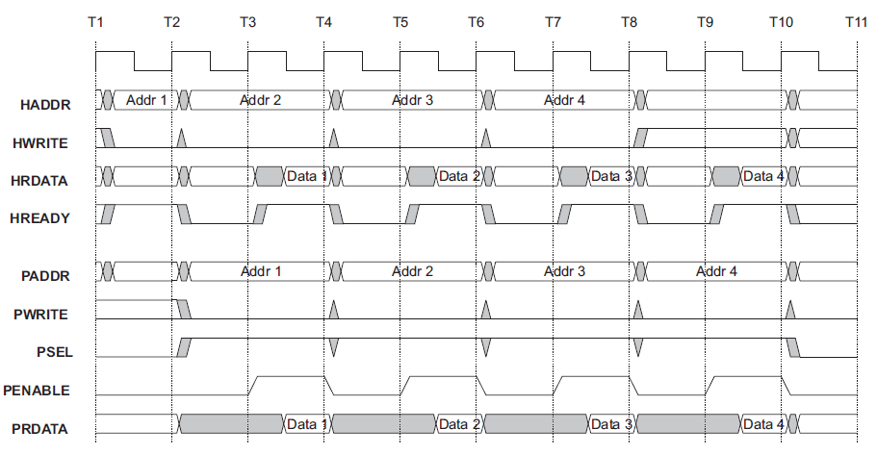
Interfacing APB to AHB: Burst of Read Transfers

Slide 55
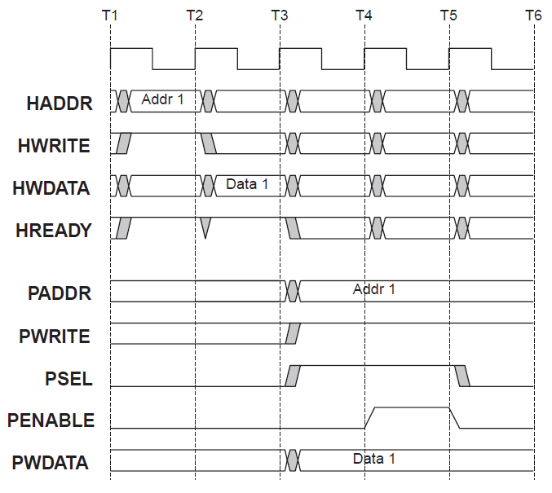
Interfacing APB to AHB: Write Transfer

Slide 56
Memory Components
Several different types of memory:
  RAM: DRAM, SRAM
  ROM: EEPROM, Flash
2-D array: row address and
column address
Each type of memory comes in varying:
  Capacities
  Widths
Packaging: single in-line memory modules (SIMMs) vs. dual in-line memory modules (DIMMs)
  SIMM(32-bit data bus), DIMM (64-bit data bus)

Slide 57
Random-Access Memory
Dynamic RAM is dense, refreshed periodically; inaccessible during refresh
Static RAM is faster, less dense, consumes more power
SDRAM: sync., command pipelining, interleaved banks
  SDR 1 word/cycle 133 MHz 3.3 V
  DDR 2 words/cycle 200 MHz 2.5 V
  DDR2 4 words/cycle 533 MHz 1.8 V
  DDR3 8 words/cycle 1066 MHz 1.5 V
  DDR4 8 words/cycle 1600 MHz 1.2 V
Burst access: perform several accesses in sequence using a single address

Slide 58
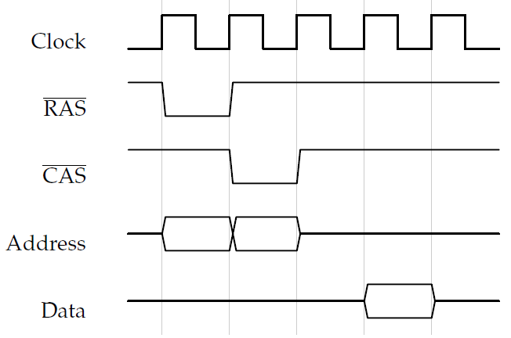
SDRAM Operation

Slide 59
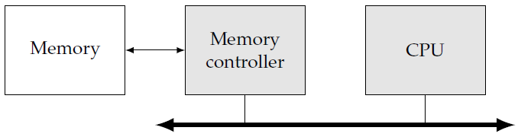
Memory Controllers
Memory has complex internal organization
Memory controller hides details of memory interface, schedules transfers to maximize performance
Provide additional features: multiple requests, additional burst access

Slide 60
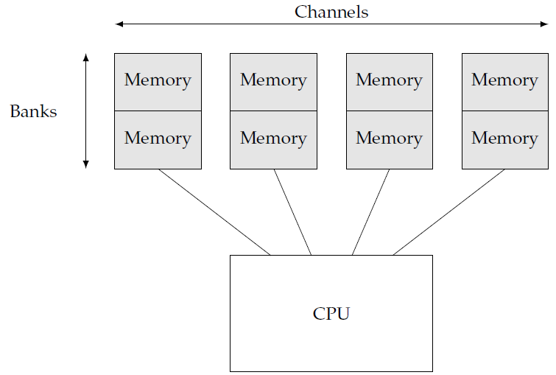
Memory Channels and Banks
Channels and banks are two ways to add parallelism to the memory system
Each channel has its own memory components and its own connection to the processor
CPU can perform multiple independent accesses using different channels
Banks are separate memory arrays, can perform accesses in parallel

Slide 61
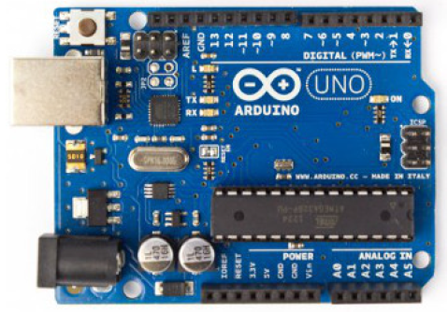
Example Embedded Platforms: ARDUINO
HTTP://ARDUINO.CC/
  Open-source electronics prototyping platform
  Intended for artists, designers, hobbyists
  Uses Atmel’s ATMEGA microcontrollers
  AVR architecture: modified Harvard 8-bit RISC

Slide 62

Example Embedded Platforms: BEAGLEBOARD
HTTP://BEAGLEBOARD.ORG
  Credit-card sized, low-power, open-hardware computers
  Uses ARM Cortex-A8 by TI – started by a TI engineer
  512MB DDR3 RAM, 3D graphics, USB, Ethernet, HDMI
  Runs Ubuntu, Android, Ångström Linux, and others

Slide 63

Example Embedded Platforms: LPCXPRESSO
HTTP://WWW.LPCWARE.COM/LPCXPRESSO
  Uses LPC microcontrollers, by NXP
  Free version of development software
  Includes debugging module

Slide 64
Choosing a Platform
CPU: architecture, clock speed, integrated peripherals
Bus: data bandwidth. May affect choice of CPU
Memory: size, speed, RAM, ROM, on-chip, off-chip
I/O devices: integrated devices vs. custom PCB
Run-time software: operating system, libraries
Support software: development environment, debugging tools

Slide 65

Development Environment
Host and target are connected by a USB or Ethernet link
  Host: where development happens
  Target: where the code will finally run
Target must support host communication
  Small software, interrupt vectors
The host should be able to
  Load programs into the target
  Start and stop program execution on target
  Examine memory and CPU registers
A cross-compiler runs on the host and generates code that runs on the target

Slide 66
Debugging
Cross debugger:
  displays target state, allows target system to be controlled
Software debugger
  A monitor program residing on the target provides basic debugger functions
  Debugger should have a minimal footprint in memory
Breakpoints
  A breakpoint allows the user to stop execution, examine system state, and change state
  Replace the break pointed instruction with a subroutine call to the monitor program

Slide 67
Debugging
Debugging Tools
  I/O: LEDs, UART, other peripherals
    The embedded alternative of the PC’s print
    USB: debugging, diagnosis, upgrades
  ICE: In-Circuit Emulators
    Specialized hardware that allows inspecting and modifying CPU state
  Logic analyzer (oscilloscope)
Debugging Challenges
  May be hard to generate realistic inputs
  Timing errors in real-time code

Slide 68

Platform-Level Performance
Performance depends on all the elements of the system
  CPU (provides an upper bound on performance)
  Cache
  Bus
  Main memory
  I/O device
Bandwidth is the rate of data movement (in seconds)
Bandwidth captures performance of several components
  Memory
  Bus
  CPU

Slide 69
Bandwidth as Performance
Different parts of the system run at different clock rates
Different components may have different widths (bus, memory)
Example: video transfer
  Frame rate: 30 fps, Frame size: 320 x 240, 3 bytes/pixel
  What is the required bandwidth?
Required bandwidth: 320 x 240 x 3 x 30=6,912,000 B/s
  1 MHz 8-bit wide bus --too slow
  How can we make the bus satisfy bandwidth requirements?
    Increase bus speed to 7 MHz with 8-bit wide bus
    Increase bus width to 32 bits and bus clock rate to 2 MHz

Slide 70


Bus Bandwidth Modeling
T: # bus cycles
P: bus clock period
Total time for transfer: t = TP
N: Number of bytes to transfer
W: Bus width (#bytes per transfer)
D: Clock cycles per data transfer. Ideally, D = 1
O: Overhead clock cycles per transfer e.g. addresses, handshaking (O1+O2)
$T(N) = (D + O) \frac{N}{W}$

Slide 71


Bus Burst Transfer Bandwidth
B: #transfers per burst
D: clock cycles per transfer
O: cycles overhead per burst
$T(N) = (BD + O) \frac{N}{BW}$

Slide 72

Memory Performance
Memory bandwidth is determined by memory width
  64 Mb: 64M x 1 bit, 8M x 1 byte, 2M x 32 bits
Multiple memories can be used to build wider memory
Memory modules can determine memory width, e.g. SIMMs, DIMMs
Preferred width depends on data format and required speed
Data width and memory width may not align
  Pixel: 3 bytes, W = 4 bytes

Slide 73

Memory Performance
E: Number of data elements
w: Width of a data element in bytes
W: Memory width in bytes
A: Number of memory accesses
$A=\left\lceil \frac{wE}{W}\right\rceil$

Slide 74
Bus Performance Bottlenecks
Objective: Read 30-fps 320x240 video from memory to CPU
  Bus: 1 MHz, W = 2 B, D = 1, O = 2
  Memory: 10 MHz, B = 8, W = 1 B, D = 1, O = 3
  Is performance bottleneck bus or memory?
N = 320 x 240 x 30 x 3 = 6,912,000 bytes
Tbus = (1 + 2) (6,912,000/2) = 10,368,000 cycles
tbus = 10,368,000 x 10⁻⁶= 10.368 seconds
Tmem = (8 x 1 + 3) (6,912,000/8x1) = 9,504,000 cycles
tmem = 9,504,000 x 10⁻⁷ = 0.9504 seconds
How do we make it work?

Slide 75
Bus Performance Examples
We would like to investigate the performance of a bus system in relation to a digital audio application. Digital audio is specified by three main parameters:
  Number of channels, e.g. stereo audio uses two channels.
  Sampling rate: number of digital samples per second.
  Sample size (or bit depth): number of bits per sample.
Assume a system bus that runs at 1.5 MHz, and requires a total of 6 cycles to complete a single 16-bit transfer. Assuming uncompressed 6-channel audio (5.1 speaker configuration), what is the best combination of sampling rate and sample size that can be handled by this system bus? Justify your choice.

Slide 76

Bus Performance Examples
Typical sampling rates: 16 kHz, 22.05 kHz, 32 kHz, 44.1 kHz (Audio CD), 48 kHz (DVD). Typical sample sizes: 8-bit, 16-bit (Audio CD), 20-bit, 24-bit, 32-bit.
First, we find the number of bits that the described system bus can transfer per second, N_{bus}:
$$T=\left(D+O\right)\frac{N}{W} => Nbus= \frac{WT}{(D+O)}=\frac{1.5×{10}^{6}×16}{6}=4×{10}^{6} bits$$
Considering Audio CD quality (sampling rate: 44.1 kHz, sample size: 16 bits), the required bandwidth is:
N_{audio} = 6 x 44,100 x 16 = 4,233,600 bit/second > 4 x 10⁶

Slide 77
Bus Performance Examples
We can either reduce the sampling rate, or the sample size, to lower the required bandwidth to match the system bus capacity:
  N_{audio1} = 6 x 32,000 x 16 = 3,072,000 bit/second < 4 x 10⁶
  N_{audio2} = 6 x 44,100 x 8 = 2,116,800 bit/second < 4 x 10⁶
Since Naudio2 halves the sample size, it is expected to have a greater impact on audio quality. Hence, reducing the sampling rate is preferred, resulting in a sampling rate of 32 kHz and a sample size of 16 bits.
Furthermore, we can achieve better audio quality by increasing the sample size of Naudio1 from 16 to 20 bits:
  N_{audio3} = 6 x 32,000 x 20 = 3,840,000 bit/second < 4 x 10⁶

Slide 78
Bus Performance Examples
A real-time system receives data through an I/O device, the CPU processes the data, then the results of the processing are transferred to system memory.
The I/O device, the CPU, and the memory controller are all on the same system bus, which runs at 1MHz. The CPU runs at 10MHz.
Each bus transaction (transfer) between any two devices on the bus takes 5 bus cycles, 1 of which is used to transfer data, and the remaining cycles are used by the bus protocol. The bus has 32 data lines, transferring 32 bits per data-transfer cycle.
The I/O device receives 512 bytes at a time.

Slide 79
Bus Performance Examples
While processing the received data, for each received byte, the CPU generates 4 bytes. Only generated data is transferred from the CPU to system memory.
If the I/O device receives new data at a rate of 200 times per second (512 bytes each), how many CPU cycles can be spent processing each byte without violating the real-time requirements?
Assume that the memory is fast enough to handle any requests received by the memory controller.

Slide 80
Bus Performance Examples
For each second:
  N_{I/O} = 512 B x 200 = 102400 B
  T_{I/O}(N) = (D +O) N/W = 5 x 102400/4= 128000 cycles
  N_{mem} = 512 B x 200 x 4 = 409600 B
  T_{mem}(N) = 5 x 409600/4 = 512000 cycles
  T_{bus} = 128000+ 512000= 640000 cycles
t_{bus} = T_{bus} P = 640000 x 10⁻⁶ = 0.64 s
t_{CPU} = 1 - 0.64 = 0.36 s
T_{CPU} = t_{CPU} * f_{CPU} = 0.36 x 10 x 10⁶ = 3600000 cycles
Number of CPU cycles can be spent processing each byte without violating real-time requirements = 3600000 / 102400 = 35.156 => 35 cycles per Byte.

