Slide 1
Processes and Operating Systems Chapter 6
COE 306: Introduction to Embedded Systems
Dr. Aiman El-Maleh
Computer Engineering Department
College of Computer Sciences and Engineering
King Fahd University of Petroleum and Minerals

Slide 2
Next . . .
Processes and Operating Systems
Real Time Operating System (RTOS)
The Scheduling Problem
Rate Monotonic Scheduling (RMS)
Earliest-Deadline-First Scheduling (EDFS)
FreeRTOS

Slide 3
Processes and Operating Systems
Processes and operating system are abstractions
allow us to build complex applications on microprocessors
provide much greater flexibility to satisfy timing requirements
Let us switch the state of the processor between multiple tasks
Process defines the state of an executing program
A process is a unique execution of a program
Several copies of a program may run simultaneously or at different times
A process has its own state: registers and memory
Threads share the same address space

Slide 4
Processes and Operating Systems
The Operating System (OS) manages processes
OS provides the mechanism for switching execution between processes
Real-Time Operating System (RTOS) is OS that provides facilities for satisfying real-time requirements
Allocates resources based on real-time requirements
General-purpose OSs use other criteria, e.g. fairness
RTOS helps build more complex systems using several programs that run concurrently

Slide 5
Tasks and Processes
A task is a functional description of a connected set of operations
Task can also mean a collection of processes
Multiple tasks means multiple processes
Multiple processes help with timing complexity:
multiple rates
multimedia
automotive
asynchronous input
user interfaces
communication systems

Slide 6
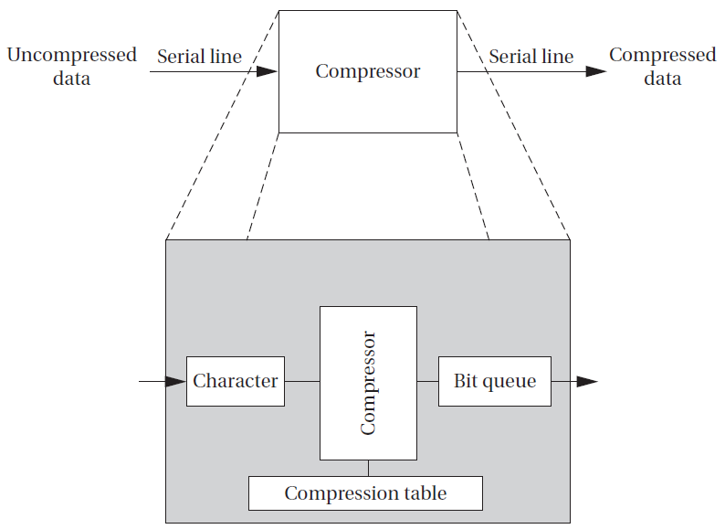
Compression Unit Example
Variable data rates
need to receive and send data at different rates
program may emit two bits for first byte and then seven bits for second byte
must ensure to process inputs and outputs at the proper rates
Asynchronous input
a compression mode button that disables or enables compression
Keeping up with input and output data while checking on button can introduce complex control code into program

Slide 7
Compression Unit Example
Sampling the button’s state too slowly can cause the machine to miss a button depression entirely
Sampling it too frequently can cause the machine to incorrectly compress data due to executing later than expected
Variable execution times of code causes other code to execute later than expected
We need to be able to keep track of these two different tasks separately, applying different timing requirements to each
Complex control is usually quite difficult to verify for either functional or timing properties

Slide 8
Multi-Rate Systems
Multirate embedded computing systems are very common, including automobile engines, printers, and cell phones
Certain operations must be executed periodically, and each operation is executed at its own rate
Tasks may be synchronous or asynchronous
Synchronous tasks may recur at different rates
Processes run at different rates based on computational needs of the tasks

Slide 9
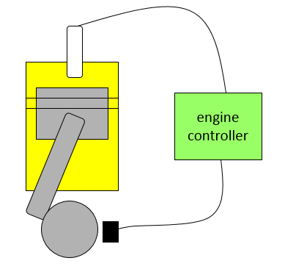
Example: Engine Control
Tasks:
spark control
Firing the spark plug periodically
Spark timing varies with engine speed
regulate exhaust emissions
crankshaft sensing
fuel/air mixture
oxygen sensor
multimode control scheme
engine warm-up , cruise, climbing steep hills
Rates at which engine inputs and outputs must be handled range between 2ms and 1s

Slide 10
Typical Rates in Engine Controllers
Variable | Update period (ms)
Engine spark timing | 2
Throttle | 2
Air flow | 4
Battery voltage | 4
Fuel flow | 10
Recycled exhaust gas | 25
Status switches | 20
Air temperature | 400
Barometric pressure | 1000
Spark (dwell) | 1
Fuel adjustment | 8
Carburetor | 25
Mode actuators | 100

Slide 11
Real-Time Systems
Perform a computation to conform to external timing constraints
Deadline frequency:
Periodic
Aperiodic
Deadline type:
Hard: failure to meet deadline causes system failure
Car Airbag system, car brakes
Soft: failure to meet deadline causes degraded response
Room temperature control, car multimedia system
Firm: late response is useless; Infrequent deadline misses are tolerable, but may degrade the system's quality of service
A digital cable set-top box frame decoder

Slide 12
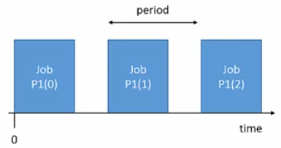
Types of Process Timing Requirements
Release time: time at which process becomes ready to execute
Deadline: time at which process must finish execution
Periodic process: a process executes every period
e.g. Firing the spark plugs
Aperiodic process: executes on demand
Processing a button press
Period : interval between process activations
Initiation Interval or Rate = 1/period

Slide 13
Types of Process Timing Requirements
Jitter: Allowable variation in task completion time
Example: multimedia synchronization
What happens when a process misses a deadline?
Can be catastrophic such as in an automotive control system
a missed deadline in a telephone system may cause a temporary silence on the line
Example: Space Shuttle software error
Space Shuttle’s first launch was delayed by a software timing error
Change to one routine added delay that threw off start time calculation

Slide 14
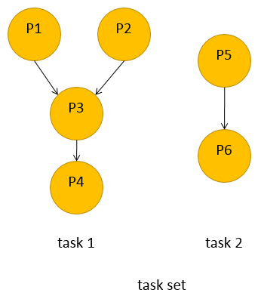
Task Graphs
Tasks may have data dependencies---must execute in certain order
Task graph shows data/control dependencies between processes
Task: connected set of processes
Task set: One or more tasks
Task graph assumes that all processes in each task run at the same rate, tasks do not communicate
In reality, some amount of inter-task communication is necessary

Slide 15
Process Execution Characteristics
Process execution time T_{i}
Execution time in absence of preemption
Possible time units: seconds, clock cycles
Worst-case, best-case execution time may be useful in some cases
Sources of variation:
Data dependencies
Memory system
CPU pipeline

Slide 16
CPU Utilization
CPU utilization
Fraction of the CPU that is doing useful work
Often calculated assuming no scheduling overhead
Utilization:
U = (CPU time for useful work) / (total available CPU time)
Utilization over a time interval [t1, t2]
= $\frac{\sum{proci Ti(t2−t1)}}{t_{2}−t_{1}}$
= T/t

Slide 17
Running Periodic Processes
Need code to control execution of processes
Simplest implementation: process = subroutine
While loop implementation
Simplest implementation has one loop
No control over execution timing
Pad the loop with NOP instructions
Used by some video games in the 1970s
Broken: hard to determine execution time, conditionals, re-evaluation upon code change
while (TRUE) {
p1();
p2();
}

Slide 18
Running Periodic Processes
Timed loop implementation
Encapsulate set of all processes in a single function that implements the task set
Use timer to control execution of the task
No control over timing of individual processes
Multiple timers implementation
Each task has its own function
Each task has its own timer
May not have enough timers to implement all the rates
void pall() {
p1();
p2();
}
void A(){ /* rate A */
p1(); p3();
}
void B(){ /* rate B */
p2(); p4(); p5();
}

Slide 19
Running Periodic Processes
Timer + counter implementation
Use a software count to divide the timer
Only works for clean multiples of the timer period
Implementing processes
All of these implementations are inadequate.
Need better control over timing
Need a better mechanism than subroutines
Real-time operating systems (RTOS)
int p2count = 0;
void pall(){
p1();
if (p2count >= 2) {
p2();
p2count = 0;
}
else p2count++;
p3();
}

Slide 20
Operating Systems
The operating system controls resources
who gets the CPU
when I/O takes place
how much memory is allocated
The most important resource is the CPU itself
CPU access controlled by the scheduler

Slide 21
Real-Time Operating Systems
Solves the main problems of a cooperative multitasking system
Executes processes based on timing requirements provided by system designer
Based on two basic concepts:
Preemption: the ability to interrupt a process to switch to another
Context switching: switching execution and CPU state between processes

Slide 22
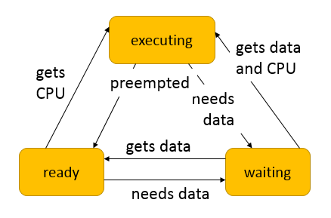
State of a Process
A process can be in one of three states:
executing on the CPU
ready to run
waiting for I/O, another process, timer, next period
The operating system selects the next executing process
At most one executing process

Slide 23
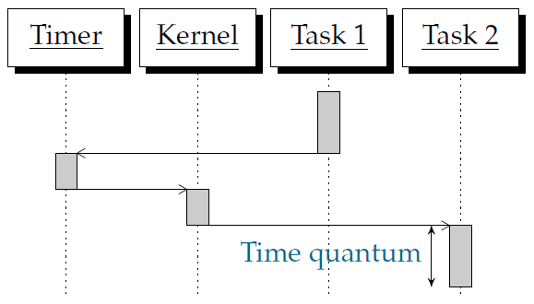
Preemptive Execution
Kernel: part of the OS. Determines which process runs
The kernel is activated periodically by the timer
The timer period is known as the time quantum
The smallest time unit in which CPU activity can be controlled

Slide 24
Context Switching
Context: The set of registers that define a process
Context Switching: Switching the registers from one process to another
Timer interrupt: transfer control from a process to kernel
Kernel saves current process context
Kernel selects next process (scheduling)
Kernel restores next process context
Context switching code is usually assembly code
Task priorities make selecting processes flexible and fast

Slide 25
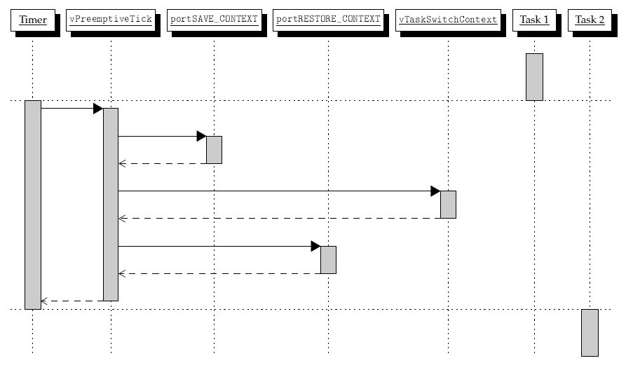
Context Switching in FREERTOS

Slide 26
The Scheduling Problem
Choosing the order of running processes is known as scheduling
Workstations try to avoid starving processes of CPU access
Fairness = access to CPU
Embedded systems must meet deadlines
Low-priority processes may not run for a long time
Scheduling feasibility
Resource constraints make schedulability analysis NP-hard
Must show that the deadlines are met for all timings of resource requests

Slide 27
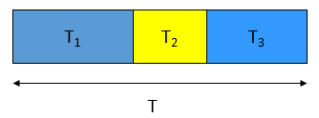
Scheduling Feasibility
Assume:
No resource conflicts
Constant process execution times
Require:
T (period) ≥ Σ_{i} T_{i}
Can’t use more than 100% of the CPU.
Hyperperiod: least common multiple (LCM) of the task periods
Must look at the hyperperiod schedule to find all task interactions
Hyperperiod can be very long if task periods are not chosen carefully

Slide 28
Hyperperiod Example
Long hyperperiod:
P1 7 ms
P2 11 ms
P3 15 ms
LCM = 1155 ms
Example:
P1 period 1 ms, CPU time 0.1 ms
P2 period 1 ms, CPU time 0.2 ms
P3 period 5 ms, CPU time 0.3 ms
Shorter hyperperiod:
P1 8 ms
P2 12 ms
P3 16 ms
LCM = 96 ms

Slide 29
Round-Robin Scheduling
All the processes are kept on a list and scheduled one after the other
Time slices are assigned to each process in equal portions and in circular order
Common in general-purpose Oses
Schedule process only if ready
Always test processes in the same order
Start round-robin again after finishing a round
Schedule based on least common multiple (LCM) of the process periods

Slide 30
Priority-Based Scheduling
Each process has a priority
CPU goes to highest-priority process that is ready
Priorities determine scheduling policy:
fixed priority
time-varying priorities
Example:
each process has a fixed priority (1 highest)
highest-priority ready process gets CPU
process continues until done

Slide 31
Priority-Based Scheduling Example
P3 ready t=18
P2 ready t=0
P1 ready t=15
P2
P1
P2
P3
0
10
20
30
40
50
60
time

Slide 32
Scheduling Metrics
How do we evaluate a scheduling policy:
Ability to satisfy all deadlines
CPU utilization---percentage of time devoted to useful work
Scheduling overhead---time required to make scheduling decision

Slide 33
Rate Monotonic Scheduling (RMS)
RMS is widely-used, analyzable scheduling policy
A static scheduling policy: processes have fixed priorities
RMS Model
All processes run on single CPU
Context switching time is ignored
No data dependencies between processes
Process execution time is constant
All deadlines are at the end of the period
Highest-priority ready process runs first
Priority assignment: The process with the shortest period is assigned the highest priority

Slide 34
Rate Monotonic Scheduling (RMS)
RMS always provides a feasible schedule if such a schedule exists
Optimal static assignment
No fixed-priority scheme does better
Highest CPU utilization while ensuring that all processes meet their deadlines
T_{i} is computation time of process i
τ_{i} is period of process i
Absolute deadline
Released
Execution time Ti
τ_{i}

Slide 35
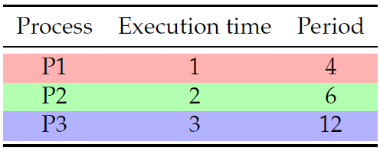
Rate Monotonic Scheduling Example
What if execution times become 2, 3, 3?

Slide 36
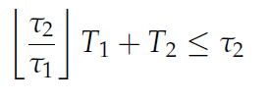
Rate Monotonic Analysis (RMA)
If P1 has higher priority, required constraint on CPU time:
If P2 has higher priority, required constraint on CPU time:
There are cases where first
relationship can be satisfied
and second cannot.
There are no cases where
second relationship can be
satisfied and first cannot
Consider T1=2 and T2=2,
τ1=3, τ2=6.

Slide 37
RMS CPU utilization
Utilization for n processes is:
Given n processes and ratio between any two periods less than 2, RMS CPU utilization upper bound:
n = 2; U ≤ 0.83
n = 3; U ≤ 0.78
n→ ∞; U ≤ ln2 ≈ 0.69, 31% idle time
RMS may not be able to use 100% of CPU, even with zero context switch overhead

Slide 38
RMS CPU Utilization Example
Utilization = 1/4 + 2/6 + 3/12 = 0.83

Slide 39
Response Time
Response time
Duration from released time to finish time
Response Time
P₁
(1,4)
P₂
(2,5)
5
10
15
P₃
(2,10)
5
10
15

Slide 40
Response Time
Response Time (r_{i}) [Audsley et al., 1993]
HP(P_{i}) : a set of higher-priority tasks than P_{i}
Real-time system is schedulable under RMS
if and only if r_{i} ≤ τ_{i} for all processes P_{i}(T_{i}, τ _{i})

Slide 41
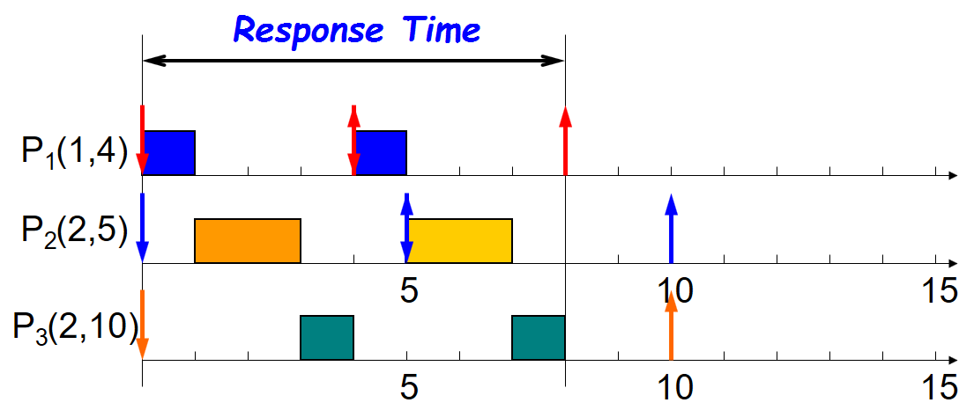
Response Time
Response time computation for P3
r3 = 2 + 0 = 2
r3 = 2 + 2 + 1 = 5
r3 = 2 + 2 + 2 = 6
r3 = 2 + 4 + 2 = 8
r3 = 2 + 4 + 2 = 8

Slide 42
RMS- Schedulability Check
A set of n processes is schedulable on a uniprocessor by the RMS algorithm if the processor utilization (utilization test):
This condition is sufficient, but not necessary
If U is less than the given bound, a schedule exists
If there is a schedule, U could be greater than the bound
Example:
P1: (T1=1, τ1=2), P2: (T2=2, τ2=4)
There is a schedule with U=100%

Slide 43
Another RMS Example
P1: T1=1, τ1=4
P2: T2=2, τ2=5
P3: T3=2, τ2=7
P₁
(1,4)
P₂
(2,5)
5
10
15
P₃
(2,7)
5
10
15

Slide 44
Another RMS Example
P₁
(1,4)
P₂
(2,5)
5
10
15
P₃
(2,7)
5
10
15

Slide 45
Another RMS Example
Deadline Miss !
P₁
(1,4)
P₂
(2,5)
5
10
15
P₃
(2,7)
5
10
15

Slide 46
Earliest-Deadline-First Scheduling
EDFS: dynamic priority scheduling scheme
Process closest to its deadline has highest priority
Requires recalculating processes priorities at every timer interrupt
Can achieve 100% utilization;higher utilization than RMS
On each timer interrupt
compute time to deadline
choose process closest to deadline
Optimal scheduling algorithm
if there is a schedule for a set of real-time tasks, EDF can schedule it

Slide 47
EDFS Example
P1: T1=1, τ1=4
P2: T2=2, τ2=5
P3: T3=2, τ2=7
P₁
(1,4)
P₂
(2,5)
5
10
15
P₃
(2,7)
5
10
15

Slide 48
EDFS Example
P₁
(1,4)
P₂
(2,5)
5
10
15
P₃
(2,7)
5
10
15

Slide 49
EDFS Example
P₁
(1,4)
P₂
(2,5)
5
10
15
P₃
(2,7)
5
10
15

Slide 50
EDFS Example
P₁
(1,4)
P₂
(2,5)
5
10
15
P₃
(2,7)
5
10
15

Slide 51
Processor Demand Bound
Demand Bound Function : dbf(t)
the maximum processor demand by workload over any interval of length t
t
P₁
(1,4)
P₂
(2,5)
5
10
15
P₃
(2,7)
5
10
15

Slide 52
EDFS - Schedulability Analysis
Real-time system is schedulable under EDFS if and only if
∑U_{i} ≤ 1
Real-time system is schedulable under EDFS
if and only if dbf(t) ≤ t for all interval t

Slide 53
EDFS – Overload Conditions
Domino effect during overload conditions
Example: P₁(3,4), P₂(3,5), P₃(3,6), P₄(3,7)
Deadline Miss !
P₁
P₂
P₃
P₄
0
3
5
6
7
Better schedules :
P₁
P₃
P₁
P₄
0
3
5
6
7
0
3
5
6
7

Slide 54
FreeRTOS
FreeRTOS is a real-time kernel/scheduler on top of which MCU applications can be built to meet their hard real-time requirements.
Allows MCU applications be organized as a collection of independent threads of execution.
Decides which thread should be executed by examining the priority assigned to each thread.
Assume a single core MCU, where only a single thread can be executing at one time.
In FreeRTOS, each thread of execution is called a ‘task’.

Slide 55
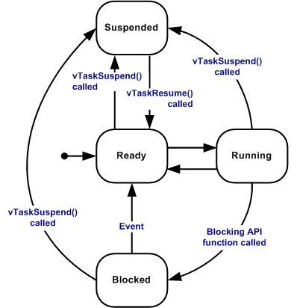
Task States in FreeRTOS
A task can exist in one of the following states:
Running
Ready
Blocked
A task is said to be in the Blocked state if it is currently waiting for either a temporal or external event.
Susepended
tasks only enter or exit the Suspended state when explicitly commanded to do so through the vTaskSuspend() and xTaskResume() API calls

Slide 56
FreeRTOS Task Functions
Tasks are implemented as C functions.
Its prototype must return void and take a void pointer parameter as the following
void ATaskFunction (void *pvParameters);
Each task is a small program in its own right.
Has an entry point
Normally runs forever within an infinite loop
Does not exit
Must not contain a ‘return’ statement
Must not be allowed to execute past the end of the function
If a task is no longer required, it should be explicitly deleted.

Slide 57
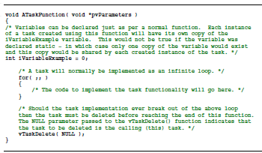
FreeRTOS Task Functions

Slide 58
Creating Tasks
xTaskCreate() API function
the most fundamental component in a multitasking system
Probably the most complex of all API functions
portBASE_TYPE xTaskCreate(
pdTASK_CODE pvTaskCode,
const signed char * const pcName,
unsigned short usStackDepth,
void *pvParameters,
unsigned portBASE_TYPE uxPriority,
xTaskHandle *pxCreatedTask
);

Slide 59
Task Parameters
pvTaskCode
a pointer to the function (just the function name) that implements the task.
pcName
A descriptive name for the task. It is not used by FreeRTOS, but a debugging aid.
usStackDepth
Each task has its own unique stack that is allocated by the kernel to the task when the task is created.
The value specifies the number of words the task stack can hold.

Slide 60
Task Parameters
pvParameters
The value assigned to pvParameters will be the values passed into the task
uxPriority
defines the priority at which the task will execute.
Priorities can be assigned from 0, which is the lowest priority, to (configMAX_PRIOIRTIES-1), which is the highest priority.
pxCreatedTask
pass out a handle to the created task; to be used to refer the created task in API calls.
E.g., change the task priority or delete the task
Set to NULL if no use for the task handle

Slide 61
Tasks Creation Examples
void vTaskFunction1(void *pvParameters);
void vTaskFunction2(void *pvParameters);
const char *pcTextForTask1 = "Task 1 is running\n";
const char *pcTextForTask2 = "Task 2 is running\n";
xTaskCreate(vTaskFunction1, "Task 1", 240, (void*) pcTextForTask1, 1, NULL);
xTaskCreate(vTaskFunction2, "Task 2", 240, (void*) pcTextForTask2, 2, NULL);
vTaskStartScheduler();

Slide 62
Running a Periodic Task
vTaskDelayUntil() API Function
void vTaskDelayUntil(
portTickType *pxPreviousWakeTime,
portTickType xTimeIncrement);)
Parameters to vTaskDelayUntil()
specify the exact tick count value at which the calling task should be moved from the Blocked state into the Ready state.
Be used when a fixed execution period is required.
Example
vTaskDelayUntil(&xLastWakeTime, (50 / portTICK_RATE_MS));

Slide 63
vTaskDelayUntil() prototype
pxPreviousWakeTime
Holds the time at which the task left the Blocked state.
Be used as a reference point to compute the time at which the task next leaves the Blocked state.
The variable pointed by pxPreviousWakeTime is updated automatically, not be modified by application code, other than when the variable is first initialized.
xTimeIncrement
Assume that vTaskDelayUtil() is being used to implement a task that executes periodically and with a fixed frequency – set by xTimeIncrement.
Be specified in ‘ticks’. The constant portTICK_RATE_MS can be used to convert ms to ticks.

Slide 64
Task Example
void vTaskFunction1(void *pvParameters) {
char *pcTaskName;
portTickType xLastWakeTime;
pcTaskName = (char *) pvParameters;
xLastWakeTime = xTaskGetTickCount();
for (;;) {
vPrintStringAndNumber("Task 1 Run @", xLastWakeTime);
vTaskDelayUntil(&xLastWakeTime, (50 / portTICK_RATE_MS));
}
}

Slide 65
FreeRTOS
An open-source RTOS available at http://www.freertos.org
Supports 34 architectures
107,000 downloads a year
Professionally developed, strictly quality controlled
Free to use in commercial products
Used in market sectors from toys to aircraft navigation
Browsing the source code
http://sourceforge.net/projects/freertos/
Files, pick version
FreeRTOS/Source/
portable/GCC/ARM7_LPC23xx (compiler / architecture)

