Slide 1
Processes and Operating Systems Chapter 6
COE 306: Introduction to Embedded Systems
Dr. Aiman El-Maleh
Computer Engineering Department
College of Computer Sciences and Engineering
King Fahd University of Petroleum and Minerals

Slide 2
Next . . .
Processes and Operating Systems
Real Time Operating System (RTOS)
The Scheduling Problem
Rate Monotonic Scheduling (RMS)
Earliest-Deadline-First Scheduling (EDFS)
Interprocess Communication Mechanisms

Slide 3
Processes and Operating Systems
Processes and operating system are abstractions
allow us to build complex applications on microprocessors
provide much greater flexibility to satisfy timing requirements
Let us switch the state of the processor between multiple tasks
Process defines the state of an executing program
A process is a unique execution of a program
Several copies of a program may run simultaneously or at different times
A process has its own state: registers and memory
Threads share the same address space

Slide 4
Processes and Operating Systems
The Operating System (OS) manages processes
OS provides the mechanism for switching execution between processes
Real-Time Operating System (RTOS) is OS that provides facilities for satisfying real-time requirements
Allocates resources based on real-time requirements
General-purpose OSs use other criteria, e.g. fairness
RTOS helps build more complex systems using several programs that run concurrently

Slide 5
Tasks and Processes
A task is a functional description of a connected set of operations
Task can also mean a collection of processes
Multiple tasks means multiple processes
Multiple processes help with timing complexity:
multiple rates
multimedia
automotive
asynchronous input
user interfaces
communication systems

Slide 6
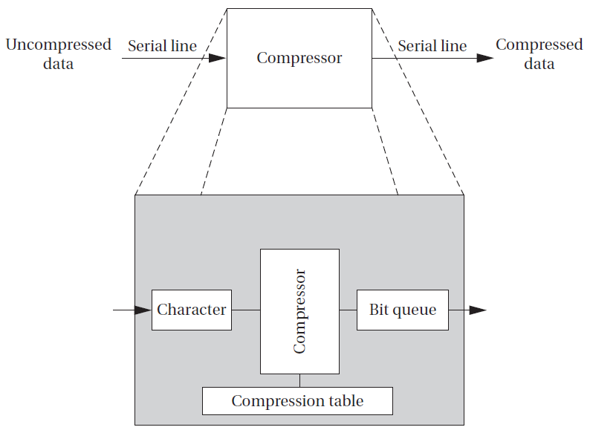
Compression Unit Example
Variable data rates
need to receive and send data at different rates
program may emit two bits for first byte and then seven bits for second byte
must ensure to process inputs and outputs at the proper rates
Asynchronous input
a compression mode button that disables or enables compression
Keeping up with input and output data while checking on button can introduce complex control code into program

Slide 7
Compression Unit Example
Sampling the button’s state too slowly can cause the machine to miss a button depression entirely
Sampling it too frequently can cause the machine to incorrectly compress data due to executing later than expected
Variable execution times of code causes other code to execute later than expected
We need to be able to keep track of these two different tasks separately, applying different timing requirements to each
Complex control is usually quite difficult to verify for either functional or timing properties

Slide 8
Multi-Rate Systems
Multirate embedded computing systems are very common, including automobile engines, printers, and cell phones
Certain operations must be executed periodically, and each operation is executed at its own rate
Tasks may be synchronous or asynchronous
Synchronous tasks may recur at different rates
Processes run at different rates based on computational needs of the tasks

Slide 9
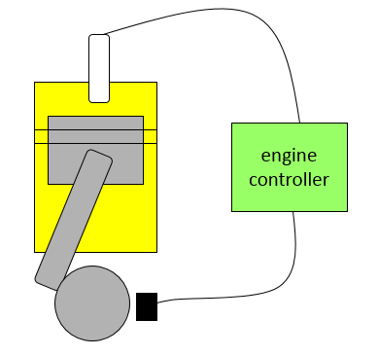
Example: Engine Control
Tasks:
spark control
Firing the spark plug periodically
Spark timing varies with engine speed
regulate exhaust emissions
crankshaft sensing
fuel/air mixture
oxygen sensor
multimode control scheme
engine warm-up , cruise, climbing steep hills
Rates at which engine inputs and outputs must be handled range between 2ms and 1s

Slide 10
Typical Rates in Engine Controllers
Variable | Update period (ms)
Engine spark timing | 2
Throttle | 2
Air flow | 4
Battery voltage | 4
Fuel flow | 10
Recycled exhaust gas | 25
Status switches | 20
Air temperature | 400
Barometric pressure | 1000
Spark (dwell) | 1
Fuel adjustment | 8
Carburetor | 25
Mode actuators | 100

Slide 11
Real-Time Systems
Perform a computation to conform to external timing constraints
Deadline frequency:
Periodic
Aperiodic
Deadline type:
Hard: failure to meet deadline causes system failure
Car Airbag system, car brakes
Soft: failure to meet deadline causes degraded response
Room temperature control, car multimedia system
Firm: late response is useless; Infrequent deadline misses are tolerable, but may degrade the system's quality of service
A digital cable set-top box frame decoder

Slide 12
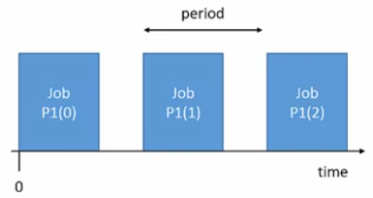
Types of Process Timing Requirements
Release time: time at which process becomes ready to execute
Deadline: time at which process must finish execution
Periodic process: a process executes every period
e.g. Firing the spark plugs
Aperiodic process: executes on demand
Processing a button press
Period : interval between process activations
Initiation Interval or Rate = 1/period

Slide 13
Types of Process Timing Requirements
Jitter: Allowable variation in task completion time
Example: multimedia synchronization
What happens when a process misses a deadline?
Can be catastrophic such as in an automotive control system
a missed deadline in a telephone system may cause a temporary silence on the line
Example: Space Shuttle software error
Space Shuttle’s first launch was delayed by a software timing error
Change to one routine added delay that threw off start time calculation

Slide 14
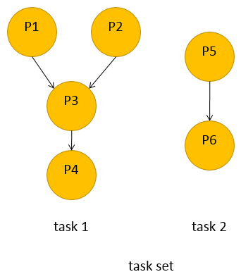
Task Graphs
Tasks may have data dependencies---must execute in certain order
Task graph shows data/control dependencies between processes
Task: connected set of processes
Task set: One or more tasks
Task graph assumes that all processes in each task run at the same rate, tasks do not communicate
In reality, some amount of inter-task communication is necessary

Slide 15
Process Execution Characteristics
Process execution time T_{i}
Execution time in absence of preemption
Possible time units: seconds, clock cycles
Worst-case, best-case execution time may be useful in some cases
Sources of variation:
Data dependencies
Memory system
CPU pipeline

Slide 16
CPU Utilization
CPU utilization
Fraction of the CPU that is doing useful work
Often calculated assuming no scheduling overhead
Utilization:
U = (CPU time for useful work) / (total available CPU time)
Utilization over a time interval [t1, t2]
= $\frac{\sum{proci Ti(t2−t1)}}{t_{2}−t_{1}}$
= T/t

Slide 17
Running Periodic Processes
Need code to control execution of processes
Simplest implementation: process = subroutine
while loop implementation
Simplest implementation has one loop
No control over execution timing
Pad the loop with NOP instructions
Used by some video games in the 1970s
Broken: hard to determine execution time, conditionals, re-evaluation upon code change
while (TRUE) {
p1();
p2();
}

Slide 18
Running Periodic Processes
Timed loop implementation
Encapsulate set of all processes in a single function that implements the task set
Use timer to control execution of the task
No control over timing of individual processes
Multiple timers implementation
Each task has its own function
Each task has its own timer
May not have enough timers to implement all the rates
void pall() {
p1();
p2();
}
void A(){ /* rate A */
p1(); p3();
}
void B(){ /* rate B */
p2(); p4(); p5();
}

Slide 19
Running Periodic Processes
Timer + counter implementation
Use a software count to divide the timer
Only works for clean multiples of the timer period
Implementing processes
All of these implementations are inadequate.
Need better control over timing
Need a better mechanism than subroutines
Real-time operating systems (RTOS)
int p2count = 0;
void pall(){
p1();
if (p2count >= 2) {
p2();
p2count = 0;
}
else p2count++;
p3();
}

Slide 20
Operating Systems
The operating system controls resources
who gets the CPU
when I/O takes place
how much memory is allocated
The most important resource is the CPU itself
CPU access controlled by the scheduler

Slide 21
Real-Time Operating Systems
Solves the main problems of a cooperative multitasking system
Executes processes based on timing requirements provided by system designer
Based on two basic concepts:
Preemption: the ability to interrupt a process to switch to another
Context switching: switching execution and CPU state between processes

Slide 22
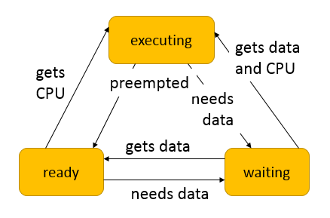
State of a Process
A process can be in one of three states:
executing on the CPU
ready to run
waiting for I/O, another process, timer, next period
The operating system selects the next executing process
At most one executing process

Slide 23
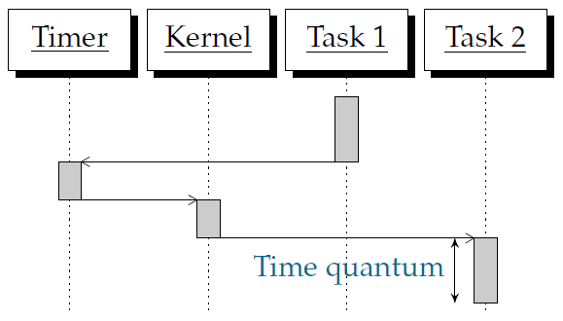
Preemptive Execution
Kernel: part of the OS. Determines which process runs
The kernel is activated periodically by the timer
The timer period is known as the time quantum
The smallest time unit in which CPU activity can be controlled

Slide 24
Context Switching
Context: The set of registers that define a process
Context Switching: Switching the registers from one process to another
Timer interrupt: transfer control from a process to kernel
Kernel saves current process context
Kernel selects next process (scheduling)
Kernel restores next process context
Context switching code is usually assembly code
Task priorities make selecting processes flexible and fast

Slide 25
FREERTOS
An open-source RTOS available at http://www.freertos.org
Supports 34 architectures
107,000 downloads a year
Professionally developed, strictly quality controlled
Free to use in commercial products
Used in market sectors from toys to aircraft navigation
Browsing the source code
http://sourceforge.net/projects/freertos/
Files, pick version
FreeRTOS/Source/
portable/GCC/ARM7_LPC23xx (compiler / architecture)

Slide 26
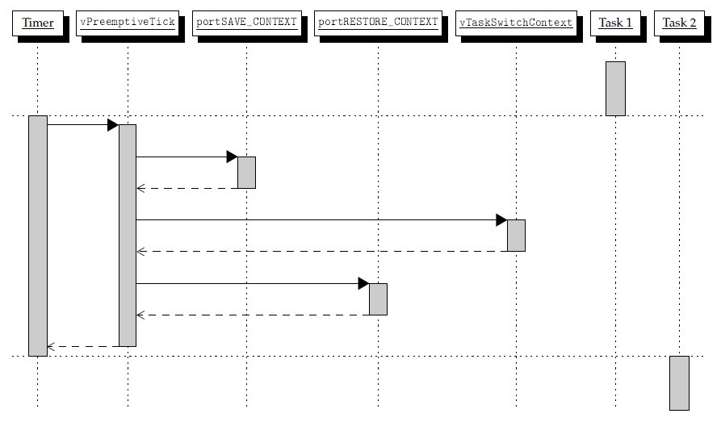
Context Switching in FREERTOS

Slide 27
The Scheduling Problem
Choosing the order of running processes is known as scheduling
Workstations try to avoid starving processes of CPU access
Fairness = access to CPU
Embedded systems must meet deadlines
Low-priority processes may not run for a long time
Scheduling feasibility
Resource constraints make schedulability analysis NP-hard
Must show that the deadlines are met for all timings of resource requests

Slide 28
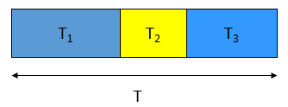
Scheduling Feasibility
Assume:
No resource conflicts
Constant process execution times
Require:
T (period) ≥ Σ_{i} T_{i}
Can’t use more than 100% of the CPU.
Hyperperiod: least common multiple (LCM) of the task periods
Must look at the hyperperiod schedule to find all task interactions
Hyperperiod can be very long if task periods are not chosen carefully

Slide 29
Hyperperiod Example
Long hyperperiod:
P1 7 ms
P2 11 ms
P3 15 ms
LCM = 1155 ms
Example:
P1 period 1 ms, CPU time 0.1 ms
P2 period 1 ms, CPU time 0.2 ms
P3 period 5 ms, CPU time 0.3 ms
Shorter hyperperiod:
P1 8 ms
P2 12 ms
P3 16 ms
LCM = 96 ms

Slide 30
Round-Robin Scheduling
All the processes are kept on a list and scheduled one after the other
Time slices are assigned to each process in equal portions and in circular order
Common in general-purpose Oses
Usually combined with preemption
Schedule process only if ready
Always test processes in the same order
Start round-robin again after finishing a round
Schedule based on least common multiple (LCM) of the process periods

Slide 31
Priority-Based Scheduling
Each process has a priority
CPU goes to highest-priority process that is ready
Priorities determine scheduling policy:
fixed priority
time-varying priorities
Example:
each process has a fixed priority (1 highest)
highest-priority ready process gets CPU
process continues until done

Slide 32
Priority-Based Scheduling Example
P3 ready t=18
P2 ready t=0
P1 ready t=15
P2
P1
P2
P3
0
10
20
30
40
50
60
time

Slide 33
Scheduling Metrics
How do we evaluate a scheduling policy:
Ability to satisfy all deadlines
CPU utilization---percentage of time devoted to useful work
Scheduling overhead---time required to make scheduling decision

Slide 34
Rate Monotonic Scheduling (RMS)
RMS is widely-used, analyzable scheduling policy
A static scheduling policy: processes have fixed priorities
RMS Model
All processes run on single CPU
Context switching time is ignored
No data dependencies between processes
Process execution time is constant
All deadlines are at the end of the period
Highest-priority ready process runs first
Priority assignment: The process with the shortest period is assigned the highest priority

Slide 35
Rate Monotonic Scheduling (RMS)
RMS always provides a feasible schedule if such a schedule exists
Optimal static assignment
No fixed-priority scheme does better
Highest CPU utilization while ensuring that all processes meet their deadlines
T_{i} is computation time of process i
τ_{i} is period of process i
Absolute deadline
Released
Execution time Ti
τ_{i}

Slide 36
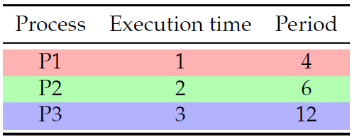
Rate Monotonic Scheduling Example
What if execution times become 2, 3, 3?

Slide 37
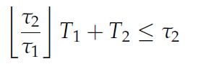
Rate Monotonic Analysis (RMA)
If P1 has higher priority, required constraint on CPU time:
If P2 has higher priority, required constraint on CPU time:
There are cases where first
relationship can be satisfied
and second cannot.
There are no cases where
second relationship can be
satisfied and first cannot
Consider T1=2 and T2=2,
τ1=3, τ2=6.

Slide 38
RMS CPU utilization
Utilization for n processes is:
Given n processes and ratio between any two periods less than 2, RMS CPU utilization upper bound:
n = 2; U ≤ 0.83
n = 3; U ≤ 0.78
n→ ∞; U ≤ ln2 ≈ 0.69, 31% idle time
RMS may not be able to use 100% of CPU, even with zero context switch overhead

Slide 39
RMS CPU utilization Example
Utilization = 1/4 + 2/6 + 3/12 = 0.83

Slide 40
RMS- Schedulability Check
A set of n processes is schedulable on a uniprocessor by the RMS algorithm if the processor utilization (utilization test):
This condition is sufficient, but not necessary
If U is less than the given bound, a schedule exists
If there is a schedule, U could be greater than the bound
Example:
P1: (T1=1, τ1=2), P2: (T2=2, τ2=4)
There is a schedule with U=100%

Slide 41
Another RMS Example
P1: T1=1, τ1=4
P2: T2=2, τ2=5
P3: T3=2, τ2=7
P₁
(1,4)
P₂
(2,5)
5
10
15
P₃
(2,7)
5
10
15

Slide 42
Another RMS Example
P₁
(1,4)
P₂
(2,5)
5
10
15
P₃
(2,7)
5
10
15

Slide 43
Another RMS Example
Deadline Miss !
T₁
(1,4)
T₂
(2,5)
5
10
15
T₃
(2,7)
5
10
15

Slide 44
Earliest-Deadline-First Scheduling
EDFS: dynamic priority scheduling scheme
Process closest to its deadline has highest priority
Requires recalculating processes priorities at every timer interrupt
Can achieve 100% utilization;higher utilization than RMS
On each timer interrupt
compute time to deadline
choose process closest to deadline
Optimal scheduling algorithm
if there is a schedule for a set of real-time tasks, EDF can schedule it

Slide 45
EDFS Example
P1: T1=1, τ1=4
P2: T2=2, τ2=5
P3: T3=2, τ2=7
P₁
(1,4)
P₂
(2,5)
5
10
15
P₃
(2,7)
5
10
15

Slide 46
EDFS Example
P₁
(1,4)
P₂
(2,5)
5
10
15
P₃
(2,7)
5
10
15

Slide 47
EDFS Example
P₁
(1,4)
P₂
(2,5)
5
10
15
P₃
(2,7)
5
10
15

Slide 48
EDFS Example
P₁
(1,4)
P₂
(2,5)
5
10
15
P₃
(2,7)
5
10
15

Slide 49
Processor Demand Bound
Demand Bound Function : dbf(t)
the maximum processor demand by workload over any interval of length t
t
P₁
(1,4)
P₂
(2,5)
5
10
15
P₃
(2,7)
5
10
15

Slide 50
EDFS - Schedulability Analysis
Real-time system is schedulable under EDFS if and only if
∑U_{i} ≤ 1
Real-time system is schedulable under EDFS
if and only if dbf(t) ≤ t for all interval t

Slide 51
EDFS – Overload Conditions
Domino effect during overload conditions
Example: T₁(3,4), T₂(3,5), T₃(3,6), T₄(3,7)
Deadline Miss !
T₁
T₂
T₃
T₄
0
3
5
6
7
Better schedules :
T₁
T₃
T₁
T₄
0
3
5
6
7
0
3
5
6
7

Slide 52
Interprocess Communication Mechanisms
Processes within a system maybe independent or cooperating
Cooperating processes might affect or might be affected by other processes
Interprocess communication (IPC): OS provides mechanisms so that processes can pass data
Purposes for IPC
Data Transfer; Sharing Data
Computational Speedup when parallelizing programs
Event notification
Resource Sharing and Synchronization
Process Control

Slide 53
Interprocess Communication Mechanisms
Major communication mechanisms
Shared memory:
Processes can exchange information by reading and writing data to the shared region
System calls are responsible only to establish shared memory region
must cooperate to avoid destroying/missing messages
Message passing:
processes send messages along a communication channel---no common address space
Two types of semantics:
blocking: sending process waits for response
non-blocking: sending process continues

Slide 54
Shared Memory Communication
Shared memory allows multiple processes to share virtual memory space
This is the fastest but not necessarily the easiest (synchronization-wise) way for processes to communicate with one another
In general, one process creates or allocates the shared memory segment
The size and access permissions for the segment are set when it is created
The process then attaches the shared segment, causing it to be mapped into its current data space

Slide 55
Shared Memory Communication
If needed, the creating process then initializes the shared memory
Once created, and if permissions permit, other processes can gain access to the shared memory segment and map it into their data space
Each process accesses the shared memory relative to its attachment address
While the data that these processes are referencing is in common, each process uses different attachment address values
For each process involved, the mapped memory appears to be no different from any other of its memory addresses

Slide 56
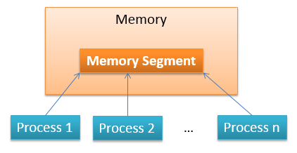
Shared Memory Communication
POSIX: shmget, shmat, shmdt, shmctl, mmap
Windows: CreateSharedMemory, CreateFileMapping, MapViewOfFile
Portable implementations: Boost.Interprocess, QSharedMemory

Slide 57
Unix Procedure for Using Shared Memory
Find a key. Unix uses this key for identifying shared memory segments.
Use shmget() to allocate a shared memory.
Use shmat() to attach a shared memory to an address space.
Use shmdt() to detach a shared memory from an address space.
Use shmctl() to deallocate a shared memory
The mmap system call can be used to map a file to a process's virtual memory address space

Slide 58
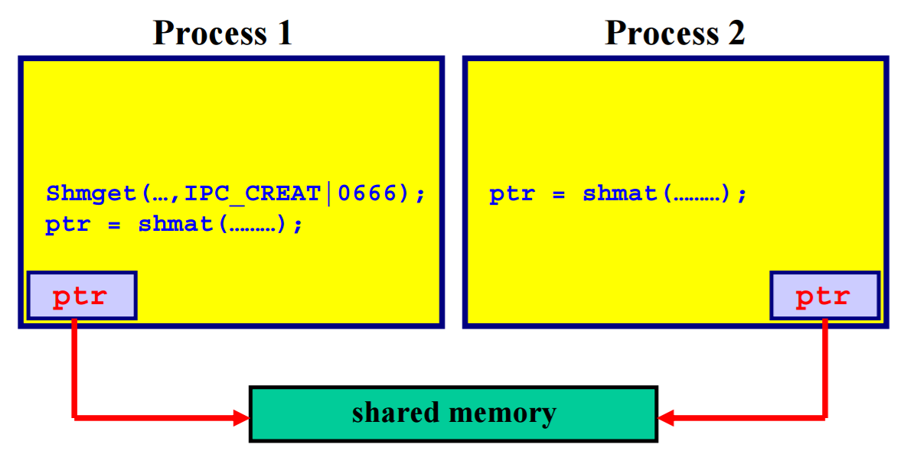
Attaching a Shared Memory

Slide 59
POSIX (Portable Operating System Interface)
Family of IEEE standards for maintaining compatibility between Unix-like operating systems
Includes APIs (threading), utilities (awk, echo), shells, I/O (file, network)
Unix developed in 1960’s at Bell Laboratories to support text processing
POSIX is a standard version of Unix
Linux is an open-source POSIX-compliant operating system
Linux versions have been developed to improve real-time responsiveness

Slide 60
Example: Creating the Segment and Connecting
A shared memory segment is ‘created’ and ‘connected to’ via the shmget() call
int shmget(key_t key, size_t size, int shmflg);
The key argument should be created using ftok().
The size, is the size in bytes of the shared memory segment.
The shmflg should be set to the permissions of the segment bitwise-ORd with IPC_CREAT if you want to create the segment, but can be 0 otherwise.
Upon successful completion, shmget() returns an identifier for the shared memory segment.

Slide 61
Example: Creating the Segment and Connecting
Here's an example call that creates a 1K segment with 644 permissions (rw-r--r--)
key_t key;
int shmid;
key = ftok("/home/beej/somefile3", 'R');
shmid = shmget(key, 1024, 0644 | IPC_CREAT);

Slide 62
Example: Getting a Pointer to the Segment
The shared memory segment must be attached using shmat() before its used.
void *shmat(int shmid, void *shmaddr, int shmflg);
shmid is the shared memory ID from the shmget() call.
shmaddr, which you can use to tell shmat() which specific address to use. When set it to 0, the OS will decide the address.
shmflg can be set to SHM_RDONLY if you only want to read from it, 0 otherwise.

Slide 63
Example: Getting a Pointer to the Segment
Here's a more complete example of how to get a pointer to a shared memory segment:
key_t key;
int shmid;
char *data;
key = ftok("/home/beej/somefile3", 'R');
shmid = shmget(key, 1024, 0644 | IPC_CREAT);
data = shmat(shmid, (void *)0, 0);

Slide 64
Example: Reading and Writing
The data pointer from the above example is a char pointer. Thus it reads chars from it.
lets say the 1K shared memory segment contains a null-terminated string.
It can be printed like this:
printf("shared contents: %s\n", data);
And we could store something in it as easily as this:
printf("Enter a string: ");
gets(data);

Slide 65
Example: Detaching from and Deleting Segments
When you're done with the shared memory segment, your program should detach itself from it using the shmdt() call:
int shmdt(void *shmaddr);
The only argument, shmaddr, is the address you got from shmat().
The function returns -1 on error, 0 on success.
A segment is destroyed using a call to shmctl()
shmctl(shmid, IPC_RMID, NULL);
The above call deletes the shared memory segment, assuming no one else is attached to it.

Slide 66
Race Condition in Shared Memory
Assume that two processes P1 and P2 have a shared memory
Flag is set to indicate that the shared memory is used by the process
Problem when two processes try to write the same location:
Process 1 reads flag and sees 0 (context switch)
Process 2 reads flag and sees 0 (context switch)
Process 1 sets flag to one and writes location (context switch)
Process 2 sets flag to one and overwrites location (context switch)

Slide 67
Atomic Test and Set
Problem can be solved with an atomic test-and-set:
single bus operation reads memory location, tests it, writes it.
ARM test-and-set provided by SWP:
ADR r0,SEMAPHORE
LDR r1,#1
GETFLAG SWP r1,r1,[r0]
BNZ GETFLAG

Slide 68
Semaphores & Critical Region
Critical region: section of code that cannot be interrupted by another process
Semaphore: OS primitive for controlling access to critical regions
Protocol:
Get access to semaphore with P(): acquire
Perform critical region operations
Release semaphore with V(): release
Process i
P(S);
Critical Section
V(S);
Remainder Section
P(S) {
while(S ≤ 0);
S--;
}
V(S) {
S++;
}

Slide 69
Shared Memory, Pros and Cons
Pros
Fast bidirectional communication among any number of processes
Saves Resources
Cons
Needs concurrency control (leads to data inconsistencies)
Lack of data protection from Operating System (OS)

Slide 70
Message Passing Communication
processes communicate with each other without resorting to shared variables
We have at least two primitives:
send(destination, message) or send(message)
receive(source, message) or receive(message)
Message size is fixed or variable.
Message Passing Mechanisms
message passing interfaces, mailboxes and message queues
sockets, pipes, signals

Slide 71
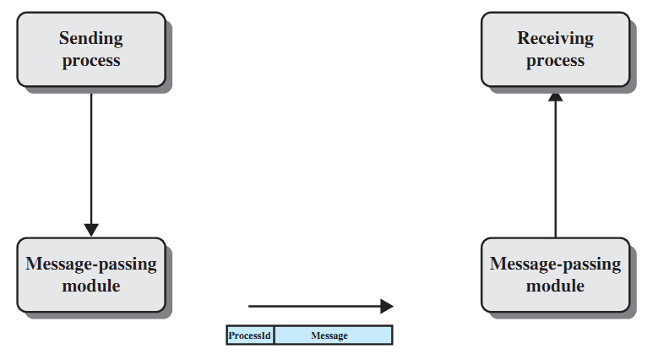
Basic Message-Passing Primitives

Slide 72
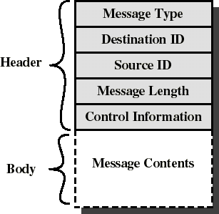
Message Format
Consists of header and body of message
In Unix: no ID, only message type
Control info:
what to do if run out of buffer space
sequence numbers
priority
Queuing discipline: usually FIFO but can also include priorities.

Slide 73
Synchronization in Message Passing
Message passing may be blocking or non-blocking.
Blocking is considered synchronous
Blocking send has the sender block until the message is received
Blocking receive has the receiver block until a message is available
Non-blocking is considered asynchronous
Non-blocking send has the sender send the message and continue
Non-blocking receive has the receiver receive a valid message or null

Slide 74
Synchronization in Message Passing
For the sender: it is more natural not to be blocked after issuing send:
can send several messages to multiple destinations
but sender usually expect acknowledgment of message receipt (in case receiver fails)
For the receiver: it is more natural to be blocked after issuing receive:
the receiver usually needs the information before proceeding
but could be blocked indefinitely if sender process fails before send

Slide 75
Synchronization in Message Passing
There are really 3 combinations here that make sense:
Blocking send, Blocking receive
Nonblocking send, Nonblocking receive
Nonblocking send, Blocking receive – most popular
example: Server process that provides services/resources to other processes. It will need the expected information before proceeding.

Slide 76
Message Passing Requirements
If P and Q wish to communicate, they need to:
establish communication link between them
exchange messages via send/receive
Queue of messages attached to the link; implemented in one of three ways:
1. Zero capacity – 0 messages Sender must wait for receiver (rendezvous)
2. Bounded capacity – finite length of n messages Sender must wait if link full
3. Unbounded capacity – infinite length Sender never waits

Slide 77
Pipes
Pipes
Unidirectional communication
Implemented with finite size, FIFO byte stream buffer maintained by the kernel
One process writes data into tail end of pipe while another process reads from head end of the pipe

Slide 78
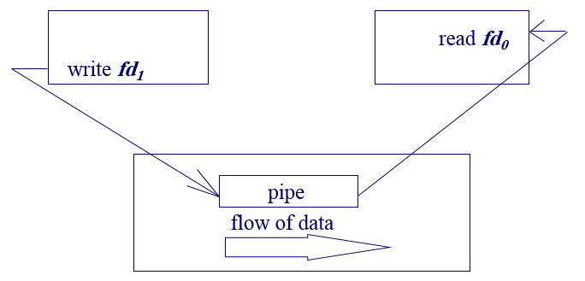
Pipes
An unnamed pipe is created by calling pipe(), which returns an array of 2 file descriptors (int).
The file descriptors are for reading and writing, respectively
Syntax: int pipe (int pipefd[2]);
If successful, the pipe system call will return two integer file descriptors, pipefd[0] and pipefd[1]
pipefd[1] is the write end to the pipe
pipefd[0] is the read end from the pipe

Slide 79
Pipes
Named pipes use an access point (A file on the file system)
Two unrelated processes open this file to communicate
One process writes and the other reads, thus it is a half-duplex communication
The function mkfifo can be used to create a named pipe
int mkfifo(const char *path, mode_t mode)
It is handled just like any other normal file in the system

Slide 80
Signals
Signals
the mechanism whereby processes are made aware of events occurring
asynchronous - can be received by a process at any time in its execution
Similar to interrupts; do not pass data
Common in Unix-like systems; Unix ^c sends kill signal to process
examples of Linux signal types:
SIGINT : interrupt from keyboard
SIGFPE : floating point exception
SIGKILL : terminate receiving process
SIGCHLD : child process stopped or terminated
SIGSEGV : segment access violation

Slide 81
Signals
Process can send a signal to another - Kernel can send signal to a process (like an interrupt)
A process can:
ignore/discard the signal (not possible with SIGKILL or SIGSTOP)
execute a signal handler function, and then possibly resume execution or terminate
carry out the default action for that signal
The signal() system call installs a new signal handler for the signal with number signum.
The signal handler is set to sighandler which may be a user specified function

Slide 82
Signals Example
int main() {
signal( SIGINT, foo );
/* do usual things until SIGINT */
return 0;
}
void foo( int signo ) {
/* deal with SIGINT signal */
return; /* return to program */
}

Slide 83
Examples of Signals
User types Ctrl-c
Event gains attention of OS
OS stops the application process immediately, sending it a 2/SIGINT signal
Signal handler for 2/SIGINT signal executes to completion
Default signal handler for 2/SIGINT signal exits process
Process makes illegal memory reference
Event gains attention of OS
OS stops application process immediately, sending it a 11/SIGSEGV signal
Signal handler for 11/SIGSEGV signal executes to completion
Default signal handler for 11/SIGSEGV signal prints “segmentation fault” and exits process

Slide 84
Mailboxes
Mailboxes
Mailboxes can be viewed as objects into which messages placed by processes and from which messages can be removed by other process
Each mailbox has a unique ID
Owner is typically the process that creates it
Two processes can communicate only if they have a shared mailbox
send ( A, message ) : send a message to mailbox A
receive ( A, message ) : receive a message from mailbox A

Slide 85
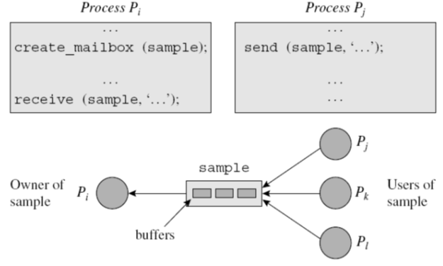
Creation and Use of Mailboxes

Slide 86
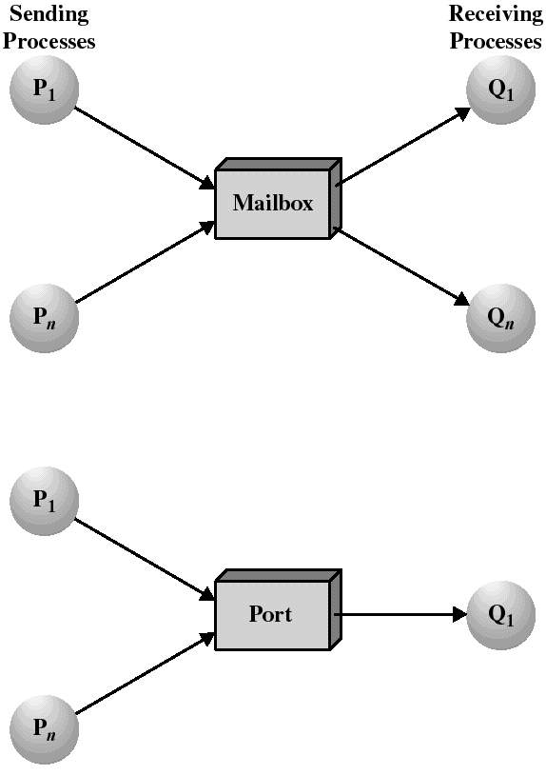
Mailboxes and Ports
A mailbox can be private to one sender/receiver pair
The same mailbox can be shared among several senders and receivers:
the OS may then allow the use of message types (for selection)
Port: is a mailbox associated with one receiver and multiple senders
used for client/server applications: the receiver is the server

Slide 87
Sockets
Sockets
Socket is an abstraction for an end point of communication that can be manipulated with a file descriptor
It is an abstract object from which messages are sent and received
Sockets are created within a communication domain just as files are created within a file system
socket is associated with IP address and port number
any port
agreed port
socket
socket
message
client
server
other ports
Internet address = 138.37.94.248
Internet address = 138.37.88.249

Slide 88
Sockets
The interface that the OS provides to its networking subsystem
application layer
application layer
User Process
Internet
User Process
Socket
Socket
OS network
stack
OS network
stack
transport layer (TCP/UDP)
transport layer (TCP/UDP)
Internet
network layer (IP)
network layer (IP)
link layer (e.g. ethernet)
Internet
link layer (e.g. ethernet)

Slide 89
Sockets – Delivering Data
Application
Read data from and write data to the socket
Interpret the data (e.g., render a Web page)
Operating system
Deliver data to the destination socket
Based on the destination port number (e.g., 80)
Network
Deliver data packet to the destination host
Based on the destination IP address

Slide 90
Socket Types
Datagram Socket: User Datagram Protocol (UDP)
Independent packets
Not necessarily in-order delivery
Best effort: No guarantee of delivery
Connectionless: Must address each packet
Example UDP applications: Multimedia, voice over IP (Skype)
Stream Socket: Transmission Control Protocol (TCP)
Stream of bytes: in-order delivery
Reliable: guarantee delivery
Connection-oriented: Setup connection followed by data transfer
Example TCP applications: Web, Email, Telnet

Slide 91
UNIX Socket API
Socket interface
Originally provided in Berkeley UNIX
Later adopted by all popular operating systems
Simplifies porting applications to different OSes
In UNIX, everything is like a file
All input is like reading a file
All output is like writing a file
File is represented by an integer file descriptor
API implemented as system calls
E.g., connect, send, recv, close, …

Slide 92
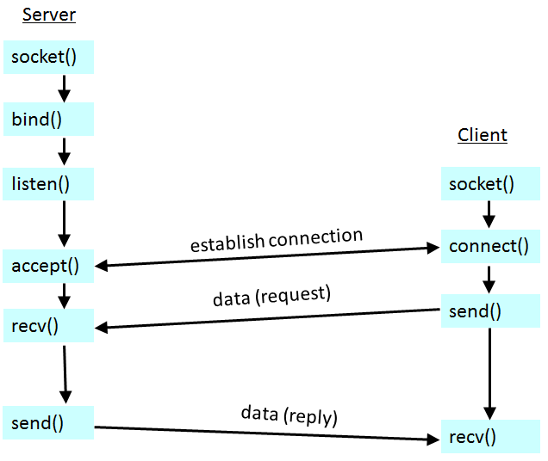
Connection-oriented Example (Stream Sockets -TCP)

Slide 93
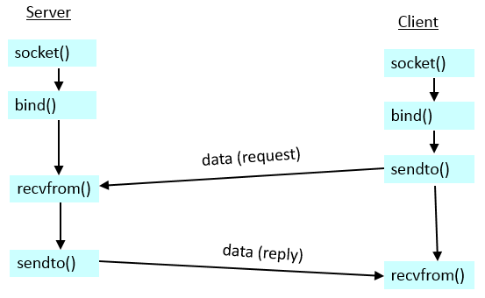
Connectionless Example (Datagram Sockets - UDP)

