Slide 1
Instruction Sets Chapter 2
COE 306: Introduction to Embedded Systems
Dr. Aiman El-Maleh
Computer Engineering Department
College of Computer Sciences and Engineering
King Fahd University of Petroleum and Minerals

Slide 2
Next . . .
Computer Architecture Taxonomy
ARM Instruction Set
PIC16F Instruction Set
TI CX55 DSP
TI C64X DSP

Slide 3
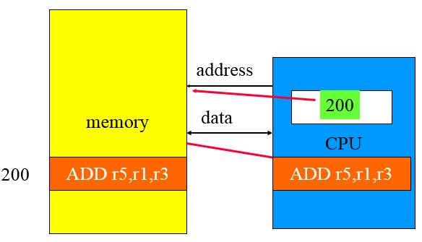
Von Neumann Architecture
Memory holds data, instructions
Central processing unit (CPU) fetches instructions from memory
Allows self-modifying code

Slide 4
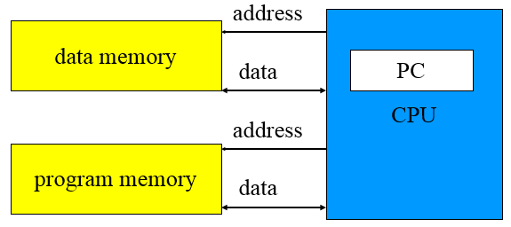
Harvard Architecture
Has separate memories for data and program & allows two simultaneous memory fetches
Harvard architectures are widely used today
the separation of program and data memories provides higher performance for digital signal processing (DSP); higher memory bandwidth

Slide 5
Instruction Set Characteristics
The instruction set of the computer defines the interface between software modules and the underlying hardware.
Instruction set characteristics:
Fixed vs. variable length
Addressing modes
Number of operands and type
Types of operations supported
We often characterize architectures by their word length: 4-bit, 8-bit, 16-bit, 32-bit, 64-bit, etc.
Instruction set architecture: instruction set, memory, programmer accessible registers

Slide 6
RISC vs. CISC
Complex instruction set computer (CISC):
a variety of instructions that may perform very complex tasks;
many addressing modes.
Reduced instruction set computer (RISC):
fewer and simpler instructions;
load/store;
pipelined instructions.
Early RISC designs substantially outperformed CISC designs.
Performance gap between RISC and CISC has narrowed as CISC used RISC techniques to efficiently execute CISC instructions.

Slide 7
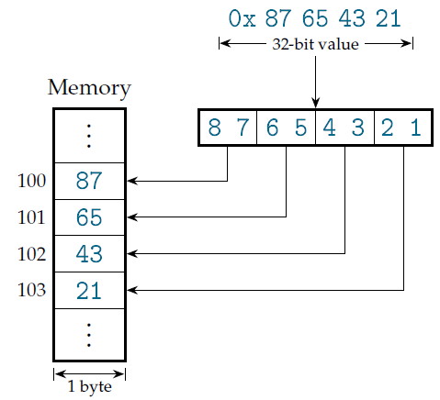
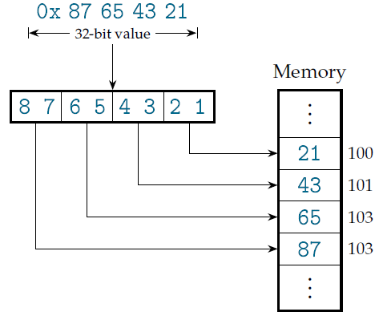
Little-Endian vs. Big-Endian
Little-endian: least-significant byte first
Big-endian: most-significant byte first
Big-Endian
Little-Endian

Slide 8
Instruction Execution
Single-issue: A single-issue processor executes one instruction at a time.
Multiple-issue
A superscalar processor uses specialized logic to identify at run time instructions that can be executed simultaneously
A VLIW processor relies on the compiler to determine what combinations of instructions can be legally executed together
VLIW is more energy-efficient than superscalar
VLIW is widely used in signal processing
Multimedia processing
Processing multiple channels of signals

Slide 9
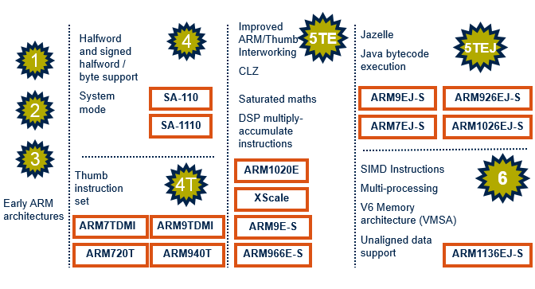
Development of the ARM Architecture

Slide 10
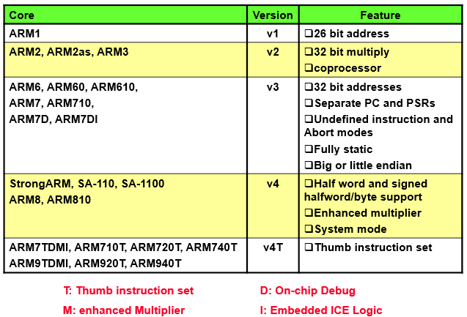
ARM Architecture Version Summary

Slide 11
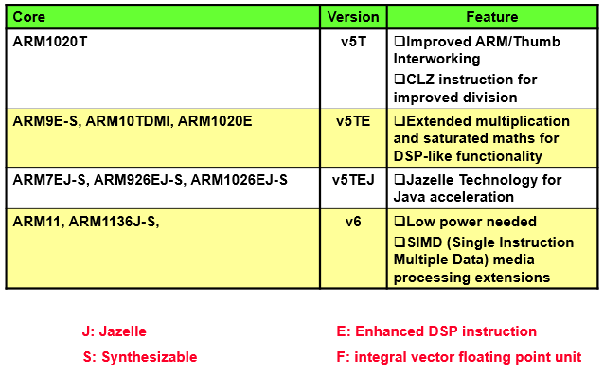
ARM Architecture Version Summary

Slide 12
ARM Instruction Set
RISC architecture: load/store
32-bit words and instructions
ARM7: Von Neumann architecture – our focus
ARM9: Harvard architecture
Cortex-M: either architecture based on model
ARM7: 32-bit addresses, byte-addressable
Configurable endianness on power-up
Most ARM’s implement two instruction sets
32-bit ARM Instruction Set
16-bit Thumb Instruction Set

Slide 13
ARM Processor Modes
ARM has seven basic operating modes:
User: unprivileged mode under which most tasks run
FIQ: entered when a high priority (fast) interrupt is raised
IRQ: is used for general-purpose interrupt handling
Supervisor: is a protected mode for the operating system entered when the CPU is reset or a software interrupt instruction is executed
Abort: used to handle memory access violations
Undefined: entered when an undefined instruction is executed
System: privileged mode for the operating system. It is not entered due to an exception

Slide 14
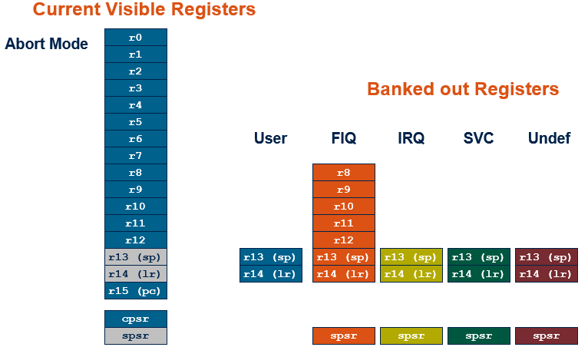
The ARM Register Set
ARM has 37 registers
Note: System mode uses the User mode register set

Slide 15
The ARM Register Set
ARM has 37 registers all of which are 32-bits long.
1 dedicated program counter (pc)
1 dedicated current program status register (cpsr)
5 dedicated saved program status registers (spsr)
30 general purpose registers
The current processor mode governs which of several banks is accessible. Each mode can access
a particular set of r0-r12 registers
a particular r13 (stack pointer, sp) and r14 (link register, lr)
the program counter, r15 (pc)
the current program status register, cpsr
Privileged modes (except System) can also access
a particular spsr (saved program status register)

Slide 16
Program Counter (r15)
When the processor is executing in ARM state:
All instructions are 32 bits wide
All instructions must be word-aligned
Therefore the PC value is stored in bits [31:2] with bits [1:0] undefined (as instruction cannot be halfword)
When the processor is executing in Thumb state:
All instructions are 16 bits wide
All instructions must be halfword-aligned
Therefore the PC value is stored in bits [31:1] with bits [0] undefined (as instruction cannot be byte-aligned)

Slide 17
Program Status Registers
Condition code flags
N = Negative result from ALU
Z = Zero result from ALU
C = ALU operation Carried out
V = ALU operation oVerflowed
Sticky Overflow flag - Q flag
Architecture 5TE/J only
Indicates if saturation has occurred
J bit
Architecture 5TEJ only
J = 1: Processor in Jazelle state
Interrupt Disable bits.
I = 1: Disables the IRQ.
F = 1: Disables the FIQ.
T Bit
Architecture xT only
T = 0: Processor in ARM state
T = 1: Processor in Thumb state
Mode bits
Specify the processor mode

Slide 18
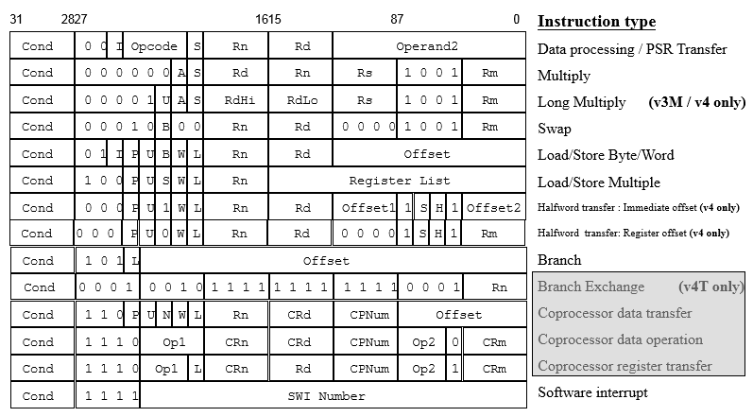
ARM Instruction Set Format

Slide 19
Conditional Execution
Most instruction sets only allow branches to be executed conditionally.
However by reusing the condition evaluation hardware, ARM effectively increases number of instructions.
All instructions contain a condition field which determines whether the CPU will execute them.
This removes the need for many branches, which stall the pipeline.
Allows very dense in-line code, without branches.

Slide 20
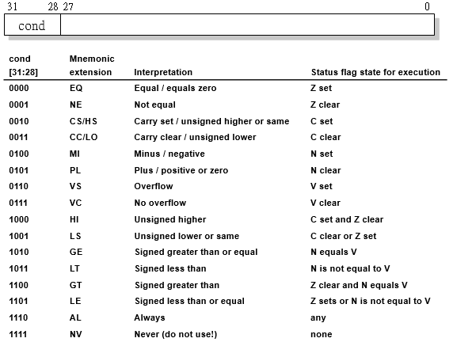
The Condition Field

Slide 21
Data Processing Instructions
Largest family of ARM instructions, all sharing the same instruction format.
Contains:
Arithmetic operations
Comparisons (no results - just set condition codes)
Logical operations
Data movement between registers
They each perform a specific operation on one or two operands.
First operand always a register - Rn
Second operand sent to the ALU via barrel shifter.

Slide 22
Data Processing Instructions
31
28
27
26
25
24
21
20
19
16
15
12
1
1
0
cond
0 0
#
opcode
S
Rn
Rd
operand 2
destination register
first operand register
set condition codes
arithmetic/logic function
25
1
1
8
7
0
1
#rot
8-bit immediate
immediate alignment
1
1
7
6
5
4
3
0
#shift
Sh
0
Rm
25
immediate shift length
0
shift type
second operand register
1
1
8
7
6
5
4
3
0
Rs
0
Sh
1
Rm
register shift length

Slide 23
Arithmetic Operations
Operations are:
ADD operand1 + operand2
ADC operand1 + operand2 + carry
SUB operand1 - operand2
SBC operand1 - operand2 + carry - 1
RSB operand2 - operand1
RSC operand2 - operand1 + carry - 1
Syntax: <Operation>{<cond>}{S} Rd, Rn, Operand2
Examples
ADD r0, r1, r2
SUBGT r3, r3, #1
RSBLES r4, r5, #5

Slide 24
Logical Operations
Operations are:
AND operand1 AND operand2
EOR operand1 EOR operand2
ORR operand1 OR operand2
BIC operand1 AND NOT operand2 [i.e. bit clear]
Syntax: <Operation>{<cond>}{S} Rd, Rn, Operand2
Examples:
AND r0, r1, r2
BICEQ r2, r3, #7
EORS r1,r3,r0

Slide 25
Comparisons
The only effect of the comparisons is to
UPDATE THE CONDITION FLAGS. Thus no need to set S bit.
Operations are:
CMP operand1 - operand2, but result not written
CMN operand1 + operand2, but result not written
TST operand1 AND operand2, but result not written
TEQ operand1 EOR operand2, but result not written
Syntax: <Operation>{<cond>} Rn, Operand2
Examples:
CMP r0, r1
TSTEQ r2, #5

Slide 26
Data Movement
Operations are:
MOV operand2
MVN NOT operand2
Note that these make no use of operand1.
Syntax: <Operation>{<cond>}{S} Rd, Operand2
Examples:
MOV r0, r1
MOVS r2, #10
MVNEQ r1,#0

Slide 27
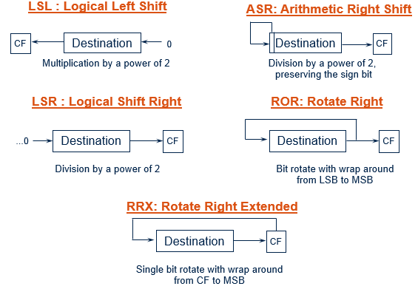
The Barrel Shifter
ARM doesn’t have actual shift instructions.
A barrel shifter provides a mechanism to carry out shifts as part of other instructions.

Slide 28
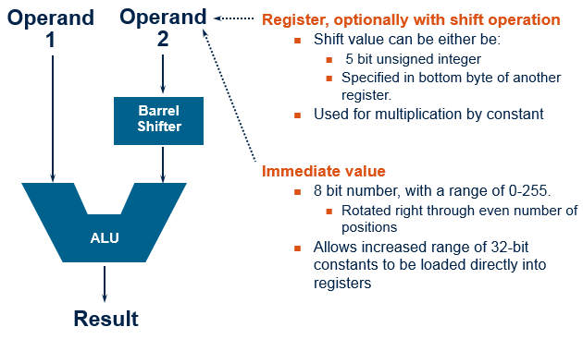
Using the Barrel Shifter: The Second Operand

Slide 29
Second Operand: Using a Shifted Register
Multiplication by constants can often be done by using some combination of MOVs, ADDs, SUBs and RSBs with shifts.
Multiplications by a constant equal to a ((power of 2) ± 1) can be done in one cycle.
Example: r0 = r1 * 5 Example: r0 = r1 + (r1 * 4)
ï ADD r0, r1, r1, LSL #2
Example: r2 = r3 * 105 Example: r2 = r3 * 15 * 7 Example: r2 = r3 * (16 - 1) * (8 - 1)
ï RSB r2, r3, r3, LSL #4 ; r2 = r3 * 15 ï RSB r2, r2, r2, LSL #3 ; r2 = r2 * 7

Slide 30
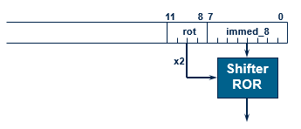
Second Operand: Immediate Value
No ARM instruction can contain a 32 bit immediate constant
All ARM instructions are fixed as 32 bits long
The data processing instruction format has 12 bits available for operand2
4 bit rotate value (0-15) is multiplied by two to give range 0-30 in steps of 2
Values that cannot be generated in this way will cause an error.

Slide 31
Second Operand: Immediate Value
This gives us:
0 - 255 [0 - 0xff]
256,260,264,..,1020 [0x100-0x3fc, step 4, 0x40-0xff ror 30]
1024,1040,1056,..,4080 [0x400-0xff0, step 16, 0x40-0xff ror 28]
4096,4160, 4224,..,16320 [0x1000-0x3fc0, step 64, 0x40-0xff ror 26]
These can be loaded using, for example:
MOV r0, #0x40, 26 ; => MOV r0, #0x1000 (i.e. 4096)
To make this easier, the assembler will convert to this form for us if simply given the required constant:
MOV r0, #4096 ; => MOV r0, #0x1000 (i.e. 0x40 ror 26)
The bitwise complements can also be formed using MVN: MOV r0, #0xFFFFFFFF; assembles to MVN r0, #0

Slide 32
Loading 32-bit Constants
To allow larger constants to be loaded, the assembler offers a pseudo-instruction: LDR rd, =const
This will either:
Produce a MOV or MVN instruction to generate the value (if possible).
Generate a LDR instruction with a PC-relative address to read the constant from a literal pool (Constant data area embedded in the code).
For example
LDR r0,=0xFF => MOV r0,#0xFF
LDR r0,=0x55555555 => LDR r0,[PC,#Imm12] … … DCD 0x55555555

Slide 33
Multiplication Instructions
The Basic ARM provides two multiplication instructions.
Multiply
MUL{<cond>}{S} Rd, Rm, Rs ; Rd = Rm * Rs
Multiply Accumulate - does addition for free
MLA{<cond>}{S} Rd, Rm, Rs, Rn ; Rd = (Rm * Rs) + Rn
Restrictions on use:
Rd and Rm cannot be the same register
Cannot use PC.
Operands can be considered signed or unsigned
Up to user to interpret correctly.

Slide 34
Load / Store Instructions
LDR STR Word
LDRB STRB Byte
LDRH STRH Halfword
LDRSB Signed byte load
LDRSH Signed halfword load
Syntax:
LDR{<size>} {<cond>} Rd, <address>
STR{<size>} {<cond>} Rd, <address>
All of these instructions can be conditionally executed by inserting the appropriate condition code after STR / LDR.
e.g. LDRBEQ

Slide 35
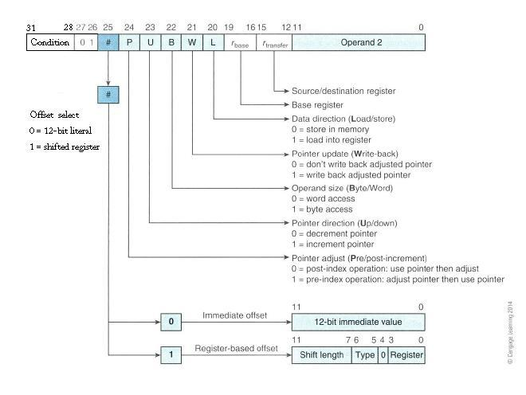
Encoding Format of LDR & STR

Slide 36
Address Accessed
Address accessed by LDR/STR is specified by a base register plus an offset
For word and unsigned byte accesses, offset can be
An unsigned 12-bit immediate value (i.e. 0 - 4095 bytes). LDR r0,[r1,#8]
A register, optionally shifted by an immediate value LDR r0,[r1,r2] LDR r0,[r1,r2,LSL#2]
Offset can be either added or subtracted from the base register: LDR r0,[r1,#-8] LDR r0,[r1,-r2] LDR r0,[r1,-r2,LSL#2]

Slide 37
Address Accessed
For halfword and signed halfword / byte, offset can be:
An unsigned 8 bit immediate value (i.e. 0-255 bytes).
A register (unshifted).
For all accesses, offset can be applied
before the transfer is made: Pre-indexed addressing
optionally auto-incrementing the base register, by postfixing the instruction with an ‘!’.
after the transfer is made: Post-indexed addressing
causing the base register to be auto-incremented.

Slide 38
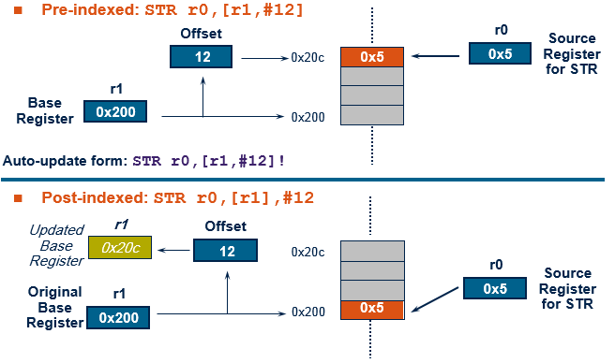
Pre- or Post-Indexed Addressing

Slide 39
ARM ADR Pseudo-Op
Cannot refer to an address directly in an instruction.
ADR pseudo-op generates instruction required to calculate address:
ADR r1,FOO
Generates value by performing arithmetic on PC.

Slide 40
Arithmetic Operations Example
C: x = (a + b) - c;
ARM Assembly:
ADR r4,a ; get address for a
LDR r0,[r4] ; get value of a
ADR r4,b ; get address for b, reusing r4
LDR r1,[r4] ; get value of b
ADD r3,r0,r1 ; compute a+b
ADR r4,c ; get address for c
LDR r2,[r4] ; get value of c
SUB r3,r3,r2 ; complete computation of x
ADR r4,x ; get address for x
STR r3,[r4] ; store value of x

Slide 41
Arithmetic Operations Example
C: y = a * (b + c);
ARM Assembly:
ADR r4,b ; get address for b
LDR r0,[r4] ; get value of b
ADR r4,c ; get address for c
LDR r1,[r4] ; get value of c
ADD r2,r0,r1 ; compute partial result
ADR r4,a ; get address for a
LDR r0,[r4] ; get value of a
MUL r2,r0,r2 ; compute final value for y
ADR r4,y ; get address for y
STR r2,[r4] ; store y

Slide 42
Logical Operations Example
C: z = (a << 2) | (b & 15);
ARM Assembly:
ADR r4,a ; get address for a
LDR r0,[r4] ; get value of a
MOV r0,r0,LSL 2 ; perform shift
ADR r4,b ; get address for b
LDR r1,[r4] ; get value of b
AND r1,r1,#15 ; perform AND
ORR r1,r0,r1 ; perform OR
ADR r4,z ; get address for z
STR r1,[r4] ; store value for z

Slide 43
ARM Branches and Subroutines
Branch: B{<cond>} label
PC relative: ±32 Mbyte range.
Branch with Link: BL{<cond>} sub_routine_label
Stores return address in LR
Returning implemented by restoring the PC from LR
MOV pc, lr

Slide 44
Control Flow: If Statement Example
C:
if (a > b) { x = 5; y = c + d; } else x = c - d;
ARM Assembly:
; compute and test condition
ADR r4,a ; get address for a
LDR r0,[r4] ; get value of a
ADR r4,b ; get address for b
LDR r1,[r4] ; get value for b
CMP r0,r1 ; compare a > b
BLE fblock ; if a <= b, branch to false block

Slide 45
Control Flow: If Statement Example
; true block
MOV r0,#5 ; generate value for x
ADR r4,x ; get address for x
STR r0,[r4] ; store x
ADR r4,c ; get address for c
LDR r0,[r4] ; get value of c
ADR r4,d ; get address for d
LDR r1,[r4] ; get value of d
ADD r0,r0,r1 ; compute y
ADR r4,y ; get address for y
STR r0,[r4] ; store y
B after ; branch around false block

Slide 46
Control Flow: If Statement Example
; false block
Fblock ADR r4,c ; get address for c
LDR r0,[r4] ; get value of c
ADR r4,d ; get address for d
LDR r1,[r4] ; get value for d
SUB r0,r0,r1 ; compute c-d
ADR r4,x ; get address for x
STR r0,[r4] ; store value of x
after ...

Slide 47
Control Flow: Switch Statement
C:
switch (test) { case 0: … break; case 1: … }
ARM Assembly:
ADR r2,test ; get address for test
LDR r0,[r2] ; load value for test
ADR r1,switchtab ; load address for switch table
LDR r1,[r1,r0,LSL #2] ; index switch table
MOV pc, r1
switchtab DCD case0
DCD case1
...

Slide 48
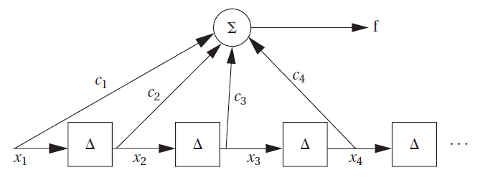
Control Flow: For Loop
C:
for (i=0, f=0; i<N; i++)
f = f + c[i]*x[i];
ARM Assembly:
; loop initiation code
MOV r0,#0 ; use r0 for i
MOV r8,#0 ; use separate index for arrays
ADR r2,N ; get address for N
LDR r1,[r2] ; get value of N
MOV r2,#0 ; use r2 for f
FIR FILTER

Slide 49
Control Flow: For Loop
ADR r3,c ; load r3 with base of c
ADR r5,x ; load r5 with base of x
; loop body
loop LDR r4,[r3,r8] ; get c[i]
LDR r6,[r5,r8] ; get x[i]
MUL r4,r6,r4 ; compute c[i]*x[i]
ADD r2,r2,r4 ; add into running sum
ADD r8,r8,#4 ; add one word offset to array index
ADD r0,r0,#1 ; add 1 to i
CMP r0,r1 ; exit?
BLT loop ; if i < N, continue

Slide 50
Examples of Conditional Execution
Use a sequence of several conditional instructions
if (a==0) func(1);
CMP r0,#0 MOVEQ r0,#1 BLEQ func
Set the flags, then use various condition codes
if (a==0) x=0; if (a>0) x=1;
CMP r0,#0 MOVEQ r1,#0 MOVGT r1,#1
Use conditional compare instructions
if (a==4 || a==10) x=0;
CMP r0,#4 CMPNE r0,#10 MOVEQ r1,#0

Slide 51
Block Data Transfer
The Load and Store Multiple instructions (LDM / STM) allow between 1 and 16 registers to be transferred to or from memory.
Base register used to determine where memory access should occur.
4 different addressing modes allow increment and decrement of the base register before or after the memory access.
The base register can be incremented or decremented by one word for each register in the operation.
Base register can be optionally updated following the transfer by appending it with an ‘!’.
Lowest register number is always transferred to/from lowest memory location accessed.

Slide 52
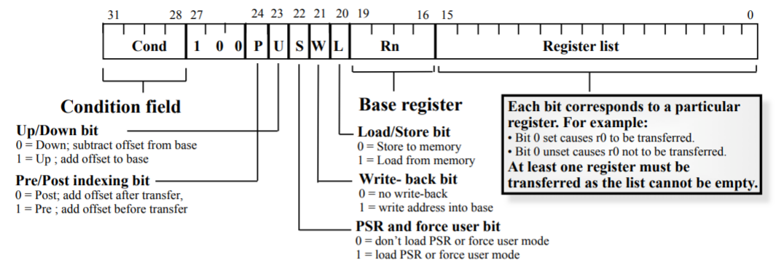
Block Data Transfer
These instructions are efficient for:
Saving and restoring context (stack)
Moving large blocks of data around memory

Slide 53
Stack
A stack is an area of memory which grows as new data is “pushed” onto the “top” of it, and shrinks as data is “popped” off the top.
Two pointers define the current limits of the stack.
A base pointer
used to point to the “bottom” of the stack (the first location).
A stack pointer
used to point the current “top” of the stack.

Slide 54
Stack Operation
Traditionally, a stack grows down in memory, with the last “pushed” value at the lowest address.
ARM also supports ascending stacks, where the stack structure grows up through memory.
The value of the stack pointer can either:
Point to the last occupied address (Full Stack)
and so needs pre-decrementing (i.e. before the push)
Point to the next occupied address (Empty Stack)
and so needs post-decrementing (i.e. after the push)

Slide 55
Stack Operation
The stack type to be used is given by the postfix to the instruction:
STMFD / LDMFD : Full Descending stack
STMFA / LDMFA : Full Ascending stack.
STMED / LDMED : Empty Descending stack
STMEA / LDMEA : Empty Ascending stack

Slide 56
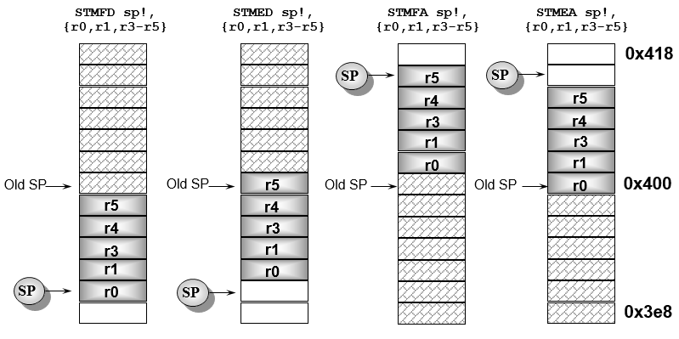
Stack Examples

Slide 57
Function Calls
Branch-and-link instruction: BL
Uses r14 (lr) to store the current PC
Procedure call stack
Allows nested function calls
Allows passing of parameters and return values
Structure is left to the programmer
Compilers use frames
Also store local variables
Stack pointer (sp) and frame pointer (fp)

Slide 58
ARM Procedure Call Standard(APCS)
r0 – r3: first 4 parameters
Additional parameters use the stack frame
r0: return value
r4 – r7: register variables
r11: frame pointer (fp)
r12: intra procedure (ip) scratch register
r13: stack pointer (sp)
r10: stack size

Slide 59
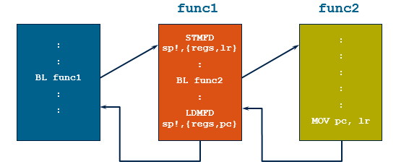
Stacks and Subroutines
Any registers needed can be pushed onto the stack at start of subroutine and popped off again at end so as to restore them before return to the caller:
STMFD sp!,{r0-r12, lr} ; stack all registers
........ ; and the return address
LDMFD sp!,{r0-r12, pc} ; load all the registers
; and return automatically

Slide 60
PICmicro PIC16F Instruction Set
8-bit word size, 14-bit instructions
Harvard architecture
Instruction flash memory up to 8192 (i.e., 8K) words
13-bit PC
Data memory includes up to
368 words SRAM
256 bytes EEPROM
Low-power features:
Sleep mode
Support for multiple clocks

Slide 61
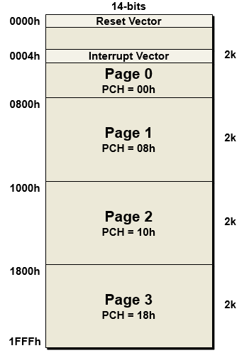
Instruction Memory Organization
Program memory is divided into four 2k×14 pages
Interrupt vectors in bottom of memory
PC can be loaded from 8-level stack.
Separate from program and data memory.
Stack operates as a circular buffer

Slide 62
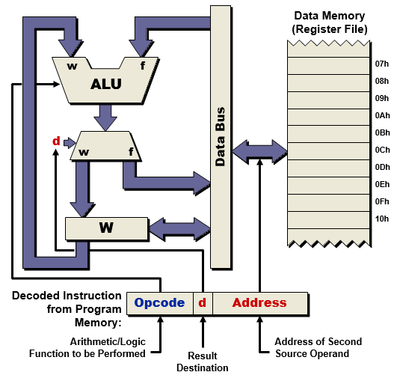
Register File Concept
All of data memory is part of the register file, so any location in data memory may be operated on directly
All peripherals are mapped into data memory as a series of registers
W is working register

Slide 63
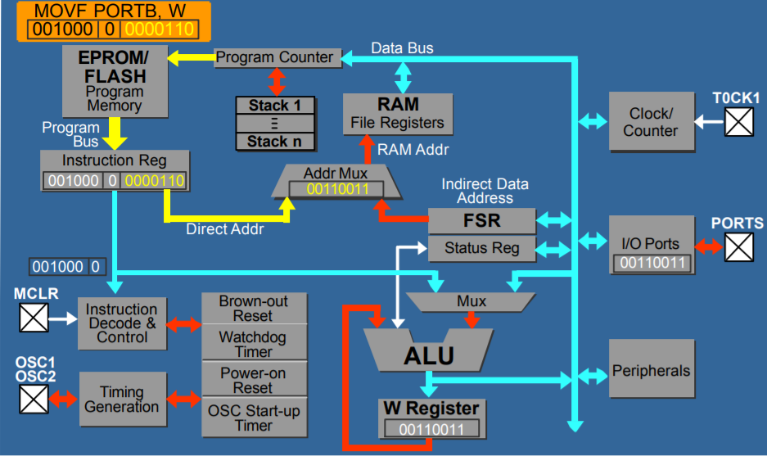
Architecture Block Diagram

Slide 64
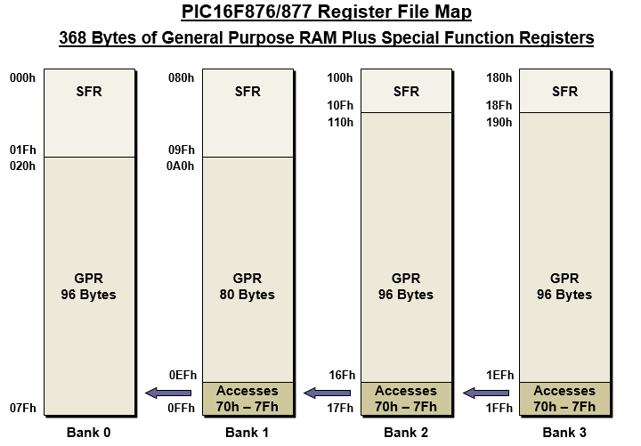
Data Memory Organization

Slide 65
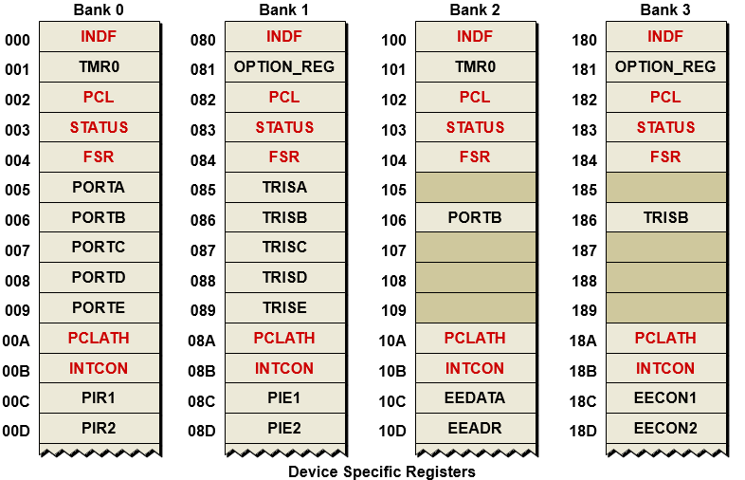
Data Memory Organization

Slide 66
Status Register
IRP: Register Bank Select (used for Indirect addressing)
0 = Bank 0, 1 1 = Bank 2, 3
RP1:RP0: Register Bank Select Bits (used for direct addressing)
00 = Bank 0, 01 = Bank 1, 10 = Bank 2, 11 = Bank 3
TO: Time-out bit
0 = A WDT time-out occurred
PD: Power-down bit
0 = SLEEP instruction executed
Z: Zero bit
1 = Result of arithmetic operation is zero
DC: Digit cary / borrow bit
1 = Carry out of 4th low order bit occurred / No borrow occurred
C: Carry / borrow bit
1 = Carry out of MSb occurred / No borrow occurred

Slide 67
Program Counter
13-bit PC can access up to 2¹³ = 8192 words
Contains address of NEXT instruction
Lower byte accessible in data memory as PCL
Upper byte indirectly accessible via PCLATH
Runs freely across page boundaries
PCL register can be used as an operand in instructions

Slide 68
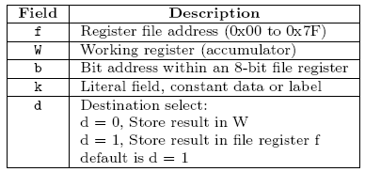
PIC Instruction Set – Description Convention

Slide 69
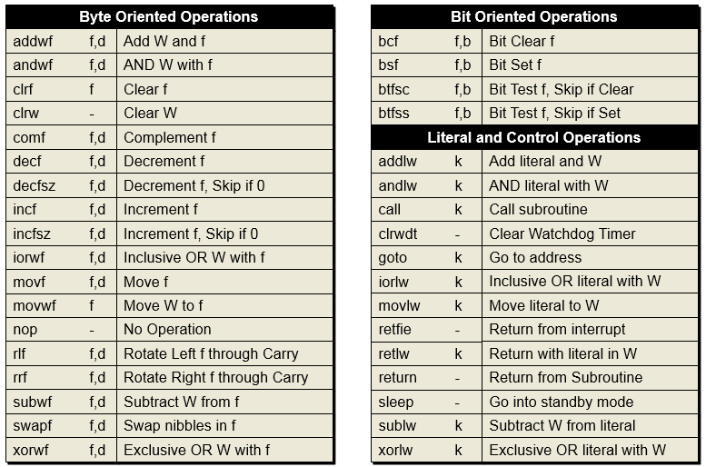
PIC16 Instruction Set

Slide 70
Instruction Set Overview

Slide 71
Instruction Set Overview

Slide 72
Instruction Set Overview

Slide 73
PIC16 Addressing Modes
Data Memory Access
Direct addwf <data_address>, <d>
Indirect addwf INDF, <d>
Immediate (Literal) movlw <constant>
Indirect addressing controlled by INDF and FSR (File Select Register) registers
Access to INDF causes indirect load through FSR
Program Memory Access
Absolute goto <program_address>
Relative addwf PCL,f

Slide 74
Data Memory: Direct Addressing

Slide 75
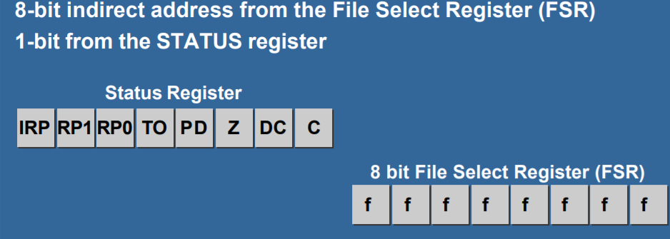
Data Memory: Indirect Addressing
8 bits from FSR + 1 bit from IRP = 9 bits
Effective 2⁹ = 512 memory locations

Slide 76
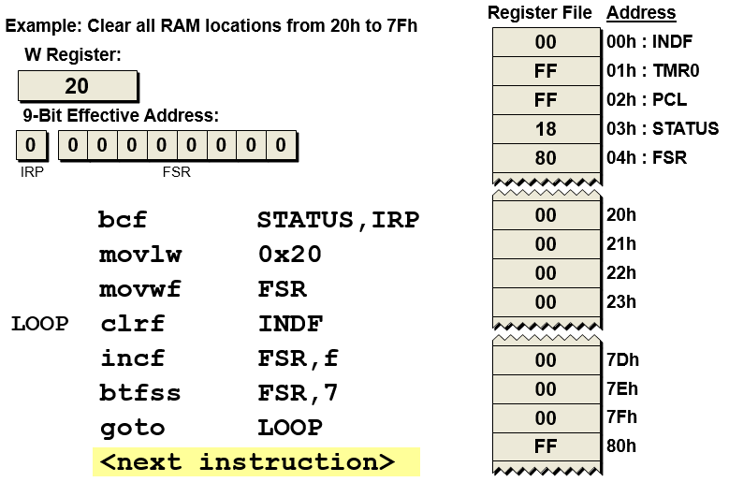
Register Indirect Addressing

Slide 77
Control Flow Instructions
GOTO: Unconditional branch
INCFSZ: Increment f, skip if 0
DECFSZ: Decrement f, skip if 0
BTFSC: Bit test f, skip if clear
BTFSS: Bit test f, skip if set
CALL: Call subroutine
RETURN: Return from subroutine
RETLW: Return with literal in W
RETFIE: Return from interrupt
SLEEP: Go into standby mode

Slide 78
PC Absolute Addressing
CALL and GOTO Instructions
PC Absolute Addressing (Program Memory)
Jump to another program memory location out of PC sequence
Call a subroutine
Used by the CALL and GOTO instructions
11 bits of the required 13 address bits are encoded in the instruction
2 additional bits will come from the PCLATH register
Used when performing Computed Goto operation
Address to jump to is calculated by the program
Computed address is written directly into the Program Counter

Slide 79
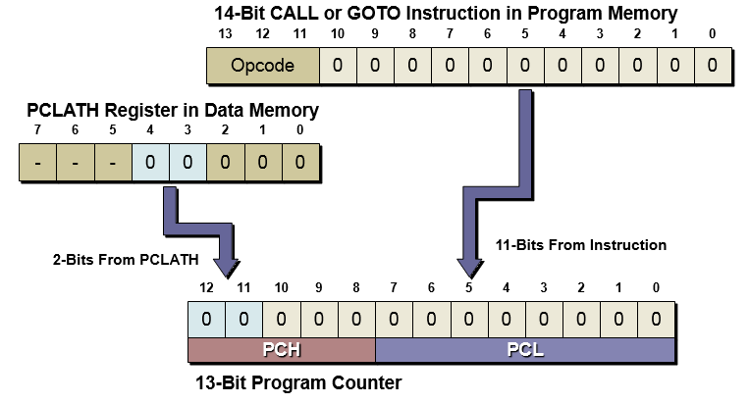
PC Absolute Addressing

Slide 80
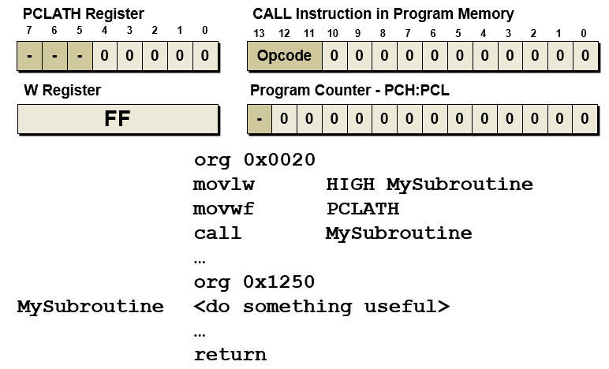
PC Absolute Addressing

Slide 81
PC Relative Addressing

Slide 82
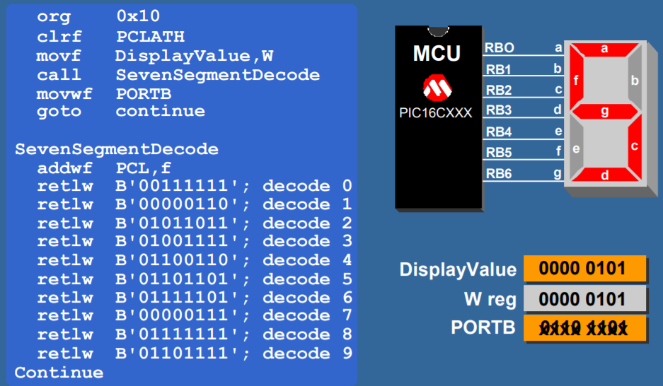
PC Relative Addressing: Lookup Table
Note: After fetching an instruction PCL gets incremented by 1.

Slide 83
TI C55X Organization
Relatively high-performance digital signal processor
Accumulator architecture
Word: 16-bit, Longword: 32-bit
Some instructions are bit-addressable
Most registers are special-purpose
Most registers are memory-mapped
Can be accessed by name or address
Can execute two instructions in parallel
Has a variable length instruction set (8-16-24-32-40-64 bits)

Slide 84
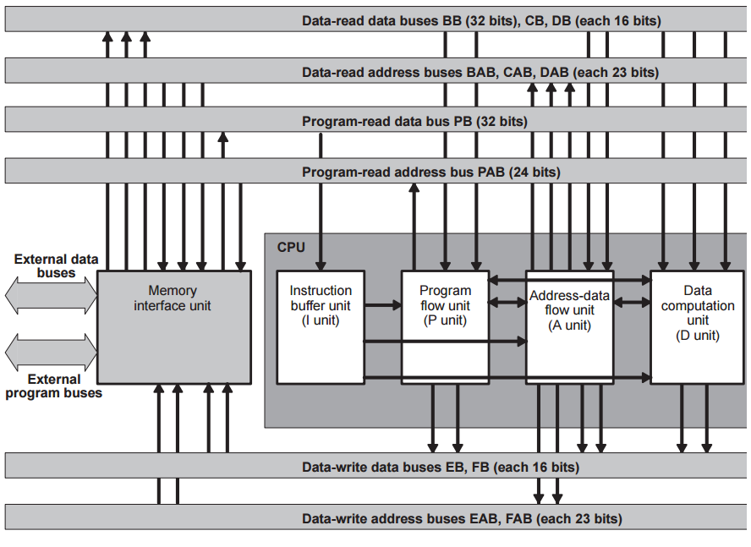
TI C55x Microarchitecture

Slide 85
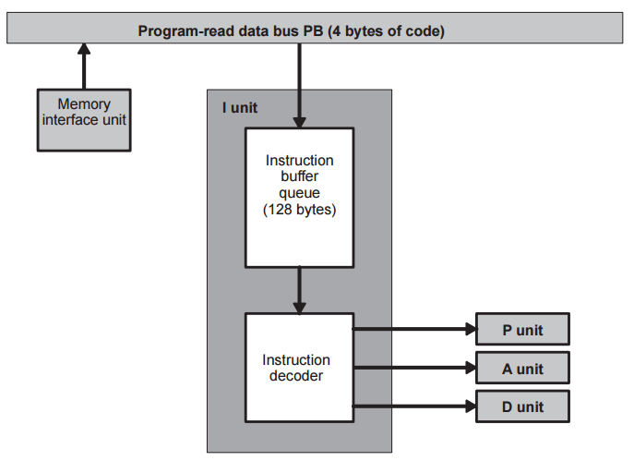
Instruction Buffer Unit (I Unit)
Receives program code into its instruction buffer queue and decodes instructions
Passes data to the P unit, the A unit, and the D unit for the execution of instructions
The CPU fetches 32 bits at a time from program memory
8 bytes are transferred from the queue to the instruction decoder

Slide 86
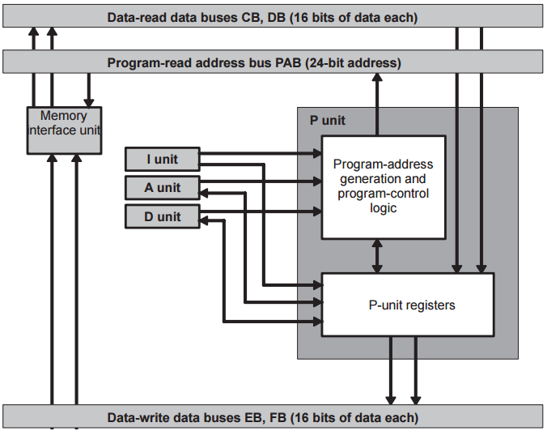
Program Flow Unit (P Unit)
The program-address generation logic is responsible for generating 24-bit addresses for fetches from program memory
The program control logic performs the following actions:
Tests whether a condition is true for a conditional instruction
Initiates interrupt servicing
Controls execution of repetition instructions
Manages instructions that are executed in parallel.

Slide 87
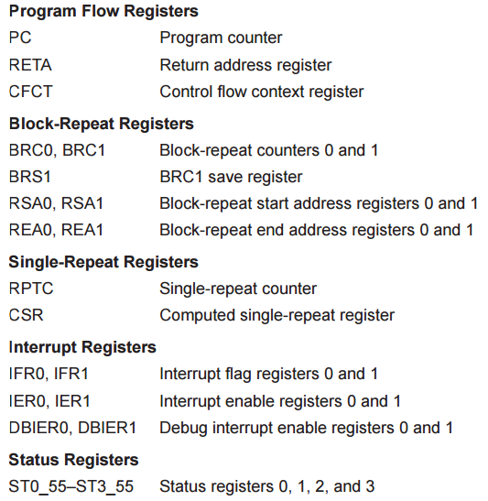
P-Unit Registers

Slide 88
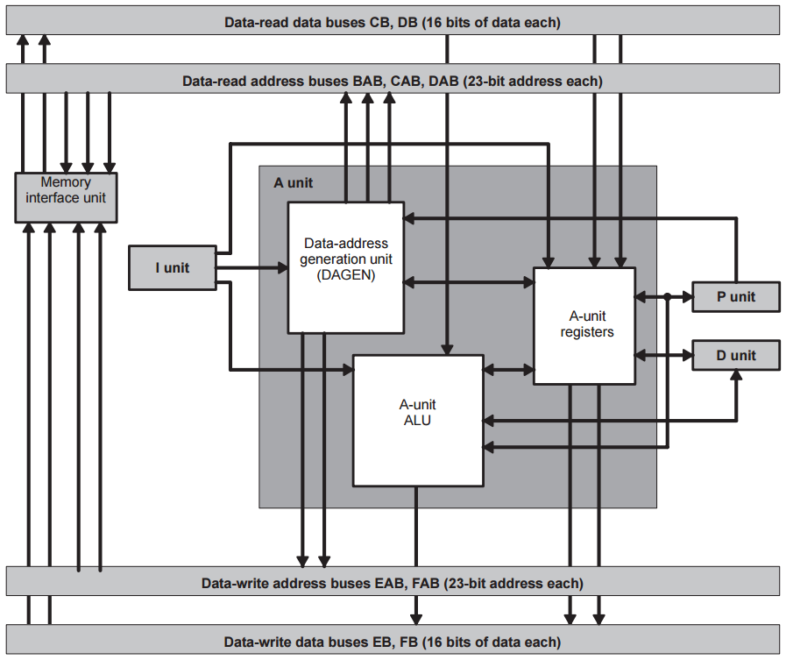
Address-Data Flow Unit (A Unit)
Data-Address Generation Unit (DAGEN)
generates all addresses for reads from or writes to data space and I/O space
A-Unit Arithmetic Logic Unit (A-Unit ALU)
Performs additions, subtractions, comparisons, Boolean logic operations, signed shifts, logical shifts, and absolute value calculations

Slide 89
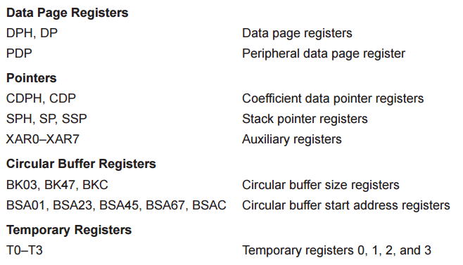
A-Unit Registers

Slide 90
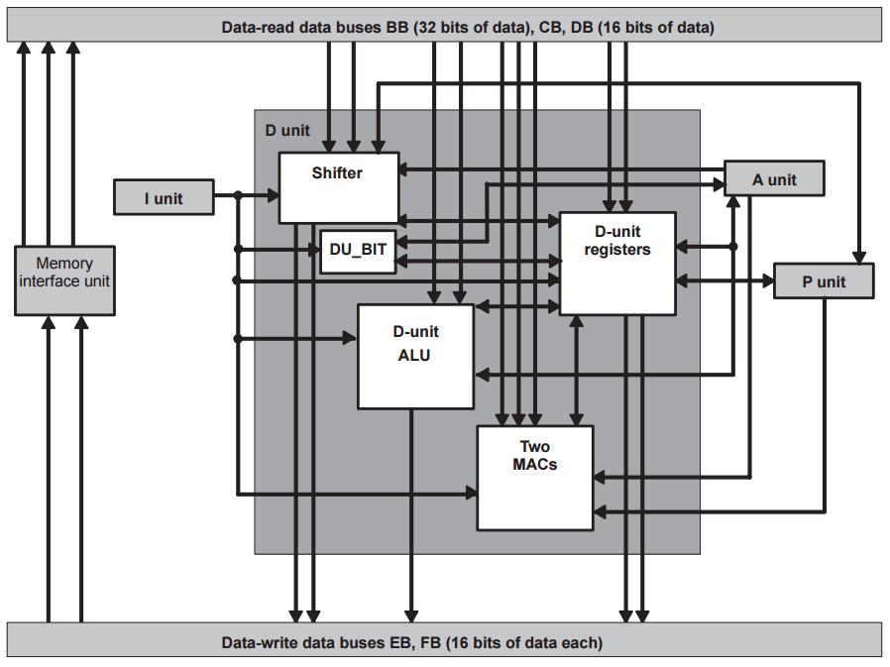
Data Computation Unit (D Unit)
40-bit shifter
40-bit ALU
Two Multiply-and-Accumulate Units (MACs)
each MAC can perform a 17-bit ×17-bit multiplication (fractional or integer) and a 40-bit addition or subtraction with optional 32-/40-bit saturation
D-Unit Bit Manipulation Unit (D-Unit BIT)
Extracts and expands bit fields, and performs bit counting

Slide 91
D-Unit Registers
Accumulators
AC0–AC3 40-bit Accumulators 0, 1, 2, and 3
AC0L: low-order bits 0 – 15
AC0H: high-order bits 16 – 31
AC0G: guard bits 32-39
Increase the range for intermediate calculations
Transition Registers
TRN0, TRN1 16-bit Transition registers 0 and 1

Slide 92
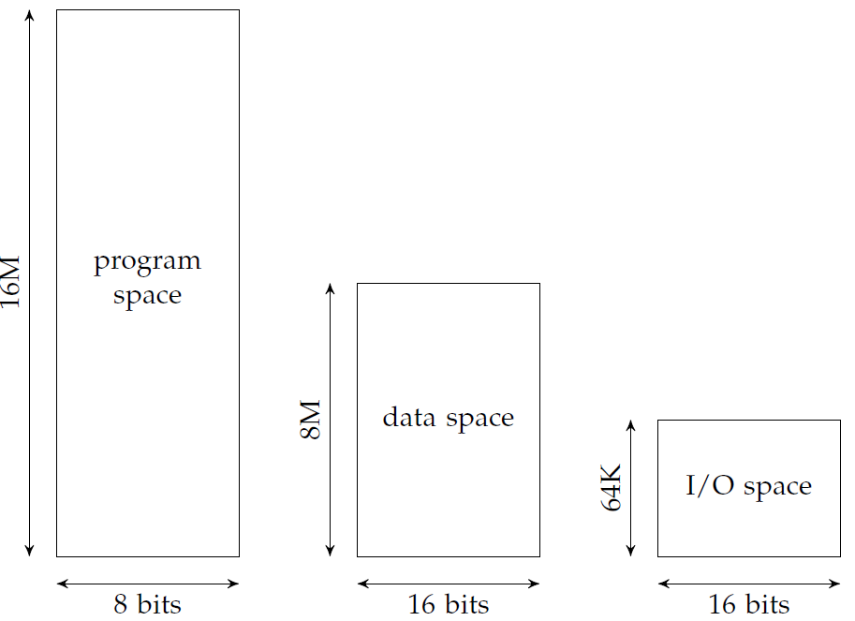
Memory Organization

Slide 93
Memory Organization
24-bit address space
Data, program, and I/O spaces are mapped to the same physical memory
Program space: byte-addressable, 24-bit addresses
Data space: word-addressable
I/O space: 64K words
Data space: 128 pages of 64K words each
Partial on-chip memory
First 96 words of data page 0 & First 192 words of program space
Memory-mapped registers

Slide 94
C55x Addressing Modes
Three addressing modes:
Absolute addressing supplies an address in an instruction.
Direct addressing supplies an offset.
Indirect addressing uses a register as a pointer.
Absolute Addressing
k16: 16-bit + DPH register = 23-bit absolute address
k23: 23-bit unsigned value
I/O absolute address: 16-bit unsigned value, e.g. port(#1234)

Slide 95
Direct Addressing Modes
DP direct
Uses an offset relative to data page register (DP) to access a memory location; A_{DP} = DPH[22:15](DP+Doffset)
SP direct
Uses an offset relative to data stack pointer (SP) to access stack values in data memory; A_{SP} = SPH[22:15](SP+Soffset)
Register-bit direct
Uses an offset from LSB to specify a bit address, used to access one register bit or two adjacent register bits
PDP direct
Uses an offset relative to peripheral data page register (PDP) to specify an I/O address; A_{PDP} = PDP[15:6]PDPoffset

Slide 96
Indirect Addressing Modes
AR indirect addressing: uses one of eight auxiliary registers (AR0–AR7) to point to data
Dual AR indirect addressing: similar to AR indirect mode; used with an instruction that accesses two or more data-memory locations at the same time
CDP indirect addressing: uses the coefficient data pointer (CDP) to point to coefficient data
Coefficient indirect addressing: similar to CDP indirect mode; used for instructions that can access a coefficient in data memory at the same time they access two other data-memory values using the dual AR indirect addressing mode

Slide 97
C55x Data Instructions Examples
MOV src, dst register/memory →register/memory
ADD src, dst dst = dst + src
ADD dual(Lmem),ACx,ACy
LO(ACy) = LO(Lmem) + LO(ACx)
HI(ACy) = HI(Lmem) + HI(ACx)
MPY src, dst Integer multiplication of 16-bit values
MAC ACx, Tx, ACy
ACy = ACy + (ACx * Tx)
CMP src == dst, TC1
Compare and set a test control flag TC1 in ST0_55 register

Slide 98
Control Flow Instructions
Unconditional branch
B ACx
B label
Conditional branch
BCC label, cond
Examples of cond
ACx <= #0; content is less than or equal to 0
!overflow(ACx) ACOVx bit is cleared to 0
ARx != #0 content is not equal to 0
CARRY; CARRY bit is set to 1
TC1 ^ TC2; TC1 XOR TC2 is equal to 1

Slide 99
Loops and Procedure Calls
Loops
Single-instruction repeat registers: RPTC, CSR
Block-repeat registers: BRC0, RSA0, REA0, BRC1, . . .
2 levels of block-repeat
Procedures:
CALL target: Unconditional procedure call. Uses the stack
CALLCC addr, cond: Conditional procedure call
Fast-return vs. slow-return

Slide 100
TI 64X DSP
High-performance VLIW DSP.
Up to eight instructions per cycle
Divided into two data paths A and B
Floating-point and integer arithmetic
Harvard architecture
Load/store architecture
Separate data and program on-chip memories
Combined external memory
Instruction grouping: fetch packet and execute packet

Slide 101
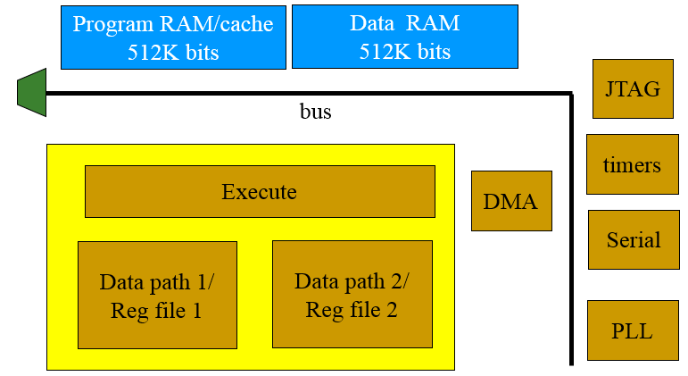
C64x Block Diagram
Execution divided between two data paths
Each data path has its own register file and 4 different functional units

Slide 102
Function units
.L1 and .L2 perform 32/40-bit arithmetic, 32-bit logical, data packing/unpacking.
.S1 and .S2 perform 32-bit arithmetic, 32/40-bit shift and bit-field ops, 32-bit logical ops, branches, etc.
.M1 and .M2 perform multiplications, bit interleaving, rotation, Galois field multiplication, etc.
.D1 and .D2 perform address calculations, loads/stores, etc.

Slide 103
TI C64X VLIW Organization
Fetch packet:
A group of instructions fetched together
8 words, aligned on 256-bit boundaries
Up to 14 instructions per fetch packet
Execute packet:
A group of instructions that execute together
Up to 8 instructions, if they use different functional units
A fetch packet may result in multiple execute packets

Slide 104
Summary
Both the von Neumann and Harvard architectures are in common use today
ARM is a load-store architecture. It provides a few relatively complex instructions, such as saving and restoring multiple registers
The PIC16F is a very small, efficient microcontroller
The C55x provides a number of architectural features to support the arithmetic loops that are common on digital signal processing code
The C64x organizes instructions into execution packets to enable parallel execution

