Slide 1
Introduction
COE 301 Computer Organization
Prof. Aiman El-Maleh
College of Computer Sciences and Engineering
King Fahd University of Petroleum and Minerals
[Adapted from slides of Dr. M. Mudawar, COE 301, KFUPM]

Slide 2
Next . . .
High-Level, Assembly-, and Machine-Languages
Components of a Computer System
Technology Improvements
Programmer’s View of a Computer System

Slide 3
Some Important Questions to Ask
What is Assembly Language?
What is Machine Language?
How is Assembly related to a high-level language?
Why Learn Assembly Language?
What is an Assembler, Linker, and Debugger?

Slide 4
A Hierarchy of Languages
Application Programs
High-Level Languages
Machine independent
High-Level Language
Machine specific
Low-Level Language
Assembly Language
Machine Language
Hardware

Slide 5
Assembly and Machine Language
Machine language
Native to a processor: executed directly by hardware
Instructions consist of binary code: 1s and 0s
Assembly language
Slightly higher-level language
Readability of instructions is better than machine language
One-to-one correspondence with machine language instructions
Assemblers translate assembly to machine code
Compilers translate high-level programs to machine code
Either directly, or
Indirectly via an assembler

Slide 6
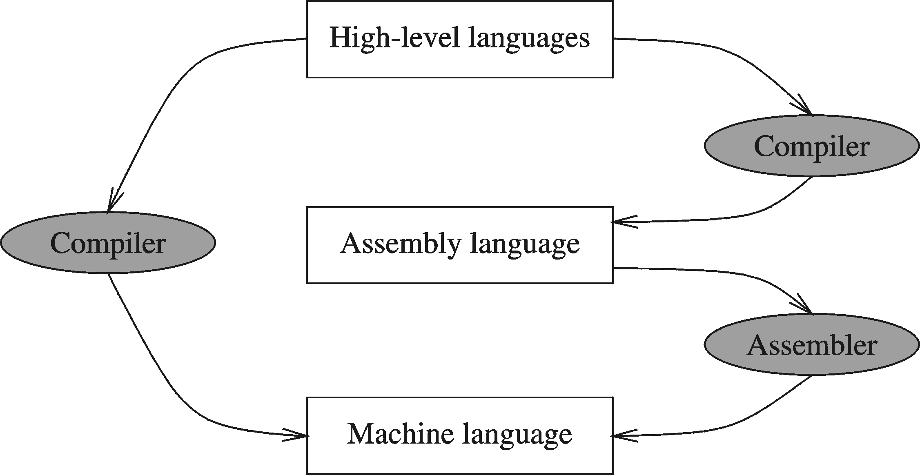
Compiler and Assembler

Slide 7
Instructions and Machine Language
Each command of a program is called an instruction (it instructs the computer what to do).
Computers only deal with binary data, hence the instructions must be in binary format (0s and 1s) .
The set of all instructions (in binary form) makes up the computer's machine language. This is also referred to as the instruction set.

Slide 8
Instruction Fields
Machine language instructions usually are made up of several fields. Each field specifies different information for the computer. The major two fields are:
Opcode field which stands for operation code and it specifies the particular operation that is to be performed.
Each operation has its unique opcode.
Operands fields which specify where to get the source and destination operands for the operation specified by the opcode.
The source/destination of operands can be a constant, the memory or one of the general-purpose registers.

Slide 9
Translating Languages
Program (C Language):
swap(int v[], int k) {
int temp;
temp = v[k];
v[k] = v[k+1];
v[k+1] = temp;
}
A statement in a high-level language is translated typically into several machine-level instructions
Compiler
MIPS Assembly Language:
sll $2,$5, 2
add $2,$4,$2
lw $15,0($2)
lw $16,4($2)
sw $16,0($2)
sw $15,4($2)
jr $31
MIPS Machine Language:
00051080
00821020
8C620000
8CF20004
ACF20000
AC620004
03E00008
Assembler

Slide 10
Advantages of High-Level Languages
Program development is faster
High-level statements: fewer instructions to code
Program maintenance is easier
For the same above reasons
Programs are portable
Contain few machine-dependent details
Can be used with little or no modifications on different machines
Compiler translates to the target machine language
However, Assembly language programs are not portable

Slide 11
Why Learn Assembly Language?
Many reasons:
Accessibility to system hardware
Space and time efficiency
Accessibility to system hardware
Assembly Language is useful for implementing system software
Also useful for small embedded system applications
Space and Time efficiency
Understanding sources of program inefficiency
Tuning program performance
Writing compact code

Slide 12
Assembly Language Programming Tools
Editor
Allows you to create and edit assembly language source files
Assembler
Converts assembly language programs into object files
Object files contain the machine instructions
Linker
Combines object files created by the assembler with link libraries
Produces a single executable program
Debugger
Allows you to trace the execution of a program
Allows you to view machine instructions, memory, and registers

Slide 13
Assemble and Link Process
Source
File
Assembler
Object
File
Source
File
Assembler
Object
File
Linker
Executable
File
Source
File
Assembler
Object
File
Link
Libraries
A project may consist of multiple source files
Assembler translates each source file separately into an object file
Linker links all object files together with link libraries

Slide 14
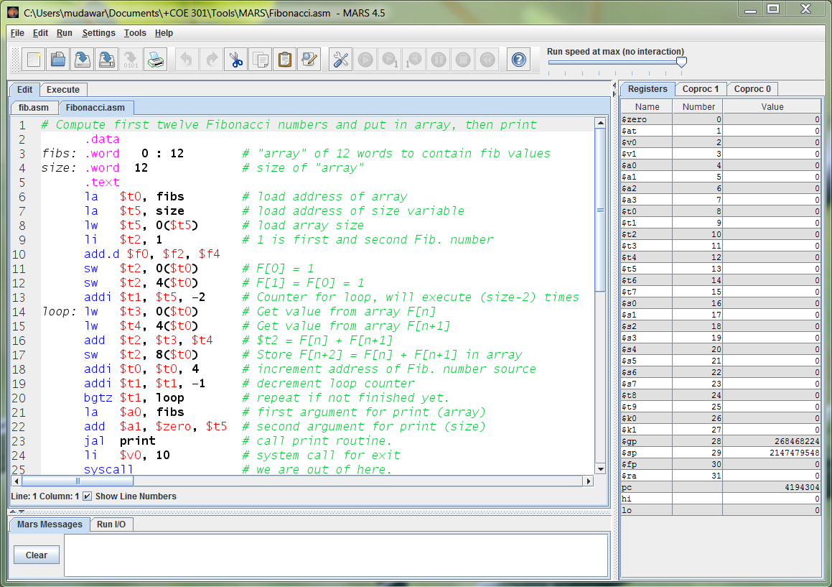
MARS Assembler and Simulator Tool

Slide 15
MARS Assembler and Simulator Tool
Simulates the execution of a MIPS program
No direct execution on the underlying Intel processor
Editor with color-coded assembly syntax
Assembler
Converts MIPS assembly language programs into object files
Debugger
Allows you to trace the execution of a program and set breakpoints
Allows you to view machine instructions, edit registers and memory

Slide 16
Next . . .
High-Level, Assembly-, and Machine-Languages
Components of a Computer System
Technology Improvements
Programmer’s View of a Computer System

Slide 17
Components of a Computer System
Processor
Datapath
Control
Memory & Storage
Main Memory
Disk Storage
Input devices
Output devices
Bus: Interconnects processor to memory and I/O
Network: newly added component for communication
Computer
Memory
I/O Devices
Control
Input
BUS
Processor
Output
Datapath
Disk
Network

Slide 18
Memory
Ordered sequence of bytes
The sequence number is called the memory address
Byte addressable memory
Each byte has a unique address
Supported by almost all processors
Physical address space
Determined by the address bus width
Pentium has a 32-bit address bus
Physical address space = 4GB = 2³² bytes
Itanium with a 64-bit address bus can support
Up to 2⁶⁴ bytes of physical address space

Slide 19
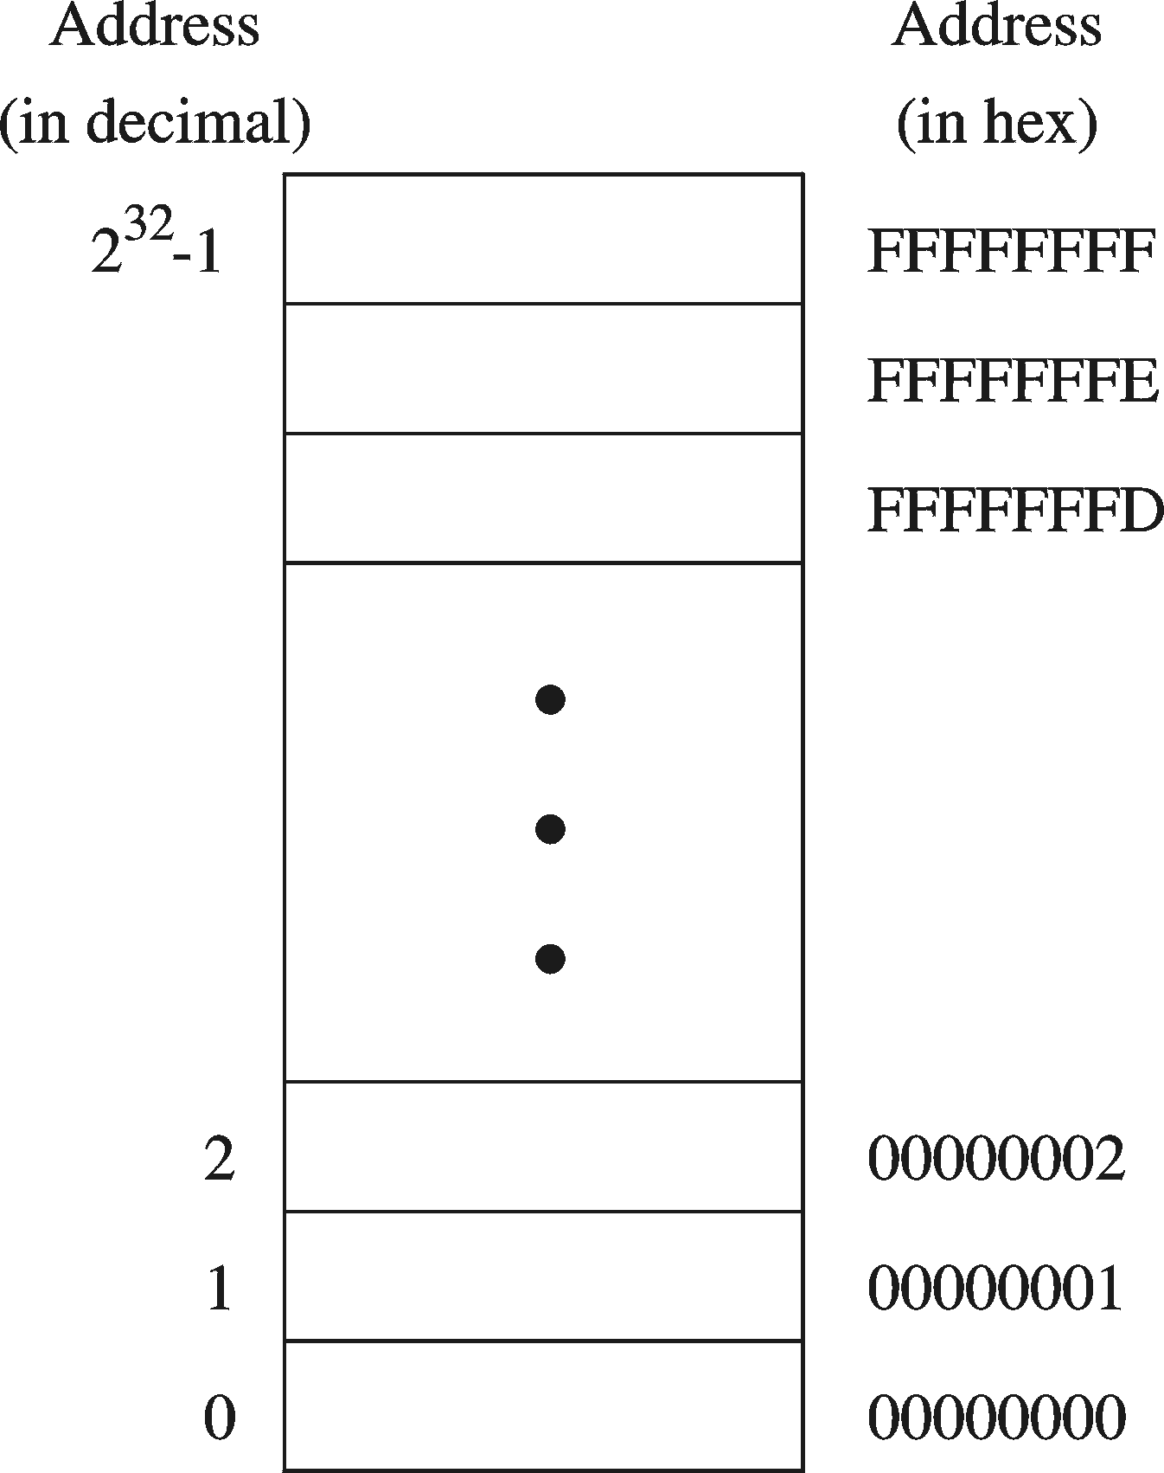
Address Space
Address Space is the set of memory locations (bytes) that can be addressed

Slide 20
Address, Data, and Control Bus
Address Bus
Memory address is put on address bus
If memory address = a bits then 2ª locations are addressed
Data Bus: bi-directional bus
Data can be transferred in both directions on the data bus
Control Bus
Signals control
transfer of data
Read request
Write request
Done transfer
Processor
Memory
address bus
0
Address Register
a bits
1
data bus
2
Data Register
d bits
3
read
. . .
Bus Control
write
done
2ª – 1

Slide 21
Memory Devices
Volatile Memory Devices
Data is lost when device is powered off
RAM = Random Access Memory
DRAM = Dynamic RAM
1-Transistor cell + trench capacitor
Dense but slow, must be refreshed
Typical choice for main memory
SRAM: Static RAM
6-Transistor cell, faster but less dense than DRAM
Typical choice for cache memory
Non-Volatile Memory Devices
Stores information permanently
ROM = Read Only Memory
Used to store the information required to startup the computer
Many types: ROM, EPROM, EEPROM, and FLASH
FLASH memory can be erased electrically in blocks

Slide 22
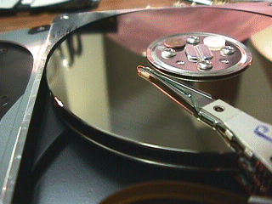
Magnetic Disk Storage
A Magnetic disk consists of a collection of platters
Provides a number of recording surfaces
Read/write head
Actuator
Arm provides read/write heads for all surfaces
The disk heads are connected together and move in conjunction
Recording area
Track 2
Track 1
Track 0
Arm
Direction of rotation
Platter
Spindle

Slide 23
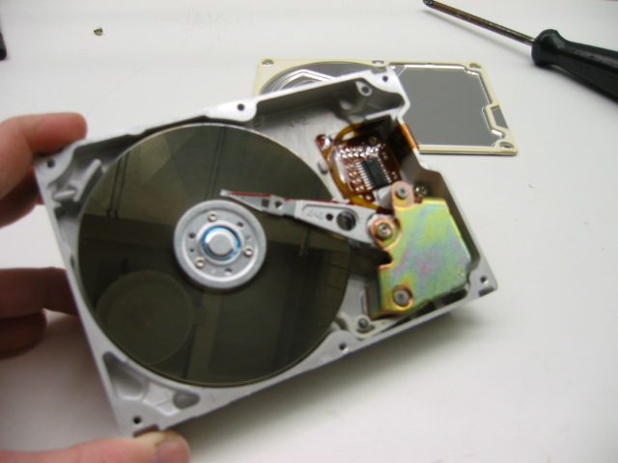
Magnetic Disk Storage
Disk Access Time =
Seek Time +
Rotation Latency +
Transfer Time
Sector
Read/write head
Actuator
Recording area
Seek Time: head movement to the desired track (milliseconds)
Rotation Latency: disk rotation until desired sector arrives under the head
Transfer Time: to transfer data
Track 2
Track 1
Track 0
Arm
Direction of rotation
Platter
Spindle

Slide 24
Example on Disk Access Time
Given a magnetic disk with the following properties
Rotation speed = 7200 RPM (rotations per minute)
Average seek = 8 ms, Sector = 512 bytes, Track = 200 sectors
Calculate
Time of one rotation (in milliseconds)
Average time to access a block of 32 consecutive sectors
Answer
Rotations per second
Rotation time in milliseconds
Average rotational latency
Time to transfer 32 sectors
Average access time
= 7200/60 = 120 RPS
= 1000/120 = 8.33 ms
= time of half rotation = 4.17 ms
= (32/200) * 8.33 = 1.33 ms
= 8 + 4.17 + 1.33 = 13.5 ms

Slide 25
Processor-Memory Performance Gap
CPU: 55% per year
1000
“Moore’s Law”
100
Processor-Memory
Performance Gap: (grows 50% per year)
Performance
10
DRAM: 7% per year
1
1981
1982
1983
1984
1985
1986
1987
1988
1989
1990
1991
1992
1993
1994
1995
1996
1997
1998
1980
1999
2000
1980 – No cache in microprocessor
1995 – Two-level cache on microprocessor

Slide 26
The Need for a Memory Hierarchy
Widening speed gap between CPU and main memory
Processor operation takes less than 1 ns
Main memory requires more than 50 ns to access
Each instruction involves at least one memory access
One memory access to fetch the instruction
A second memory access for load and store instructions
Memory bandwidth limits the instruction execution rate
Cache memory can help bridge the CPU-memory gap
Cache memory is small in size but fast

Slide 27
Typical Memory Hierarchy
Registers are at the top of the hierarchy
Typical size < 1 KB
Access time < 0.5 ns
Level 1 Cache (8 – 64 KB)
Access time: 0.5 – 1 ns
L2 Cache (64 KB – 8 MB)
Access time: 2 – 10 ns
Main Memory (1 – 64 GB)
Access time: 50 – 70 ns
Disk Storage (> 200 GB)
Access time: milliseconds
Microprocessor
Registers
L1 Cache
L2 Cache
Faster
Memory Bus
Bigger
Memory
I/O Bus
Disk, Tape, etc

Slide 28
Processor
Datapath: part of a processor that executes instructions
Control: generates control signals for each instruction
Next Program
Counter
Instruction
Cache
Registers
Data
Cache
A
L
U
Program Counter
Instruction
Control

Slide 29
Datapath Components
Program Counter (PC)
Contains address of instruction to be fetched
Next Program Counter: computes address of next instruction
Instruction Register (IR)
Stores the fetched instruction
Instruction and Data Caches
Small and fast memory containing most recent instructions/data
Register File
General-purpose registers used for intermediate computations
ALU = Arithmetic and Logic Unit
Executes arithmetic and logic instructions
Buses
Used to wire and interconnect the various components

Slide 30
Fetch - Execute Cycle
Instruction Fetch
Fetch instruction
Compute address of next instruction
Instruction Decode
Generate control signals for instruction
Read operands from registers
Execute
Compute result value
Infinite Cycle implemented in Hardware
Memory Access
Read or write memory (load/store)
Writeback Result
Writeback result in a register

Slide 31
Next . . .
Assembly-, Machine-, and High-Level Languages
Components of a Computer System
Technology Improvements
Programmer’s View of a Computer System

Slide 32
Technology Improvements
Vacuum tube → transistor → IC → VLSI
Processor
Transistor count: about 30% to 40% per year
Memory
DRAM capacity: about 60% per year (4x every 3 yrs)
Cost per bit: decreases about 25% per year
Disk
Capacity: about 60% per year
Opportunities for new applications
Better organizations and designs

Slide 33
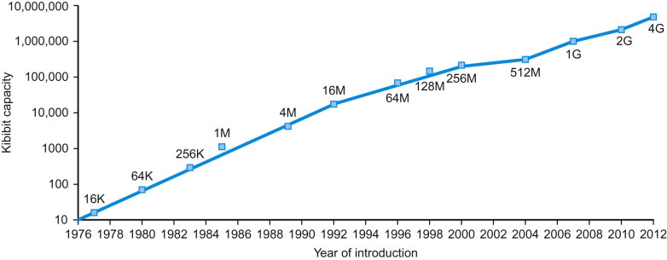
Growth of Capacity per DRAM Chip
DRAM capacity quadrupled almost every 3 years
60% increase per year, for 20 years

Slide 34
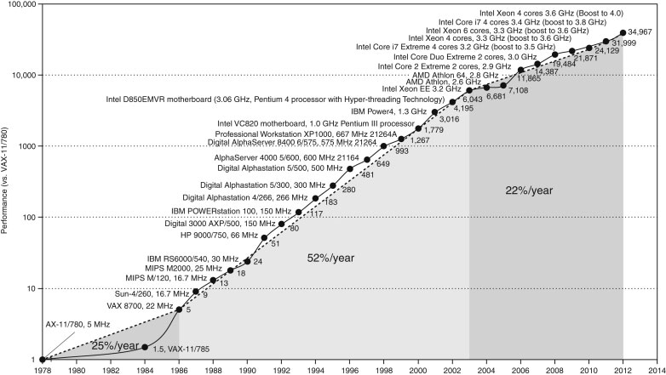
Processor Performance
Slowed down by power and memory latency
Almost 10000x improvement between 1978 and 2005

Slide 35
Next . . .
Assembly-, Machine-, and High-Level Languages
Components of a Computer System
Technology Improvements
Programmer’s View of a Computer System

Slide 36
Programmer’s View of a Computer System
Application Programs
High-Level Language
Increased level of abstraction
Level 5
Software
Assembly Language
Level 4
Operating System
Level 3
Interface SW & HW
Instruction Set
Architecture
Level 2
Microarchitecture
Level 1
Each level hides the details of the level below it
Hardware
Physical Design
Level 0

Slide 37
Programmer’s View of a Computer System
Application Programs (Level 5)
Written in high-level programming languages
Such as Java, C++, Pascal, Visual Basic . . .
Programs compile into assembly language level (Level 4)
Assembly Language (Level 4)
Instruction mnemonics (symbols) are used
Have one-to-one correspondence to machine language
Calls functions written at the operating system level (Level 3)
Programs are translated into machine language (Level 2)

Slide 38
Programmer’s View of a Computer System
Operating System (Level 3)
Provides services to level 4 and 5 programs
Translated to run at the machine instruction level (Level 2)
Instruction Set Architecture (Level 2)
Interface between software and hardware
Specifies how a processor functions
Machine instructions, registers, and memory are exposed
Machine language is executed by Level 1 (microarchitecture)

Slide 39
Programmer’s View of a Computer System
Microarchitecture (Level 1)
Controls the execution of machine instructions (Level 2)
Implemented by digital logic
Physical Design (Level 0)
Implements the microarchitecture at the transistor-level
Physical layout of circuits on a chip

