Slide 1
Arithmetic Functions & Circuits
COE 202
Digital Logic Design
Dr. Aiman El-Maleh
College of Computer Sciences and Engineering
King Fahd University of Petroleum and Minerals

Slide 2
Outline
Hierarchical Design
Iterative Arithmetic Combinational Circuits
Functional Block: Half-Adder
Functional Block: Full-Adder
4-bit Ripple-Carry Adder (RCA)
Carry Lookahead Adder (CLA)
Signed Number Representation
Adder/Subtractor for Signed 2’s Complement
BCD Adder
Binary Multiplier

Slide 3
Hierarchical Design
Let us consider the design of a 4-bit Equal Comparator
Direct implementation
8 input variables
Truth table: 256 rows
8-variable K-map!!
Go hierarchical: Solve a large problem as a set of smaller problems
4 X 2-bit comparators
+ 1 Final comparator
Advantages:
Handle simpler problem, Use fewer symbols, Repeated use
A
B
4 bits
4 bits
E = 1
If A = B

Slide 4
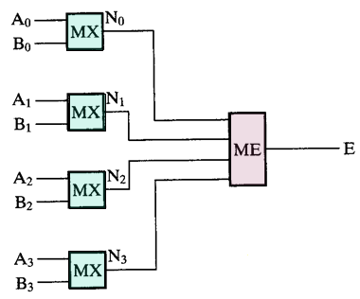
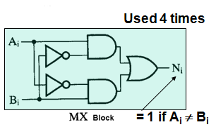
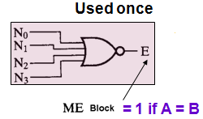
Hierarchical Design

Slide 5
Advantages of the Hierarchical Approach to Design
Simpler representation of complex systems:
5 interconnected blocks in the hierarchical design
Versus 21 interconnected gates in a flat approach
Shielding of complexity: Details of further complexity stop at the symbol of a predefined block (leaf)
Reusability reduces the design effort required (fewer different functional blocks to be designed):
(Only 1 MX and 1 ME)
Easy to upgrade design later by using improved predefined blocks
Different teams can work simultaneously and independently on different parts→ Speed up the design

Slide 6
Iterative (Repetitive) Arithmetic Combinational Circuits
Practical Arithmetic Functions:
Operate on binary bit vectors (e.g. a 32-bit adder adds two 32-bit numbers and produces a 32-bit number)
Same basic subfunction is used in each bit position
Designing for the input vectors directly can be very difficult (huge # of inputs & outputs!) (Huge truth tables/Maps!)
Solution: Design functional block for subfunction (e.g. for a bit) and repeat it (iterate it) to obtain a functional block for the overall operation
Cell = subfunction block
Iterative array = An array of interconnected cells

Slide 7
Iterative (Repetitive) Arithmetic Combinational Circuits
An iterative array can be in a single dimension (1D) or multiple dimensions (spatially)
Iterative array takes advantage of the regularity to make design feasible
Block Diagram of a 1D Iterative Array

Slide 8
Functional Blocks: Addition
Binary addition is used frequently
“Addition” Development:
Half-Adder (HA), a 2-input bit-wise addition functional block
Full-Adder (FA), a 3-input bit-wise addition functional block
Ripple Carry Adder, an iterative array to perform binary addition
Carry-Look-Ahead Adder (CLA), Speeds up performance by generating carries from the input numbers directly to avoid carry ripple delay.
A half adder (HA) is an arithmetic circuit that is used to add two bits. The block diagram of HA is shown. It has two inputs and two outputs.

Slide 9
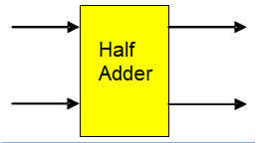
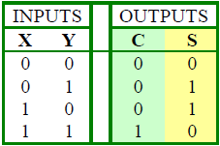
Functional Block: Half-Adder
A 2-input (no carry input), 1-bit width binary adder that performs the following computations:
A half adder adds two bits to produce two bits: S & C
The output is expressed as a sum bit , S and a carry bit, C
The half adder can be specified as a truth table for S and C
X
0
0
1
1
+ Y
+ 0
+ 1
+ 0
+ 1
C S
0 0
0 1
0 1
1 0

Slide 10
Logic Simplification: Half-Adder
The K-map for S, C is:
By inspection:
and
These equations lead to several implementations.
S
Y
C
Y
1
S
=
X
Y
+
X
Y
=
X
⊕
Y
0
1
0
1
X
1
X
1
=
+
+
2
3
2
3
S
(
X
Y
)
(
X
Y
)
C
=
X
Y
C
=
(
(
X
Y
)
)

Slide 11
Five Implementations: Half-Adder
We can derive following sets of equivalent equations for the half-adder:
(
a
)
S
=
X
Y
+
X
Y
(
d
)
S
=
(
X
+
Y
)
C
C
=
X
Y
C
=
(
X
+
Y
)
(
b
)
S
=
(
X
+
Y
)
(
X
+
Y
)
(
e
)
S
=
X
⊕
Y
C
=
X
Y
C
=
X
Y
(
c
)
S
=
(
C
+
X
Y
)
Most common implementation
For the half-adder
C
=
X
Y

Slide 12
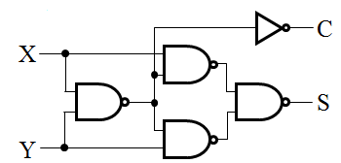
Implementations: Half-Adder
The most common half adder implementation is:
A NAND only implementation is:
X
S
Y
S
=
X
⊕
Y
C
C
=
X
Y

Slide 13
Functional Block: Full-Adder
A full adder is similar to a half adder, but includes a carry-in bit from lower stages. Like the half-adder, it computes a sum bit, S and a carry bit, C.
For a carry-in (Z) of 0, it is the same as the half-adder:
For a carry- in (Z) of 1:
Z
0
0
0
0
X
0
0
1
1
+ Y
+ 0
+ 1
+ 0
+ 1
C S
0
0
0 1
0 1
1 0
Z
1
1
1
1
X
0
0
1
1
+ Y
+ 0
+ 1
+ 0
+ 1
C S
0 1
1 0
1 0
1
1

Slide 14
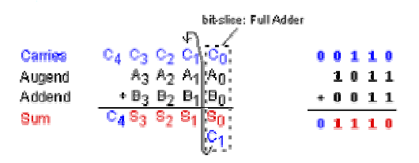
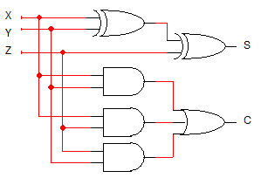
Logic Optimization: Full-Adder
Full Adder Truth Table
X
Y
Z
C
S
0
0
0
0
0
0
0
1
0
1
0
1
0
0
1
0
1
1
1
0
1
0
0
0
1
1
0
1
1
0
Full Adder K-Maps
1
1
0
1
0
1
1
1
1
1
S
Y
C
Y
1
1
1
0
1
3
2
0
1
3
2
X
1
1
X
1
1
1
4
5
7
6
4
5
7
6
Z
Z

Slide 15
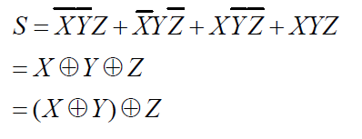
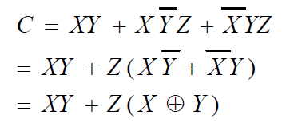
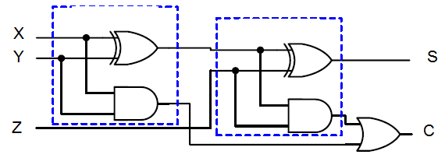
Equations: Full-Adder
The Boolean functions for the sum and carry outputs can be manipulated to simplify the circuit, as shown below:
Thus the full adder can be implemented using two half adders and an OR gate as shown below:

Slide 16
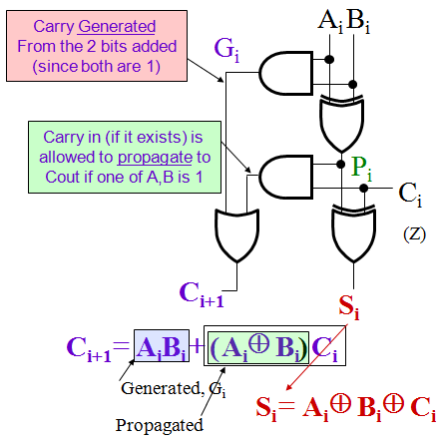
Implementation: 1-bit Full Adder
The term X·Y is “carry generate” at the bit position (i.e. from X and Y)
The term X⊕Y is “carry propagate” (i.e. allow Z to be passed as carry out)
The Carry bit C is 1 if both X and Y are 1 (the sum is 2), or if the sum is 1 and a carry-in (Z) occurs.
C
=
X
Y
+
(
X
⊕
Y
)
. Z
C_{i+1} = G_{i} + P_{i} · C_{i}
G_{i =} A_{i} B_{i}
P_{i =} A_{i} ⊕ B_{i}
Here X, Y, and Z, and C are A_{i}, B_{i}, C_{i} and C_{i+1}, respectively.

Slide 17
4-bit Ripple-Carry Adder (RCA)
A 4-bit Ripple-Carry Adder made from four 1-bit Full Adders:
N-bit Ripple-Carry Adder:

Slide 18
4-bit RCA: Carry Propagation & Delay
One problem with the addition of binary numbers is the length of time taken to propagate the ripple carry from the least significant bit to the most significant bit.
Gate-level propagation path for the 4-bit
ripple carry adder (XOR = 3 gate delays)
Critical (longest) delay path
(Worst case scenario)
A₃
A₂
A₁
A₀
B₃
B₂
B₁
B₀
C₃
C₂
Why not
from C0?
C₁
C₀
Why not
to C4?
C₄
S₃
S₂
S₁
S₀
Longest Total Carry Ripple Delay from inputs to S3 = 3 + 3 + 2(n-1) gate delays
where n is the number of stages (= 4 here) → 12 gate delays

Slide 19
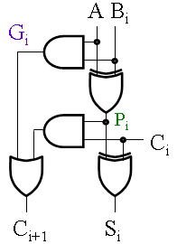
Carry Lookahead Adder (CLA)
Defining the equations for the Full Adder in terms of the P_{i} and G_{i}:
In the ripple carry adder:
G_{i}, P_{i}, C_{i} and S_{i} are obtained locally at each bit cell of the adder (i.e. limited to that bit)
In the carry lookahead adder, in order to reduce the length of the ripple carry chain, C_{i} is changed to a more global function spanning multiple cells
P
=
A
⊕
B
G
=
A
B
i
i
i
i
i
i
S
=
P
⊕
C
C
=
G
+
P
C
i
i
i
i
+
1
i
i
i

Slide 20
Carry Lookahead Development
C_{i+1} can be removed from the cells and used to derive a set of carry equations spanning multiple cells.
Beginning at the cell 0 with carry in C₀:
Carry does not ripple anymore!
All 4 carry outputs can be generated in one go from:
The C0 and the two input numbers A,B
C₁ = G₀ + P₀ C₀
C₂ = G₁ + P₁ C₁ = G₁ + P₁(G₀ + P₀ C₀)
= G₁ + P₁G₀ + P₁P₀ C₀
2-Level logic
(Only 2 gate delays)
No Rippling
C₃ = G₂ + P₂ C₂ = G₂ + P₂(G₁ + P₁G₀ + P₁P₀ C₀)
= G₂ + P₂G₁ + P₂P₁G₀ + P₂P₁P₀ C₀
C₄ = G₃ + P₃ C₃ = G₃ + P₃G₂ + P₃P₂G₁+ P₃P₂P₁G₀ +P₃P₂P₁P₀ C₀
= G₀₋₃ + P₀₋₃ C₀

Slide 21
Carry Lookahead Development
Partial Full adder (PFA), (excludes carry handling stuff) to allow use of ripple or lookahead
4-bit Ripple-Carry adder

Slide 22
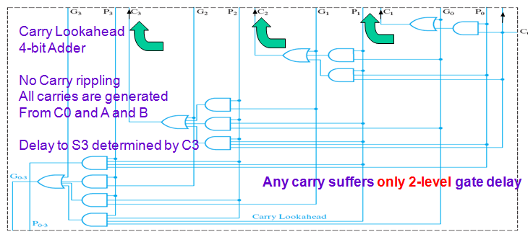
Carry Lookahead Development

Slide 23
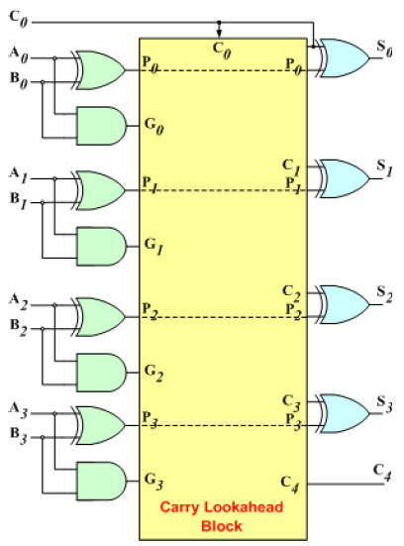
Carry Lookahead Development
The 4-bit carry look-ahead (CLA) adder consists of 3 levels of logic:
First level: Generates all the P & G signals. Four sets of P & G logic (each consists of an XOR gate and an AND gate).
Second level: The Carry Look-Ahead (CLA) logic block which consists of four 2-level implementation logic circuits. It generates the carry signals (C¹, C², C³, and C⁴).
Third level: Four XOR gates which generate the sum signals (S^{i}) (S^{i} = P^{i} ⊕ C^{i}), (S⁰, S¹, S², and S³).

Slide 24
Delay for the 4-bit CLA Adder
A₃
B₃
Delay from {A₃,B₃, C₃} to S₃ (sum from last bit) is
3 gate delays (XOR) + max (delay in P3, Delay in C3)
G₃
C₃ = G₂ + P₂ C₂ = G₂ + P₂(G₁ + P₁G₀ + P₁P₀ C₀)
= G₂ + P₂G₁ + P₂P₁G₀ + P₂P₁P₀ C₀
3
P₃
5
P’s need 3 gate delays
+ 1 for the AND (Product)
+ 1 for the OR (Sum)
5 Gates
C₃
3
C₄
S₃
= 3 + max (3,5) = 3 + 5 = 8 gate delays
Vs 12 gate delays for the carry ripple adder
More significant improvements for wider adders,
e.g. 16-bit, 32-bit, and 64-bit
Lower delay
Critical delay path
Last of the 4-bit adder stages

Slide 25
Signed Number Representation
To represent signed numbers, the most significant bit is used to indicate the sign of the number: 0 (+), 1 (-).
There are three representations for signed numbers:
Sign-Magnitude Representation
1’s complement Representation
2’s complement Representation
Sign-Magnitude Representation
The most significant bit is the sign bit and the remaining bits represent the value in binary format
e.g. +9 is represented as 01001, -9 is represented as 11001
Range: Using n bits, the range of numbers that can be represented is from -(2^{n-1} - 1) to +2^{n-1} - 1

Slide 26
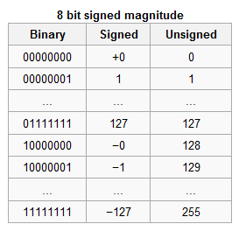
Sign-Magnitude Representation
Advantages: Simple (number representation is straight forward).
Disadvantages:
Has the problem of double representing the 0 (-0 and +0),
Harder to implement addition/subtraction
The sign and magnitude parts have to be processed independently.
Sign bits of the operands have to be examined to determine the actual operation (addition or subtraction).
Separate circuits are required to perform the addition and subtraction operations.

Slide 27
Signed-Magnitude Addition/Subtraction
M±N (each of M and N can be + ive or – ive)
Follow rules of ordinary arithmetic
We compare only the signs of the two operands and conclude the sign of the result based on these signs and the outcome of operation
Addition/Subtraction of magnitudes is similar to using unsigned integers
Addition: (operations done on magnitudes)
a. If the two signs are equal: (+A) + (+B) = +(A+B) or (-A) + (-B) = -(A+B)
1. Add the two (unsigned) magnitudes, overflow can occur
2. Check that there is no overflow (an end carry out of the mag.)
3. The sign of the result is the same as the common sign

Slide 28
Signed-Magnitude Addition/Subtraction
b. If the two signs are different: (+A) + (-B) = +(A-B) or (-A) + (+B) = -(A-B)
Subtract the smallest magnitude from the largest
(Since we subtract 2 unsigned #s, Overflow can not occur)
The sign of the result is based on initial sign and the sign of the operand with larger magnitude
For +(A-B), if A>B, the result is positive otherwise negative
For -(A-B), if A>B, the result is negative otherwise positive
Subtraction: (operations done on magnitudes)
a. If the two signs are different: (+A) - (-B) = +(A+B) or (-A) - (+B) = -(A+B)
b. If the two signs are equal: (+A) - (+B) = +(A-B) or (-A) - (-B) = -(A-B)

Slide 29
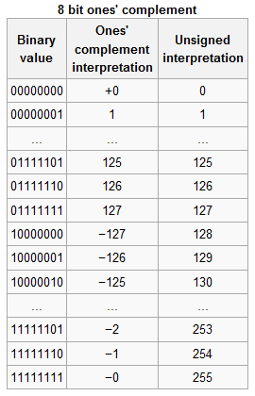
One’s Complement Representation
Positive numbers are represented using normal binary equivalent .
Negative numbers are represented by the 1's complement (complement) of the normal binary representation of the magnitude.
Example:
+9 is represented as 01001
-9 is represented as 10110 (obtained by complementing the binary representation of 9).

Slide 30
Why is it called “one’s complement?”
Complementing a single bit is equivalent to subtracting it from 1.
0’ = 1, and 1 - 0 = 1 1’ = 0, and 1 - 1 = 0
Similarly, complementing each bit of an n-bit number is equivalent to subtracting that number from 2^{n}-1.
For example, we can negate the 5-bit number 01101.
Here n=5, and 2^{n}-1 = 31₁₀ = 11111₂.
Subtracting 01101 from 11111 yields 10010:
1 1 1 1 1
- 0 1 1 0 1
1 0 0 1 0

Slide 31
One’s Complement Representation
Range: Using n bits, the range of numbers that can be represented is from -(2^{n-1} - 1) to +2^{n-1} - 1 .
Advantages:
Still relatively simple to represent the numbers,
Simpler Add/Subtract circuit design (subtracting a number from another involves complementing the subtracted and then adding it to the other number).
Disadvantages:
Has the problem of double representing the 0 (-0 and +0),
It may require two addition operations as if there is a carry out it has to be added to get the correct result
Overflow: occurs when the result is out of range

Slide 32
One’s Complement Addition
Example 1: Adding 0111 + 0111
The result is 1110 and the carry out is 0, hence an overflow has occurred (adding two positive numbers resulted in a negative number, -1 in this case).
Example 2: Subtracting 0001 - 0111
First the subtrahend is complemented and becomes 1000. Then it is added to the minuend and the result is 1001 with no end carry. The result represents -6 (the correct result) and no further addition is required.
Example 3: Subtracting 0111 - 0001
Again, the subtrahend is complemented and becomes 1110. Then it is added to the minuend and the result is 0101 with an end carry of 1. This carry has to be added to the previous result and yields 0110 (+6, the correct answer).

Slide 33
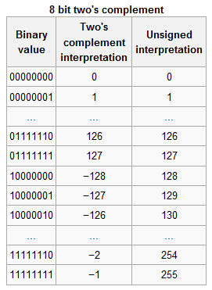
Two’s Complement Representation
Positive numbers are represented using normal binary equivalent.
Negative numbers are represented by the 2's complement of the normal binary representation of the magnitude.
The 2's complement of a binary number equals its 1's complement + 1.
Another easy way to obtain the 2's complement of a binary number:
start at the LSB, leaving all the 0s unchanged, look for the first occurrence of a 1. Leave this 1 unchanged and complement all the bits after it.

Slide 34
Two’s Complement Representation
Example:
+9 is represented as 01001
To represent -9, first obtain the binary equivalent of +9: 01001. Now leave the LSB 1 unchanged and complement all the remaining bits to get 10111, which represents -9 in 2's complement.
Range:
Using n bits, the range of numbers that can be represented is from -2^{n-1} to +2^{n-1} - 1.
The -2^{n-1} is represented by the 1000..000 code, which has no 2's complement, hence the unsymmetrical range. E.g. if 8 bits are used, the range of numbers that can be represented is from -128 to +127.

Slide 35
Two’s Complement Representation
Advantages:
No double representation of 0 (the 2's complement of 0 is still 0),
Simplest Add/Subtract circuit design (subtracting a number from another involves 2's complementing the subtracted and then adding it to the other number),
Add/Subtract operations is done in one-step, the end carry is only examined to determine if an overflow has occurred otherwise it is discarded.
The end result is already represented in 2's complement (only if there is no overflow).
That is why this is the most preferred method for signed-number representations in computers.

Slide 36
Two’s Complement Representation
Disadvantages:
The unsymmetrical range, which is not a serious problem,
It is slightly more complex to obtain the 2's complement (it involves complementing and adding 1). However this can be accomplished very easily during the Add/Subtract operations (by making the first carry in 1 and complementing the subtrahend).
Overflow: occurs if the result is out of range
Adding two positive numbers and getting a negative number
Adding two negative numbers and getting a positive number
If the last two carries are not equal

Slide 37
Two’s Complement Addition
Example 1: Adding 0111 + 0111
The result is 1110 (-2), hence an overflow has occurred (adding two positive numbers resulted in a negative number).
Example 2: Subtracting 0001 - 0111
First the subtrahend is 2's complemented and becomes 1001. Then it is added to the minuend and the result is 1010 with the last two carries being 0 (no overflow). The result represents -6 in 2's complement (the correct result) and no further operation is required.
Example 3: Subtracting 0111 - 0001
Again, the subtrahend is complemented and becomes 1111. Then it is added to the minuend and the result is 0110 (+6, the correct result). Since the last two carries being 1 no overflow has occurred and no further operations are required.

Slide 38
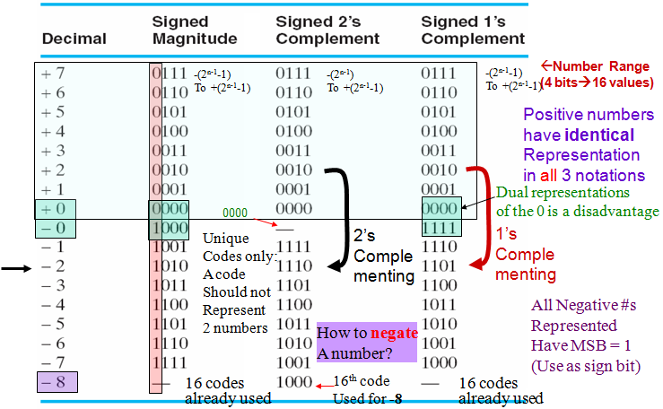
Signed Number Representation (n=4)

Slide 39
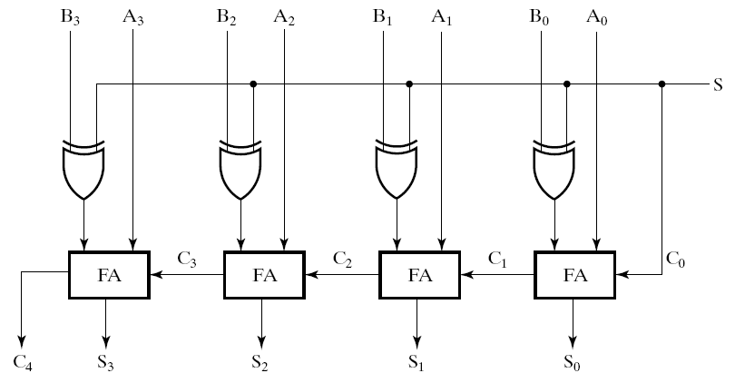
Adder/Subtractor for Signed 2’s Complement
One circuit computes A + B or A – B:
Subtraction is done by the addition of the 2's Complement
For Control = 0 (add):
B is passed through to the adder unchanged
For Control = 1 (subtract): → 2’s complement of B is obtained using XORs to form the 1’s comp + 1 applied to C₀ of
1st stage→ 2’s comp. added to A
Subtract/
Add
No correction
Needed

Slide 40
BCD Adder
If two BCD digits are added then their sum result will not always be in BCD.
Consider the two given examples:
Whenever the sum result is > 9, it will not be in BCD and will require correction to get a valid BCD result.
Correction is done through the addition of 6 to the result to skip the six invalid values.

Slide 41
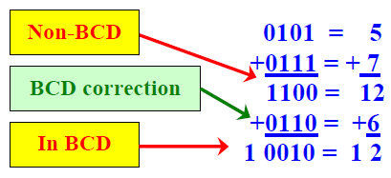
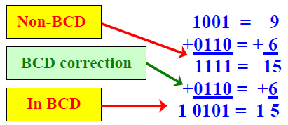
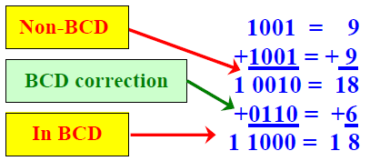
BCD Adder
Consider the given examples of non-BCD sum result and its correction:

Slide 42
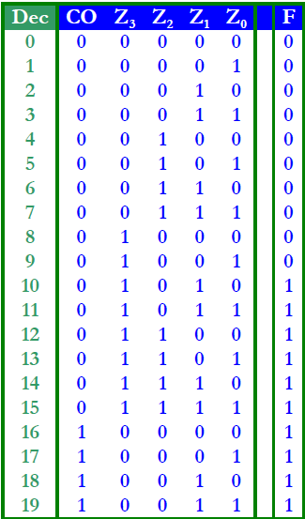
BCD Adder
The maximum sum result of a BCD input adder can be 19. As maximum number in BCD is 9 and may be there will be a carry from previous stage also, so 9 + 9 + 1 = 19 .
The logic circuit that checks the necessary BCD correction can be derived by detecting the condition where the resulting binary sum is 01010 through 10011 (decimal 10 through 19).

Slide 43
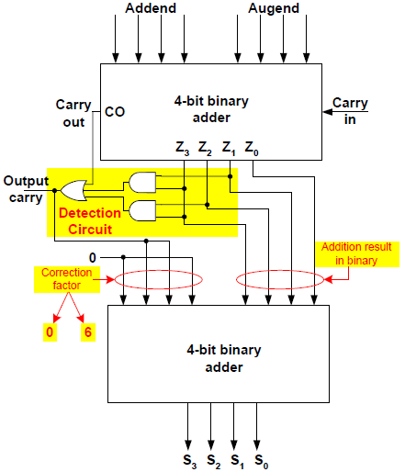
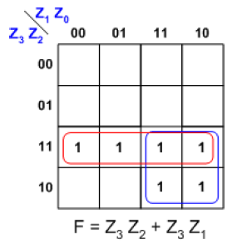
BCD Adder
F is true when CO is true OR when (Z₃ Z₂ + Z₃ Z₁) is true.
Thus, the correction step (adding 0110) is performed if the following function equals 1:

Slide 44
Binary Multiplier
Multiplication of binary numbers is performed in the same way as with decimal numbers.
The multiplicand is multiplied by each bit of the multiplier, starting from the least significant bit.
The result of each such multiplication forms a partial product. Successive partial products are shifted one bit to the left.
The product is obtained by adding these shifted partial products.

Slide 45
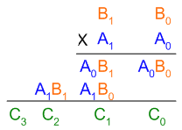
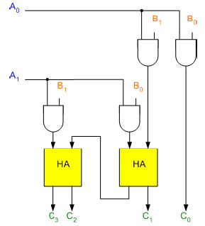
Binary Multiplier
Example 1: Consider an example of multiplication of two numbers, say A and B (2 bits each), C = A x B.
The first partial product is formed by multiplying the B₁B₀ by A₀. The multiplication of two bits such as A₀ and B₀ produces a 1 if both bits are 1; otherwise it produces a 0 like an AND operation. So the partial products can be implemented with AND gates.
The second partial product is formed by multiplying the B₁B₀ by A₁ and is shifted one position to the left.

Slide 46
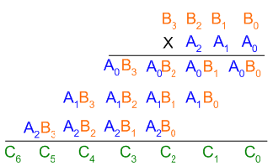
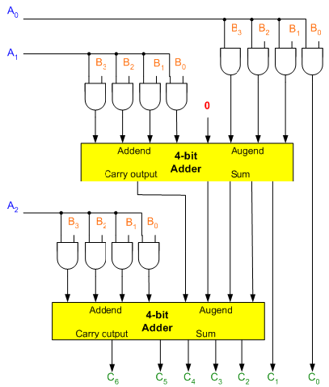
Binary Multiplier
Example 2: Consider the example of multiplying two numbers, say A (3-bit number) and B (4-bit number).
Since J = 3 and K = 4, 12 (J x K) AND gates and two 4-bit ((J - 1) K-bit) adders are needed to produce a product of seven (J + K) bits.

