Slide 1
Binary Logic and Gates
COE 202
Digital Logic Design
Dr. Aiman El-Maleh
College of Computer Sciences and Engineering
King Fahd University of Petroleum and Minerals

Slide 2
Outline
Introduction
Elements of Boolean Algebra (Binary Logic)
Logic Gates & Logic Operations
Boolean Algebra
Basic Identities of Boolean Algebra
Duality Principle
Operator Precedence
Properties of Boolean Algebra
Algebraic Manipulation

Slide 3
Introduction
Our objective is to learn how to design digital circuits.
These circuits use binary systems.
Signals in such binary systems may represent only one of 2 possible values 0 or 1.
Physically, these signals are electrical voltage signals
These signals may assume either a high or a Low voltage value.
The High voltage value typically equals the voltage of the power supply (e.g. 5 volts or 3.3 volts), and the Low voltage value is typically 0 volts (or Ground).
When a signal is at the High voltage value, we say that the signal has a Logic 1 value.
When a signal is at the Low voltage value, we say that the signal has a Logic 0 value.

Slide 4
Digital Circuits
The physical value of a signal is the actual voltage value it carries, while its Logic value is either 1 (High) or 0 (Low).
Digital circuits process (or manipulate) input binary signals and produce the required output binary signals.

Slide 5
Digital Circuits
Generally, the circuit will have a number of input signals (say n of them) as x₁, x₂, up to x_{n}, and a number of output signals (say m ) Z₁, Z₂, up to Z_{m}.
The value assumed by the i^{th} output signal Z_{i} depends on the values of the input signals x₁, x₂, up to x_{n}.
In other words, we can say that Z_{i} is a function of the n input signals x₁, x₂, up to x_{n}. Or we can write:
Z_{i} = F_{i} (x₁, x₂, ……, x_{n} ) for i = 1, 2, 3, ….m
The m output functions (F_{i}) are functions of binary signals and each produces a single binary output signal.
Thus, these functions are binary functions and require binary logic algebra for their derivation and manipulation.

Slide 6
Boolean Algebra
This binary system algebra is commonly referred to as Boolean Algebra after the mathematician George Boole.
The functions are known as Boolean functions while the binary signals are represented by Boolean variables.
To be able to design a digital circuit, we must learn how to derive the Boolean function implemented by this circuit.
Systems manipulating Binary Logic Signals are commonly referred to as Binary Logic systems.
Digital circuits implementing a particular Binary (Boolean) function are commonly known as Logic Circuits.

Slide 7
Boolean Algebra
Introduced by George Boole in 1854
A set of two values: B = {0, 1}
Two-valued Boolean algebra is also called switching algebra
Three basic operations: AND, OR, and NOT
The AND operator is denoted by a dot (·)
$x·y$ or $xy$ is read: $x$ AND $y$
The OR operator is denoted by a plus (+)
$x+y$ is read: $x$ OR $y$
The NOT operator is denoted by (') or an overbar (¯).
$x′$ or $\overline{x}$ is the complement of $x$

Slide 8
Postulates of Boolean Algebra
1. Closure: result of any Boolean operation is in B = {0, 1}
2. Identity element with respect to + is 0: $x+0=0+x=x$
Identity element with respect to · is 1: $x·1=1·x=x$
3. Commutative with respect to +: $x+y=y+x$
Commutative with respect to ·: $x·y = y·x$
4. · is distributive over +: $x·(y+z)=(x·y)+(x·z)$
+ is distributive over ·: $x+(y·z)=(x+y)·(x+z)$
5. For every $x$ in B, there exists $x′$ in B (called complement of $x$) such that: $x+x′=1$ and $x·x′=0$

Slide 9
Elements of Boolean Algebra (Binary Logic)
As in standard algebra, Boolean algebra has 3 main elements:
1. Constants,
2. Variables, and
3. Operators.
Logically
Constant Values are either 0 or 1
Binary Variables ∈{ 0, 1}
3 Possible Operators: The AND operator, the OR operator, and the NOT operator.

Slide 10
Elements of Boolean Algebra (Binary Logic)
Physically
Constants ⇒
Power Supply Voltage (Logic 1)
Ground Voltage (Logic 0)
Variables ⇒ Signals (High = 1, Low = 0)
Operators ⇒ Electronic Devices (Logic Gates)
1. AND - Gate
2. OR - Gate
3. NOT - Gate (Inverter)

Slide 11
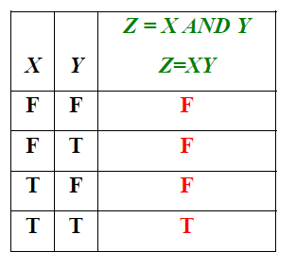
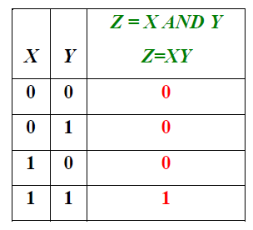
Logic Gates & Logic Operations
The AND Operation
If X and Y are two binary variables, the result of the operation X AND Y is 1 if and only if both X = 1 and Y = 1, and is 0 otherwise.
In Boolean expressions, the AND operation is represented either by a “dot” or by the absence of an operator. Thus, X AND Y is written as X.Y or just XY.

Slide 12
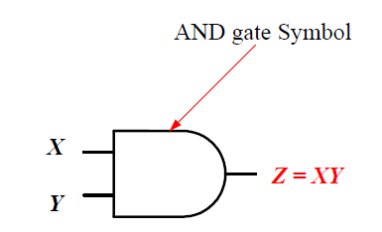
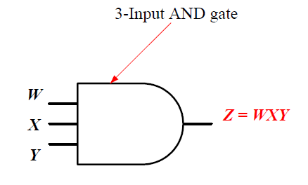
Logic Gates & Logic Operations
The AND Operation
The electronic device which performs the AND operation is called the AND gate.
Symbols of 2-input and 3-input AND gates:

Slide 13
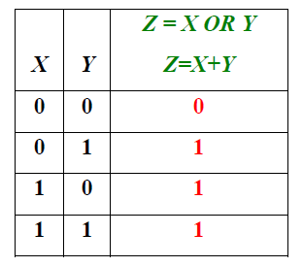
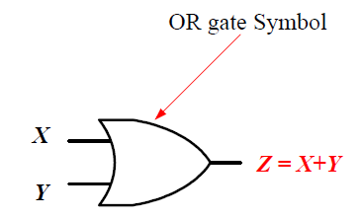
Logic Gates & Logic Operations
The OR Operation
If X and Y are two binary variables, the result of the operation X AND Y is 1 if and only if either X = 1 or Y = 1, and is 0 otherwise.
In Boolean expressions, the AND operation is represented either by a “plus” sign. Thus, X OR Y is written as X + Y.
The electronic device which performs the OR operation is called the OR gate.

Slide 14
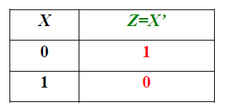
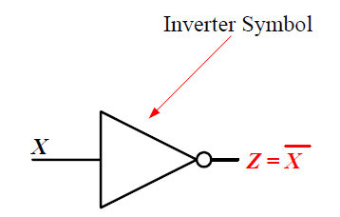
Logic Gates & Logic Operations
The NOT Operation
NOT is a “unary” operator.
IF Z=NOT X, then the value of Z is the complement of the value of X. If X = 0 then Z = 1, and if X = 1 then Z =0.
In Boolean expressions, the NOT operation is represented by either a bar on top of the variable (e.g. Z= ) or a prime (e.g. Z = X' ).
The electronic device which performs the NOT operation is called the NOT gate, or simply INVERTER.

Slide 15
Logic Circuits and Boolean Expressions
A Boolean expression (or a Boolean function) is a combination of Boolean variables, AND-operators, OR-operators, and NOT operators.
Boolean Expressions (Functions) are fully defined by their truth tables.
Each Boolean function (expression) can be implemented by a digital logic circuit which consists of logic gates.
Variables of the function correspond to signals in the logic circuit,
Operators of the function are converted into corresponding logic gates in the logic circuit.

Slide 16
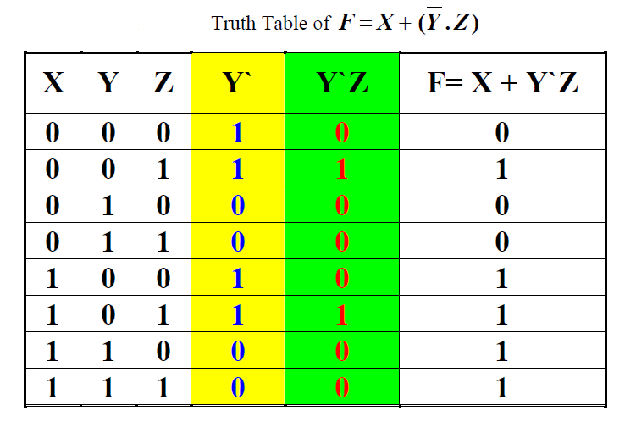
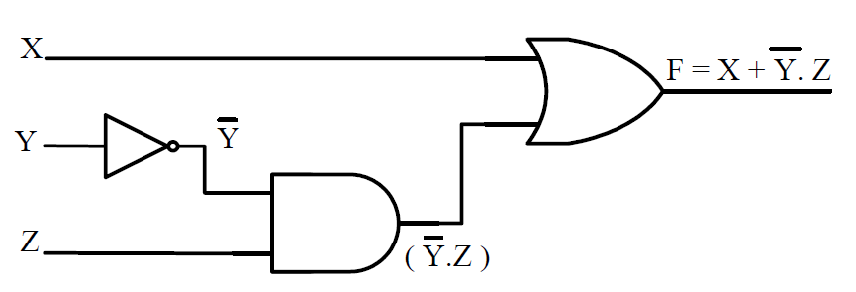
Logic Circuits and Boolean Expressions
Example: Consider the function
Logic circuit diagram of :

Slide 17
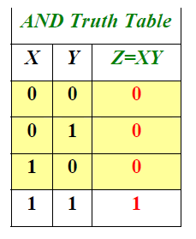
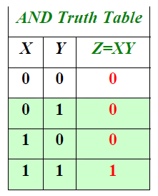
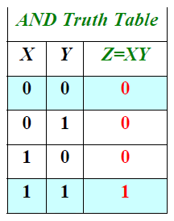
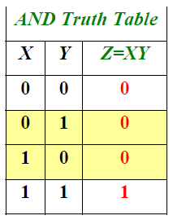
Basic Identities of Boolean Algebra
AND Identities:
0 . X = 0
1 . X = X
X . X = X
= 0

Slide 18
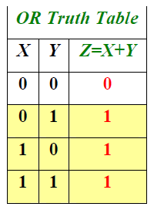
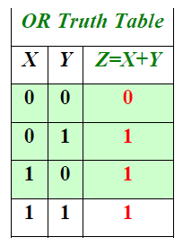
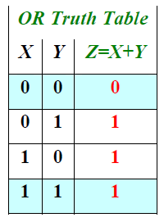
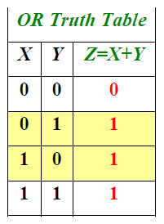
Basic Identities of Boolean Algebra
OR Identities:
1 + X = 1
0 + X = X
X + X = X
= 1

Slide 19
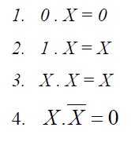
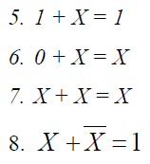
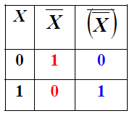
Basic Identities of Boolean Algebra
AND Identities
OR Identities
Another Important Identity

Slide 20
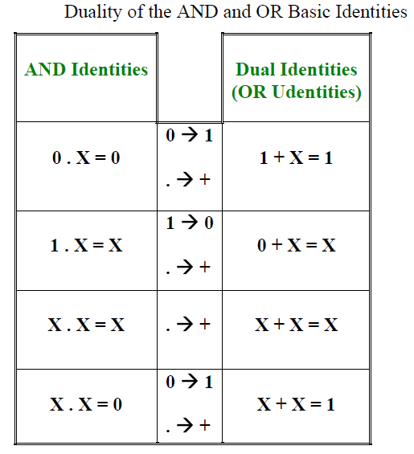
Duality Principle
Given a Boolean expression, its dual is obtained by
replacing each 1 with a 0, each 0 with a 1,
each AND (.) with an OR (+), and each OR (+) with an AND(.).
The dual of an identity is also an identity. This is known as the duality principle.
It can be easily shown that the AND basic identities and the OR basic identities are duals.

Slide 21
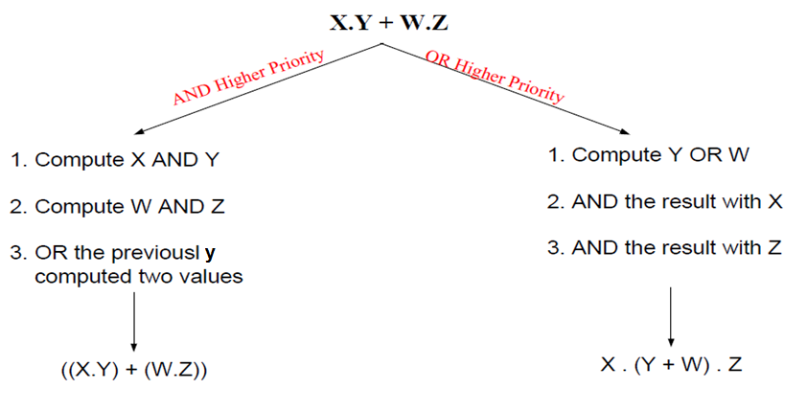
Operator Precedence
Given the Boolean expression X.Y + W.Z the order of applying the operators will affect the final value of the expression.

Slide 22
Operator Precedence
For Boolean Algebra, the precedence rules for various operators are given below, in a decreasing order of priority:

Slide 23
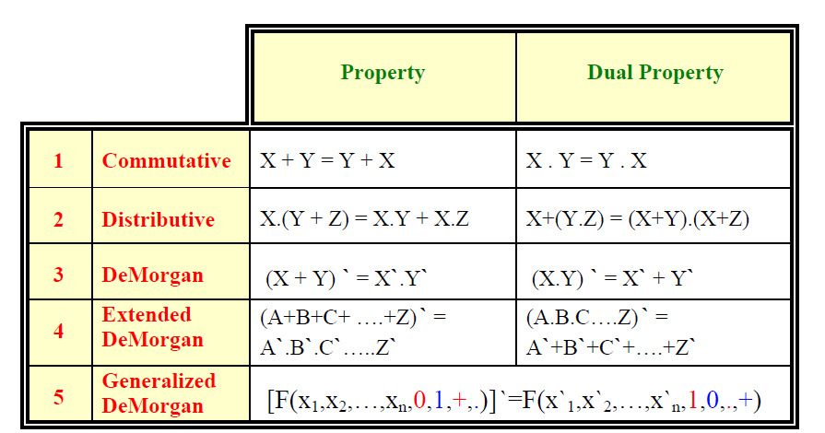
Properties of Boolean Algebra

Slide 24
Properties of Boolean Algebra
Properties of Boolean Algebra can be easily proved using truth tables.
The only difference between the dual of an expression and the complement of that expression is that
in the dual variables are not complemented while in the complement expression, all variables are complemented.
Using the Boolean Algebra properties, complex Boolean expressions can be manipulated into a simpler forms resulting in simpler logic circuit implementations.
Simpler expressions are generally implemented by simpler logic circuits which are both faster and less expensive.

Slide 25
Complementing Boolean Functions
What is the complement of $f=(a′+bc)d′+e$?
Use DeMorgan's Theorem:
Put brackets around each AND operation
Complement each variable and constant
Interchange AND and OR operators
Answer: $f=((a^{′}+(bc))d′)+e$
$f′=(a\left(b^{′}+c^{′}\right)+d)e′$

Slide 26
Algebraic Manipulation
The objective here is to acquire some skills in manipulating Boolean expressions into simpler forms for more efficient implementations.
Properties of Boolean algebra will be utilized for this purpose.
Example: Prove that X + XY = X
Proof: X + XY = X.1 + XY =X.(1 + Y) = X.1 = X
Example: Prove that X + X`Y= X + Y
Proof: X + X`Y= (X+ X`) (X + Y)= 1.(X + Y)= X + Y
OR X + X`Y= X.1 + X`Y= X.(1+Y) + X`Y= X + XY + X`Y= X + (XY +X`Y)= X + Y(X +X`)= X + Y

Slide 27
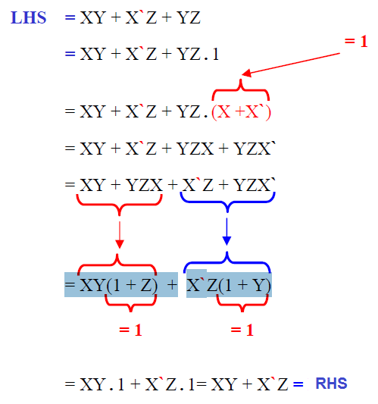
Algebraic Manipulation
Example: Consensus Theorem
XY + X`Z + YZ = XY + X`Z

Slide 28
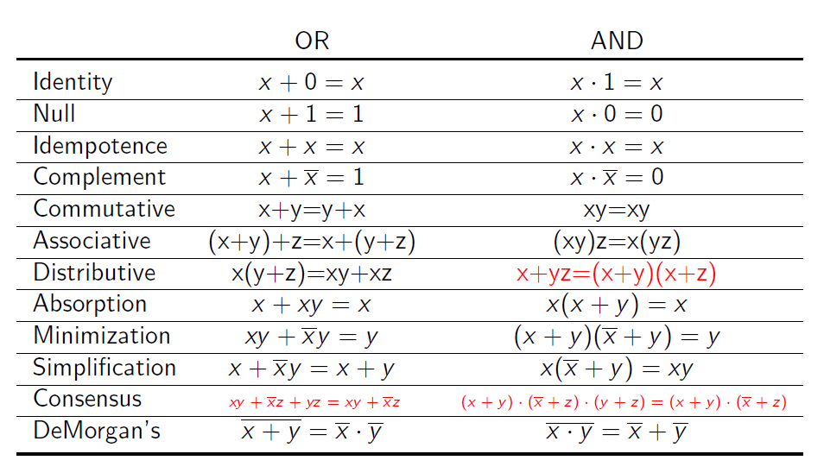
Properties, Postulates & Theorems of Boolean Algebra

Slide 29
Algebraic Manipulation Guidelines
Check if Absorption can be applied
Check if simplification can be applied
Check if taking a common factor allows minimization or simplification to be applied
Check if consensus can be applied to remove an existing term
Check if consensus could be applied to add an extra term than can be used to simplify an existing term
Repeat 1-5 after each simplification done

Slide 30
Algebraic Manipulation
Example: Simplify the function
$$F=(A+C)′+\left(A+C\right)\left(A′+C′\right)$$
F = (A + C)’ + (A’+ C’) by simplification
= A’ C’ + A’+ C’ by Demorgan law
= A’+ C’ by absorption

Slide 31
Algebraic Manipulation
Example: Simplify the function
$$F=A^{′}B′ +B′ C+A B^{′}C′ + A B$$
F = A’ B’ + B’ C + A B’ C’ + A B + B’ C’ by consensus
= A’ B’ + B’ [C+C’] + A B’ C’ + A B by distributive law
= A’ B’ + B’ + A B’ C’ + A B by complement & OR identity
= B’ + A B by absorption
= B’ + A by simplification

Slide 32
Algebraic Manipulation
Example: Simplify the function
$F=\left( A′+ B′+C′\right)\left( A+ C′\right)\left( B+ C′\right)\left( B′+ C\right)$
We first take the dual of F and we get:
A’ B’ C’ + A C’ + B C’ +B’ C
= C’ [A’ B’ + A + B] + B’C by distributive law
= C’ [B’ + A + B] + B’C by simplification
= C’ [1 + A]+ B’C by complement
= C’ + B’C by OR identity
= C’ + B’ by simplification
Then, we take the dual again, this leads to F = B’C’

Slide 33
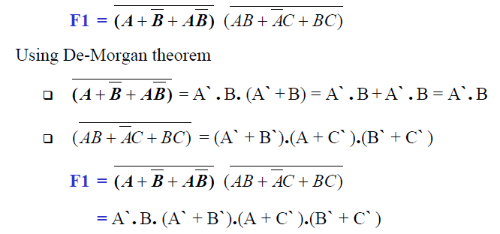
Algebraic Manipulation
Example: Simplify the function

Slide 34
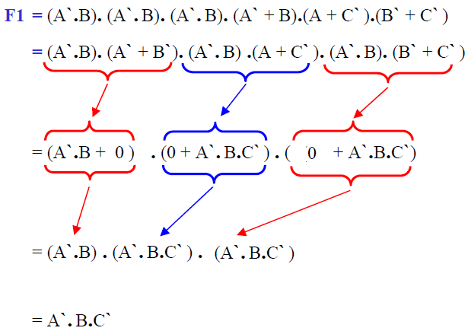
Algebraic Manipulation

Slide 35
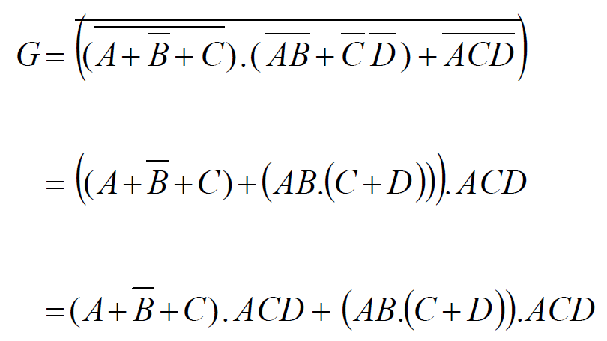
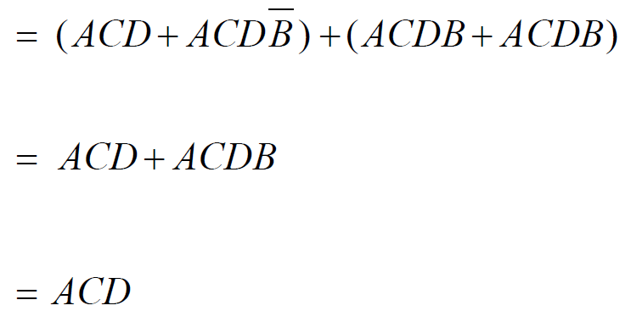
Algebraic Manipulation
Example: Simplify the function

